Slide 1


T3.2-668
Initial Operational and Processing Experience for Data from the First Commercial Unit of the Xenon International
Ryan O'Mara¹, Ashley Davies², Herbert Gohla², Jason Hutchinson¹, Rodrigo Villarreal², Matthew Wright¹ ,Seokryung Yoon²
¹General Dynamics Mission Systems (GDMS)
²CTBTO Preparatory Commission (CTBTO PrepCom)
The first commercially available unit of the Xenon International system was installed at the General Dynamics Mission Systems’ Engineering Test Bed (Chantilly, Virginia, USA) in May of 2024. In preparation for deployment into the IMS, General Dynamics and the CTBTO Preparatory Commission performed operations, verification and validation exercises similar to those for certified systems. Overall, the integration exercises have been successful and educational.
DISCLAIMER: The views expressed on this poster (presentation) are those of the author and do not necessarily reflect the view of the CTBTO or the USG. Cleared for release.
.

Slide 2
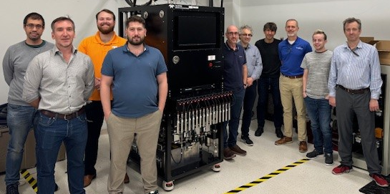
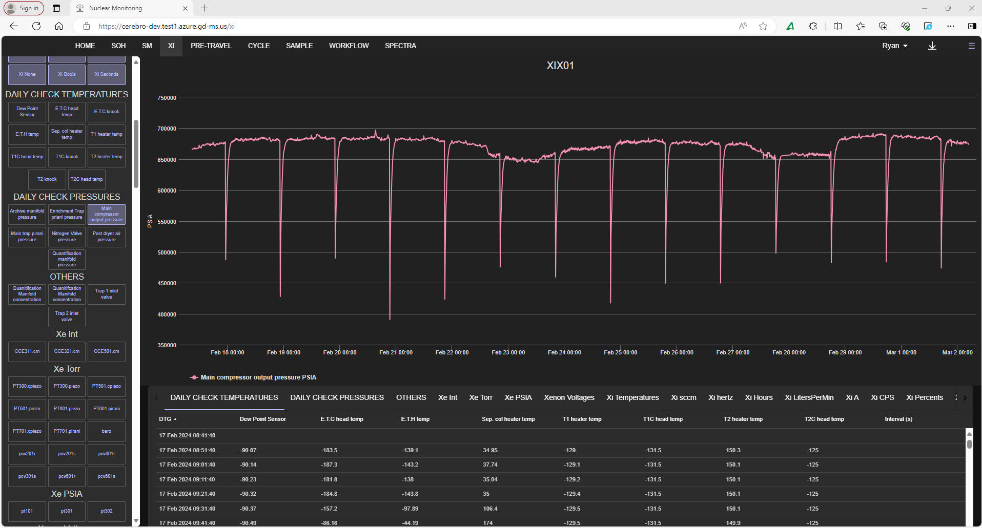
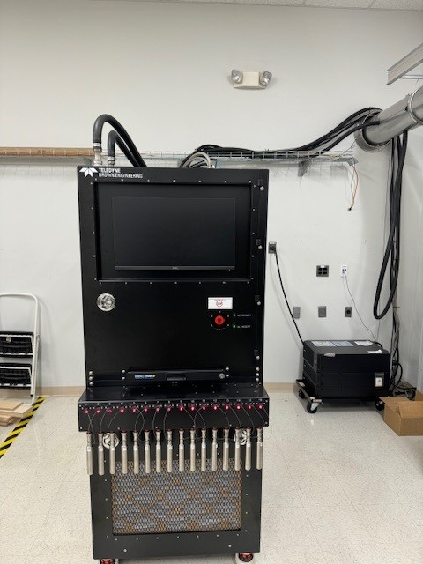
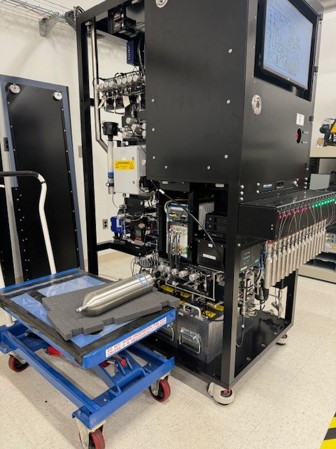
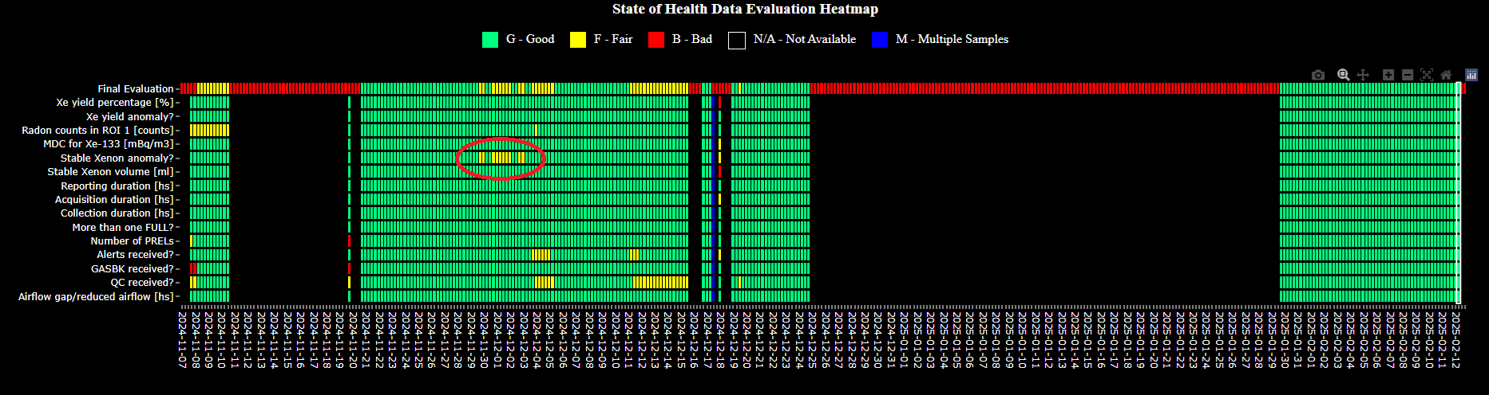
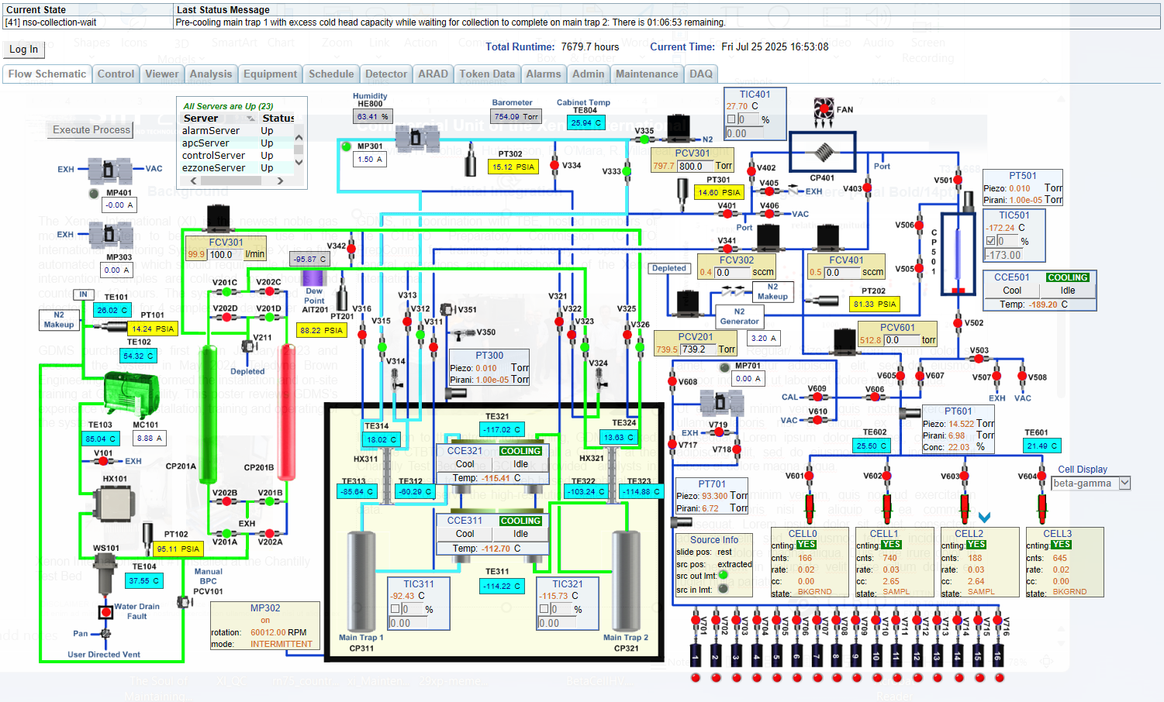
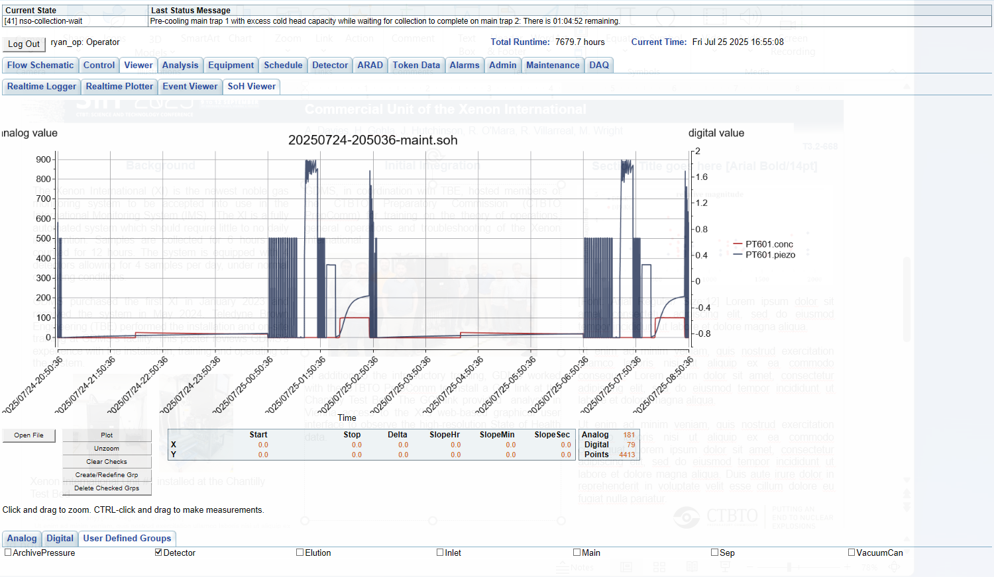
T3.2-668
Initial Operational and Processing Experience for Data from the First Commercial Unit of the Xenon International
R O'Mara , A. Davies, H. Gohla, J. Hutchinson, R. Villarreal, M. Wright, S Yoon
Background
Initial Integration
SOH Data Monitoring
The Xenon International (XI) is the newest noble gas monitoring system to be accepted into use in the International Monitoring System (IMS). The XI is a fully automated system which should require little to no daily intervention. Samples are collected for 6 hours and counted for 12 hours. The system is equipped with 4 detectors allowing for 4 samples per day, under normal operating conditions.
GDMS purchased the first XI in January 2023 and received the system in May 2024. Teledyne Brown Engineering (TBE) performed the installation and on-site training at GDMS’s facility. This poster reviews GDMS’s experience with the installation, training and operating of the system.
GDMS, in coordination with TBE, hosted members of the CTBTO Preparatory Commission (CTBTO PrepCom) for training on the theory of operations, general operations and troubleshooting of the Xenon International.
In addition to the introductory training, GDMS worked with the CTBTO PrepCom to install a GCI link at the Chantilly Test Bed. The GCI link provided analysts in Vienna access to the XI’s web-based graphical user interface to observe the high-resolution State of Health data.
GDMS integrated the standard IMS2.0 data into their in-house SOH monitoring tool, Cerebro. However, the XI also produces much higher resolution SOH data from an expanded set of sensors. The high-resolution data is generally accessed through the XI’s web-based GUI.
GDMS is actively incorporating the high-resolution data into Cerebro. This will allow for visualizing more than 12 hours of the high-resolution data at a time.
The PTS has begun incorporating SOH monitoring into the IDC/OPS tools, drawing on insights gained from the training provided at GDMS.
GDMS’s homegrown SOH trending tool, Cerebro, allows for longer term trending.
Xenon International Unit #1 installed at the Chantilly Test Bed
DISCLAIMER: The views expressed on this poster (presentation) are those of the author and do not necessarily reflect the view of the CTBTO or the USG.

Slide 3
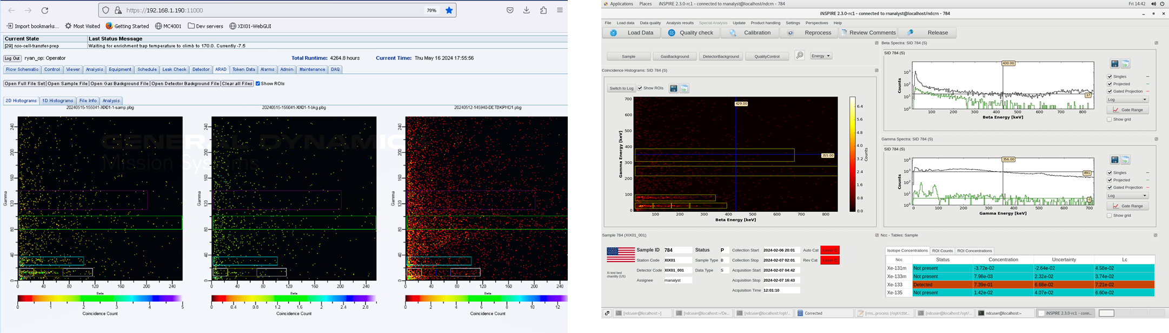
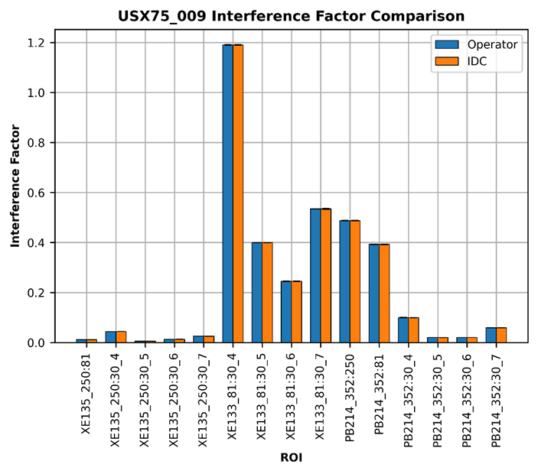
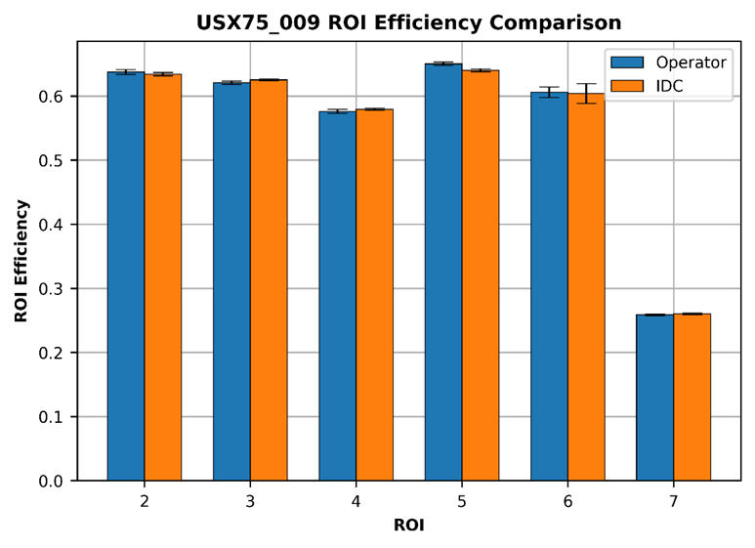
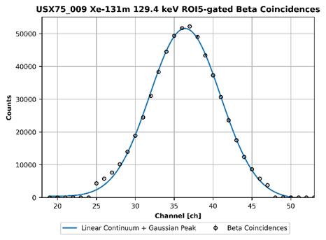
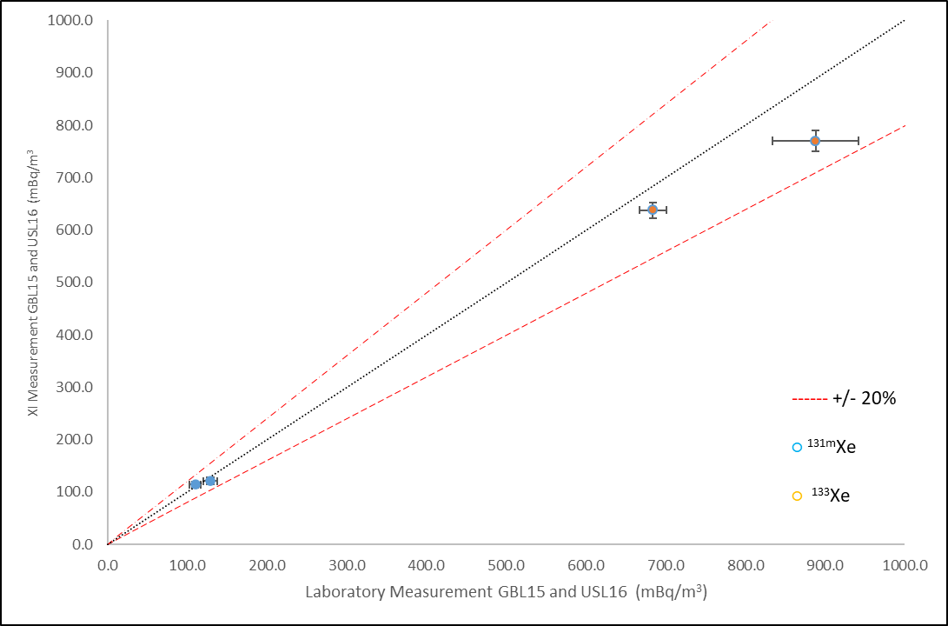
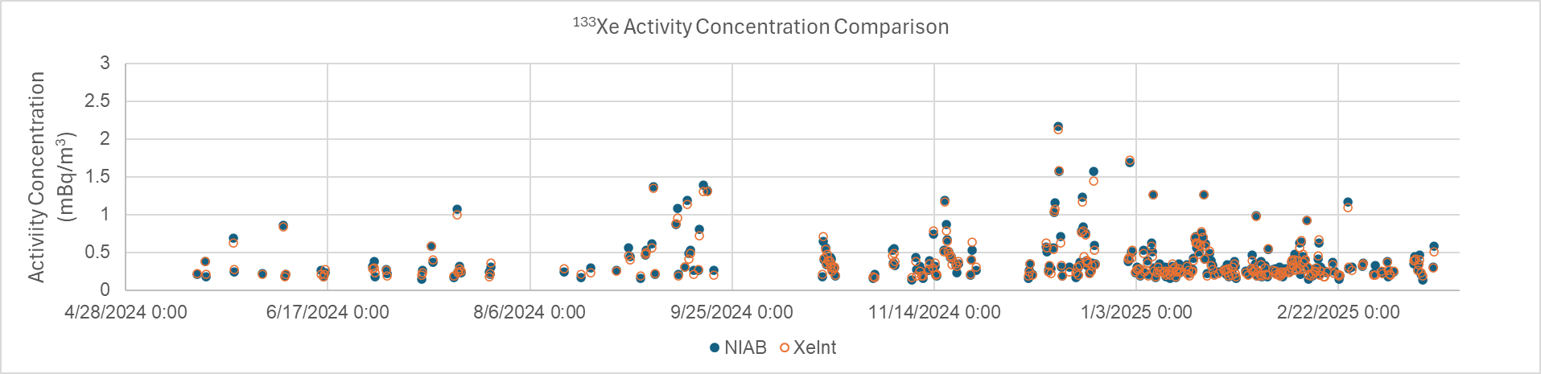
T3.2-668
Initial Operational and Processing Experience for Data from the First Commercial Unit of the Xenon International
R O'Mara , A. Davies, H. Gohla, J. Hutchinson, R. Villarreal, M. Wright, S Yoon
Spike Exercises
NDC-in-a-Box Processing
Calibration Validation
The IDC performs a calibration validation by comparing its calibration results of the Xenon International system with those conducted by the operator.
Also verifying that the system meets
the minimum requirements as
specified in INF921.
CTBTO PrepCom and GDMS performed two separate sets of inlet spike exercises on the Xenon International. The first spike included 4 xenon isotopes (Xe-133, Xe-135, Xe-131m and Xe-133m), while the second did not include Xe-131m. In both instances, the archived samples from the spike injections were sent to IMS laboratories for secondary confirmation of the measured xenon activities.
Spikes were administered via inlet injection using gas drawn up from a vial in a syringe.
During the processing of the spike samples, it was observed that the Xe-133m calculations from NDC-in-a-Box (NIAB) disagreed with the results directly from the XI. This was ultimately traced down to NIAB’s handling of the gain corrections in the XI’s data. These corrections were also applied to the IDC pipeline as similar behavior was observed.
The XI has an on-board visualization and analysis capability and produces IMS2.0 formatted pulse height data (PHD) files for analysis in NIAB.
Left: Xenon International’s on-board spectrum viewer/ analyzer. Right: NDC-in-a-box analysis of XI data.
The isotopic concentrations provided by NIAB and the XI’s on-board analysis routine were compared for a year’s worth of measurements. Only activity concentrations above the minimum detectable concentrations were considered.
For ¹³³Xe, activity concentrations calculated with NIAB and with XI on average deviated from one another by 1.3%. In general, concentrations decreased with higher activity.
¹³³ Xe and ^{131m}Xe showed good agreement with the laboratories. Discrepancies were seen between ^{133m}Xe (possibly due to large transport times) which will be further investigated.
Conclusions
The Xenon International is currently being deployed into the IMS network. In the lead up to the first system installation, GDMS and CTBTO PrepCom spent a year preparing for and testing the XI. The first network XI was installed at RN75 in March 2025. The additional time spent collaborating and familiarizing proved beneficial in the setup and initialization of the RN75 system.
DISCLAIMER: The views expressed on this poster (presentation) are those of the author and do not necessarily reflect the view of the CTBTO or the USG.

