Slide 1


P3.2-263
Global and automatic analysis of radioxenons in β−γ spectrum
Mano C.P., Paradis H^{.1,} Castillo K., Topin S., Leprieur F.
CEA/DAM, DIF, Arpajon, France
¹hugues.paradis@cea.fr
The CTBTO operates the International Monitoring System (IMS), a global network of stations that record observables characteristic of nuclear tests. Data are centralized at the International Data Centre (IDC) in Vienna and shared with National Data Centres (NDCs), including the French NDC hosted by CEA/DAM. Among the key observables, radioxenon isotopic ratios (^{131m}Xe, ^{133m}Xe, ¹³³Xe, ¹³⁵Xe) allow discrimination between civilian and military sources [1]. This work focuses on SAUNA III stations [2], equipped with low-resolution scintillators, and presents the application of a new global analysis method, “spectral unmixing” [3], to experimental SAUNA III spectra.
The method was applied to one month of experimental data and showed good agreement with the IDC results, with indications of improved sensitivity.

Slide 2
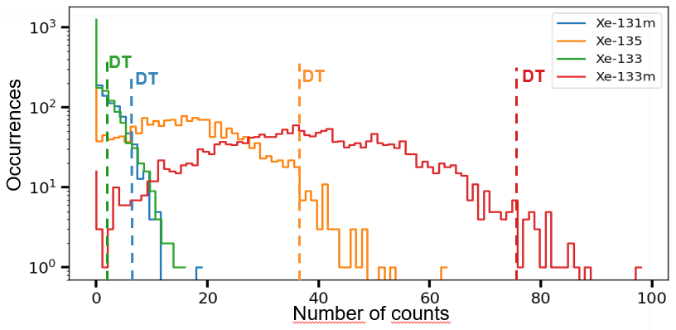
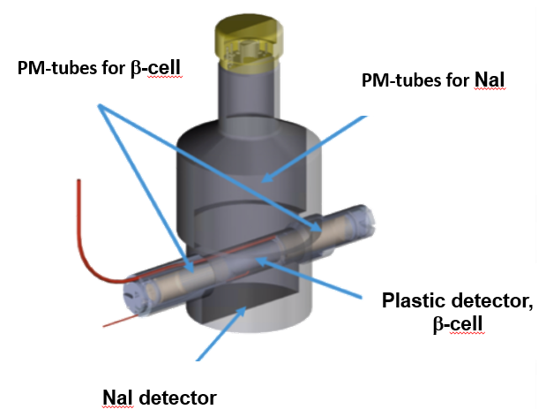
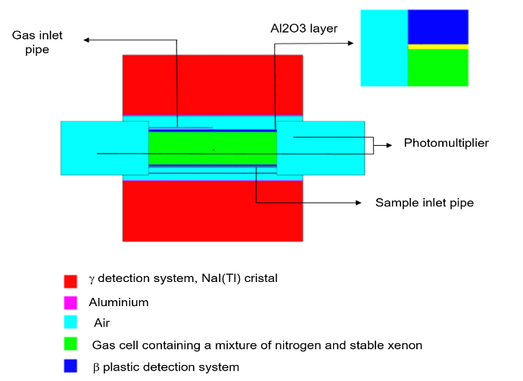
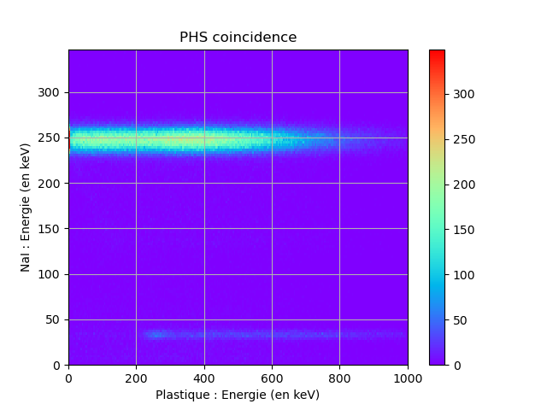
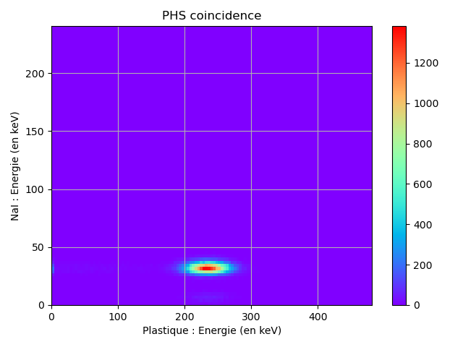
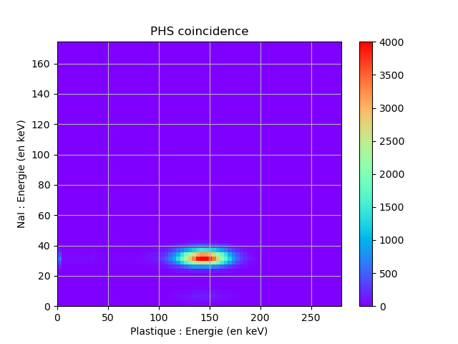
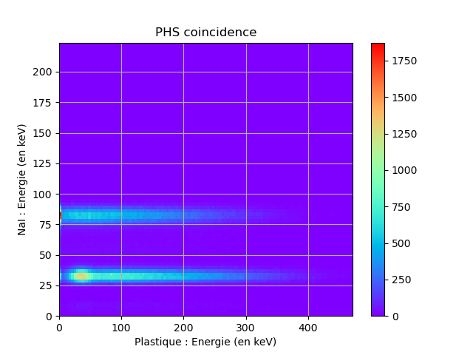

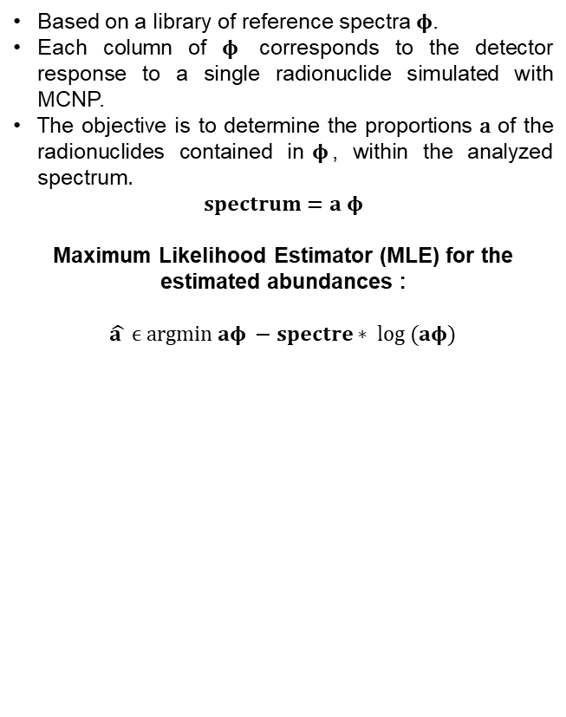
PLEASE DON‘T FORGET TO PUT THE E-POSTER TITLE AND YOUR NAME IN THE PRESENTATION HEADER.
DUPLICATE THIS SLIDE IF YOUR E-POSTER HAS MORE THAN 1 PAGE
P3.2-263
Global and automatic analysis of radioxenons in β−γ spectrum
Mano C.P., Paradis H., Castillo K., Topin S., Leprieur F.
SAUNA III detector
Spectral unmixing
Decision thresholds for spectral unmixing
The SAUNA III (Fig. 1) is a β/γ coincidence measurement system. It consists of a plastic scintillator for the detection of electrons and β-particles, and a NaI(Tl) scintillator for the detection of X-rays and γ-rays. This device provides low-resolution spectra. The first part of this work involved the development and validation of a numerical model of the system (Fig. 2) :
Based on a library of reference spectra $φ$.
Each column of $φ$ corresponds to the detector response to a single radionuclide simulated with MCNP.
The objective is to determine the proportions $\text{a}$ of the radionuclides contained in$φ$, within the analyzed spectrum$.$
$$spectrum=a φ$$
Maximum Likelihood Estimator (MLE) for the estimated abundances :
$$\hat{a } ϵ argmin aφ −spectre∗ log (aφ)$$
The Decision Thresholds (DT) of the four radioxenons are determined by unmixing 1200 spectra simulated through random sampling of the normalized reference spectrum of the SAUNA III background. The DT for each radionuclide is defined as the count level exceeding 95% of the distribution.
Fig 1. Scheme of the SAUNA III [2].
Fig 2. MCNP model of the SAUNA III.
Fig 4. Distribution of the number of counts obtained by the unmixing algorithm for 1200 simulated background spectra, for ^{131m}Xe, ^{133m}Xe, ¹³³Xe and ¹³⁵Xe.
Energy (keV) | SAUNA III efficiency | Absolute uncertainty | Model efficiency | Relative error
32 | 0,65 | 0,09 | 0,65 | 0,0%
81 | 0,72 | 0,13 | 0,78 | 8,3%
123 | 0,77 | 0,05 | 0,80 | 3,9%
165 | 0,72 | 0,05 | 0,79 | 9,7%
208 | 0,68 | 0,05 | 0,73 | 7,4%
250 | 0,64 | 0,08 | 0,69 | 7,8%
¹³⁵Xe
^{133m}Xe
^{131m}Xe
¹³³Xe
Tab 1. Comparison of the simulated direct efficiencies of the gamma channel with the SAUNA III [2] values, based on gamma simulations at different energies.
Fig 3. Reference spectra of radioxenons obtained through MCNP_CP Monte Carlo simulations.

Slide 3
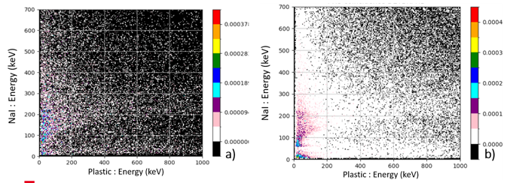
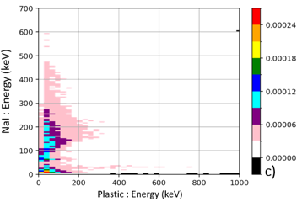
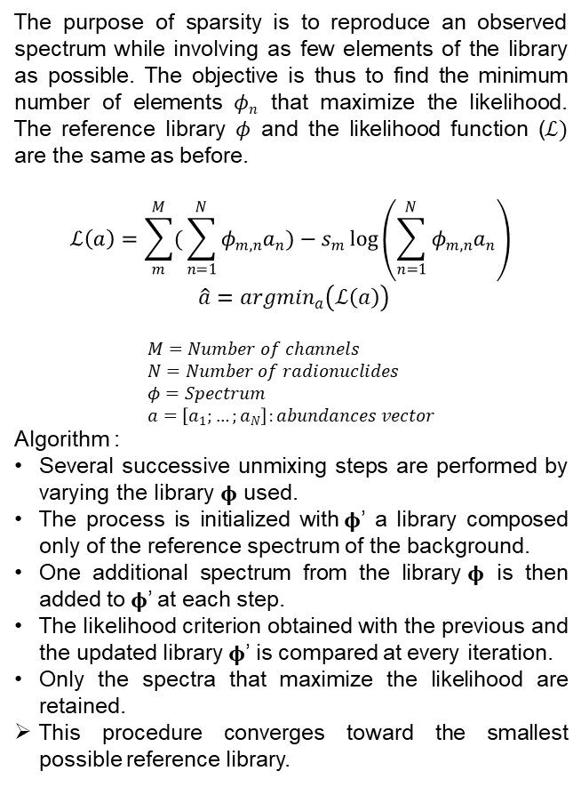
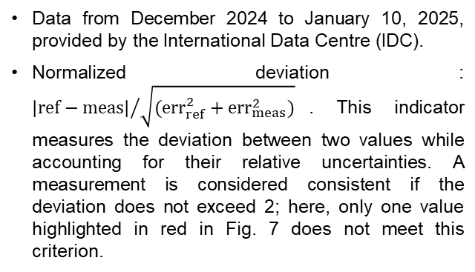
PLEASE DON‘T FORGET TO PUT THE E-POSTER TITLE AND YOUR NAME IN THE PRESENTATION HEADER.
DUPLICATE THIS SLIDE IF YOUR E-POSTER HAS MORE THAN 1 PAGE
P3.2-263
Global and automatic analysis of radioxenons in β−γ spectrum
Mano C.P., Paradis H., Castillo K., Topin S., Leprieur F.
Low statistics of the background
Sparsity approach
Application to one month experimental data
Issue: A low-statistics background spectrum of SAUNA III:
➔ Few counts and many empty channels (Fig 6.a).
Improvement: Summation of the available SAUNA III MvPs from the IMS, channel by channel
➔ Many counts and still more empty channels (Fig 6.b).
Optimization: Re-binning of 5 electron channels into 2 γ channels:
Many counts, almost fully defined matrix (Fig 6.c).
Generalization: Application of the re-binning to all spectra used for the unmixing.
The purpose of sparsity is to reproduce an observed spectrum while involving as few elements of the library as possible. The objective is thus to find the minimum number of elements $φn$ that maximize the likelihood. The reference library $φ$ and the likelihood function ($ℒ)$ are the same as before.
$$ℒ\left(a\right)=\sum_{m}^{M}{(}\sum_{n=1}^{N}{φ_{m,n}a_{n}})−s_{m}\log\left(\sum_{n=1}^{N}{φ_{m,n}a_{n}}\right)$$
$\hat{a}={argmin}_{a}\left(ℒ\left(a\right)\right)$
$$M=Number of channels \\ N=Number of radionuclides \\ φ=Spectrum \\ a=\left[a_{1};…;a_{N}\right]:abundances vector$$
Algorithm :
Several successive unmixing steps are performed by varying the library $φ$ used.
The process is initialized with$φ$’ a library composed only of the reference spectrum of the background.
One additional spectrum from the library$φ$ is then added to$φ$’ at each step.
The likelihood criterion obtained with the previous and the updated library $φ$’ is compared at every iteration.
Only the spectra that maximize the likelihood are retained.
This procedure converges toward the smallest possible reference library.
Data from December 2024 to January 10, 2025, provided by the International Data Centre (IDC).
Normalized deviation : ${\left|ref−meas\right|}/{\sqrt{({err}_{ref}^{2}+{err}_{meas}^{2})}}$. This indicator measures the deviation between two values while accounting for their relative uncertainties. A measurement is considered consistent if the deviation does not exceed 2; here, only one value highlighted in red in Fig. 7 does not meet this criterion.
Fig 6. Evolution of the number of empty channels (in black) in the SAUNA III background spectrum (a. Initial, b. Summed, c. Re-binning 5 electron channels into 2 γ channels).

Slide 4
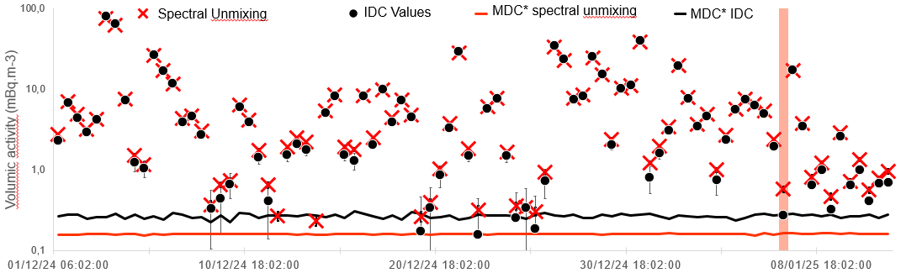
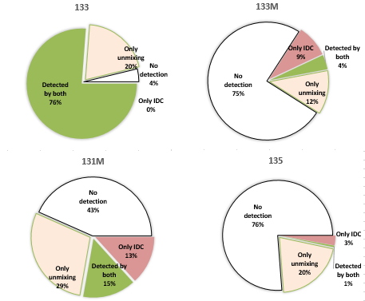
PLEASE DON‘T FORGET TO PUT THE E-POSTER TITLE AND YOUR NAME IN THE PRESENTATION HEADER.
DUPLICATE THIS SLIDE IF YOUR E-POSTER HAS MORE THAN 1 PAGE
P3.2-263
Global and automatic analysis of radioxenons in β−γ spectrum
Mano C.P., Paradis H., Castillo K., Topin S., Leprieur F.
*MDC: Minimum Detectable Concentrations.
¹³³Xe : Very good results: 88/88 detections recovered by the unmixing algorithm versus 86/88 for the IDC. This illustrates a higher sensitivity of the unmixing algorithm (confirmed by the MDCs).
^{131m}Xe + ^{133m}Xe : Consistent results. The uncertainties associated with the IDC results are, in most cases, very large, which leads to a significant number of false positives. The majority of the 18% of detections from the IDC alone may therefore correspond to false positives.
¹³⁵Xe : Good results for the common detections.

Slide 5
PLEASE DON‘T FORGET TO PUT THE E-POSTER TITLE AND YOUR NAME IN THE PRESENTATION HEADER.
DUPLICATE THIS SLIDE IF YOUR E-POSTER HAS MORE THAN 1 PAGE
P3.2-263
Global and automatic analysis of radioxenons in β−γ spectrum
Mano C.P., Paradis H., Castillo K., Topin S., Leprieur F.
Conclusion
Application of a global spectrum analysis method to International Monitoring System data for the detection of nuclear tests.
Channel-by-channel summation and optimization of information for low-resolution, low-statistics spectra.
Reference spectra produced by Monte Carlo simulation, accounting for the energy resolution of the detection system ; sparsity approach to reduce the false positive rate.
Validation of the method on one month of experimental data validated by the International Data Centre, using the ROI method.
*MDC: Minimum Detectable Concentrations.

