Slide 1
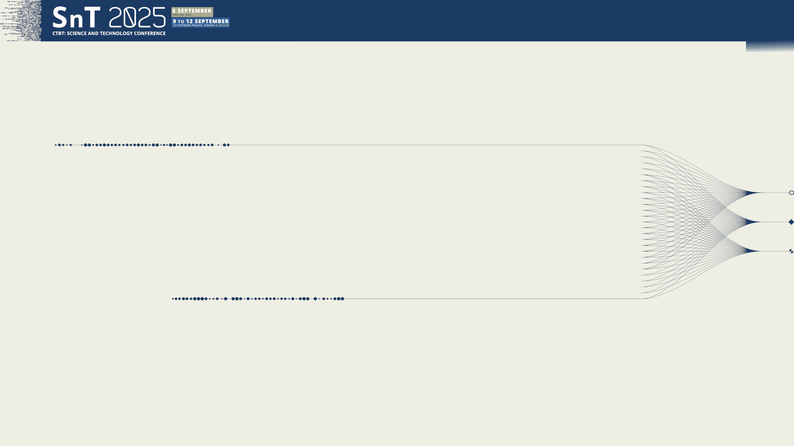

O3.2-267
Enhancements of FRL08 : metrological connection between simulation/experiment and utilization of AI tools for coincidence matrix analysis
Authors : H.-D. Lenouvel¹, H. Paradis¹
Co-authors : A. de Vismes Ott¹, P. Gross¹, S. Topin^{1,2}
¹ CEA, DAM, DIF, F-91297 Arpajon, France
² CNAM, Analyse Chimique et Bioanalyse, EPN-7, 292 rue Saint Martin, 75003 Paris, France
09 september 2025

Slide 2
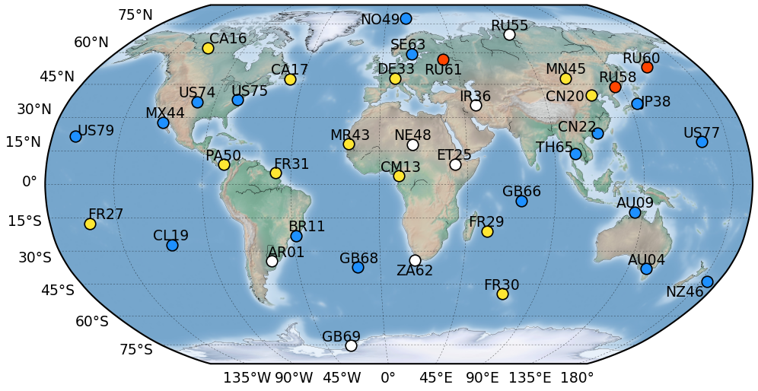
From context to modeling : systems and methods

Slide 3
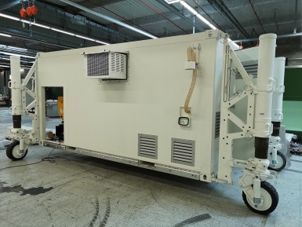
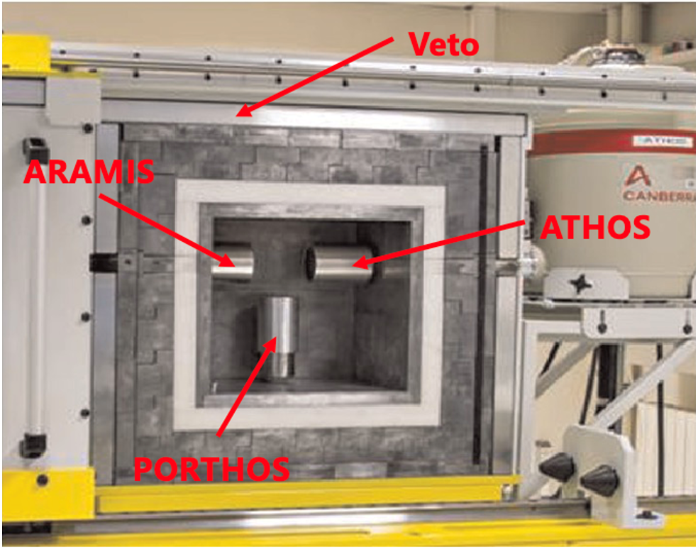
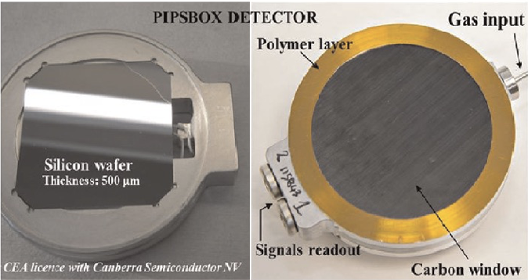
Radionuclide technology : context and stakes
Resources deployed by the CEA as part of the CTBT framework:
  Stations: SPALAX and SPALAX-NG [1]
  Certified Laboratory: FRL08 (Gamma³) [2]
  National Data Center (NDC)
Research for radionuclide measurements:
  Coincidence measurements (with the SPALAX-NG and Gamma³)
  Data analysis : AI and spectral unmixing methods (P3.2-263)
Fig 1. SPALAX-NG
Fig 2. Gamma³ (left) & PIPSBox (right)
[1] S. Topin et al., J. Environ. Radioact. 225 (2020) 106442
[2] A. Cagniant et al., Applied Radiation and Isotopes 98 (2015)

Slide 4
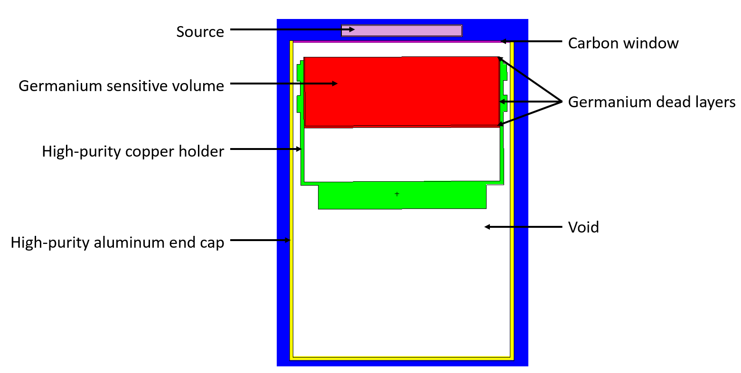
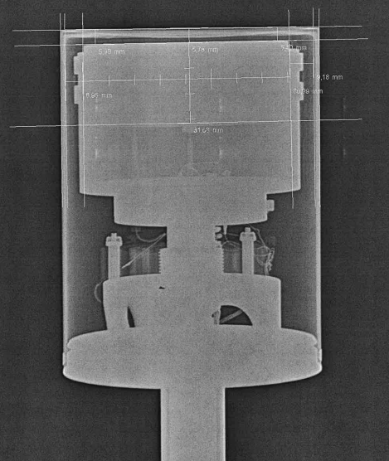
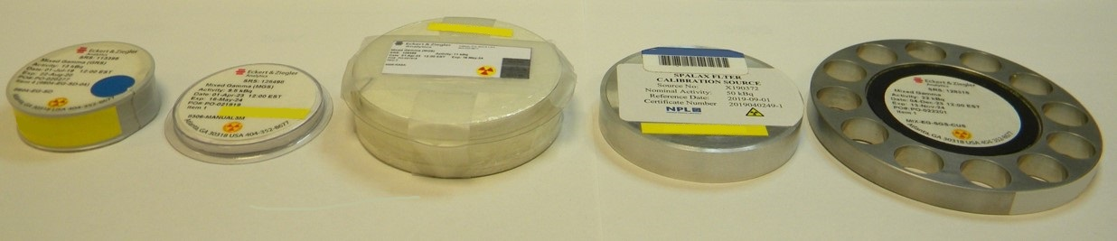
Model creation with MCNP
Modeling from:
  Technical drawings provided by the manufacturer
  Radiographies of detectors
Fig 3. Radiography of a HPGe detector (BEGe5030P)
Fig 4. Display of a cross-sectional view of a detector modeled under MCNP.
Standard sources:
  Energy range covered: [22 - 2505 keV]
  Geometries:
  compressed or uncompressed particle filters (diameter of 110 mm)
  volumetric geometries (from 20 mL to 500 mL)
BP20
3M
RASA
PIPSBox geometry
Double Face
Fig 5. Common sources geometry used by the laboratory
➔ Use of sources of different sizes and compositions to provide a general calibration

Slide 5
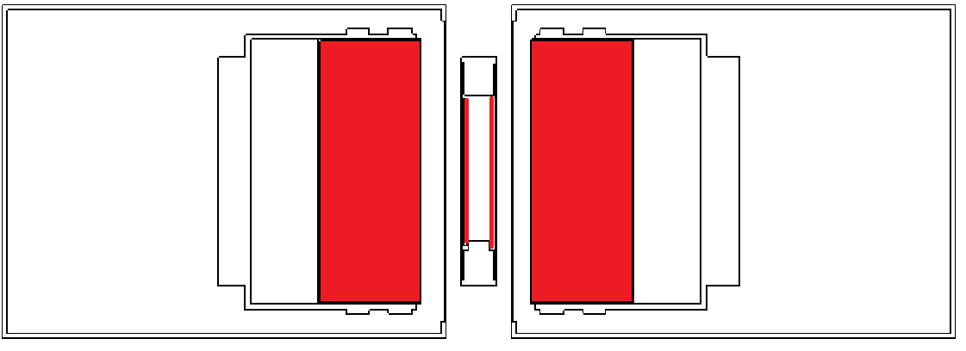
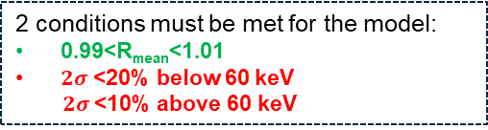
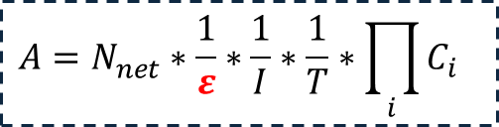

Validation of models
Detection efficiency:
$$ε=(number of particles detected)/(number of particles emitted)$$
Validation of the digital model:
3° Validation of models
1° Modeling of detectors
2° Optimization:
Mean ratio = $\left(\frac{ε_{EXP}}{ε_{MCNP}}\right)$ $≈1$
Fig 6. Modeling of the configuration (ATHOS + ARAMIS) & PIPSBox
2 conditions must be met for the model:
0.99<R_{mean}<1.01
$2σ$ <20% below 60 keV
$2σ$<10% above 60 keV
Parameters to optimize:
  Thickness of materials (dead layers, carbon window…)
  Position of the source relative to the crystal detector
  Crystal size
60 keV
Fig 7. Detection efficiency ratio (EXP/MCNP) versus energy
$$A=N_{net}^{ }∗\frac{1}{ε}∗\frac{1}{I}∗\frac{1}{T}∗\prod_{i}{C_{i}}$$
➔ Model validation enables simulation for calculating new detection efficiencies
$ε$ from A. Berlizov, MCNP-CP Upgrade Patch Version 3.2, Institute for Nuclear Research National Academy of Sciences of Ukraine, 2012

Slide 6
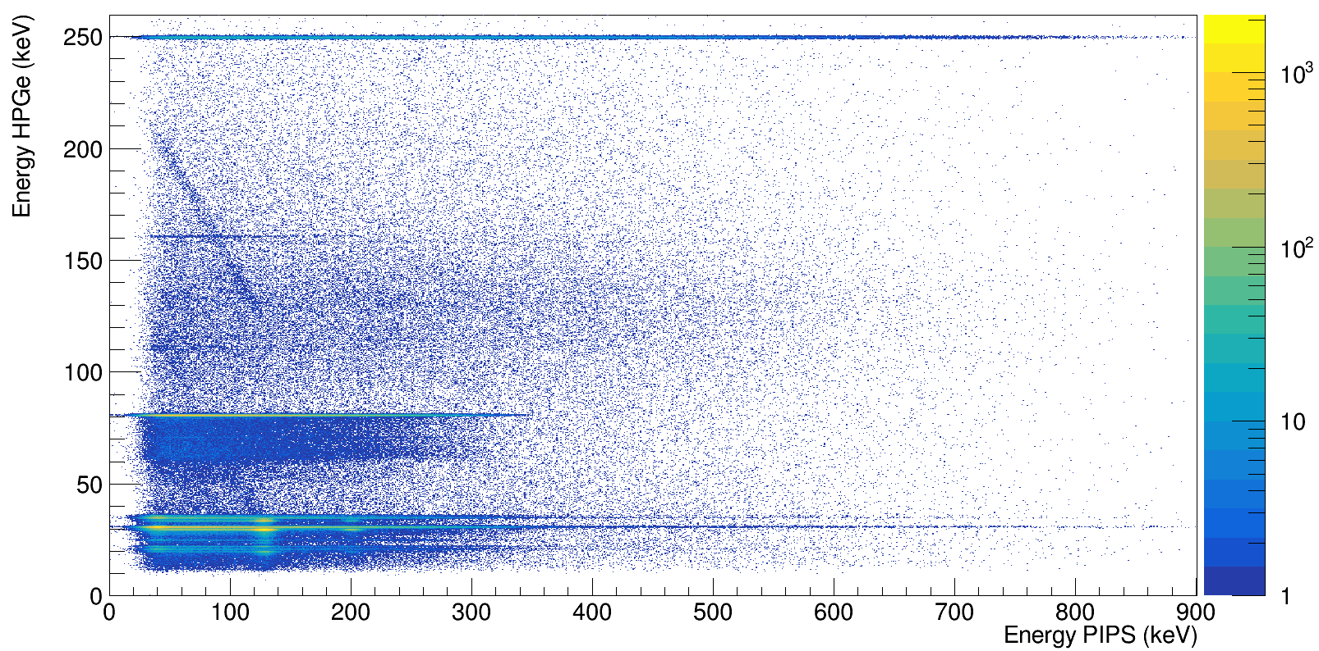
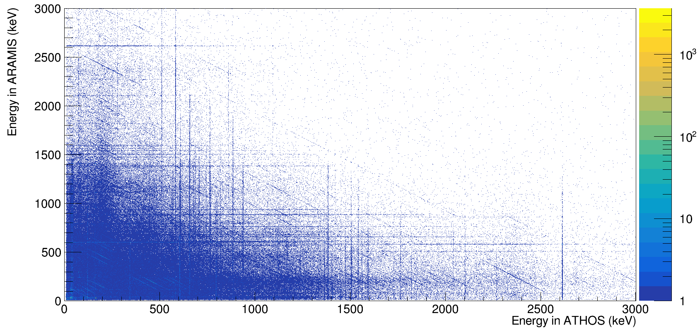


Quantification through coincidence measurements
$$β/γ$$
$γ/γ$

Slide 7
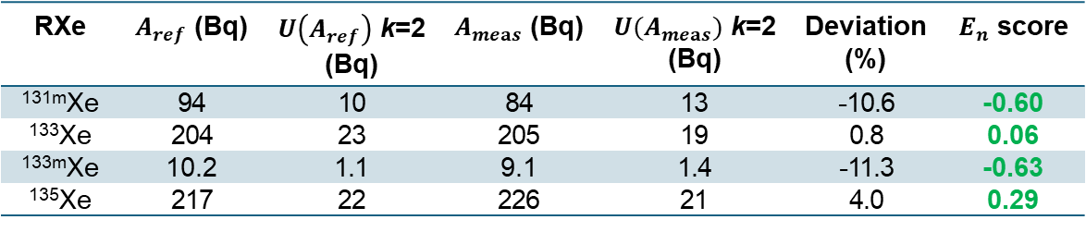
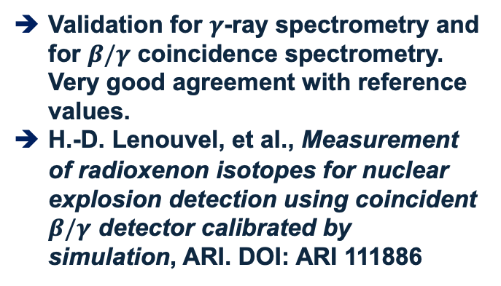

Validation of the method on a gaseous sample
Measurement:
  (ATHOS+ARAMIS)&PIPSBox
  Duration: 57600 s
Efficiency calculation:
  MCNP-CP
Tab 1. $β/γ$ detection efficiencies for the 4 radioxenon isotopes
RXe | β/γ coincidence spectrometry
^{131m}Xe | 0.16 ± 0.02
¹³³Xe | 0.20 ± 0.02
^{133m}Xe | 0.147 ± 0.023
¹³⁵Xe | 0.176 ± 0.016
Fig 8. $β/γ$ matrix obtained from the measurement
Validation for $γ$-ray spectrometry and for $β/γ$ coincidence spectrometry. Very good agreement with reference values.
H.-D. Lenouvel, et al., Measurement of radioxenon isotopes for nuclear explosion detection using coincident $β/γ$ detector calibrated by simulation, ARI. DOI: ARI 111886
Analysis:
Tab 2. Comparison between reference activities and measured activities
RXe | $A_{ref}$ (Bq) | $U\left(A_{ref}\right)$ k=2 (Bq) | $A_{meas}$ (Bq) | $U(A_{meas})$ k=2 (Bq) | Deviation (%) | $E_{n}$ score
^{131m}Xe | 94 | 10 | 84 | 13 | -10.6 | -0.60
¹³³Xe | 204 | 23 | 205 | 19 | 0.8 | 0.06
^{133m}Xe | 10.2 | 1.1 | 9.1 | 1.4 | -11.3 | -0.63
¹³⁵Xe | 217 | 22 | 226 | 21 | 4.0 | 0.29

Slide 8
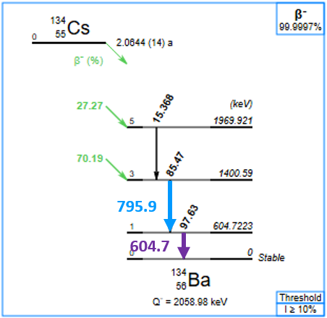
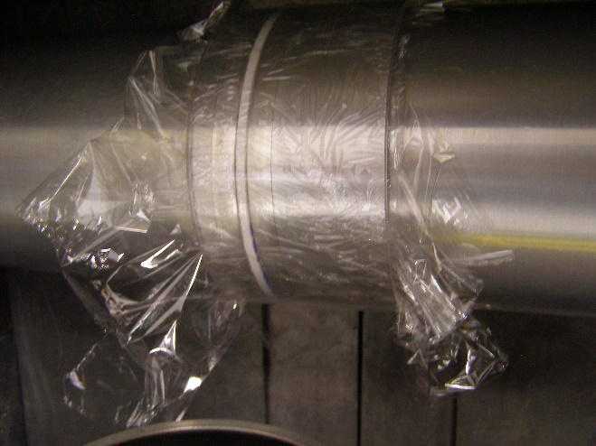
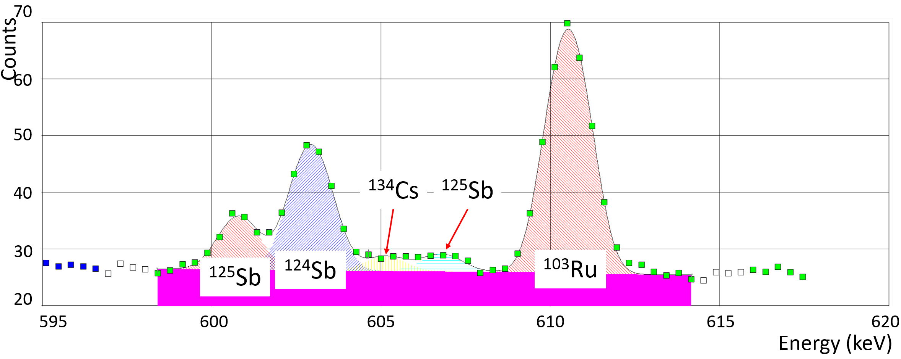
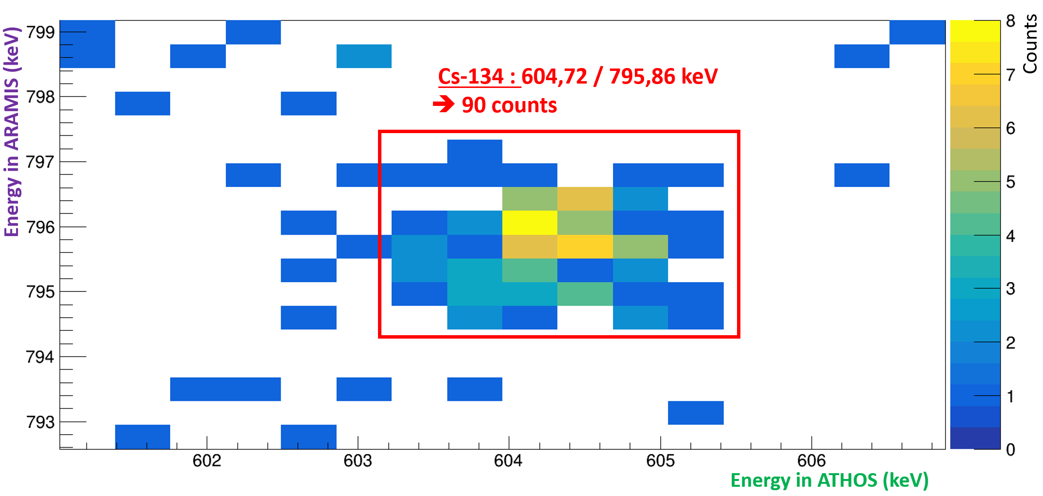

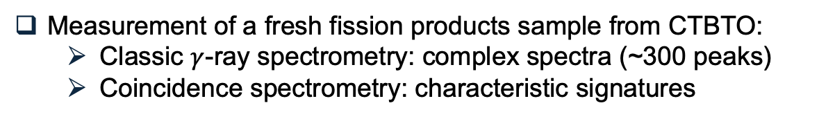


Benefits of using $γ/γ$ coincidence detection (example with ¹³⁴Cs)
Identification of ¹³⁴Cs using coincidences:
Fig 10. Particulate filter placed between two HPGe detectors with expected coincidence matrix signatures
Fig 9. Decay scheme of ¹³⁴Cs
Measurement of a fresh fission products sample from CTBTO:
  Classic $γ$-ray spectrometry: complex spectra (~300 peaks)
  Coincidence spectrometry: characteristic signatures
$SNR$ : Signal-to-Noise Ratio
$$SNR≪1$$
Fig 11. Classic 𝛾-ray with zoom around 605 keV
Fig 12. Coincidence matrix with a zoom on the ¹³⁴Cs
$$SNR\sim 10$$
High SNR values make it easier to qualify and quantify certain radionuclides

Slide 9
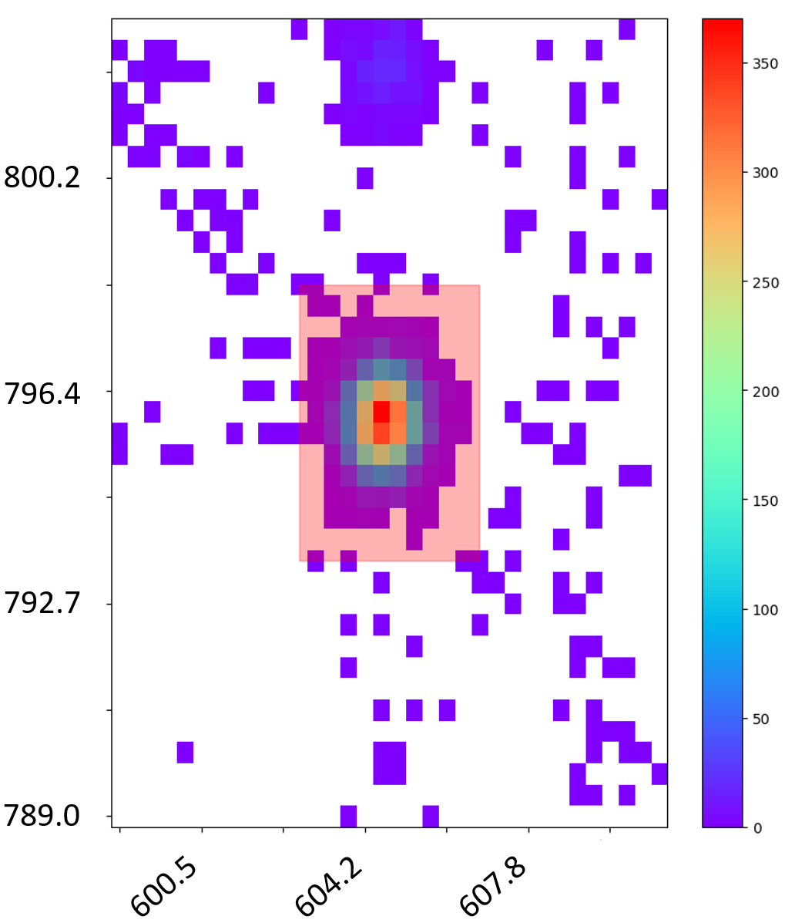
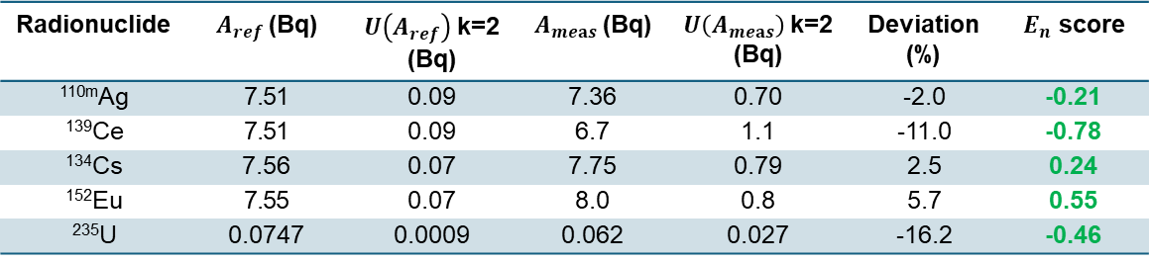
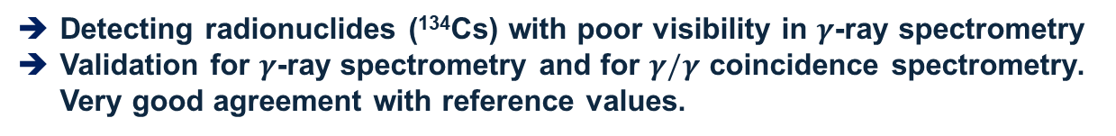
Validation of the method on a IAEA sample
Standard IAEA swipe sample
Bkgd
Measurement:
  ATHOS&ARAMIS
  Duration: 316800 s
ROI
Efficiency calculation:
  MCNP-CP
Fig 13. $γ/γ$ matrix obtained from the measurement with a zoom on the ¹³⁴Cs
Analysis:
Tab 3. Comparison between reference activities and measured activities
Radionuclide | $A_{ref}$(Bq) | $U\left(A_{ref}\right)$k=2 (Bq) | $A_{meas}$(Bq) | $U\left(A_{meas}\right)$k=2 (Bq) | Deviation (%) | $E_{n}$ score
^{110m}Ag | 7.51 | 0.09 | 7.36 | 0.70 | -2.0 | -0.21
¹³⁹Ce | 7.51 | 0.09 | 6.7 | 1.1 | -11.0 | -0.78
¹³⁴Cs | 7.56 | 0.07 | 7.75 | 0.79 | 2.5 | 0.24
¹⁵²Eu | 7.55 | 0.07 | 8.0 | 0.8 | 5.7 | 0.55
²³⁵U | 0.0747 | 0.0009 | 0.062 | 0.027 | -16.2 | -0.46
Detecting radionuclides (¹³⁴Cs) with poor visibility in $γ$-ray spectrometry
Validation for $γ$-ray spectrometry and for $γ/γ$ coincidence spectrometry. Very good agreement with reference values.

Slide 10
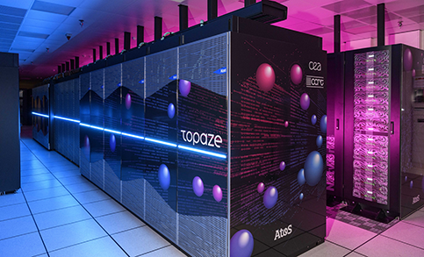

Qualitative AI model
$γ/γ$

Slide 11
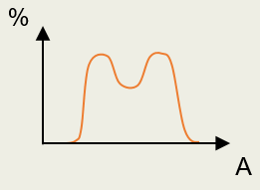
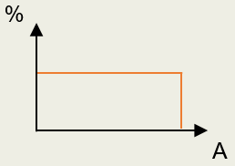
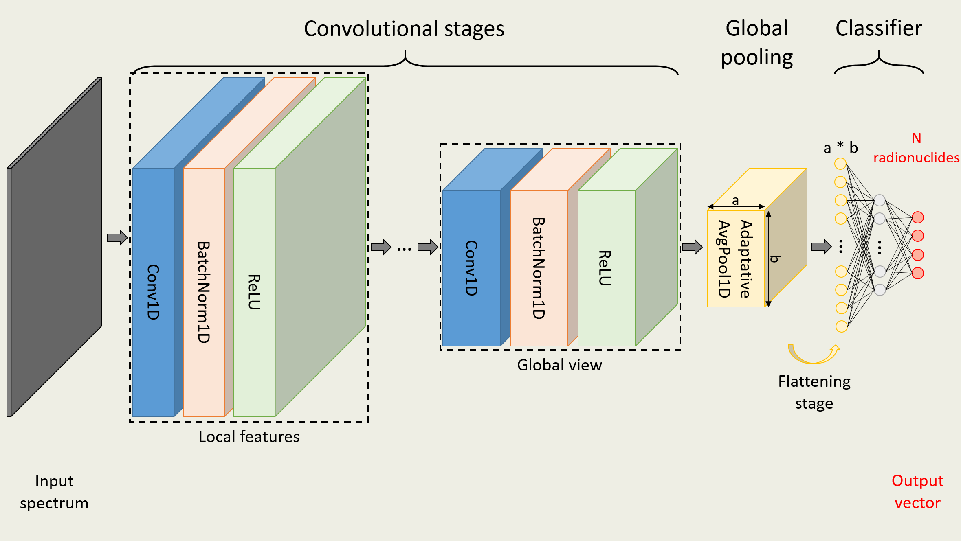
Database & CNN architecture
Memory-intensive 2D spectrum ➔ spectra size reduced by ~300x
Composition of simulated samples : ~130 000 spectra
  ~3% : spectral signature of each radionuclide of the relevant list
  ~18% : fission products from ²³⁵U (High Enriched Uranium) with fast neutrons (14 MeV)
  ~79% : random distributions
Convolutional Neural Network (CNN):
Ensuring both physical accuracy and sufficient representation of each radionuclide
Setting thresholds for each radionuclide to determine their presence
Fig 14. Representation of the CNN architecture employed

Slide 12
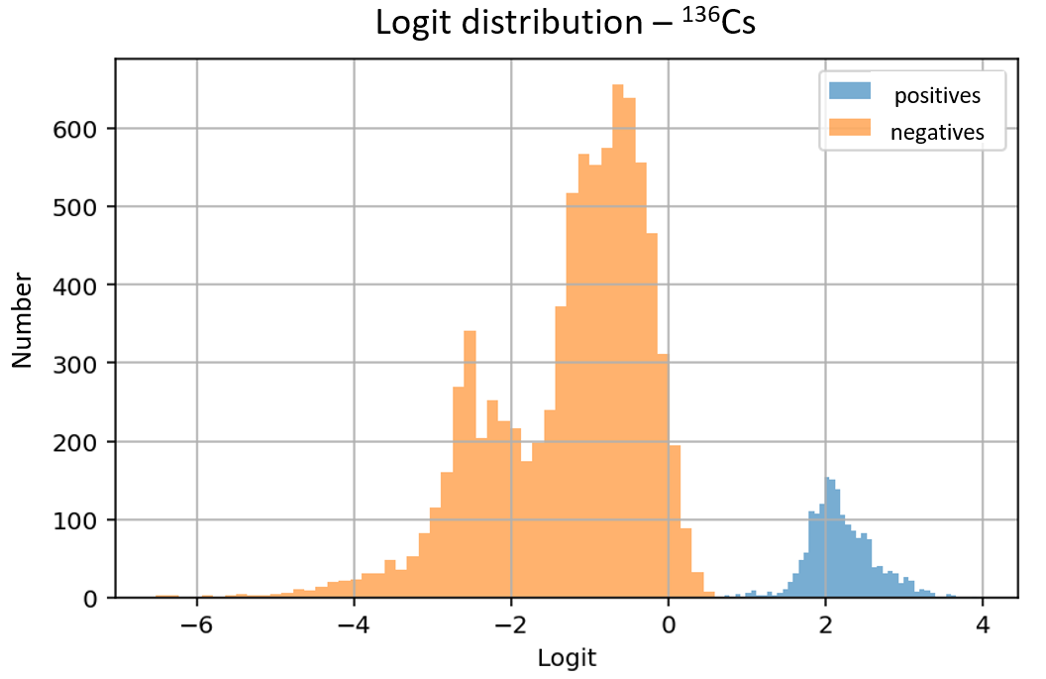
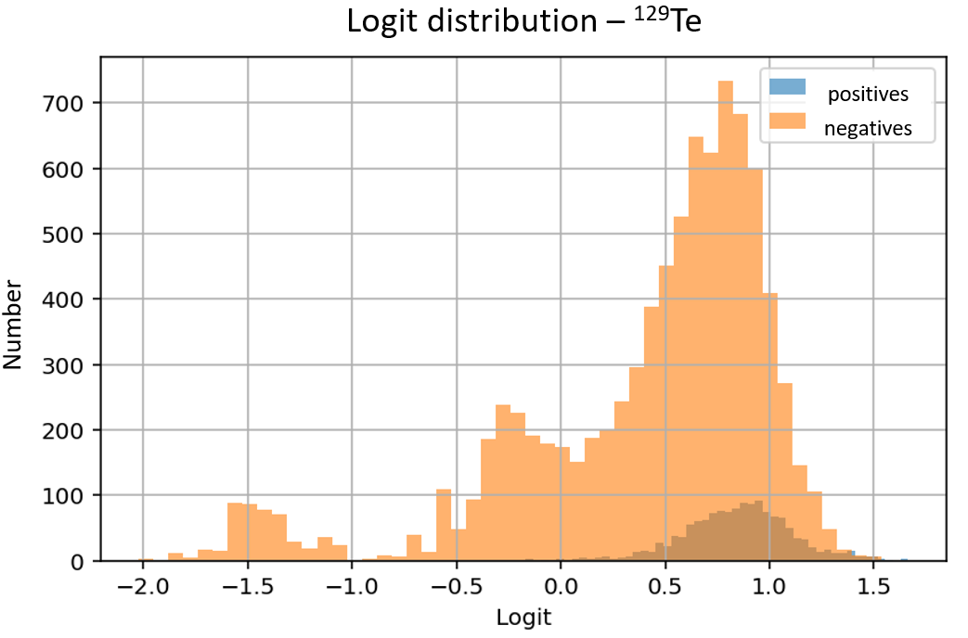
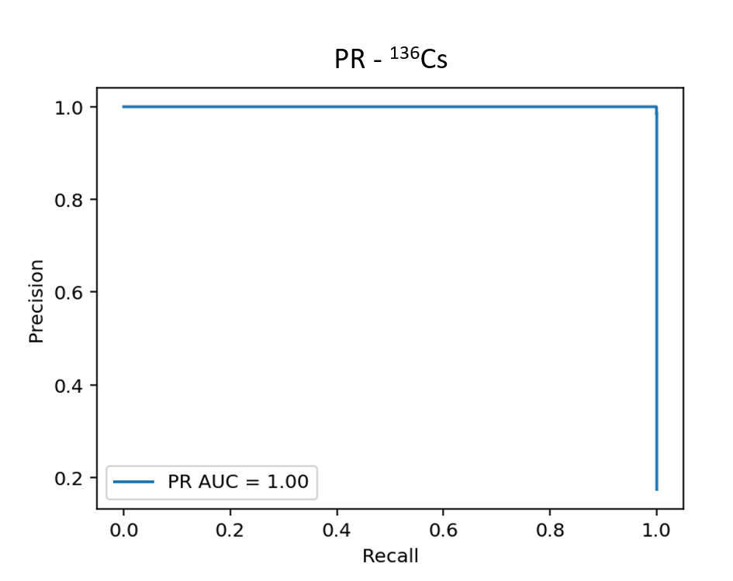
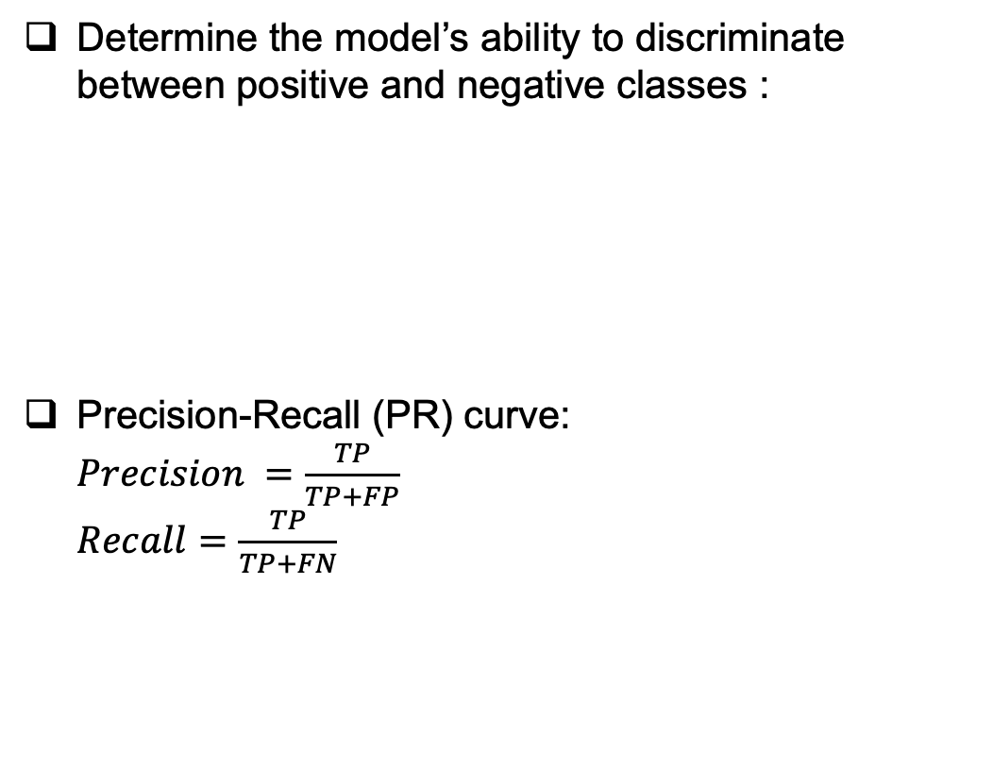
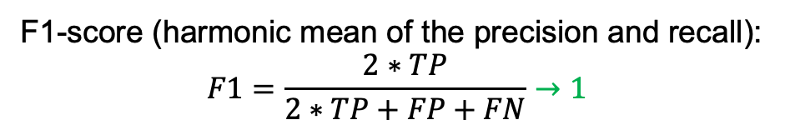
Evaluation of the spectral CNN
Determine the model’s ability to discriminate between positive and negative classes :
Precision-Recall (PR) curve:
$Precision =\frac{TP}{TP+FP}$
$Recall=\frac{TP}{TP+FN}$
Threshold
Fig 15. Distribution of positives/negatives as a function of the raw output
F1-score (harmonic mean of the precision and recall):
$$F1=\frac{2∗TP}{2∗TP+FP+FN}→1$$
For this model:
Precision: 0.78
Recall: 0.84
F1-score: 0.79
Fig 16. PR curve for ¹³⁶Cs
High detection accuracy for specific classes
Exclusion of certain classes treated as noise
Determine the best threshold

Slide 13
Results from a standard source
Radionuclides in the source:
  Detectable by the model : ⁵⁷Co, ⁶⁰Co, ⁸⁸Y, and ¹³⁹Ce
  Undetectable by the model : ⁵⁴Mn, ⁶⁵Zn, ¹⁰⁹Cd, ¹¹³Sn, ¹³⁷Cs, and ²⁴¹Am
CNN results:
  ⁵⁷Co : only visible at low energies
Detected
Not detected
Tab 4. Model results on a 10-element standard source
Radionuclide | A (Bq) | Threshold (%) | Predicted probability of presence (%)
⁶⁰Co | 185.5 | 69 | 85
¹³⁹Ce | 919.5 | 73 | 86
⁸⁸Y | 2794 | 70 | 81
Radionuclide | A (Bq) | Threshold (%) | Predicted probability of presence (%)
⁵⁷Co | 105.2 | 71 | 24
Most of the elements detectable by the model are correctly classified
No false positives were observed

Slide 14
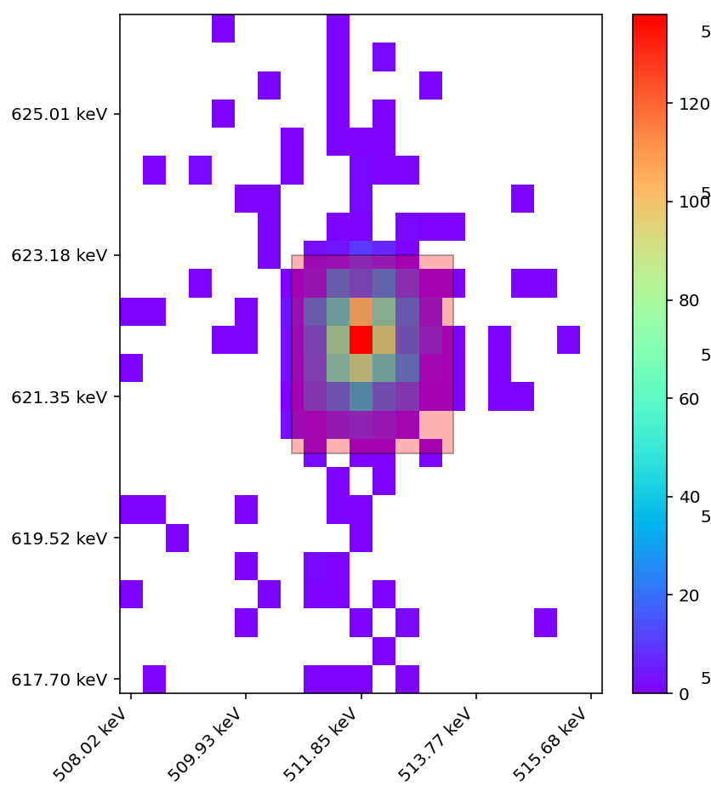
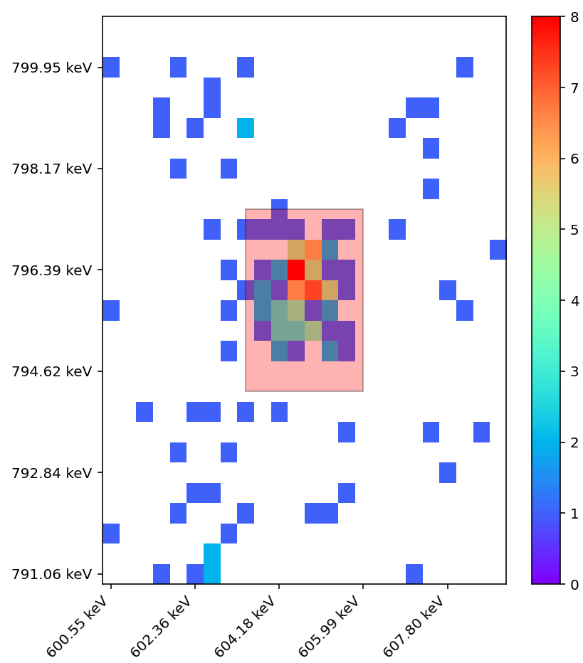
Results from the PTE 2023 (3M geometry)
CNN results:
Detected
Not detected
Tab 5. Model results on a 25-element sample
Radionuclide | Importance | A (Bq) | Threshold (%) | Predicted probability of presence (%)
¹²⁵Sb | major | 2.8 | 74 | 78
¹³⁶Cs | major | 21.2 | 66 | 82
⁹⁵Nb | major | 26.2 | 62 | 85
¹⁴⁷Nd | major | 35.1 | 70 | 74
⁹⁵Zr | major | 63.7 | 69 | 96
¹⁰³Ru | major | 81.0 | 70 | 98
¹⁴⁰Ba | major | 93.8 | 70 | 93
¹⁴⁰La | major | 108.0 | 71 | 93
¹⁰⁶Ru | / | / | 68 | 82
¹²⁴Sb | major | 2.1 | 68 | 39
¹⁵⁶Eu | minor | 3.6 | 71 | 43
¹³²Te | minor | 7.0 | 71 | 16
¹²⁷Sb | minor | 10.2 | 72 | 41
¹²⁶Sb | major | 17.5 | 65 | 35
¹³¹I | major | 27.6 | 69 | 63
¹³⁴Cs | / | / | 66 | 19
¹⁰⁶Ru
¹³⁴Cs
Fig 17. Coincidence matrix with a zoom on the ¹⁰⁶Ru and ¹³⁴Cs
Most of the elements detectable by the model are correctly classified
Most undetected elements are due to low activity/emission levels or insignificant coincidence signatures

Slide 15
Conclusion & Perspectives

Slide 16
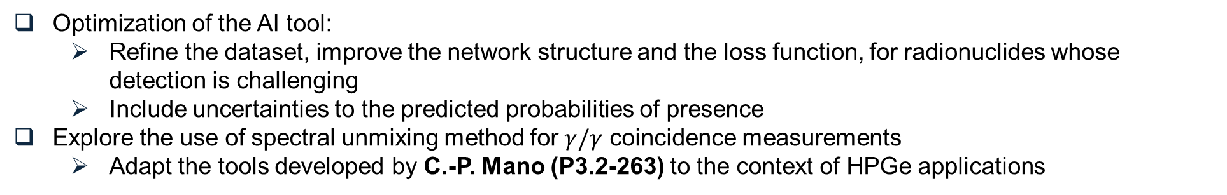
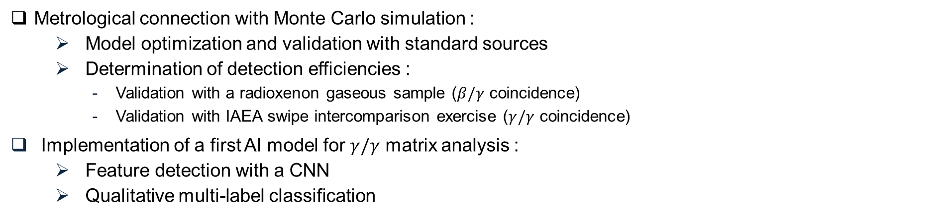
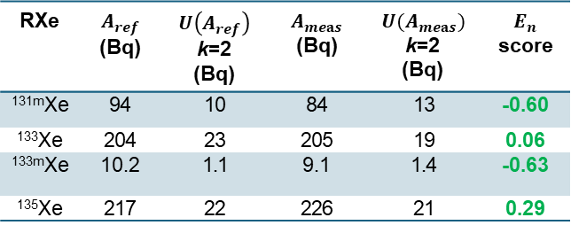
Conclusion
RXe | $A_{ref}$ (Bq) | $U\left(A_{ref}\right)$ k=2 (Bq) | $A_{meas}$ (Bq) | $U(A_{meas})$ k=2 (Bq) | $E_{n}$ score
^{131m}Xe | 94 | 10 | 84 | 13 | -0.60
¹³³Xe | 204 | 23 | 205 | 19 | 0.06
^{133m}Xe | 10.2 | 1.1 | 9.1 | 1.4 | -0.63
¹³⁵Xe | 217 | 22 | 226 | 21 | 0.29
Metrological connection with Monte Carlo simulation :
    Model optimization and validation with standard sources
    Determination of detection efficiencies :
      Validation with a radioxenon gaseous sample ($β/γ$ coincidence)
      Validation with IAEA swipe intercomparison exercise ($γ/γ$ coincidence)
Implementation of a first AI model for $γ/γ$ matrix analysis :
    Feature detection with a CNN
    Qualitative multi-label classification
Perspectives
Optimization of the AI tool:
    Refine the dataset, improve the network structure and the loss function, for radionuclides whose detection is challenging
    Include uncertainties to the predicted probabilities of presence
Explore the use of spectral unmixing method for $γ/γ$ coincidence measurements
    Adapt the tools developed by C.-P. Mano (P3.2-263) to the context of HPGe applications
Thank you.

Slide 17
Annexes

Slide 18
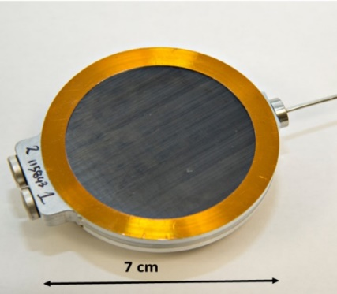
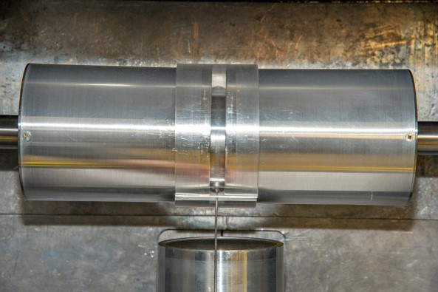
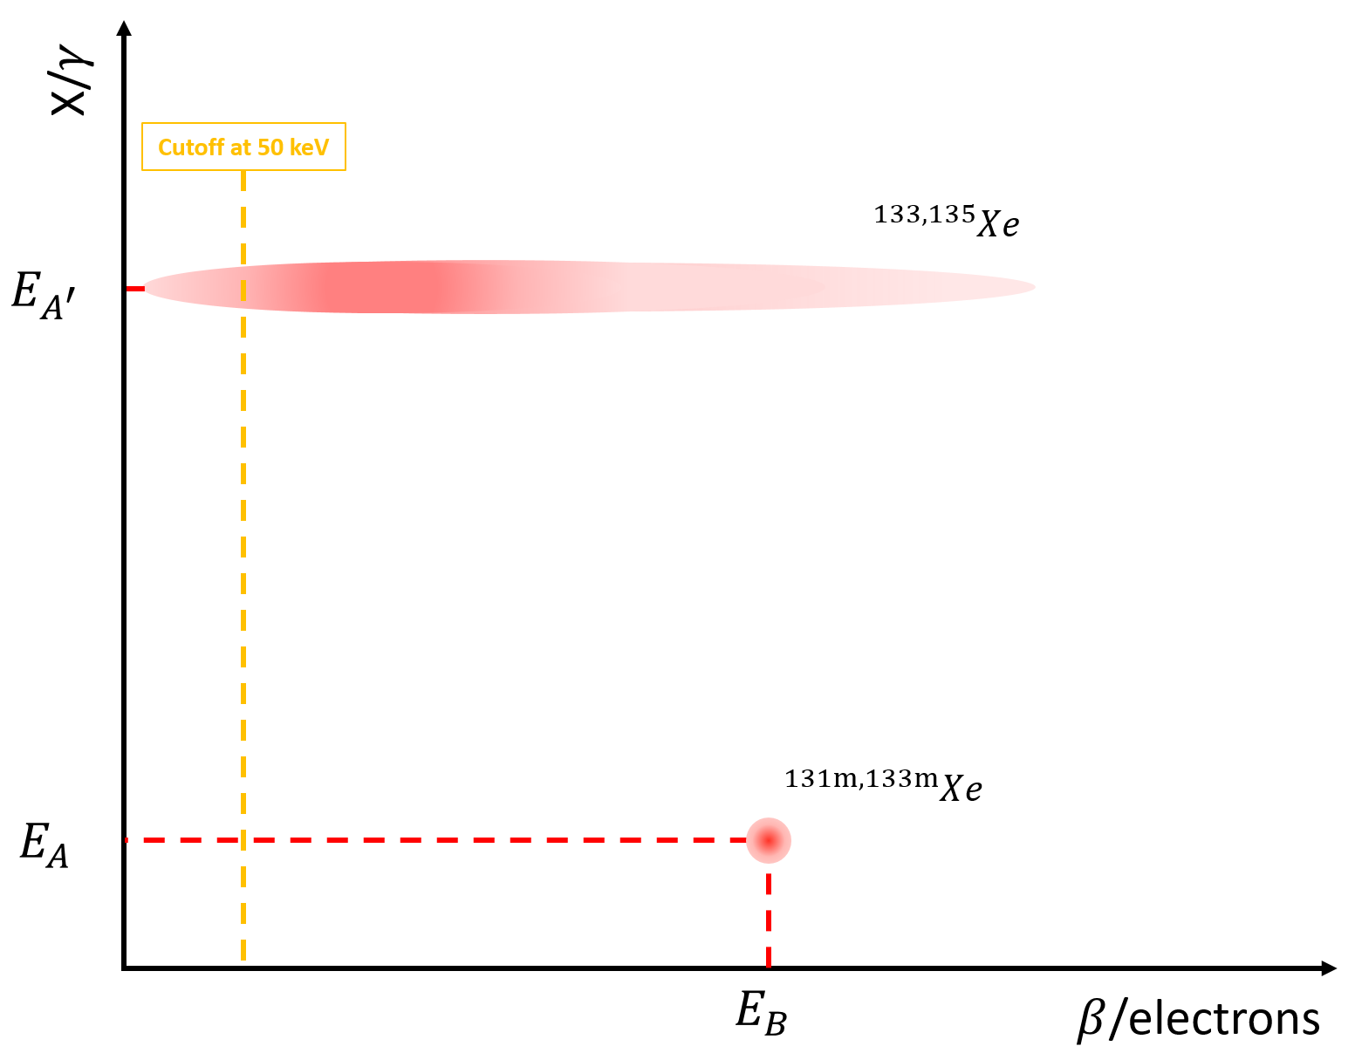
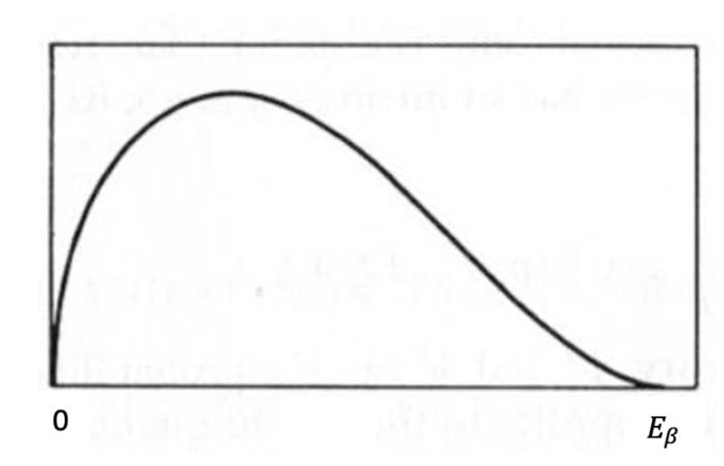
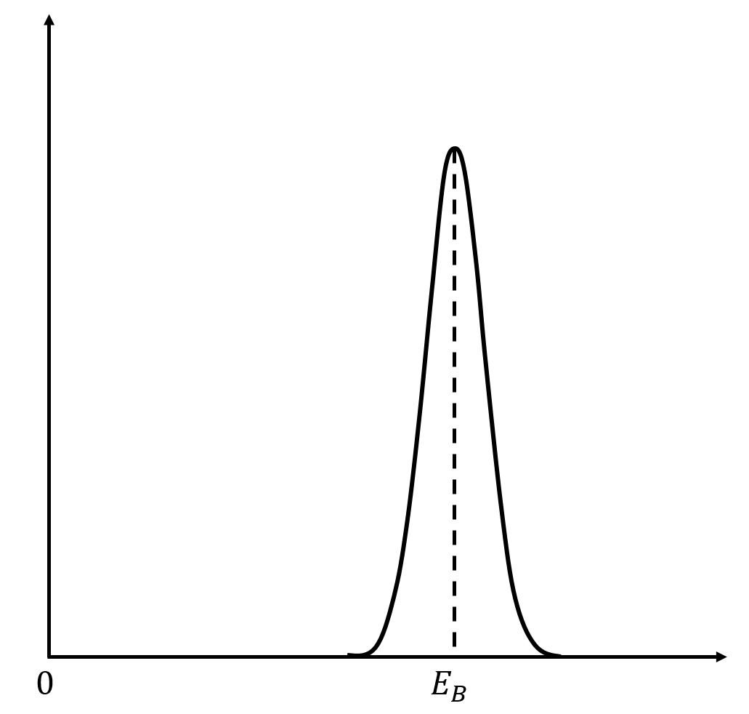
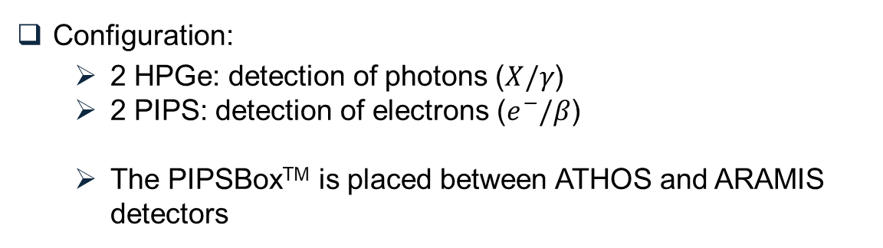
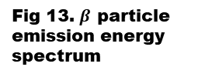

Gamma³ : configuration for the measurement of gaseous samples
Configuration:
  2 HPGe: detection of photons ($X/γ$)
  2 PIPS: detection of electrons ($e^{−}/β$)
  The PIPSBoxTM is placed between ATHOS and ARAMIS detectors
$β/γ$ coincidences:
Fig 10. (ATHOS+ARAMIS)&PIPSBox configuration
Fig 13. $β$ particle emission energy spectrum
Fig 12. Energy spectrum of the electron emitted by internal conversion
Fig 11. Depiction of the shape of the fingerprints

Slide 19
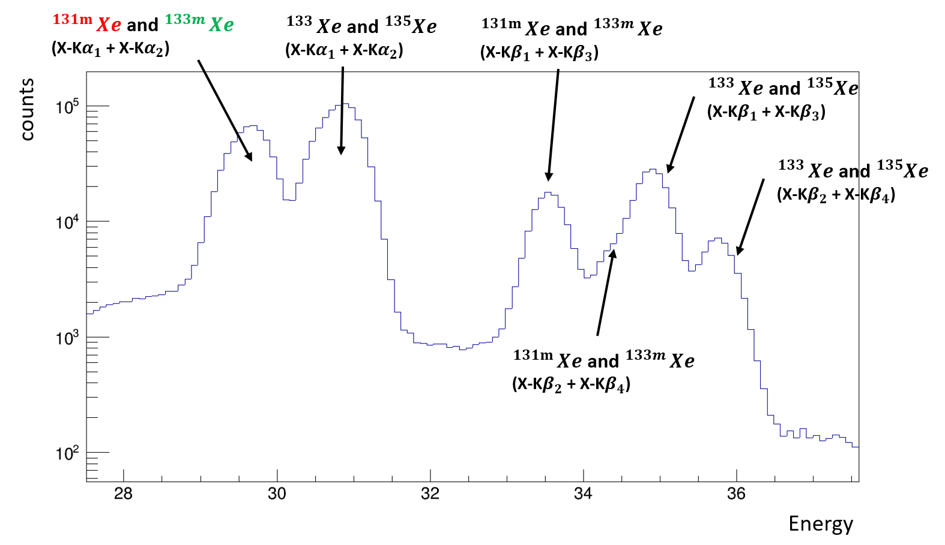
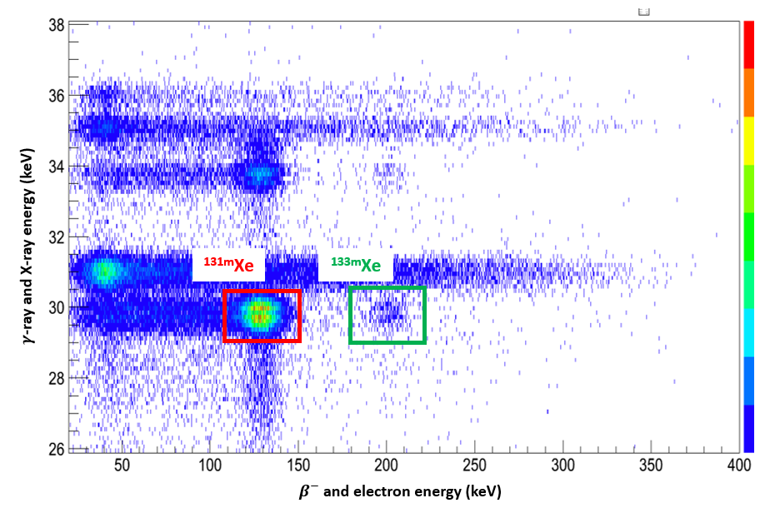
Benefit of using $β/γ$ coincidence detection
The benefit of using coincidences in the X-ray region:
Fig 14. Separation of the signatures of metastable radioxenon isotopes
Fig 15. $γ$-ray spectrum with a zoom on the X-ray region
Characteristic signatures of radionuclide (very low background)

Slide 20
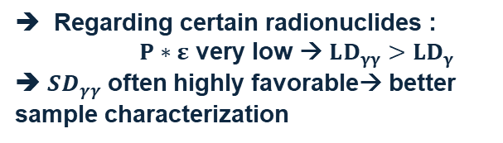
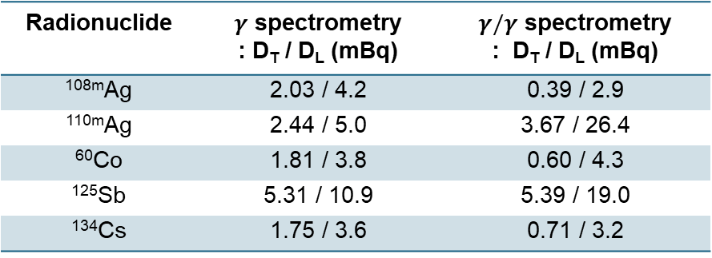

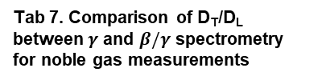
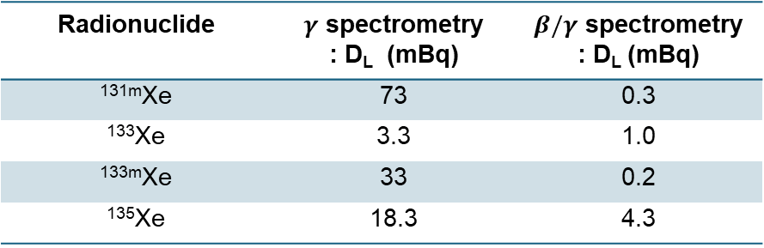

Calculation of decision thresholds (D_{T}) and detection limits (D_{L}) on a blank measurement:
  ISO standard 11929
  Comparison between the classical and coincidence spectrometry
Particulate radionuclides:
Radionuclide | $γ$ spectrometry : D_{T} / D_{L} (mBq) | $γ/γ$ spectrometry : D_{T} / D_{L} (mBq)
^{108m}Ag | 2.03 / 4.2 | 0.39 / 2.9
^{110m}Ag | 2.44 / 5.0 | 3.67 / 26.4
⁶⁰Co | 1.81 / 3.8 | 0.60 / 4.3
¹²⁵Sb | 5.31 / 10.9 | 5.39 / 19.0
¹³⁴Cs | 1.75 / 3.6 | 0.71 / 3.2
Regarding certain radionuclides :
$P∗ε$ very low → $LD_{γγ}>LD_{γ}$
➔ $SD_{γγ}$ often highly favorable→ better sample characterization
Tab 6. Comparison of D_{T}/D_{L} between $γ$ and $γ/γ$ spectrometry for particulate measurements
Noble gas sample:
Radionuclide | $γ$ spectrometry : D_{L} (mBq) | $β/γ$ spectrometry : D_{L} (mBq)
^{131m}Xe | 73 | 0.3
¹³³Xe | 3.3 | 1.0
^{133m}Xe | 33 | 0.2
¹³⁵Xe | 18.3 | 4.3
Tab 7. Comparison of D_{T}/D_{L} between $γ$ and $β/γ$ spectrometry for noble gas measurements
$β/γ$ spectrometry highly favorable for metastable radioxenon isotopes

Slide 21


Training of the spectral CNN
Activation function : sigmoid
➔ raw outputs → probabilities of presence
  multi-labels classification
Loss function : Custom FocalLoss [5] with BCEWithLogit
➔ $FL\left(p_{t}\right)=−α_{t}{\left(1−p_{t}\right)}^{γ}∗BCEWithLogits$
  $α$ → balances positive vs. negative classes
  $γ$ → focuses on hard vs. easy examples
Optimizer : Adam (step : ${10}^{−5}$)
Here :
Epochs : 15
Batch : 128 spectra
$α=0.9$ / $γ=2.5$
Strong class imbalance + avoiding underfitting of difficult classes
[5] T.-Y. Lin et al., Facebook AI Research (FAIR), 2017

