Slide 1
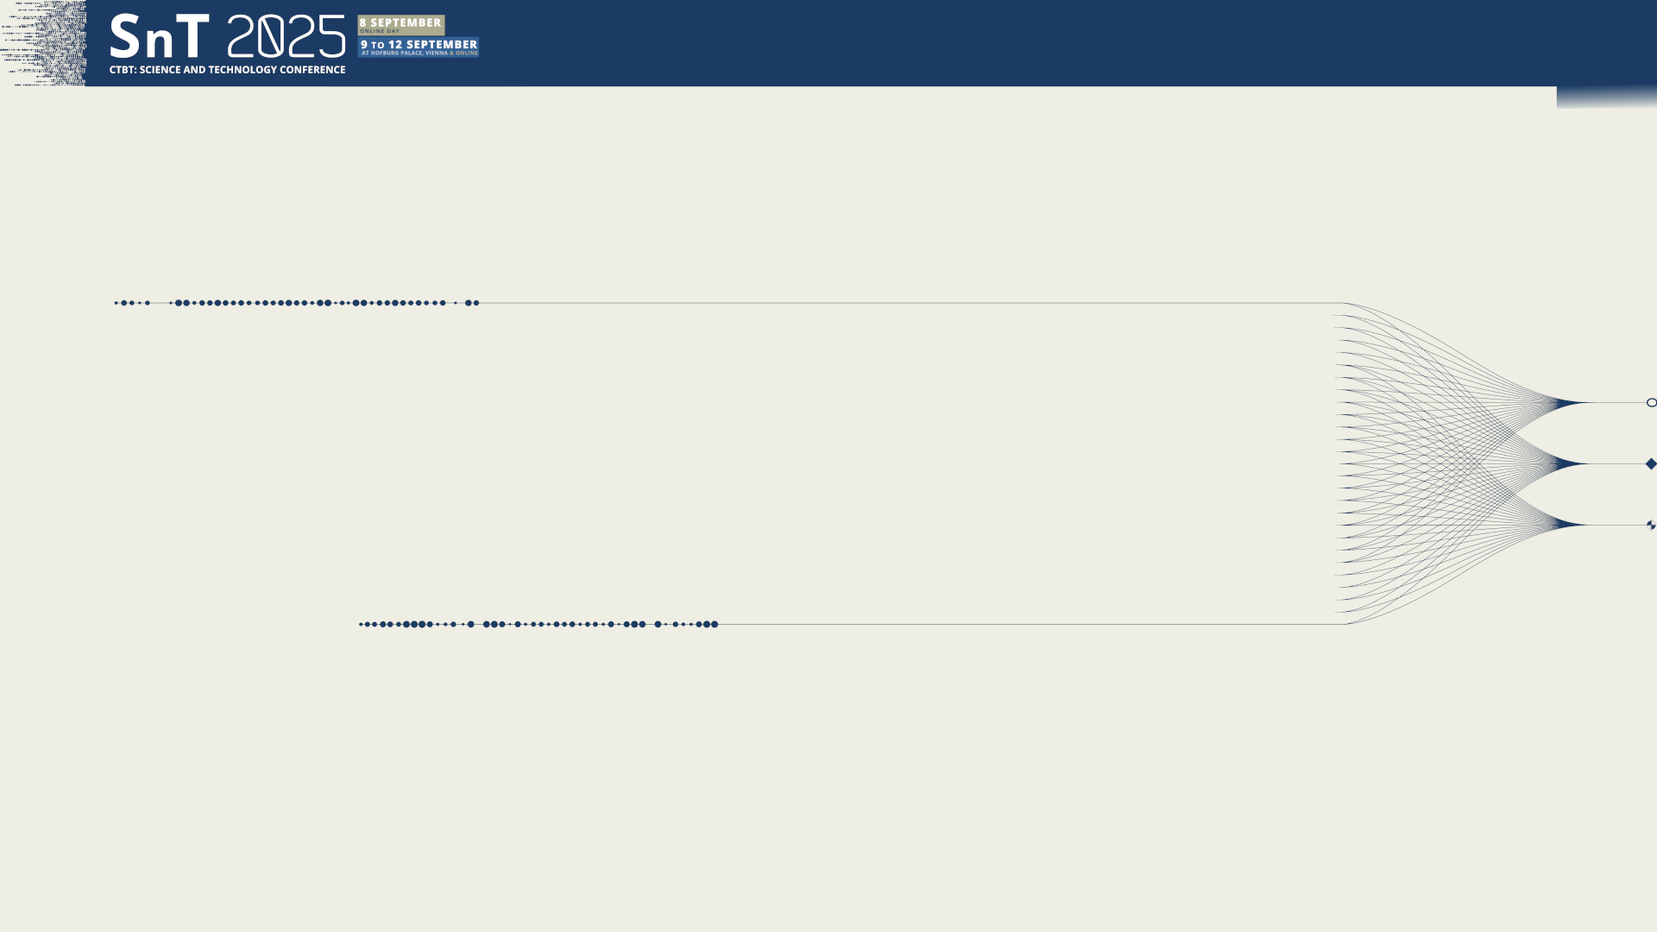

O3.2-251
A Gamma-Gamma Coincidence Detection System for Radionuclide Aerosol Monitoring
A. Couture¹, A. Carman¹, H. Miley², H. Garland¹, L. Lidey¹, M. Larche¹, M. Moore¹, N. Elmore¹, R. Guerrero¹, S. Cheng¹, and T. Butcher¹
¹Pacific Northwest National Laboratory
²Desert Research Institute
Presentation Date: 9 September 2025

Slide 2
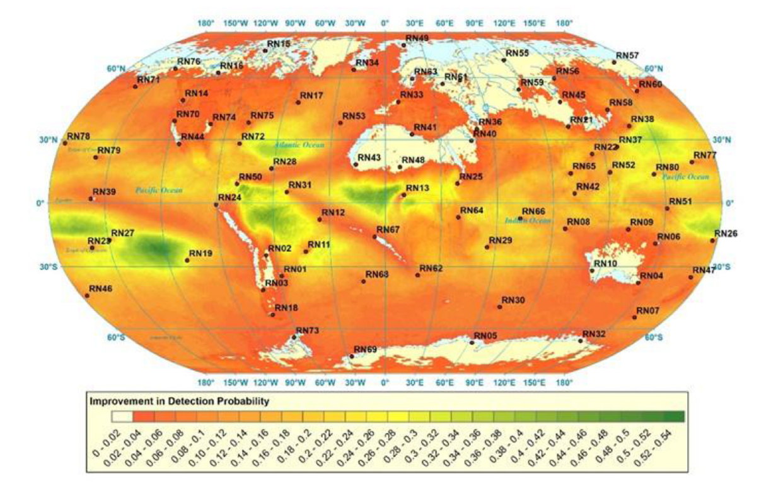
O3.2-251
A Gamma-Gamma Coincidence Detection System for Radionuclide Aerosol Monitoring
A. Couture, A. Carmen, H. Miley, H. Garland, L. Lidey, M. Larche, M. Moore, N. Elmore, R. Guerrero, S. Cheng, and T. Butcher
Motivation
Current IMS radionuclide aerosol monitoring stations collect, decay, and count – 24 hrs each (3 days total)
Filter collection & HPGe measurement – either manual or automated
Recent atmospheric transport studies indicate improved detection and location performance of the IMS network with shorter sampling intervals
Objective: Maintain IMS requirements & shorten collection/counting intervals
Proposed Solution: Gamma-gamma coincidence detection & ESP collection (RASA 2.0)
IMS Detection Improvement 24-hr to 12-hr Sampling
PW Eslinger, et al. (2023) Journal of Env. Rad., Vol 257, 107088, https://doi.org/10.1016/j.jenvrad.2022.10708

Slide 3
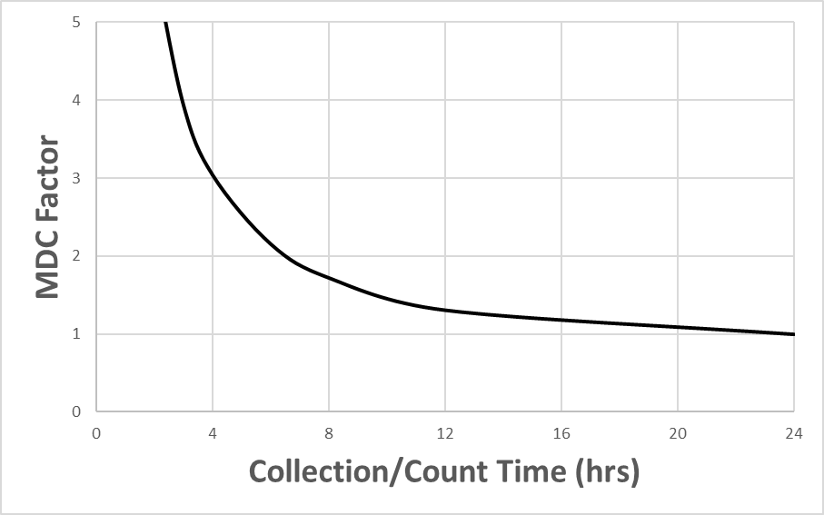
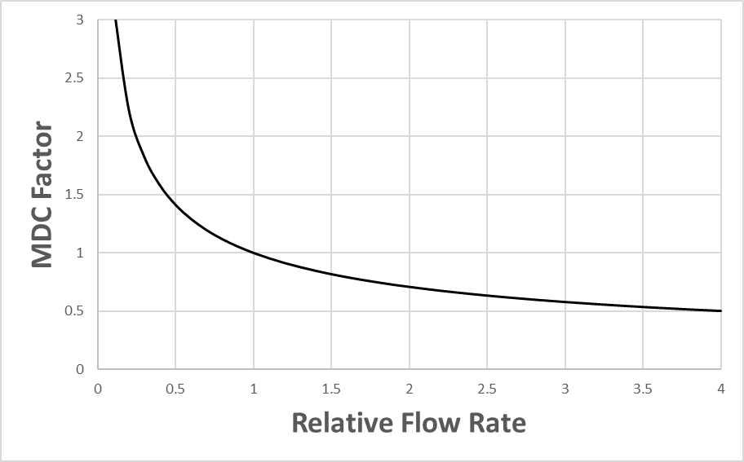
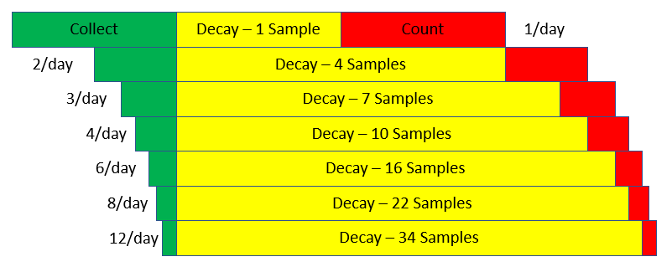
O3.2-251
A Gamma-Gamma Coincidence Detection System for Radionuclide Aerosol Monitoring
A. Couture, A. Carmen, H. Miley, H. Garland, L. Lidey, M. Larche, M. Moore, N. Elmore, R. Guerrero, S. Cheng, and T. Butcher
Timing, Flow, and Detector Efficiency
Shorter collection times
  → Better ATM transport
  → Increases MDC
Rules for Timing
  Count = Collect (required)
  Count + Decay + Collect =72 hrs (required?)
Extended decay times lower ¹⁴⁰Ba MDC at high radon stations, but increase them at low radon stations
Note sample storage complexity
Increased detector efficiency, background reduction, & increased flow can compensate for the loss in MDC

Slide 4
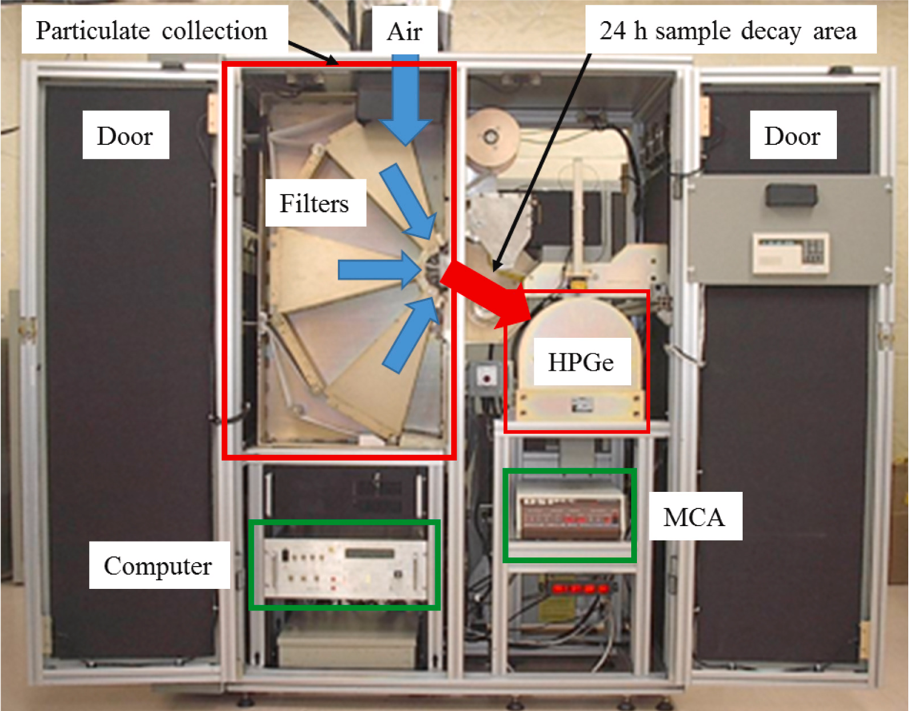
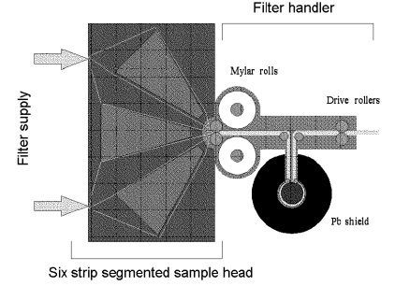
O3.2-251
A Gamma-Gamma Coincidence Detection System for Radionuclide Aerosol Monitoring
A. Couture, A. Carmen, H. Miley, H. Garland, L. Lidey, M. Larche, M. Moore, N. Elmore, R. Guerrero, S. Cheng, and T. Butcher
RASA
Radionuclide Aerosol Sampler/Analyzer was developed at PNNL in the 90s
Automated particulate collection, encapsulation, and measurement
H Miley, et al., (1998) J. Radioanal. Nucl. Chem., 235 (1–2) (1998), pp. 83-87, 10.1007/BF02385942
JL Burnett (2019) Nucl. Inst. Meth. A, Vol. 944 162473 https://doi.org/10.1016/j.nima.2019.162473

Slide 5
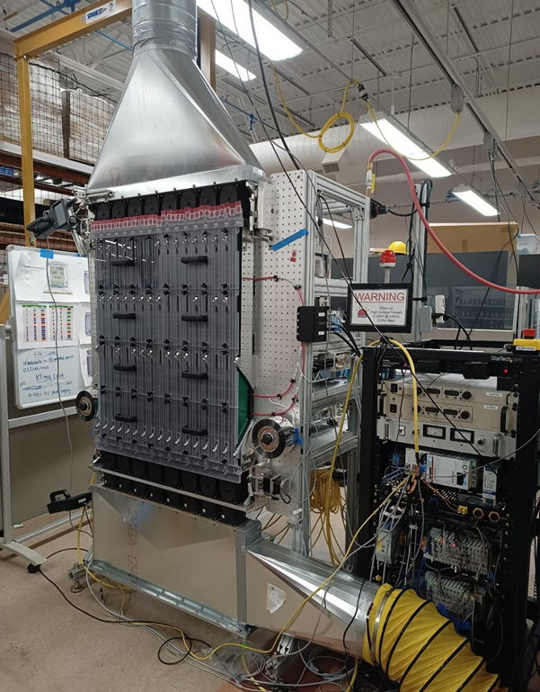
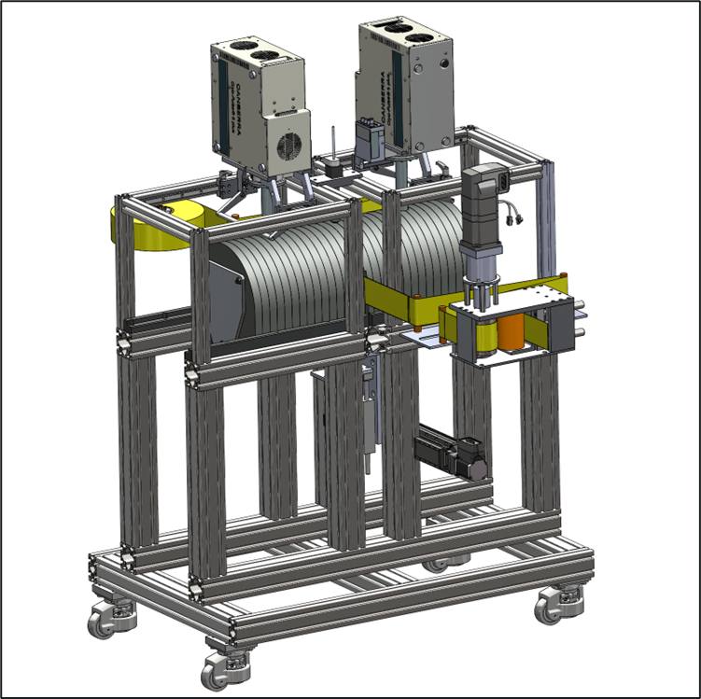
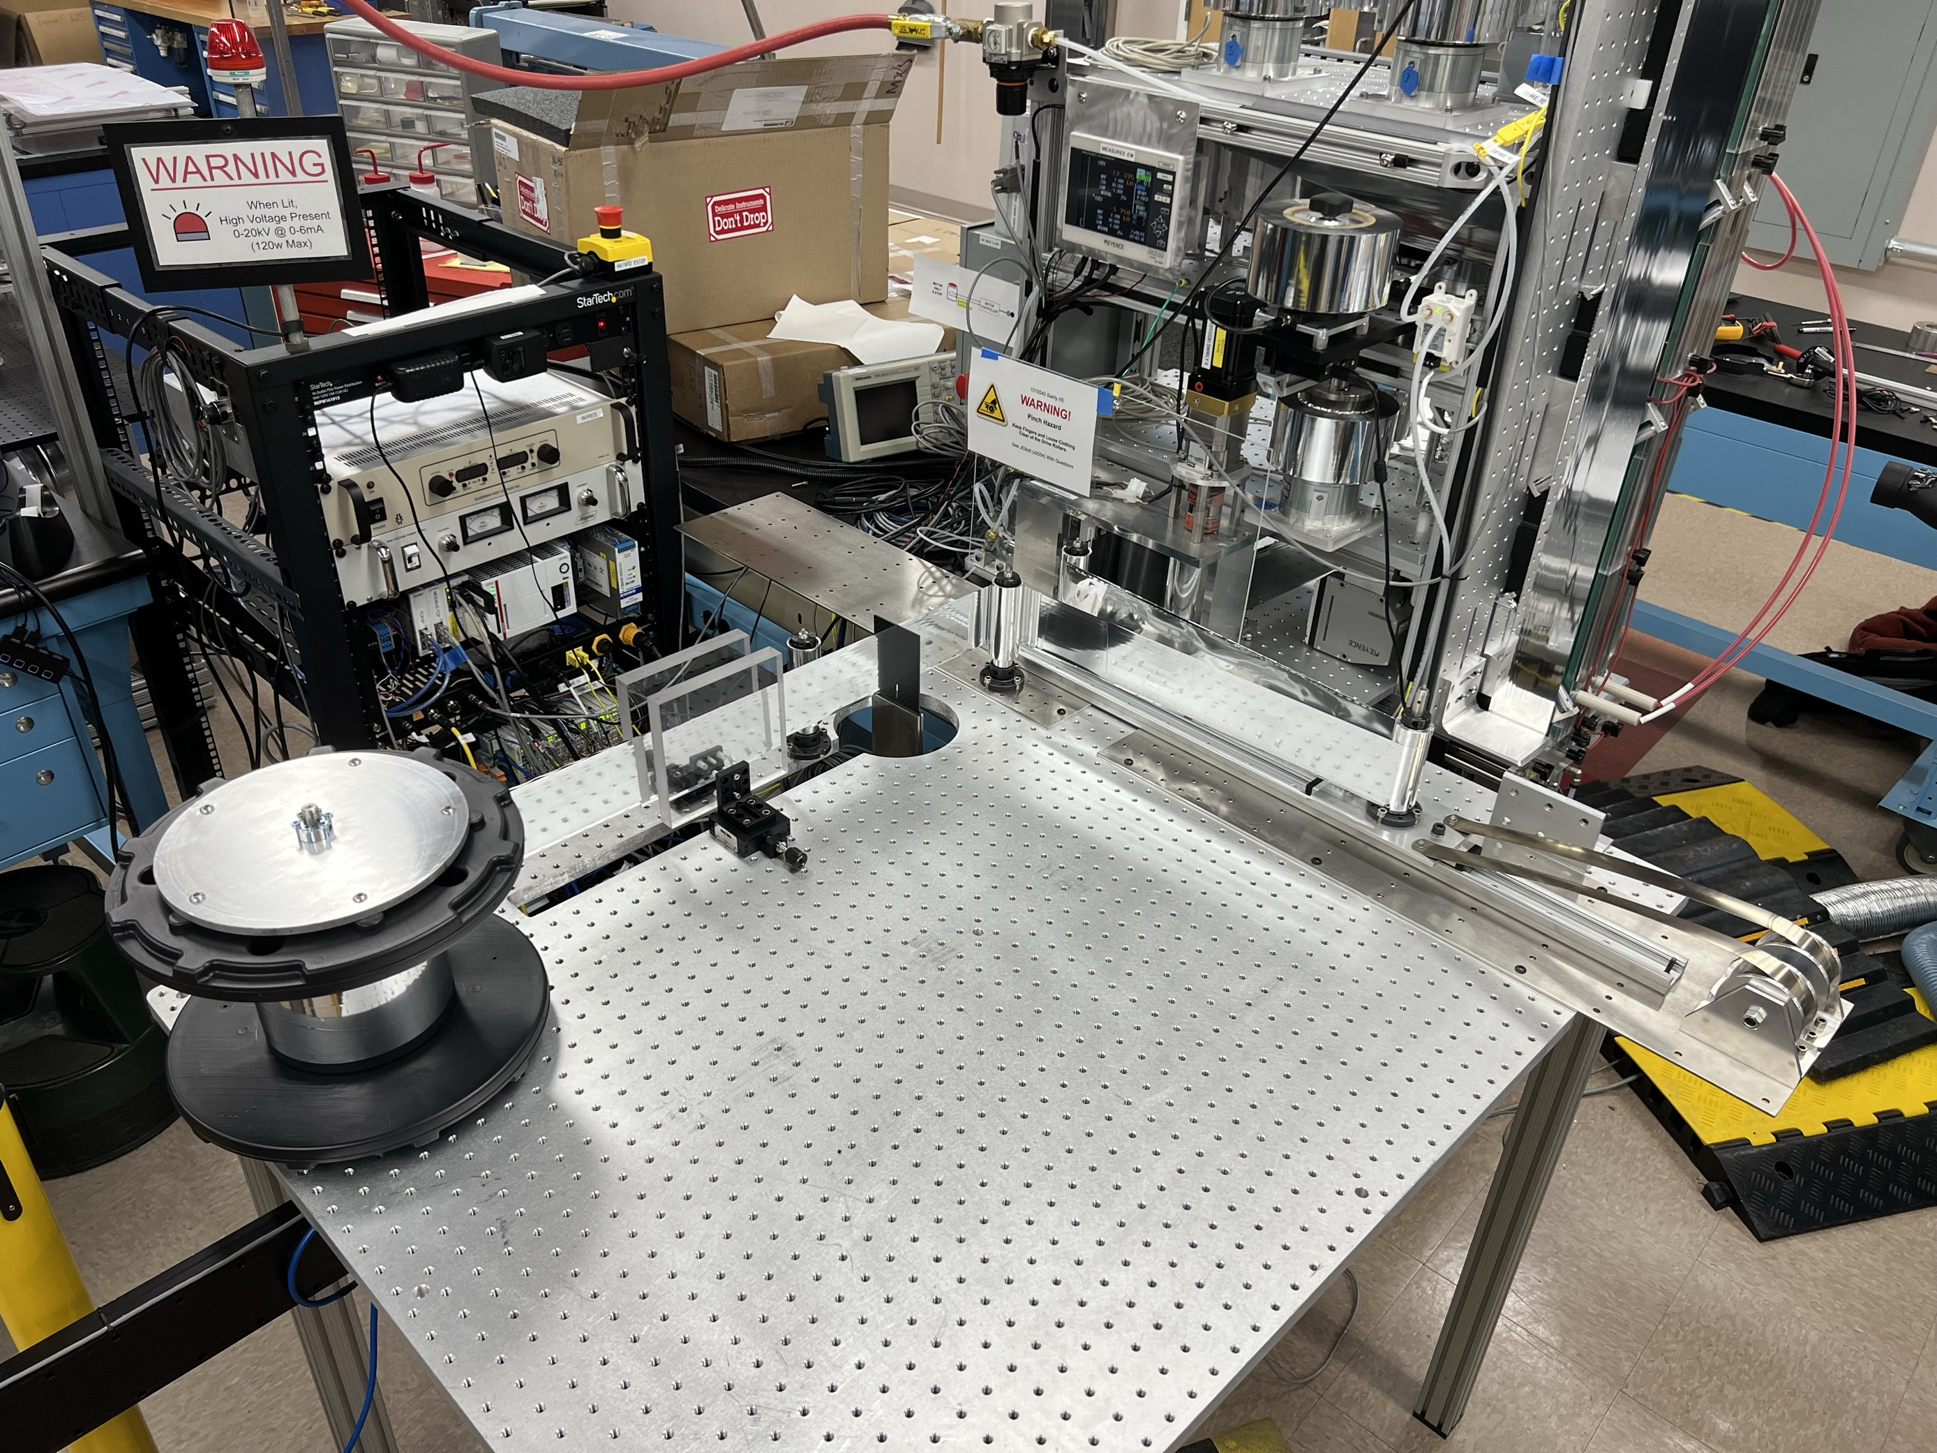
O3.2-251
A Gamma-Gamma Coincidence Detection System for Radionuclide Aerosol Monitoring
A. Couture, A. Carmen, H. Miley, H. Garland, L. Lidey, M. Larche, M. Moore, N. Elmore, R. Guerrero, S. Cheng, and T. Butcher
RASA 2.0
ESP Collector
Dual Gamma Detectors
Sample Packaging
PNNL/Creare
Creare
See Swanwick O3.2-175
PNNL

Slide 6
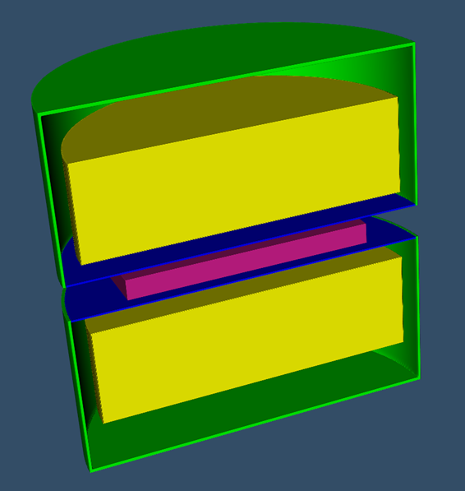
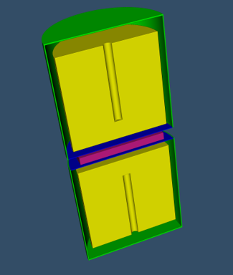
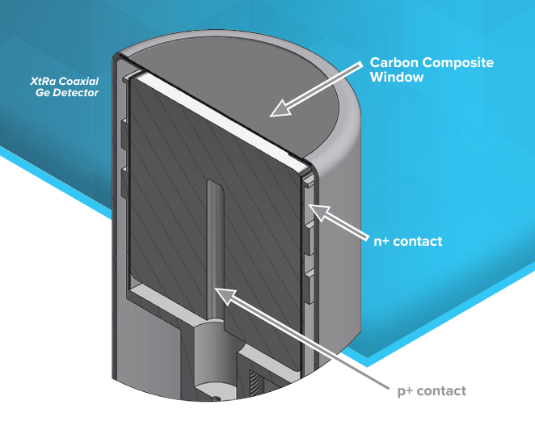
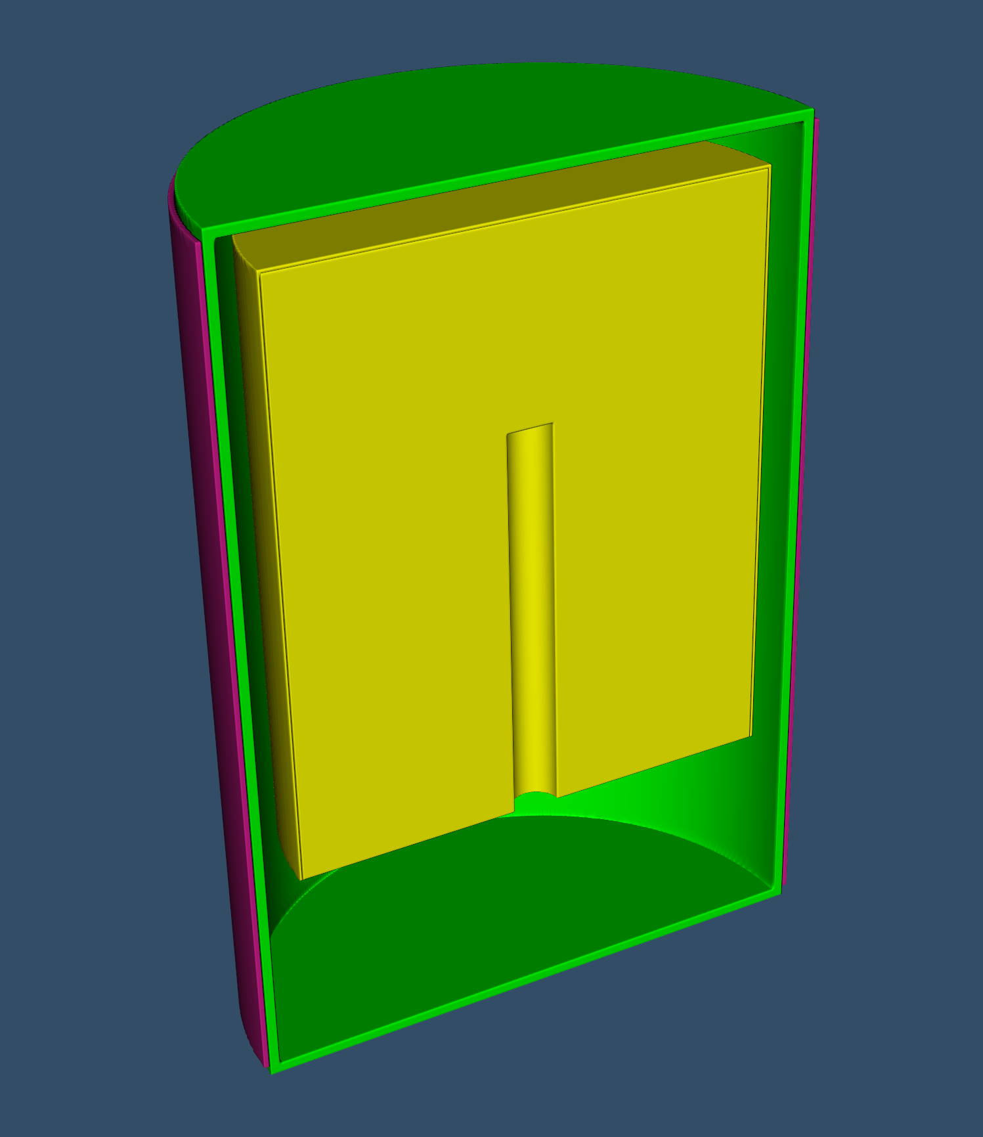
O3.2-251
A Gamma-Gamma Coincidence Detection System for Radionuclide Aerosol Monitoring
A. Couture, A. Carmen, H. Miley, H. Garland, L. Lidey, M. Larche, M. Moore, N. Elmore, R. Guerrero, S. Cheng, and T. Butcher
Modeling for Detector Selection
Mylar Source: 76 x 76 x 0.63 mm (3” x 3” x ¼”)
Detectors – (single detectors & pairs considered)
  Stock and custom BEGe’s
  XTRa’s – 4 large stock models
  Original RASA (with filter) for baseline comparison
Energy Range – 60-1600 keV
BKGD estimated based solely on ²¹²Pb – efficiency to downscattering into ROIs (focus on¹⁴⁰Ba)
Calculation of detector efficiency & relative MDCs
Cost/Sens. FOM = Rel. ¹⁴⁰Ba MDC × Price (Small = 👍)
MCNP¹ used – no consideration of coincidence
Mirion XTRa GX10020 selected
Capable of 4 samples/day at ~2.5x air flow
https://www.mirion.com/products/technologies/spectroscopy-scientific-analysis/gamma-spectroscopy/detectors/hpge-detectors-accessories/xtra-extended-range-coaxial-ge-detectors
¹C. J. Werner, et al. (2018)., Los Alamos National Laboratory, report LA-UR-18-20808. https://mcnp.lanl.gov/pdf_files/TechReport_2018_LANL_LA-UR-18-20808_WernerBullEtAl.pdf

Slide 7
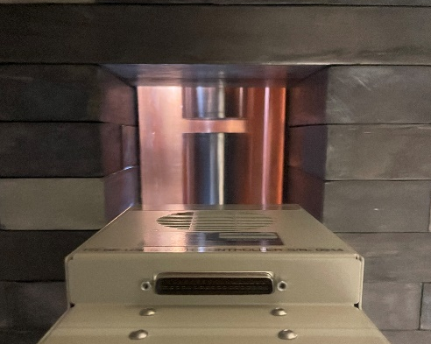
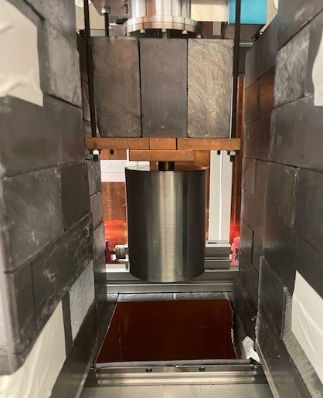
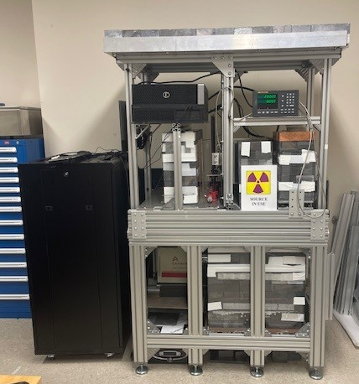
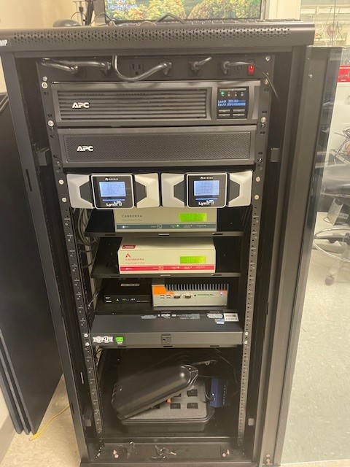
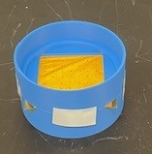
O3.2-251
A Gamma-Gamma Coincidence Detection System for Radionuclide Aerosol Monitoring
A. Couture, A. Carmen, H. Miley, H. Garland, L. Lidey, M. Larche, M. Moore, N. Elmore, R. Guerrero, S. Cheng, and T. Butcher
Dual Gamma Development Testbed – ARGO2
Advanced Radionuclide Gamma-spectrometer 2 (ARGO2)
Pair of Mirion BE6530 in Pb cave with LYNX2 MCAs
Control software & data processing development
M. Sharma, et al., (2024) Trans. of the Am. Nucl. Soc., Vol 128, 852-853, DOI:10.13182/T128-41654

Slide 8
O3.2-251
A Gamma-Gamma Coincidence Detection System for Radionuclide Aerosol Monitoring
A. Couture, A. Carmen, H. Miley, H. Garland, L. Lidey, M. Larche, M. Moore, N. Elmore, R. Guerrero, S. Cheng, and T. Butcher
Software Development
C++/Linux control software/WebGUI framework used in PNNL-designed beta/gamma coincidence systems (Xenon International, RL16)
Control server developed for pairs Mirion LYNX MCAs in TLIST mode
Live 8192 channel singles/coincidence histogram generation (20 kB/10s-100s MB)
Updates to deal with high(er) count rate scenarios & detector resolution
  Accidental coincidences
  Coincidence dead times
  Updated coincidence logic
Binary listmode data files available, but not needed for routine operation
~1.5 MB/min or 2GB/day at ~1000 cps
SoH generation – count rates, HV, cooler temperatures/power consumption, leakage currents
“First Look” detector – H3D M400 data acquisition & spectrum viewing

Slide 9
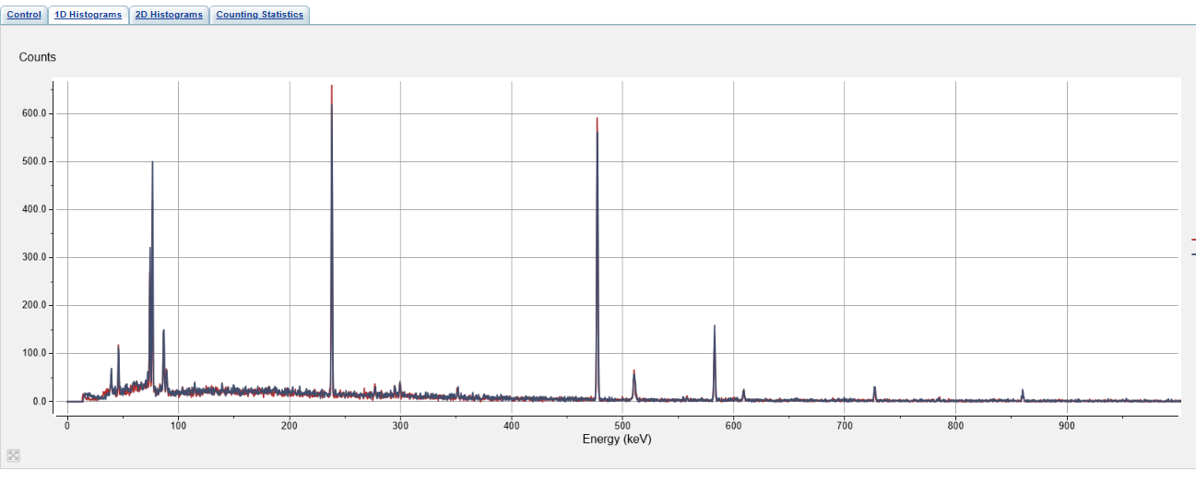
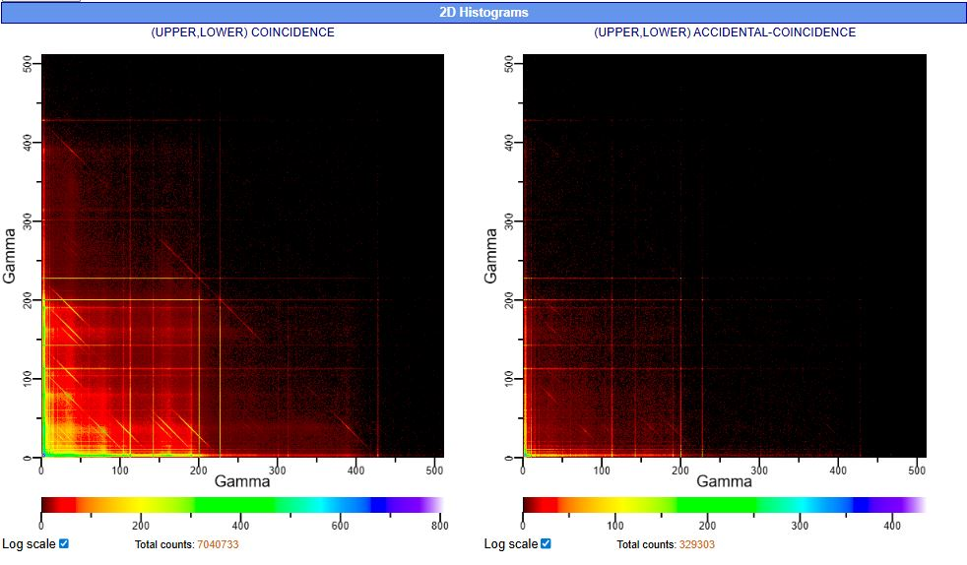
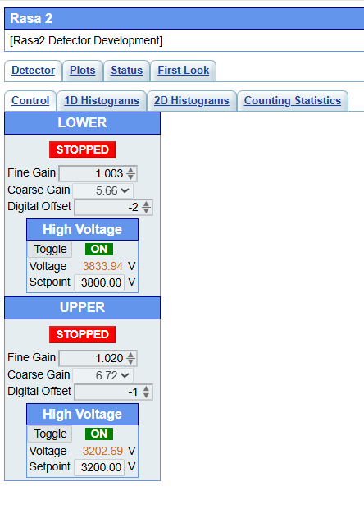
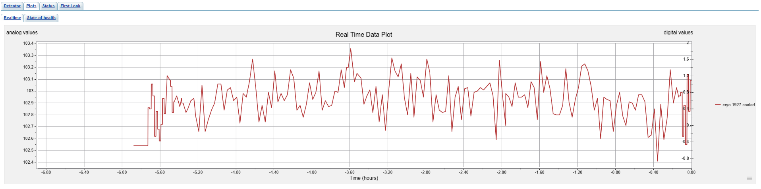
O3.2-251
A Gamma-Gamma Coincidence Detection System for Radionuclide Aerosol Monitoring
A. Couture, A. Carmen, H. Miley, H. Garland, L. Lidey, M. Larche, M. Moore, N. Elmore, R. Guerrero, S. Cheng, and T. Butcher
Software Development
Singles Histograms
Coincidence Histograms
Acquisition Control
SoH

Slide 10
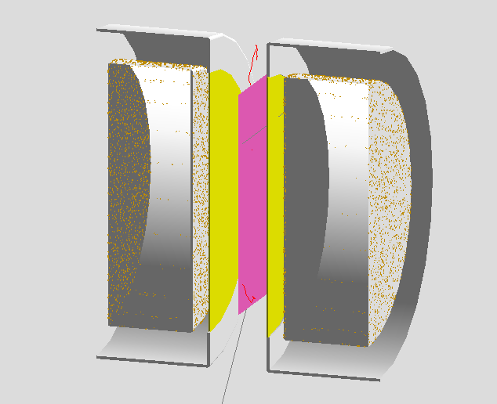
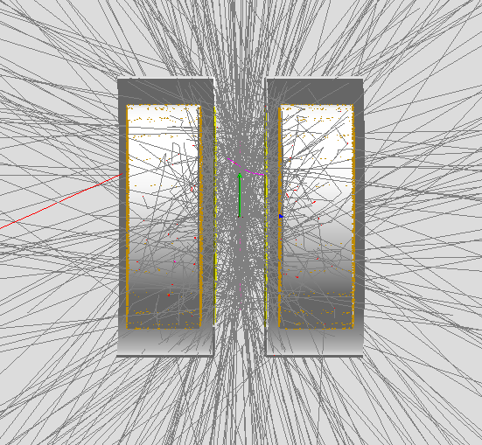
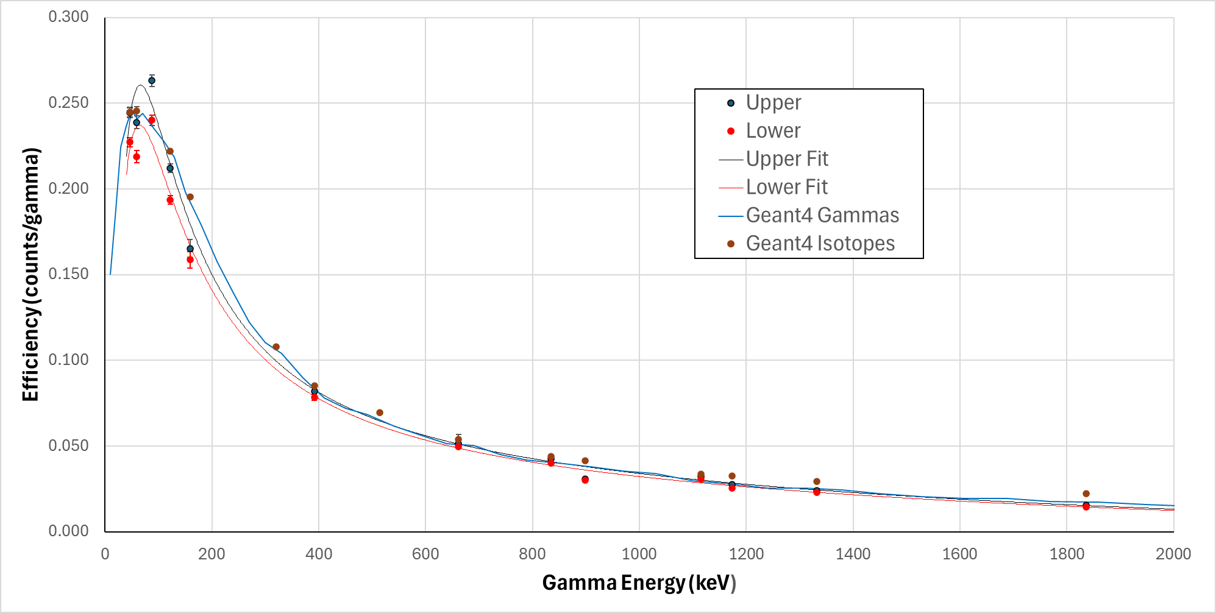
O3.2-251
A Gamma-Gamma Coincidence Detection System for Radionuclide Aerosol Monitoring
A. Couture, A. Carmen, H. Miley, H. Garland, L. Lidey, M. Larche, M. Moore, N. Elmore, R. Guerrero, S. Cheng, and T. Butcher
Geant4 Simulation – ARGO2
Simulation of ARGO2 using the Geant4 Cascade Summing Correction application
Model validated with comparison to mixed gamma standard
Near term plan
  Model RASA2.0 geometry
  Efficiency to ¹⁴⁰Ba, ¹³¹I, ⁹⁹Mo/^{99m}Tc
  Estimate ambient & sample-induced BKGD for all IMS network stations with RASA2.0 → MDCs
  Consider coincidence & Compton-summed detector pairs
  Use ATM models to estimate network sensitivity for varying collection/count times using RASA2.0
¹Pierson, B., Hagen, A., & Archambault, B. (2022) G4CSC, 0.1a. Retrieved from G4CSC - Geant4 Cascade Summing Corrections: https://gitlab.pnnl.gov/ares/g4csc

Slide 11
O3.2-251
A Gamma-Gamma Coincidence Detection System for Radionuclide Aerosol Monitoring
A. Couture, A. Carmen, H. Miley, H. Garland, L. Lidey, M. Larche, M. Moore, N. Elmore, R. Guerrero, S. Cheng, and T. Butcher
Next Steps
Air collection campaign to assess background vs. decay time using ARGO2
Evaluate RASA2.0 sensitivity for extended set of IMS-relevant radionuclides
Evaluate the integration of coincidence data into the IDC spectral analysis methodology
Further software development
  Auto gain stabilization/matching
  Historical SoH & spectal data viewing
  QC-source measurements
  External control
Build a prototype for integration with Creare ESP
  Detector acquisition
  Further mechanical design

Slide 12
O3.2-251
A Gamma-Gamma Coincidence Detection System for Radionuclide Aerosol Monitoring
A. Couture, A. Carmen, H. Miley, H. Garland, L. Lidey, M. Larche, M. Moore, N. Elmore, R. Guerrero, S. Cheng, and T. Butcher
Thank you. Questions?

