Slide 1

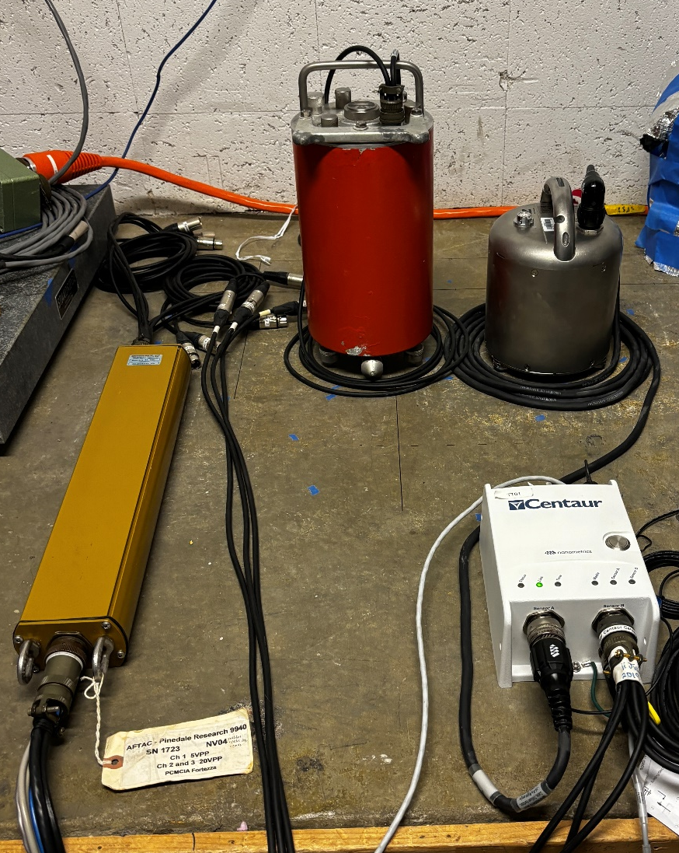
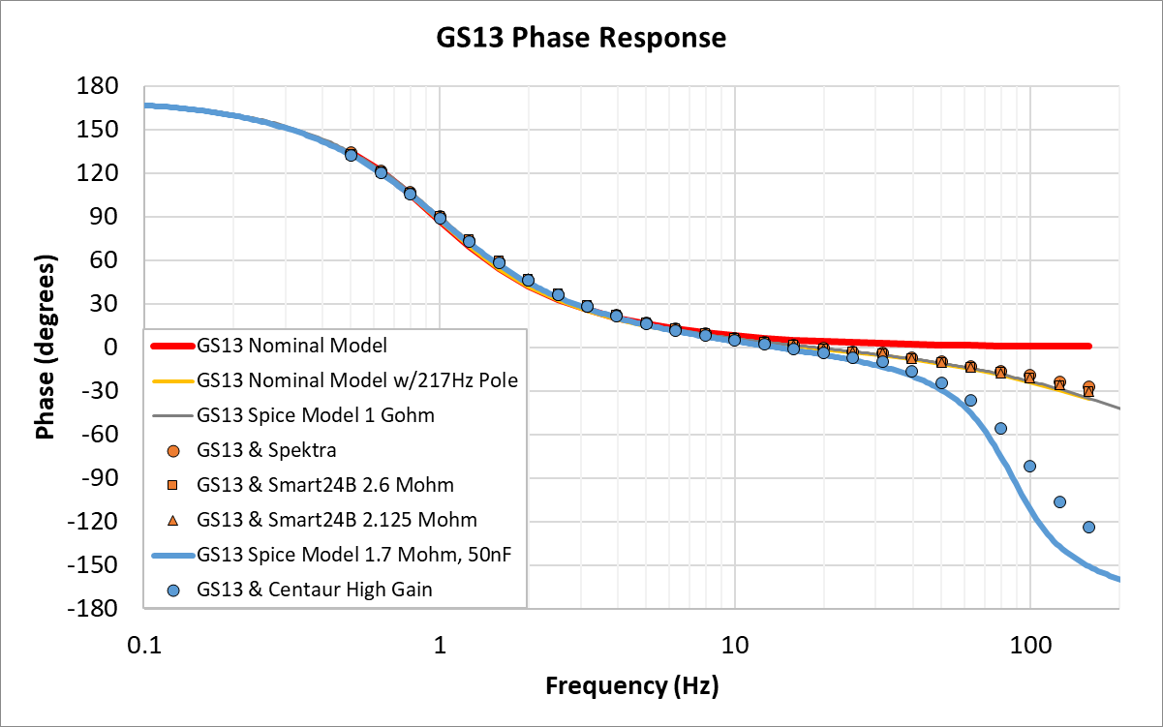
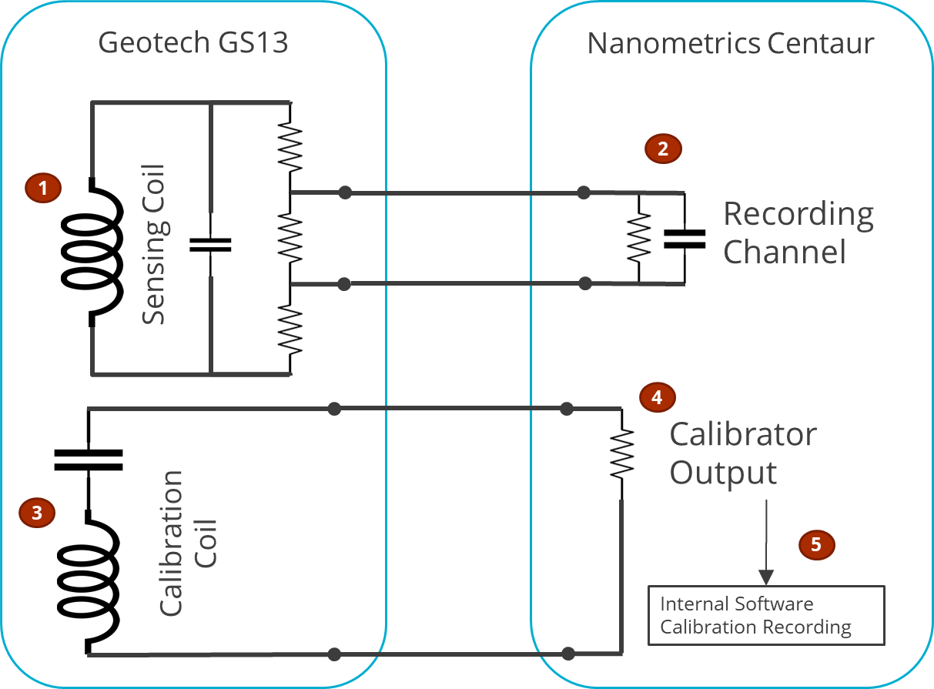

Challenges in seismometer electrical calibration:
A case study preparing for a station recapitalization
P3.1-178
John Merchant & Doug Bloomquist
Sandia National Laboratories
Seismometer electrical calibration is only as accurate as the assumed nominal responses.
New instrumentation configurations can challenge that assumption, as evidenced by
testing of equipment for the planned digitizer replacement at NVAR.
We show the results of applying metrologically traceable calibration methods to seismic instrumentation to validate the performance of the seismometer and its calibration circuits.
Sandia National Laboratories is a multimission laboratory managed and operated by National Technology and Engineering Solutions of Sandia LLC, a wholly owned subsidiary of Honeywell International Inc. for the U.S. Department of Energy’s National Nuclear Security Administration under contract DE-NA0003525.
SAND2025-10577D
Cleared for release

