Slide 1


P3.1-178
Challenges in seismometer electrical calibration: A case study preparing for a station recapitalization
John Merchant, Doug Bloomquist
Sandia National Laboratories
Electrical calibration is relied upon to ensure accurate seismometer responses. At best, this provides confidence that the response has not changed. However, electrical calibrations may not result in an accurate or traceable measure of response.
Here we show the results from a primary traceable calibration of a GS13 seismometer from NVAR to validate the actual response, confirm the influence of the digitizer replacement on the seismometer, and quantify the actual electrical calibration response.
Sandia National Laboratories is a multimission laboratory managed and operated by National Technology & Engineering Solutions of Sandia, LLC, a wholly owned subsidiary of Honeywell International Inc., for the U.S. Department of Energy’s National Nuclear Security Administration under contract DE-NA0003525.
Cleared for release.
SAND2025-10577D

Slide 2
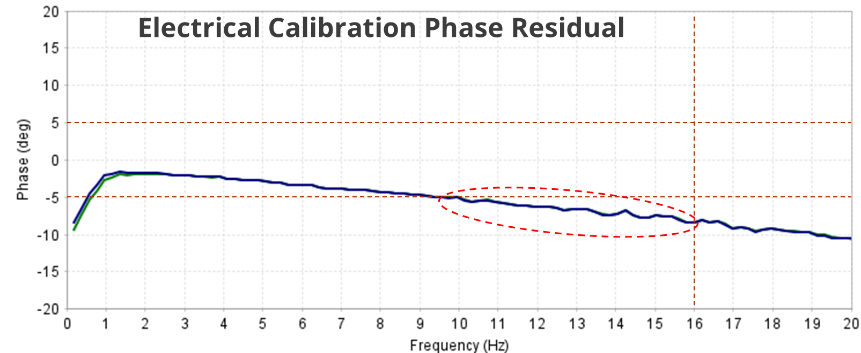
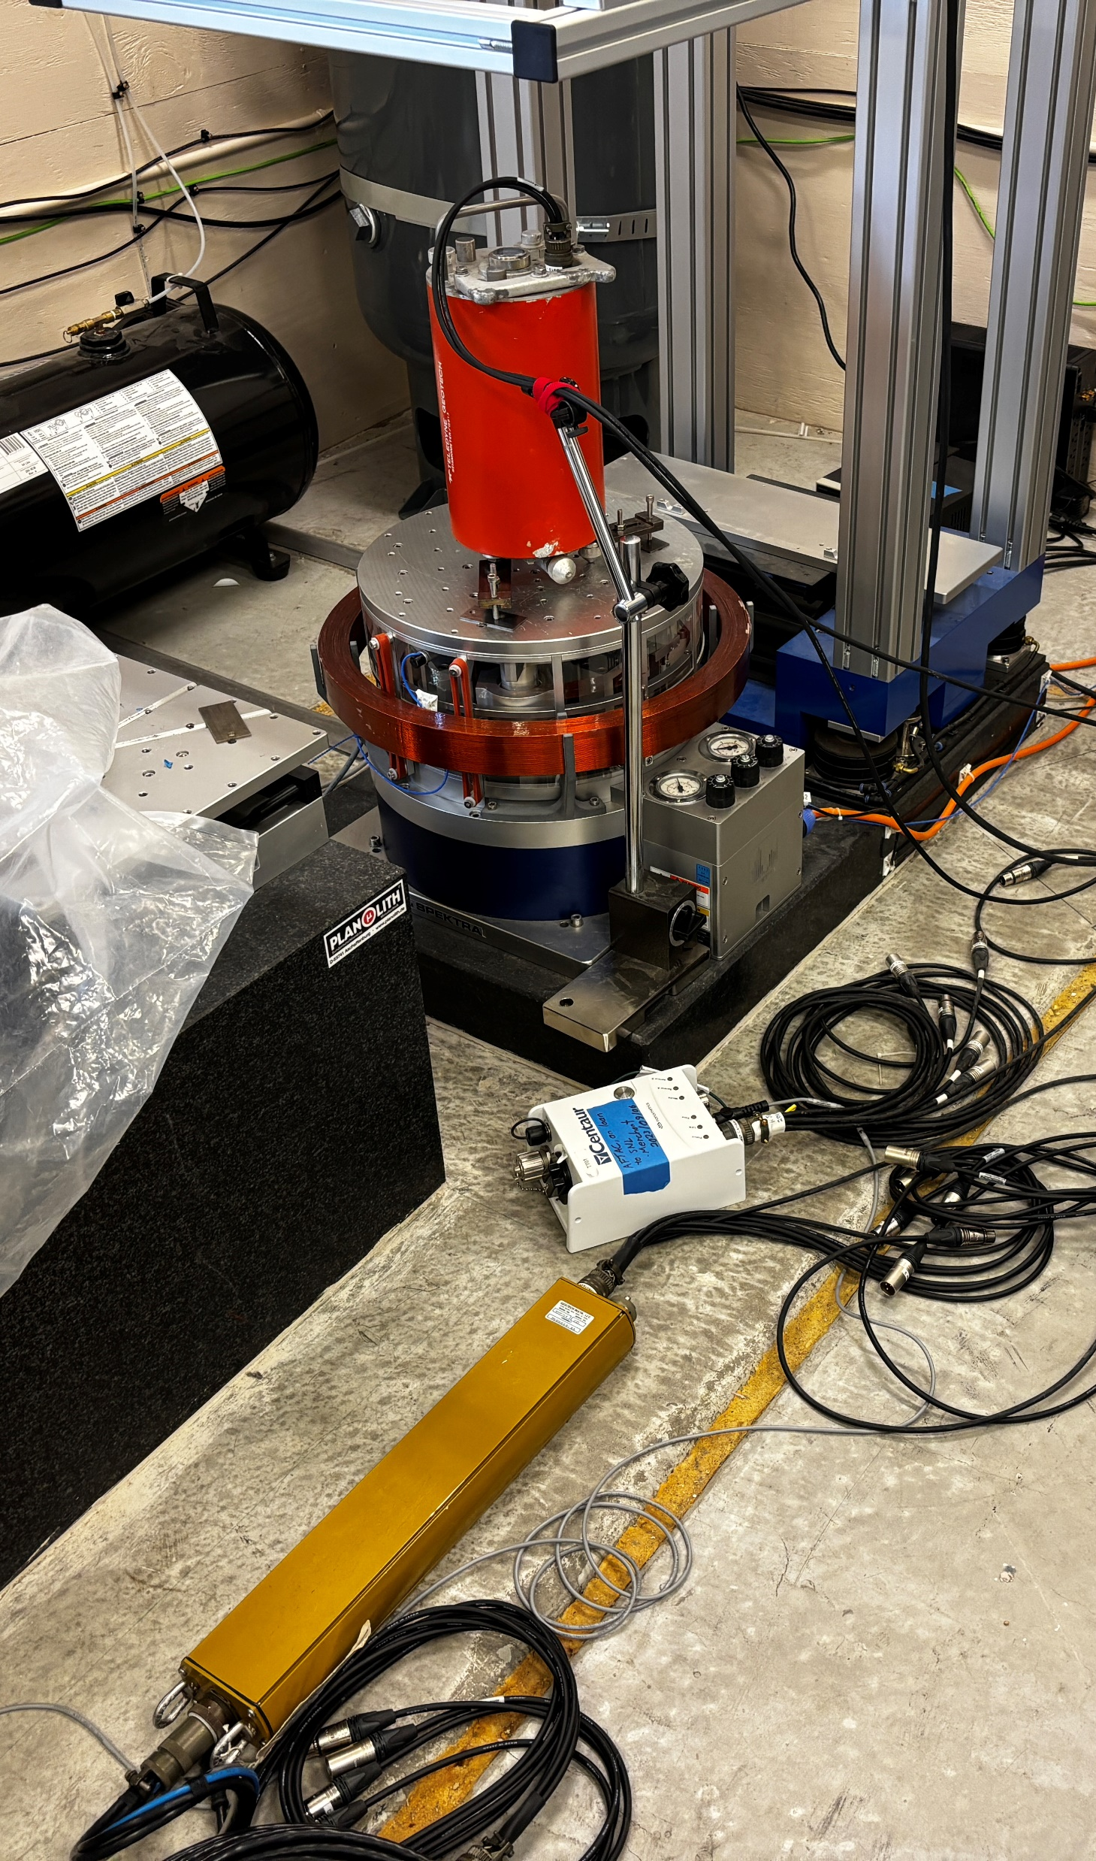
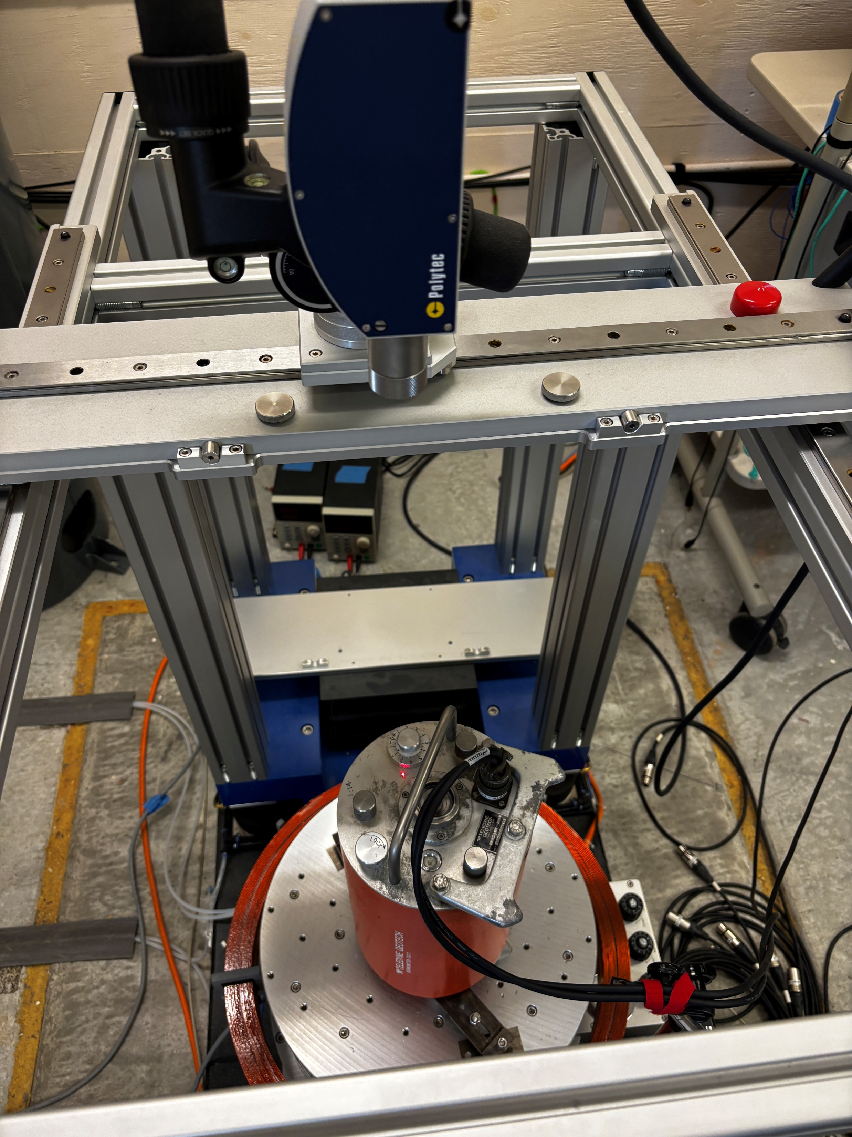
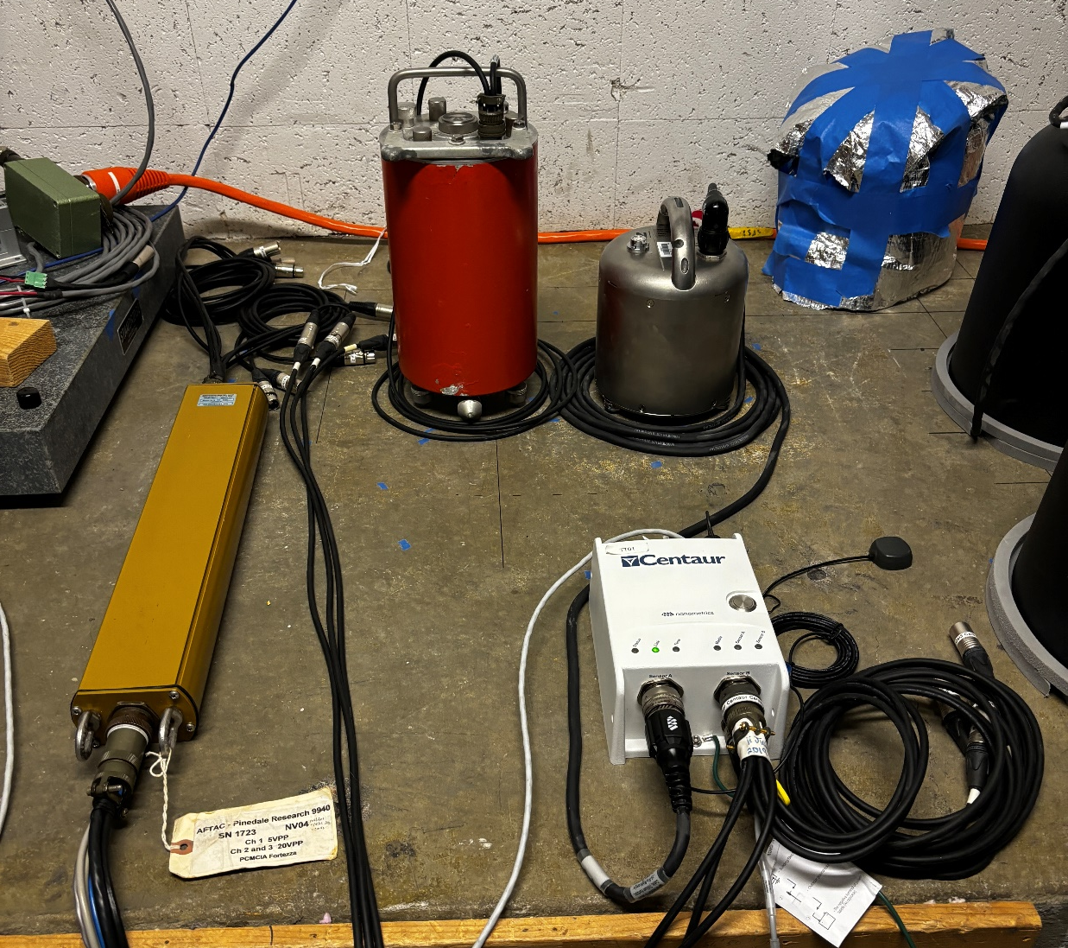
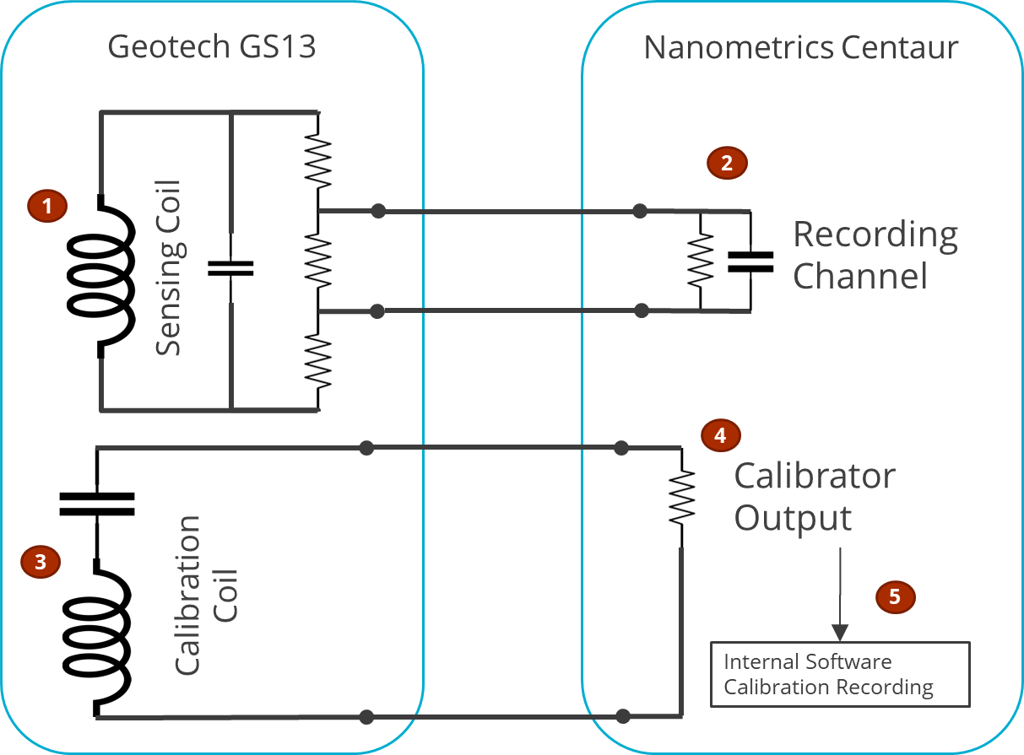

P3.1-178
Challenges in seismometer electrical calibration:
A case study preparing for a station recapitalization
John Merchant & Doug Bloomquist
Introduction
Modelling
Empirical Measurements
A recapitalization of IMS Primary Seismic station NVAR is planned, to replace aging Smart24B digitizers with Nanometrics Centaurs, while keeping the existing GS13 seismometers.
Initial configuration testing identified a change in seismometer performance when using the new digitizer, exceeding +/- 5 deg.
Modelling of the combined electrical systems was performed to validate manufacturers’ models.
A series of controlled tests helped to identify the contribution of various system components.
Primary calibration of a GS13 Seismometer from NVAR was performed over 0.5 to 160 Hz using a Spektra shake table with traceability to the SI. The GS13 was tested in multiple configurations:
GS13 directly connected to Spektra recording channel
GS13 T-ed to a Smart24B digitizer from NVAR
GS13 T-ed to a Centaur high-gain channel
 | Cause | Phase (10 Hz)
1 | GS13 “nominal” response not accounting for the inductance of the sensing coil (Rodger, 1992) | -2.4 deg
2 | As an passive, open-loop seismometer, the GS13 response is influenced by digitizer input impedance | -1.8 deg
3 | Calibration coil response mismatch from nominal | -0.5 deg
4 | Calibration coil performance influenced by the calibrator signal source | 0 deg
5 | Centaur internal calibration loopback channel timing offset, due to a capacitive calibration load | -0.36 deg
 | Total | -5.06 deg
Electrical Calibration residual phase error, after accounting for the nominal GS13 and Centaur response models
Geotech GS13 being calibrated on Spektra Calibration Table
Subsequent huddle tests were performed, comparing the GS13 and its electrical calibration against a co-located Trillium Horizon seismometer.
Clock-wise from left: Smart24B Digitizer, Geotech GS13 Seismometer, Nanometrics Trillium Horizon Seismometer, Nanometrics Centaur Digitizer
Sandia National Laboratories is a multimission laboratory managed and operated by National Technology & Engineering Solutions of Sandia, LLC, a wholly owned subsidiary of Honeywell International Inc., for the U.S. Department of Energy’s National Nuclear Security Administration under contract DE-NA0003525.
Cleared for release

Slide 3
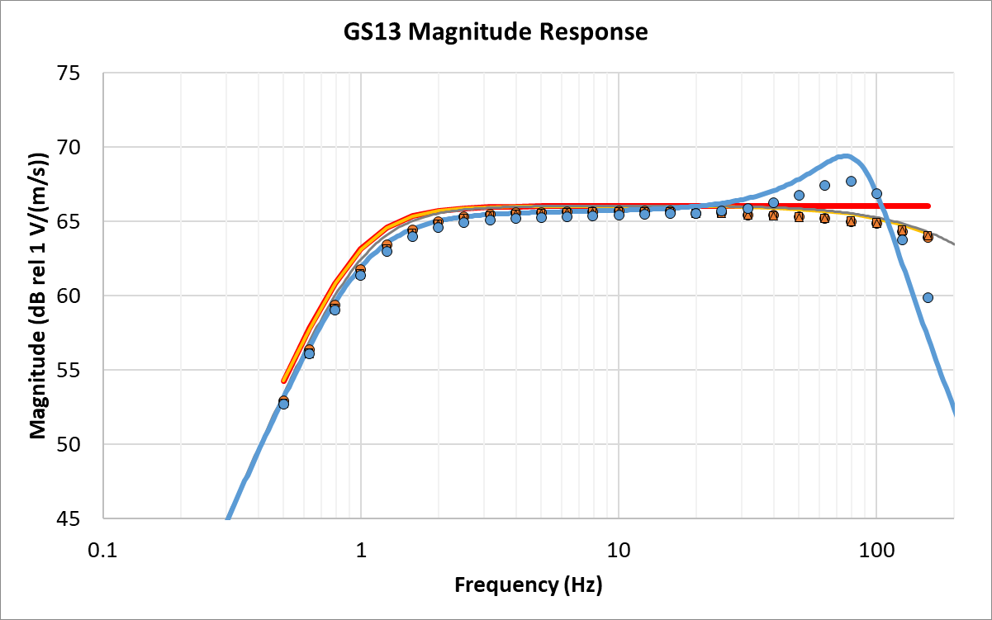
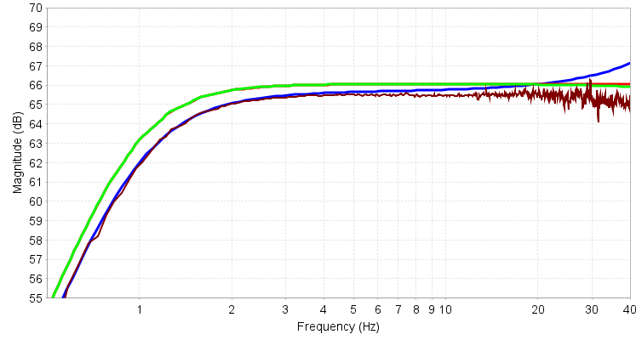
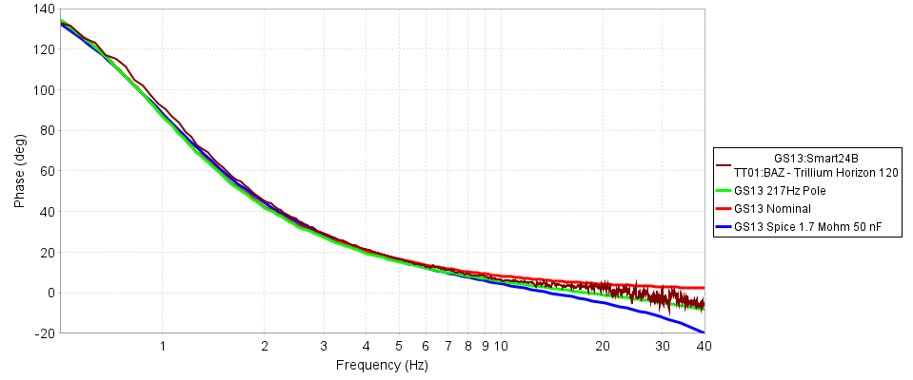
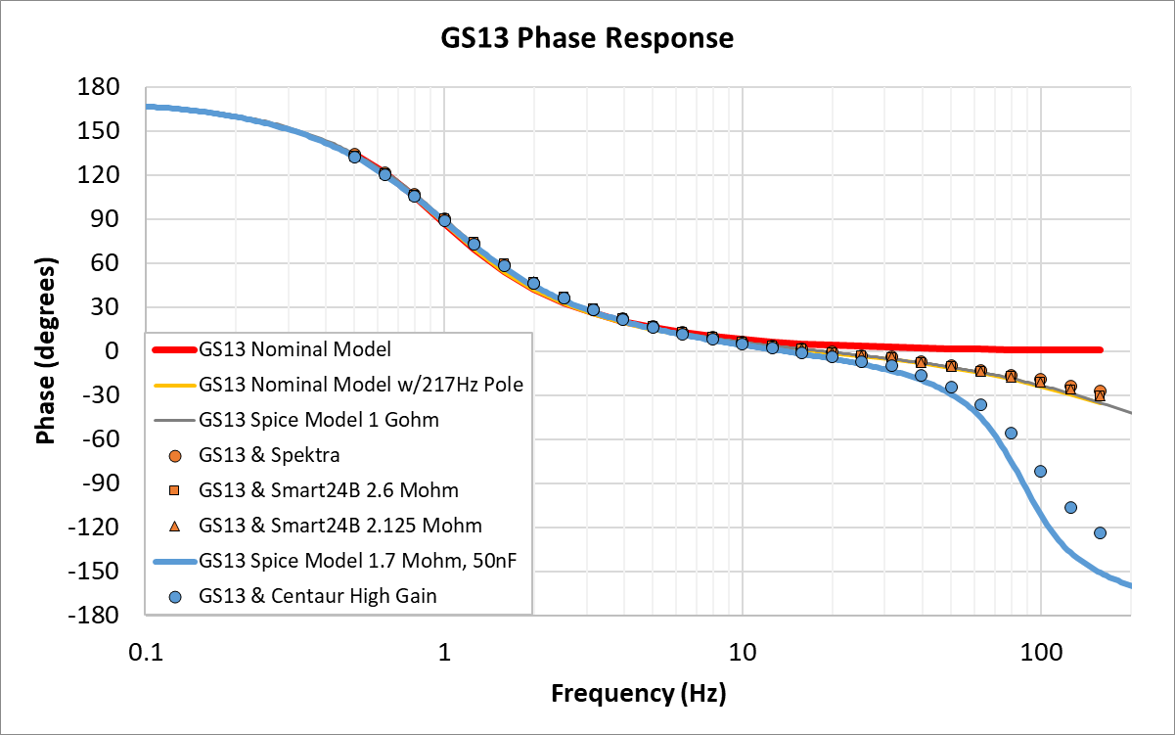
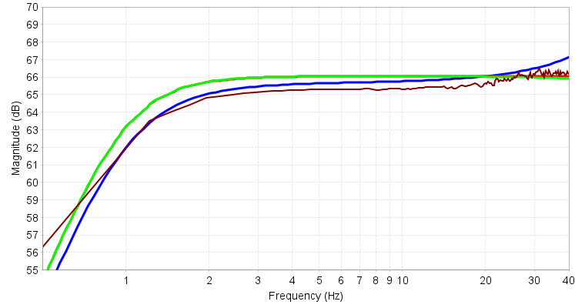
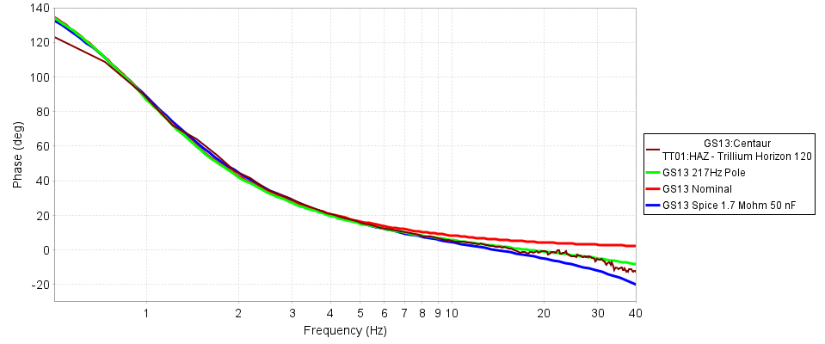
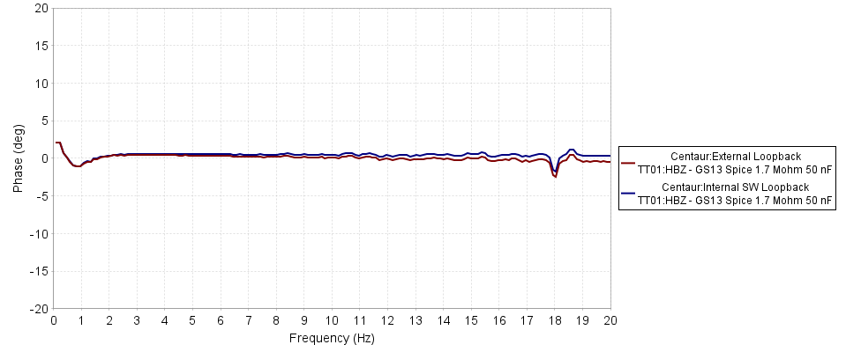
P3.1-178
Challenges in seismometer electrical calibration:
A case study preparing for a station recapitalization
John Merchant & Doug Bloomquist
Primary Calibration Results
Calibration by Comparison in a Huddle Test
The results comparing a GS13 against a broadband seismometer, using regional-distance earthquakes as a source, show that revised “nominal” responses taking the digitizer into account are consistent and result in an electrical calibration with minimal phase residual.
The results of the GS13 primary calibrations show:
Measurements and models agree in phase at low frequencies (< 5 Hz), although in amplitude there is some disagreement in the roll-off corner.
GS13 amplitude and phase responses diverge from its nominal 2-pole model at higher frequencies. The measurements are consistent with the presence of an additional pole at 217 Hz corresponding to the coil inductance (Rodgers, 1992).
Small variations in digitizer input resistance
(2.6 Mohm vs 2.125 Mohm) appear to cause only slight difference in the GS13 response.
Recording a passive coil seismometer, such as the GS13, with a Centaur high-gain channel (1.7 Mohm resistance) results in significant impacts to high frequency performance.
Modelling of a Centaur channel capacitance of 50 nF is consistent with the calibration measurements. Direct measurement of the Centaur channel capacitance is consistent with this value. Note the Smart24B has a measured channel capacitance less than 1 nF.
GS13 response by comparison, operating on Smart24B
Note the observed shift in GS13 response
GS13 response by comparison, operating on Centaur High-Gain
GS13 Magnitude and Phase Response measurements (symbols) from primary traceable calibration table compared against models (lines)
Electrical Calibration residual phase error, after accounting for the revised GS13 and Centaur response model, does not exceed +/- 5 degrees
Sandia National Laboratories is a multimission laboratory managed and operated by National Technology & Engineering Solutions of Sandia, LLC, a wholly owned subsidiary of Honeywell International Inc., for the U.S. Department of Energy’s National Nuclear Security Administration under contract DE-NA0003525.
Cleared for release

