Slide 1

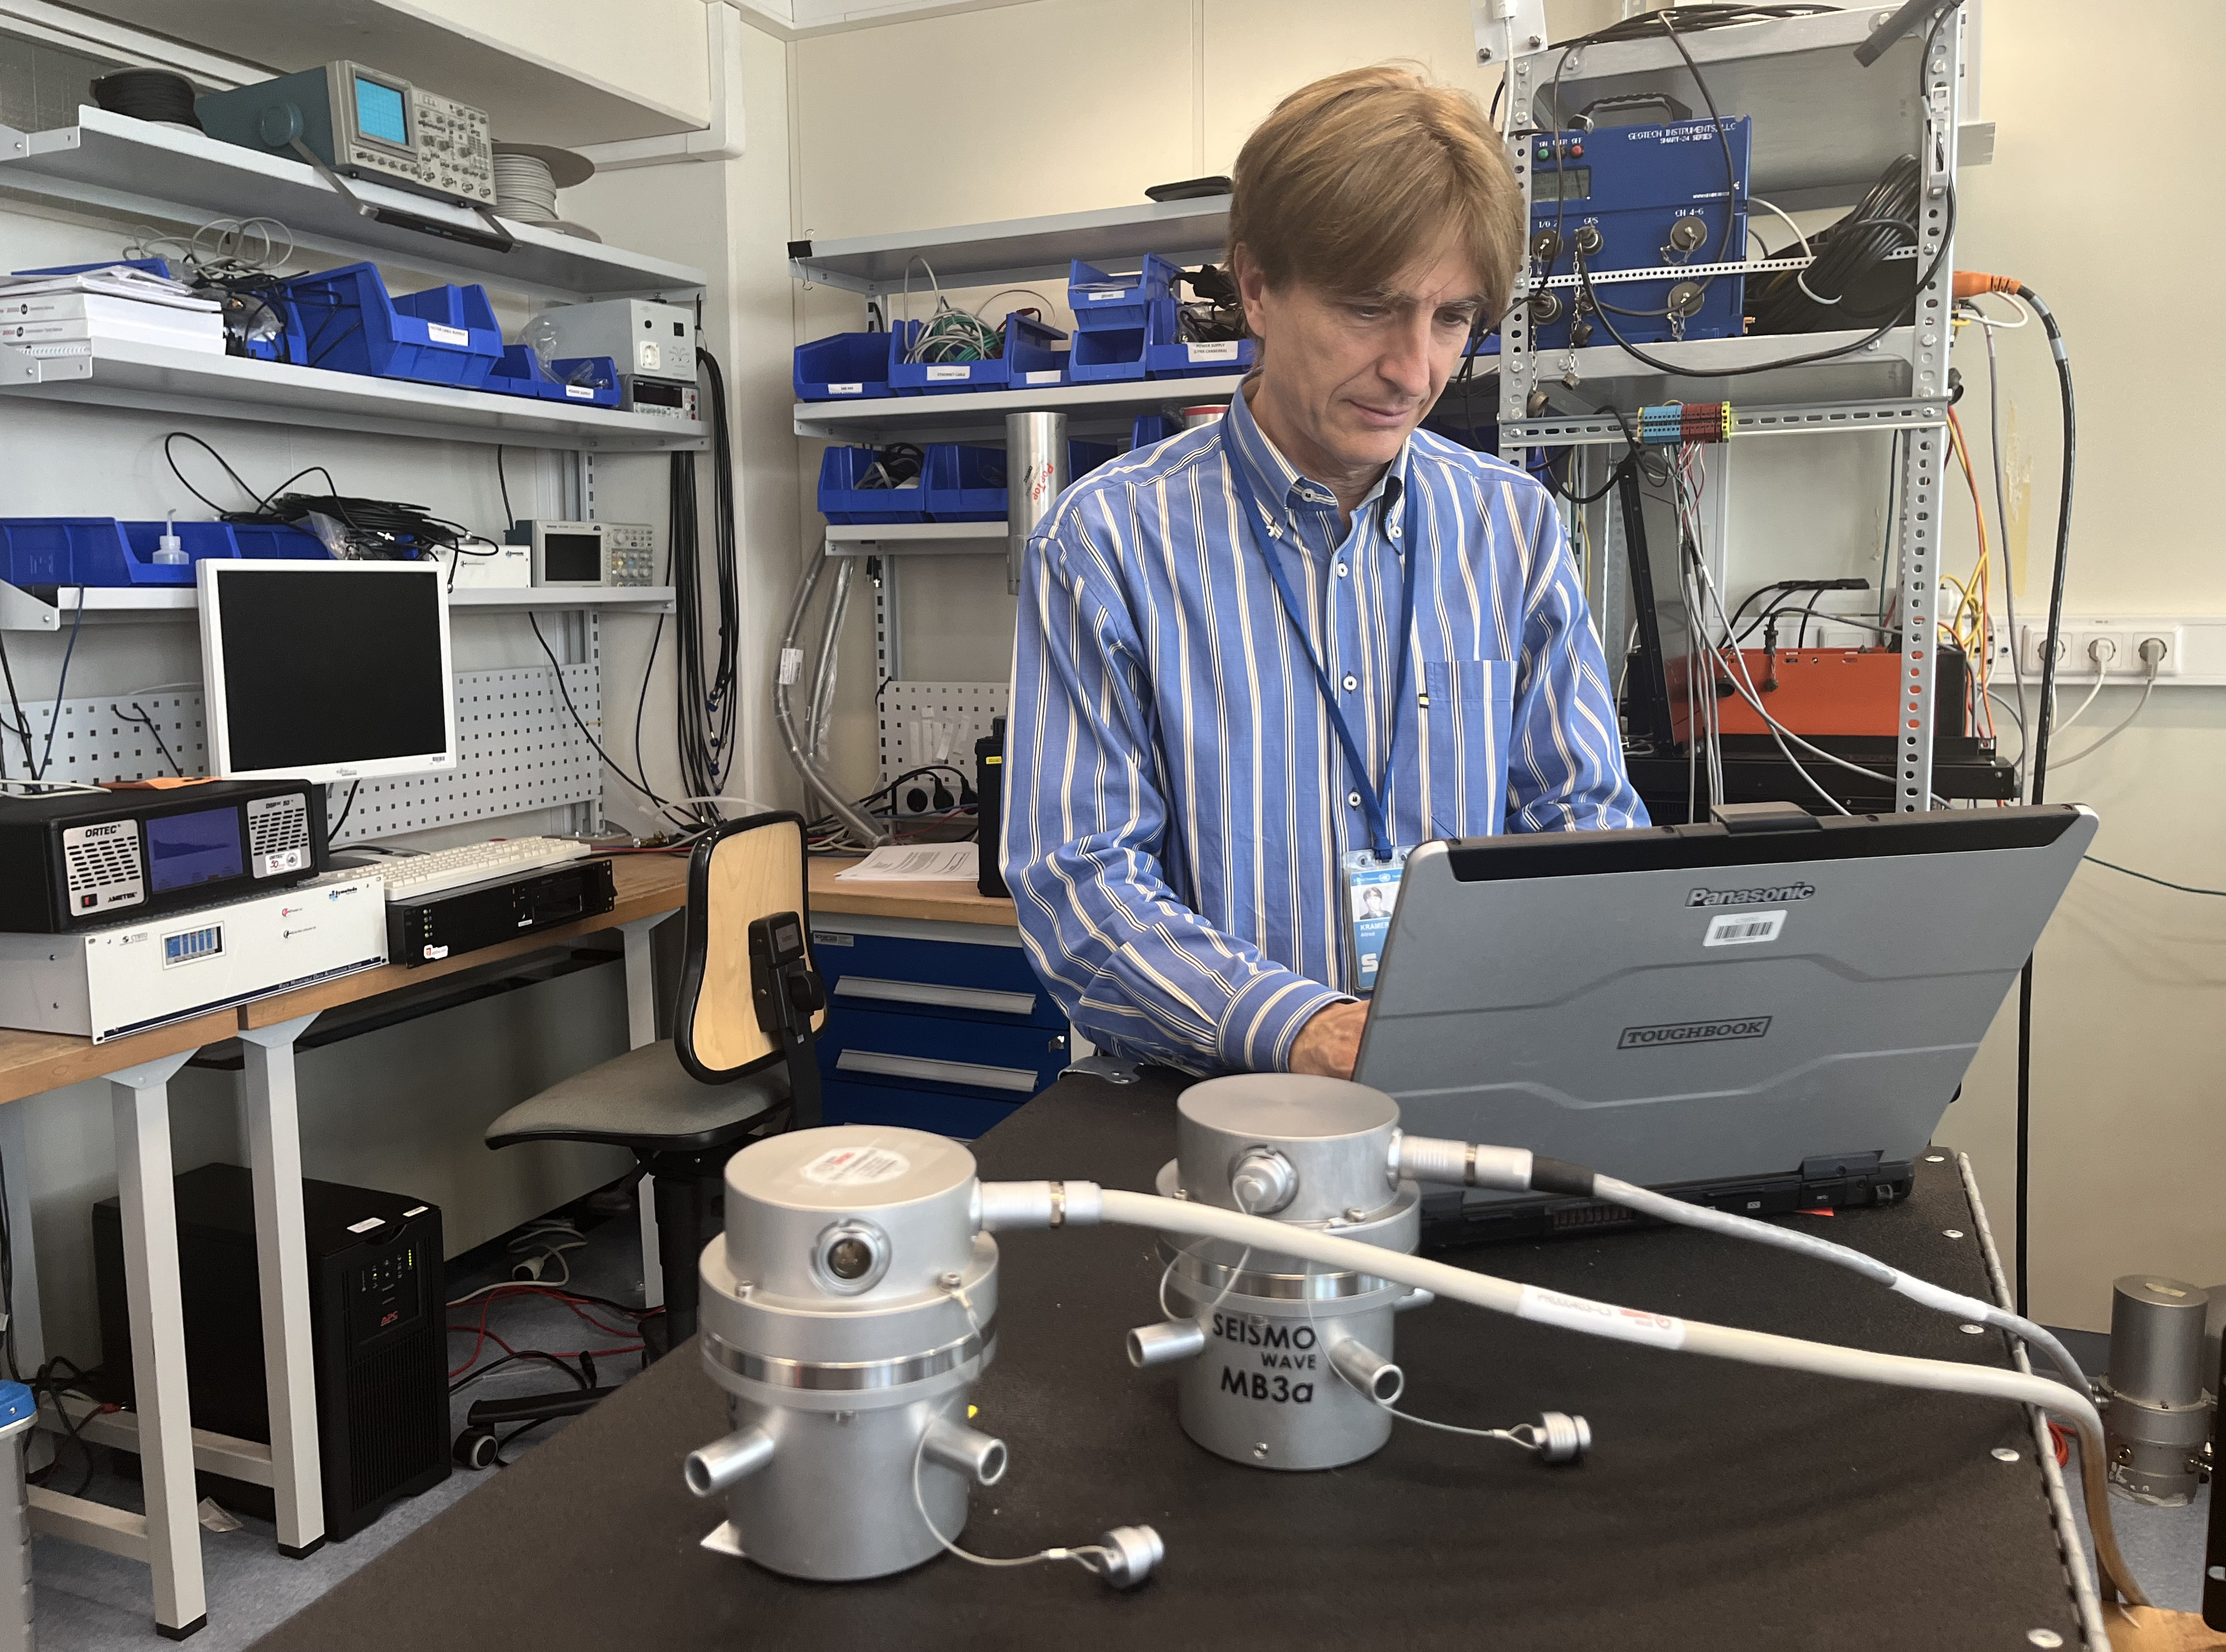
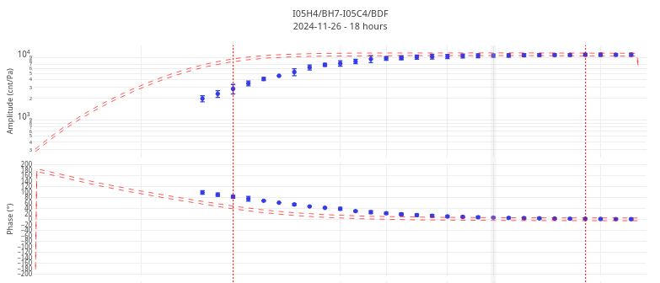


P3.1-708
From errors to insights: the role of Infrasound Calibration
in improving troubleshooting activities and system knowledge
Jean-Baptiste Le Blanc, Benoit Doury, Alfred Kramer, Gregory Brenn, Paola Campus
CTBTO Preparatory Commission
Context
Calibration is a requirement for IMS infrasound stations.
Calibration-by-comparison enables continuous quality monitoring and better system knowledge
Poster Focus
Widely applied at PTS: two use cases illustrate key insights
Highlight on the CalxPy software tool
Takeaways
Calibration-by-comparison strengthens trust in data and diagnostics
One tool, many applications — supporting operators, engineers, and designers across HQ, field, and lab
Disclaimer: The views expressed in this presentation are those of the authors and do not necessarily reflect the view of the CTBTO

