Slide 1


P3.1-457
Low-cost Digitizer based on FPGA and Raspberry
Christian Espín
Instituto Geofísico – Escuela Politécnica Nacional
Low-cost equipment is incredibly valuable in developing countries. Consequently, a prototype was developed based on FPGA and Raspberry Pi. This approach provides flexibility, speed, and reduced development complexity.
The prototype demonstrated outstanding performance under both laboratory and field conditions. MiniSEED files were successfully transmitted via Ethernet to the test server at the monitoring center.
DISCLAIMER: The presentation is for illustrative purposes only. Copyright IGEPN

Slide 2
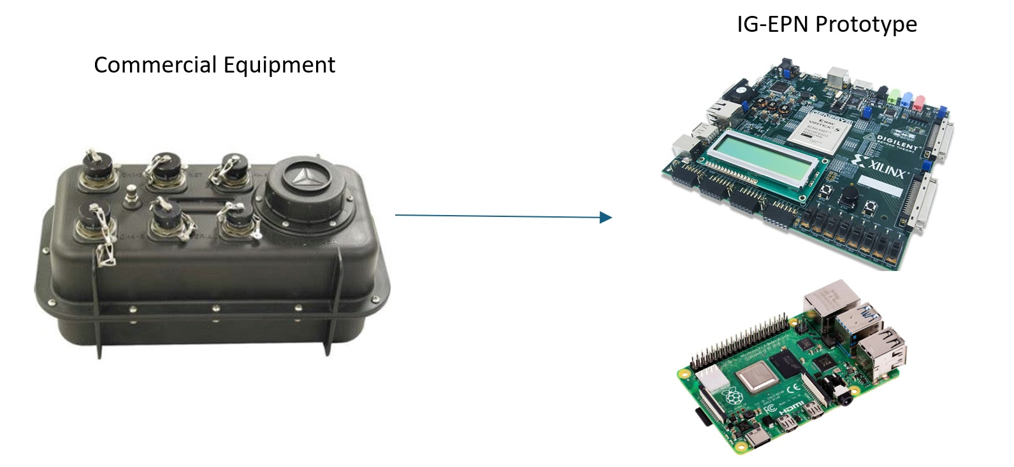
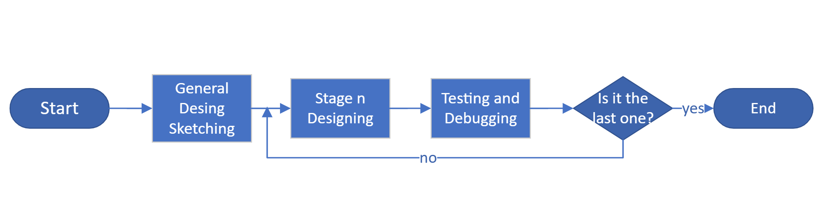
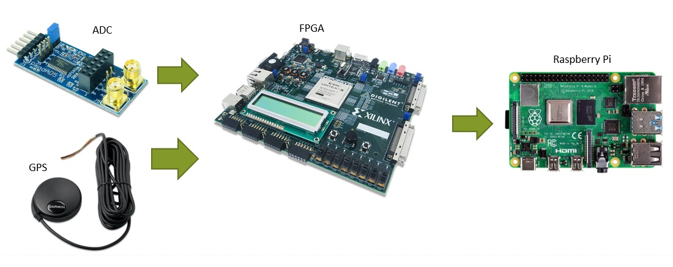
PLEASE DON‘T FORGET TO PUT THE E-POSTER TITLE AND YOUR NAME IN THE PRESENTATION HEADER.
DUPLICATE THIS SLIDE IF YOUR E-POSTER HAS MORE THAN 1 PAGE
P3.1-457
Low-cost Digitizer based on FPGA and Raspberry
Christian Espín
Introduction
Objectives
Operation
Seismic and volcanic monitoring requires a wide variety of tools for the many different scenarios found in nature.
Ecuador is a country exposed to many natural hazards. The Geophysical Institute of EPN (IG-EPN) performs monitoring activities in the country; however, budget limitations are a constant challenge. With over 300 monitoring sites, IG-EPN must ensure that everything works properly. Therefore, a low-cost digitizer is required.
FPGA technology was used along with a Raspberry Pi board. While the FPGA enabled fast, dedicated circuits, the Raspberry Pi provided a Linux-based microcontroller platform for long-term storage purposes.
Fig.1 Comparison between commercial and prototype equipment.
Develop an open, low-cost platform that can be replicated multiple times on equivalent boards.
Create a fully customizable solution that can be adapted to specific scenarios as needed.
Expand the number of channels that can be digitized by a single device in order to reduce the cost of implementing arrays of sensors.
The cascade method was used in this project. Every stage had to be fully completed before the project could move on to the next one. This approach allowed for design changes as the project progressed, in response to challenges encountered during the development of each stage.
Fig.2 Flowchart of cascade method.
For operation, the FPGA was primarily used for fast, scalable data acquisition from AD cards, as well as for date and time synchronization with a GPS device. The acquired information is then sent to a Raspberry Pi board, where it is stored on a USB drive. At this stage, the data is also converted into MiniSEED files. With proper configuration, the data can also be transmitted via Ethernet.
The analog signal is converted into a 24-bit discrete signal using a Pmod AD5 4-channel card from Digilent. This card is connected directly to the FPGA board through a Pmod interface, also developed by Digilent. The Virtex-5 FPGA board used has several Pmod interfaces, which allow for an increase in the number of acquired channels
Fig. 3 Prototype connection schematic.
Methods
DISCLAIMER: The presentation is for illustrative purposes only. Copyright IGEPN

Slide 3
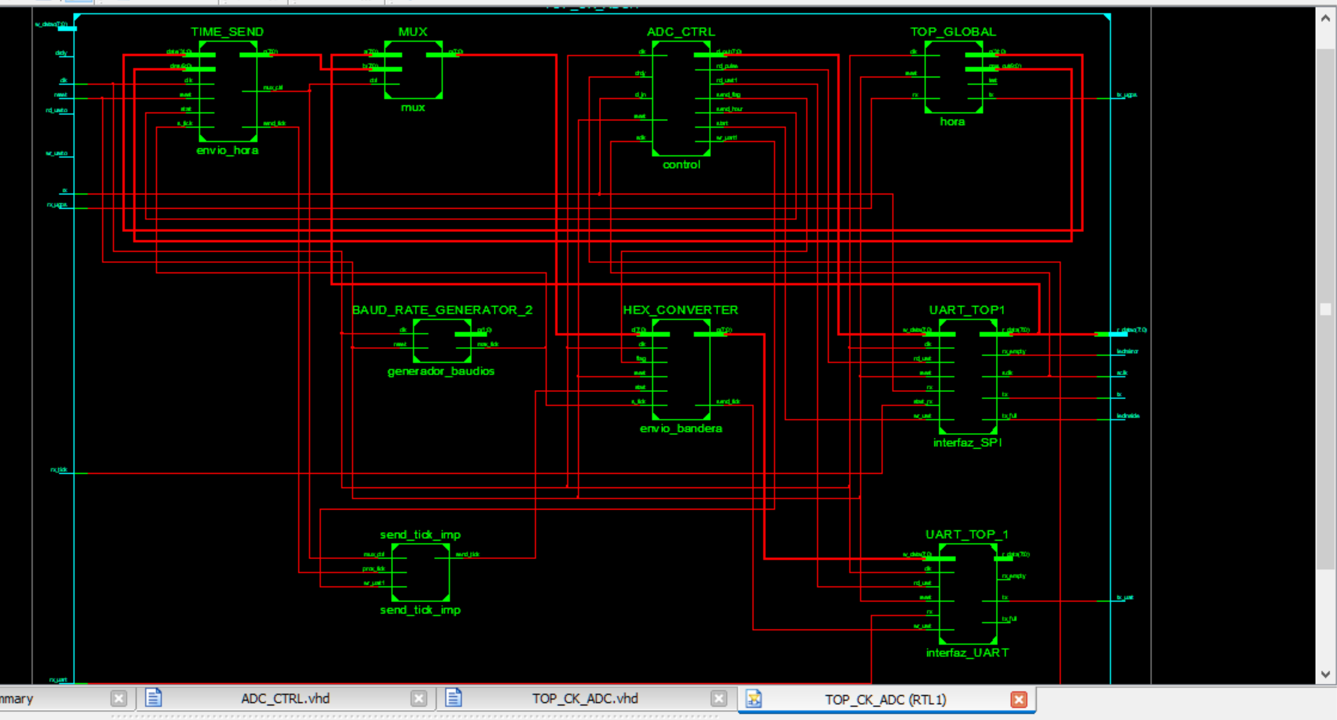
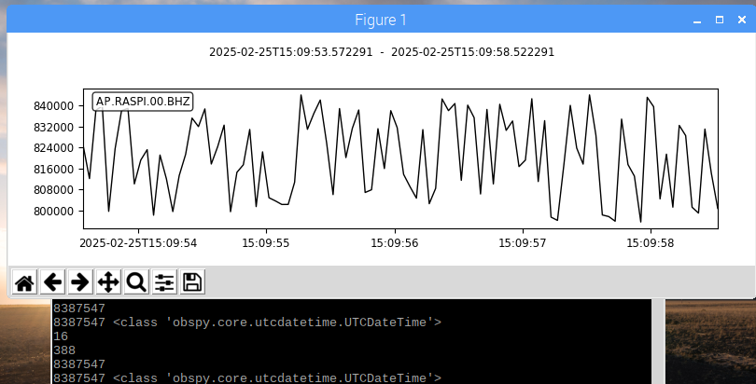
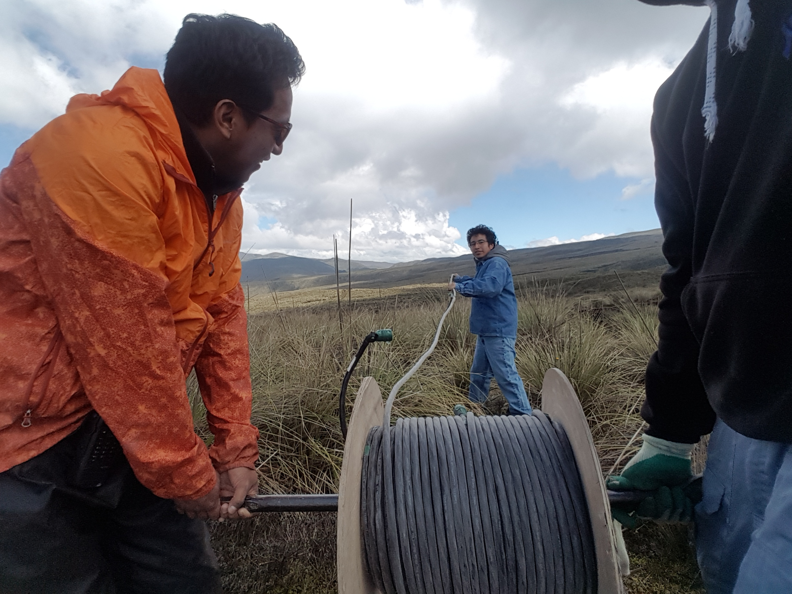
PLEASE DON‘T FORGET TO PUT THE E-POSTER TITLE AND YOUR NAME IN THE PRESENTATION HEADER.
DUPLICATE THIS SLIDE IF YOUR E-POSTER HAS MORE THAN 1 PAGE
P3.1-457
Low-cost Digitizer based on FPGA and Raspberry
Christian Espín
Key Design Parameters
Testing
Results
Figure 4. FPGA programmed circuit schematic.
VHDL was used to describe the circuits implemented in the FPGA chip. This language was compatible with the available FPGA board (Virtex-5) and allowed for detailed descriptions to optimize the circuitry.
Open-source Python was used in the Raspberry Pi stage. It provided a simple way to perform the cyclical tasks of data transformation and recording. The system was designed to create and store files on a USB drive. Python was crucial in the software development stage since it offers multiple libraries that can be used. One in particular, ObsPy, was heavily used to handle seismic data.
The prototype was tested under both laboratory and field conditions. Cotopaxi volcano was chosen for field testing due to its proximity to IG headquarters and the harsh environmental conditions that can challenge the device’s operation. Temperatures at the monitoring station can drop as low as 0 °C according to weather reports.
Figure 5. Prototype installation at remote location.
Laboratory testing showed steady performance with up to 6 channels being digitized simultaneously. However, when more channels were included, samples were dropped. To solve this problem, the Python code had to be optimized so that execution time could keep up with the samples sent by the FPGA board. Field testing, on the other hand, showed the same stability as in laboratory conditions.
Figure 6. Prototype-generated mseed file noise plotting.
Prototype generated valid .mseed files.
SeedLink protocol worked in remote transmission tests.
MiniSeed files were properly displayed at test server.
Lower cost compared to commercial equipment.
Scalability due to the possibility of replicating hardware blocks in the FPGA to add more channels as needed.
Suitable for installation in high-risk areas, where the device may be damaged due to proximity to the hazard source (e.g., lahar detection, volcano monitoring, etc.).
Advantages
DISCLAIMER: The presentation is for illustrative purposes only. Copyright IGEPN

