Slide 1

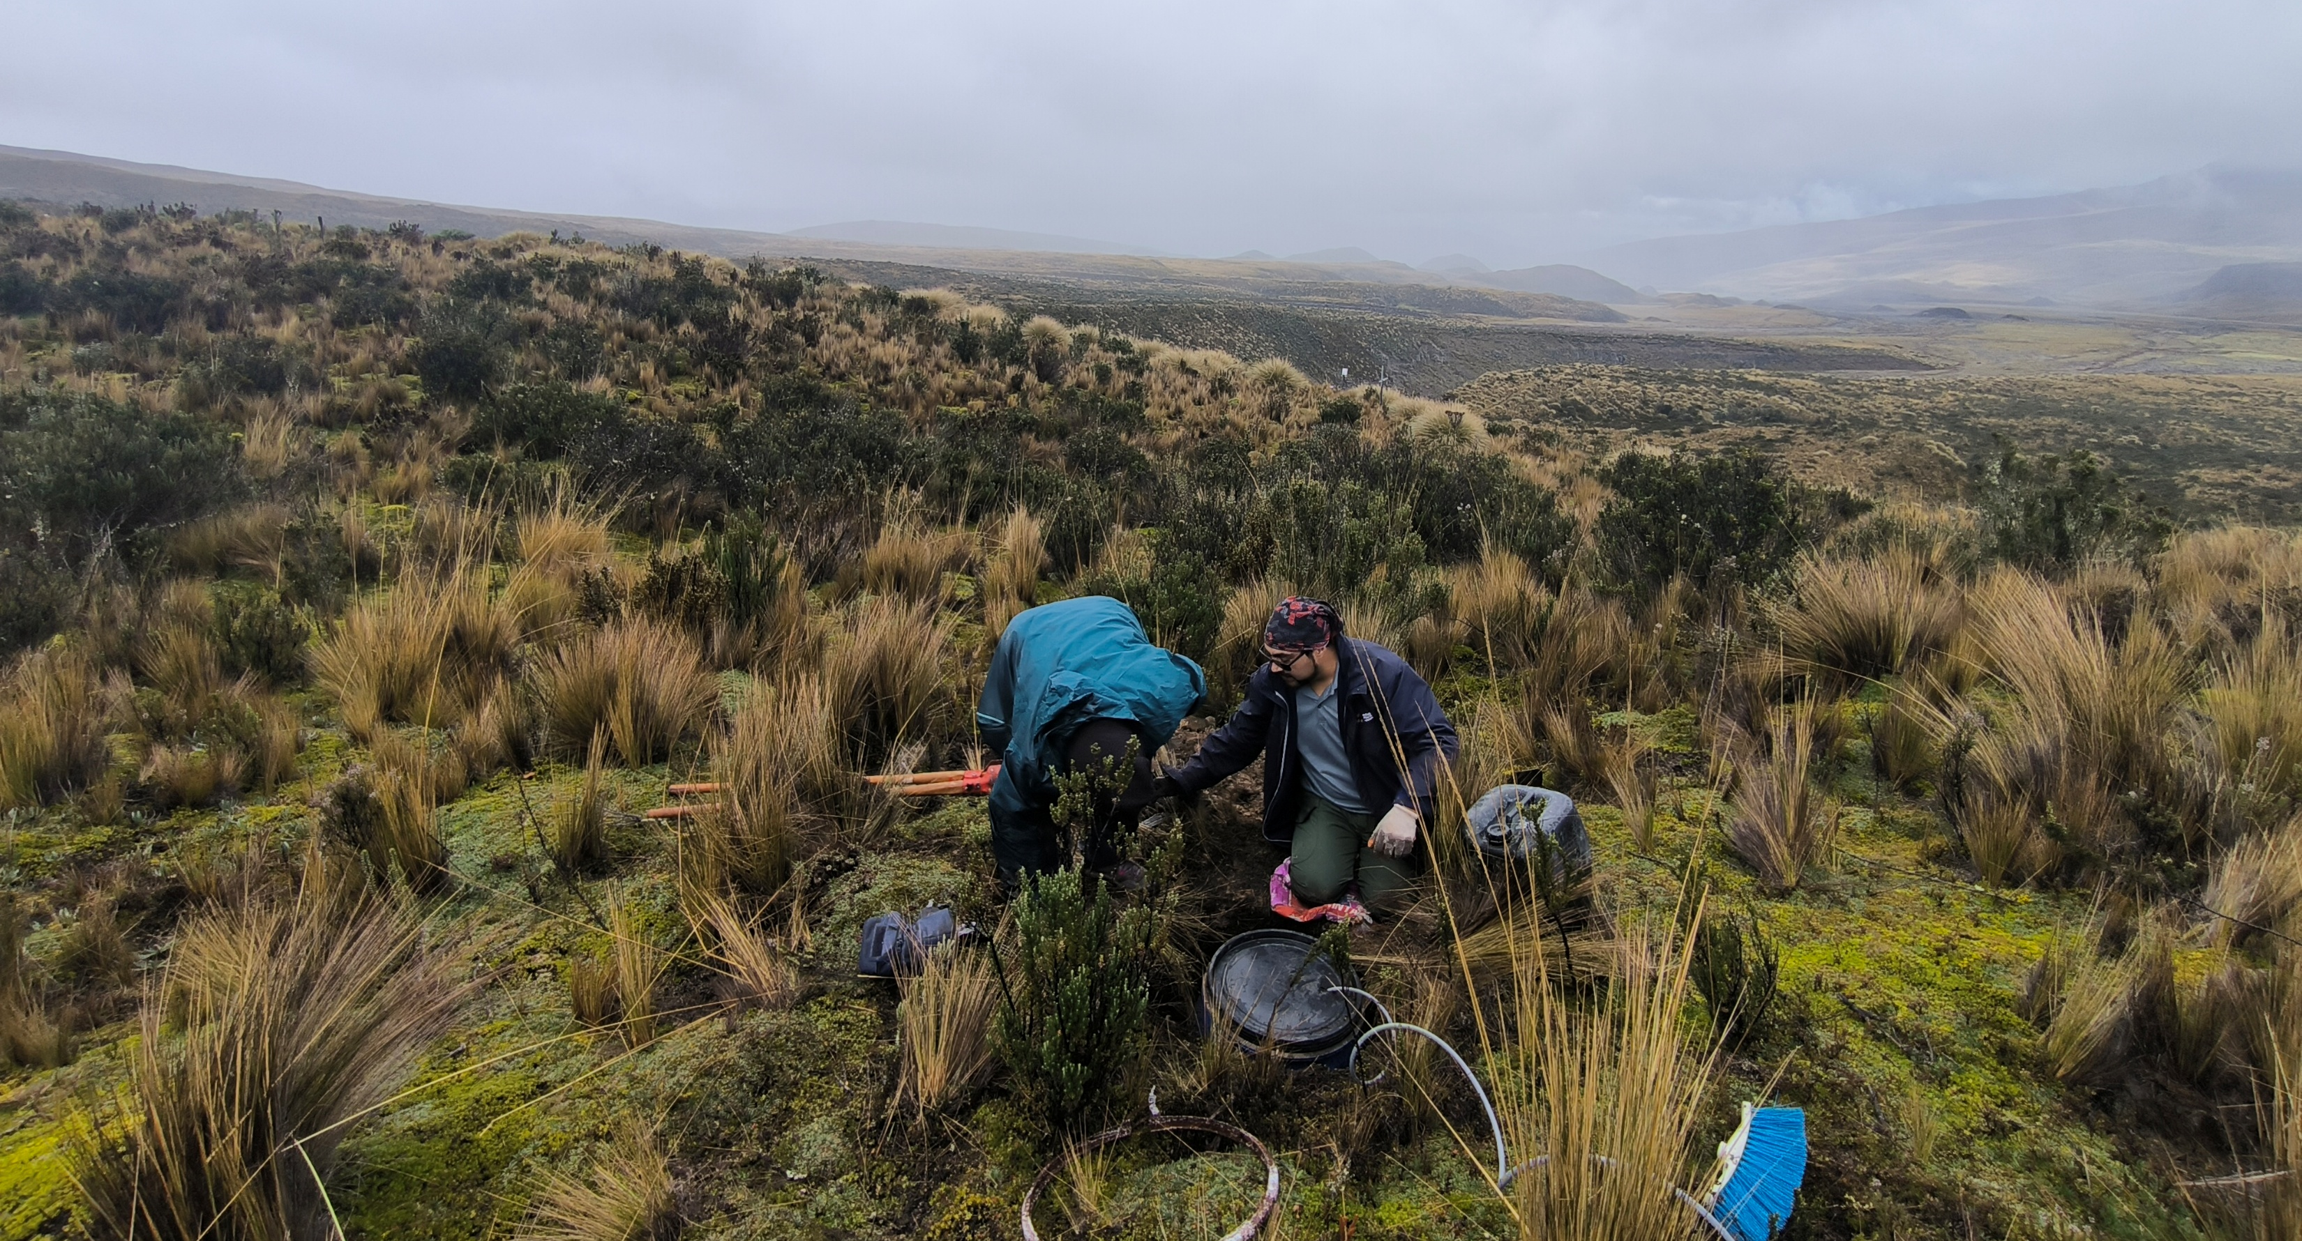

P3.1-457
Low-cost Digitizer based on FPGA and Raspberry
Christian Espín
Instituto Geofísico – Escuela Politécnica Nacional
This poster is about a low-cost digitizer prototype based on FPGA and Raspberry.
I am going to tell you how this prototype can support the monitoring activities in low-budget scenarios.
You will discover the key design features for acquiring samples from diverse sources such as seismic, explosions, etc.
The result of this project is a working digitizer prototype based on FPGA and Raspberry Pi that can generate miniSEED files and transmit them through SeedLink to real time.
If you want to find out more, come over for a chat in front of this poster
DISCLAIMER: The presentation is for illustrative purposes only. Copyright IGEPN

