Slide 1

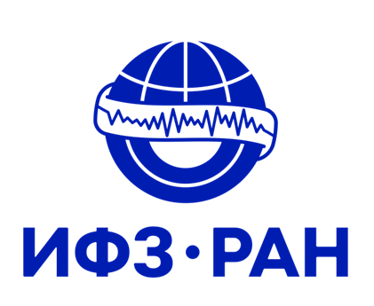

P3.1-376
Will Distributed Acoustic Sensing (DAS) be able to replace classical seismic instruments?
Gravirov V.^{1,2}, Kislov K.²
1. The Schmidt Institute of Physics of the Earth of the Russian Academy of Sciences (IPE RAS)
2. Institute of Earthquake Prediction Theory and Mathematical Geophysics of the Russian Academy of Sciences (IGP RAS)
The geophysics' field is seeing rapid development of new technologies, including Distributed Acoustic Sensing (DAS). DAS is experiencing exponential growth in its application and development today. This innovative technique attracts scientists and researchers for its ability to monitor and analyze geological and structural changes with high spatial resolution over large distances. Unlike traditional methods based on the use of stationary instruments, DAS allows to make data acquisition using a distributed network of sensors, which opens up new horizons for studying complex geophysical phenomena. However, it should be noted that, nevertheless, there are still certain difficulties in applying this technology to solve a wide range of seismological problems, and the logical question arises whether this technology will be able to replace classical geophysical instruments in the future.

Slide 2
PLEASE DON‘T FORGET TO PUT THE E-POSTER TITLE AND YOUR NAME IN THE PRESENTATION HEADER.
DUPLICATE THIS SLIDE IF YOUR E-POSTER HAS MORE THAN 1 PAGE
P3.1-376
Will Distributed Acoustic Sensing (DAS) be able to replace classical seismic instruments?
Gravirov V., Kislov K.
Benefits of DAS
Disadvantages of DAS
Conclusions
Having carefully considered all the advantages and disadvantages of virtual (based on DAS) and traditional geophysical instruments, we can confidently state that the question posed in the title currently does not have a clear answer. Obviously, distributed acoustic sensing has great chance to occupy an important place in the arsenal of geophysical methods, but a complete replacement of traditional instruments in current practice is unlikely in the near future. Although DAS has advantages, it also faces a large set of limitations that prevent it from becoming a universal solution. Most likely, it is the combination of technologies that may eventually become the most effective approach. Since both approaches have their advantages and disadvantages, their confrontation will lead to synergy rather than rivalry. In the future, technology integration may be the key to more accurate and detailed data, which in turn will have a positive impact on scientific research and practical applications in the field of geophysics. It is important to keep in mind that the world of geophysics is dynamic, and technology continues to evolve. The fusion of traditional and innovative methods can create new opportunities for exploring the Earth and its resources. Using a combined approach will partially eliminate the limitations of one technology, while offsetting them with the advantages of another. Such a symbiosis can significantly improve the quality of studying the nature of the Earth and provide a higher degree of confidence in scientific conclusions.
Low cost;
Wide availability of materials;
Easy organization of arrays of seismic points of great length;
High spatial resolution;
Easy selection any spatial sampling;
Wide frequency range from 0.001 Hz to 10 kHz;
Dynamic range over 120 dB;
Possibility of using existing fiber-optic networks;
Quick deployment with minimal connection of new equipment;
Requires one polling (central) unit located at one end of the fiber;
There is no problem of time synchronization between virtual sensors;
No need for individual power supplies for sensors and their maintenance;
Reliability, strength, durability, corrosion resistance;
Small size and weight;
Possibility of continuous operation;
Can be easily deployed even in the harshest and most unusual conditions, including the organization of a dense seismic network in a metropolis;
Insensitivity to electromagnetic fields;
Wide operating temperature range -60 ÷ +250 degrees C, as well as pressure up to 180 MPa.
Works on fiber optical cables of limited length (currently average up to 180 km);
Records only single-component axial deformation of the fiber optical cable;
Fiber optical fiber cables usually do not located in a straight line, i.e. the direction of sensitivity from one virtual sensor to another can change significantly;
The SNR ratio of different sections of the fiber optical cable is different;
Have higher noise level than conventional broadband seismometers;
Existing communication fiber optical cables are usually laid in areas with high noise levels;
The connection between the fiber optical cable and the ground may vary according to the length of the cable;
Uncertainty of fiber optical cable depth;
DAS self-noise has not been strictly assessed at present;
The location and orientation of virtual sensors is difficult to determine, especially on previously laid fiber optical cables
Difficulty estimating magnitude and focal mechanism;
There is an additional error (sensitivity to changes in temperature, humidity, pressure, external loads, freezing/thawing, etc.).

