Slide 1


P3.1-102
VNIIA Experience in Seismometer Development
A.Yu. Eltekov., O.A. Gerasimchuk, G.S. Zasimov
Federal State Unitary Enterprise «All-Russian Research Institute of Automatics» (FSUE «VNIIA»),ROSATOM
VNIIA, a leading company of Rosatom in CTBT implementation, has developed three seismometer types in compliance with the requirements for IMS seismic stations in the framework of the CTBT:
Type 1 – a vertical short-period seismometer for boreholes;
Type 2 – a three component broadband seismometer for pedestal installation;
Type 3 – a three component broadband seismometer for boreholes.

Slide 2
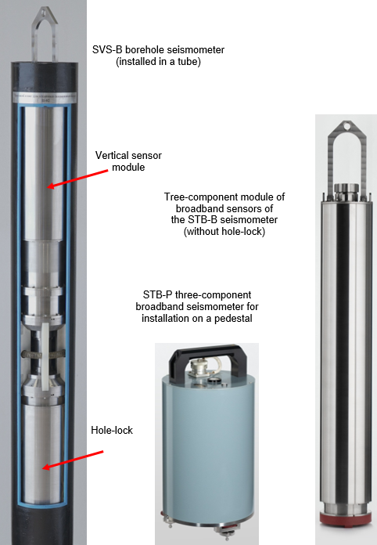
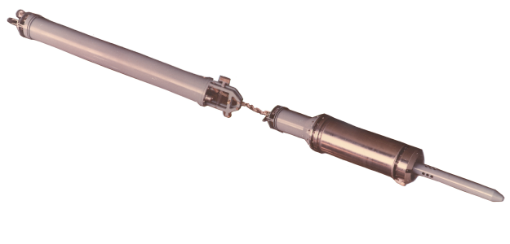
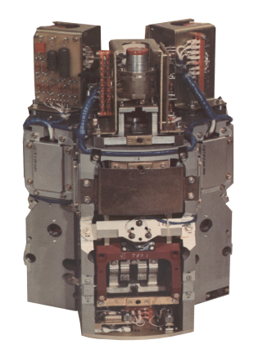

P3.1-102
VNIIA Experience in Seismometer Development
A.Yu. Eltekov., O.A. Gerasimchuk, G.S. Zasimov
Historical Information
In the 1970s VNIIA began developing two types of the borehole seismometers to ensure the compliance of the 1974 Threshold Test Ban Treaty provisions:
- three-component long-period seismometer with a frequency band from 0.02 Hz to 6 Hz;
- single-component (non-oriented) short-period seismometer with a frequency band from 1 Hz to 6 Hz.
At the next stage, the DS-3K three-component broadband seismometer was developed with a frequency band from 0.01 Hz to 20 Hz.
By the early 1990s, a series of such borehole seismometers was manufactured and installed at the seismic stations of the USSR national monitoring system for long-term operation.
In the late 2010s, VNIIA developed three new types of seismometers (Figure 1):
- Type 1 (SVS-B model) – vertical short-period borehole seismometer;
- Type 2 (STB-P model) – three-component broadband seismometer for installation on a pedestal;
Type 3 (STB-B model) – three-component broadband borehole seismometer.
Functions of the seismometers
Conversation of the vertical velocity component of the full vector of ground seismic oscillations into proportional electrical signals
Conversation of the three mutually orthogonal velocity components of the ground seismic oscillations to proportional electrical signals;
Receives and executes the control commands from external devices (computer, digitizer) via the RS-485 port.
The locking/unlocking and the mass centering processes are performed automatically
Figure 1 – New line of VNIIA seismometers

Slide 3
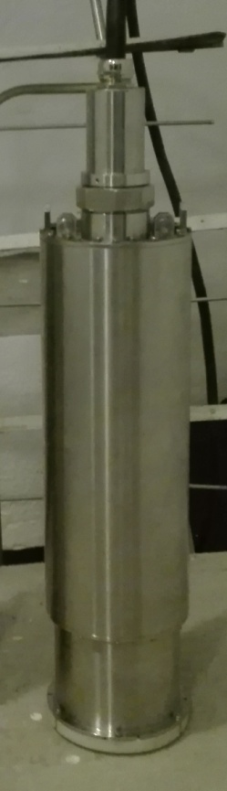
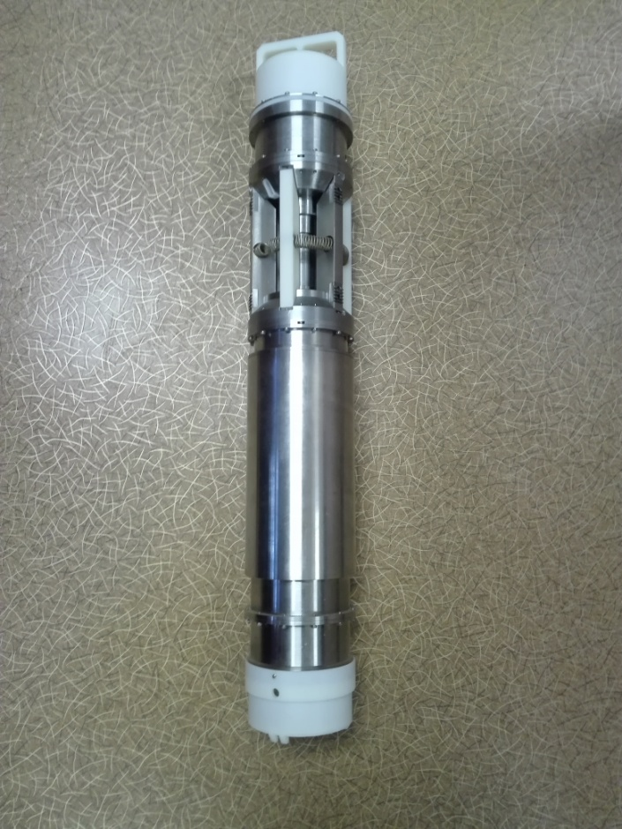
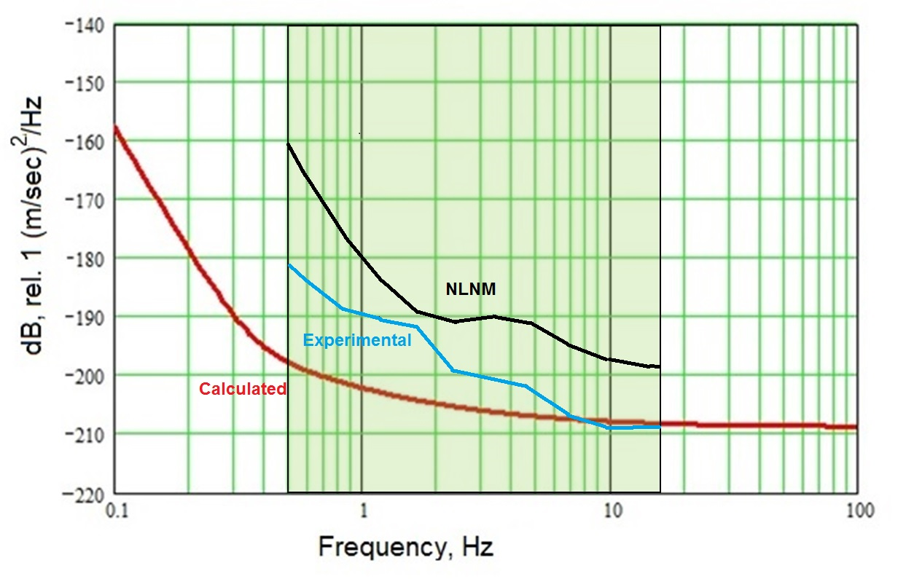
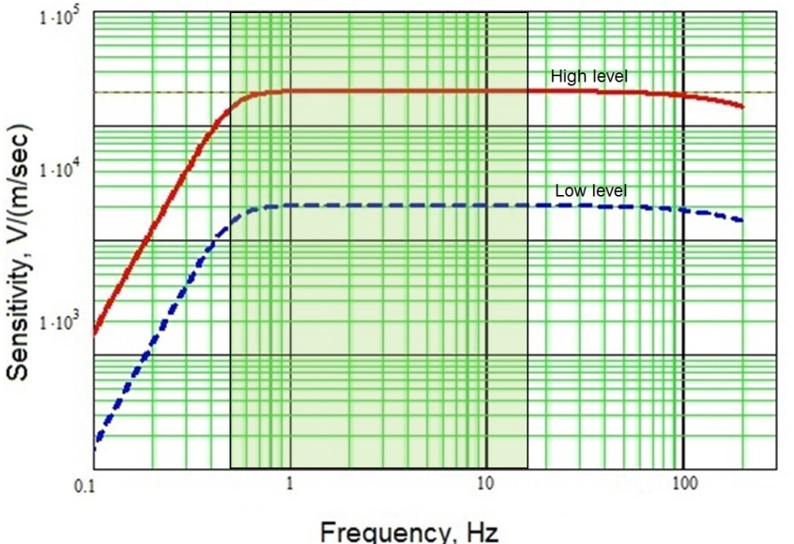
P3.1-102
VNIIA Experience in Seismometer Development
A.Yu. Eltekov., O.A. Gerasimchuk, G.S. Zasimov
VNIIA Seismometer of Type 1 (SVS-B)
Stability Test
The AFC stability was tested with an application software under various conditions [2]. The tests performed in a climatic chamber in the temperature range from -25 °C to 50 °C have demonstrated the amplitude-frequency characteristic stability within ± 6% of the initial value.
The VNIIA seismometer of Type 1 (SVS-B model) is a vertical short-period seismometer based on a magnetic-electric converter of a pendulum motion to an electric voltage, which is assembled in a waterproof stainless-steel borehole unit and is designed to operate at overpressure up to 5·10⁶ N/m².
The SVS-B seismometer can be installed in steel-cased wells with an internal diameter from 145 mm to 178 mm (up to 220 mm optional) at a depth of up to 100 m and can operate in the temperature range from minus 25 °C to 50 °C.
The seismometer is configured for operation with case tilts up to 3.5° relative to the vertical axis. The Type 1 seismometer weight is 42 kg (17 kg without the hole-lock). Diameter is 135 mm, total length is 1.5 m.
Figure 3 – Short-period vertical module, Hole-lock
Figure 5 - the SVS-B seismometer self-noise
The SVS-B seismometer self-noise is determined by the thermal noise of a coil and preamplifier resistors. The total self-noise RMS value is less than 0.2 nm/s in the frequency band from 0.5 to 16 Hz and 0.07 nm/s at the 1 Hz frequency (minus 23 dB relative to the New Low Noise Model (NLMN) [3]).
Figure 2 – Functional diagram of a seismic sensor for the SVS-B
Figure 4 - Amplitude-Frequency Characteristic
Response | 2000 or 20000 V·m⁻¹·s

Slide 4
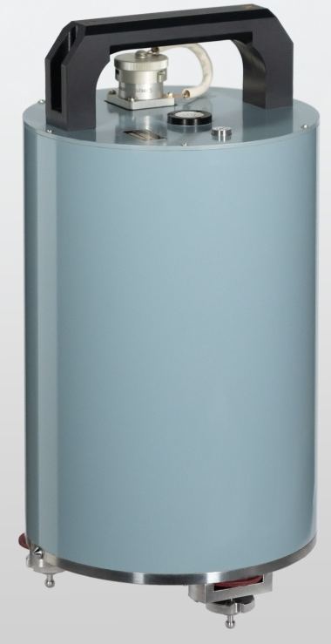
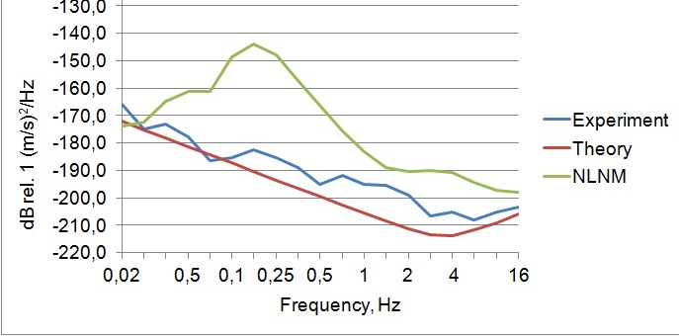
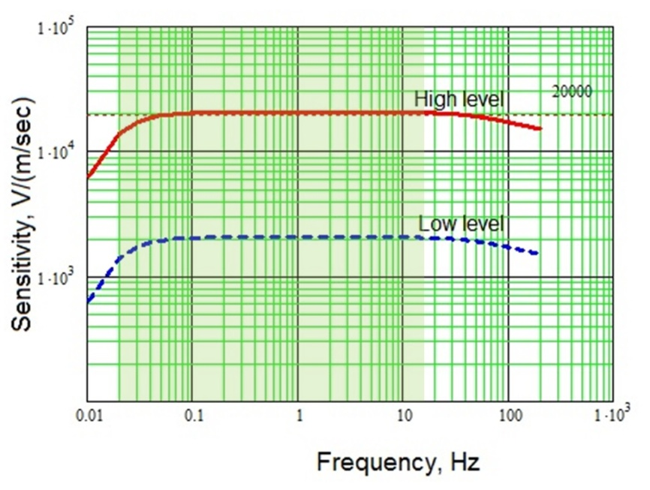
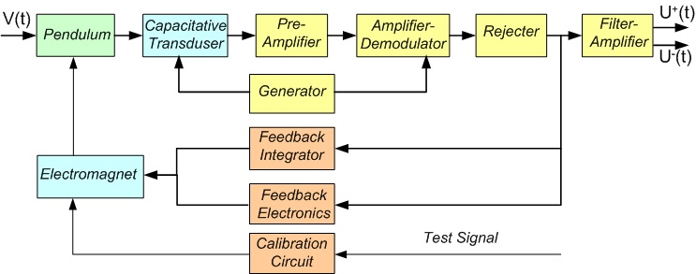
P3.1-102
VNIIA Experience in Seismometer Development
A.Yu. Eltekov., O.A. Gerasimchuk, G.S. Zasimov
VNIIA Seismometer of Type 2 (STB-P)
Stability Test
The STB-P AFC stability was tested as that of the SVS-B seismometer. The tests performed in the climatic chamber in the temperature range from -25 °C to 50 °C demonstrated the amplitude-frequency characteristic stability within ± 1% of the initial value.
The VNIIA seismometer of Type 2 (STB-P model) is a three-component broadband seismometer based on a capacitive transducer of a pendulum motion to an electric voltage, assembled in a waterproof stainless-steel case and is designed to operate at overpressure up to 3·10⁶ N/m².
The STB-P can be installed on a pedestal in a tunnel and can operate in the temperature range from minus 25 °C to 50 °C.
The pendulum levelling is performed manually when the pedestal tilt does not exceed 5.5° and is checked with a built-in tilt meter with an accuracy of 0.3°.
The STB-P seismometer weight is 13 kg, diameter is 200 mm, and height is 400 mm.
STB-P three-component broadband seismometer
Power Supply
The seismometer is powered by a direct current with a rated voltage of 24 V (voltage ranges from 10 to 36 V). The power consumption is 2.5 W
Figure 8- the STB-P seismometer self-noise
The STB-P seismometer self-noise is determined by the thermal Brownian noise of the mass and the noise of amplifiers. The calculated self-noise RMS values are 0.08 nm/s at the 1 Hz frequency (minus 21 dB relative to the NLMN [3]), less than 0.53 nm/s in the frequency range from 0.02 to 16 Hz, and less than 0.23 nm/s in the frequency range from 0.5 to 16 Hz.
Figure 7 - Amplitude-Frequency Characteristic
Figure 6 – Functional diagram of a seismic sensor for the STB-P and STB-B seismometers
Response | 2000 or 20000 V·m⁻¹·s

Slide 5
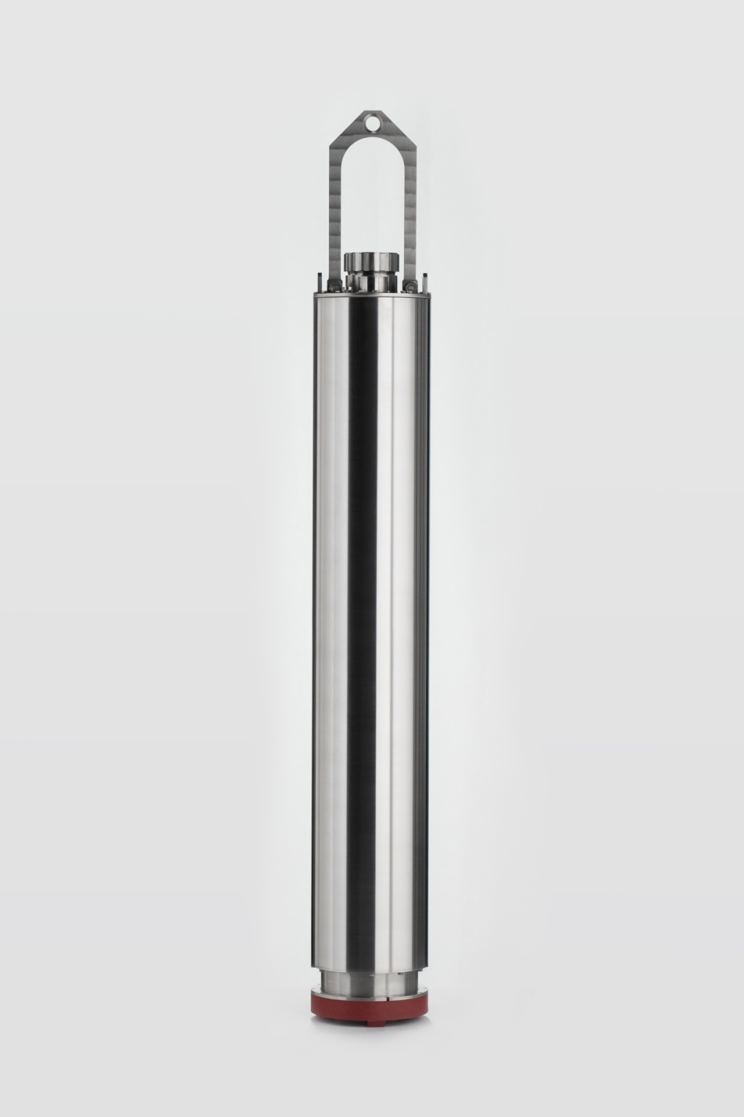
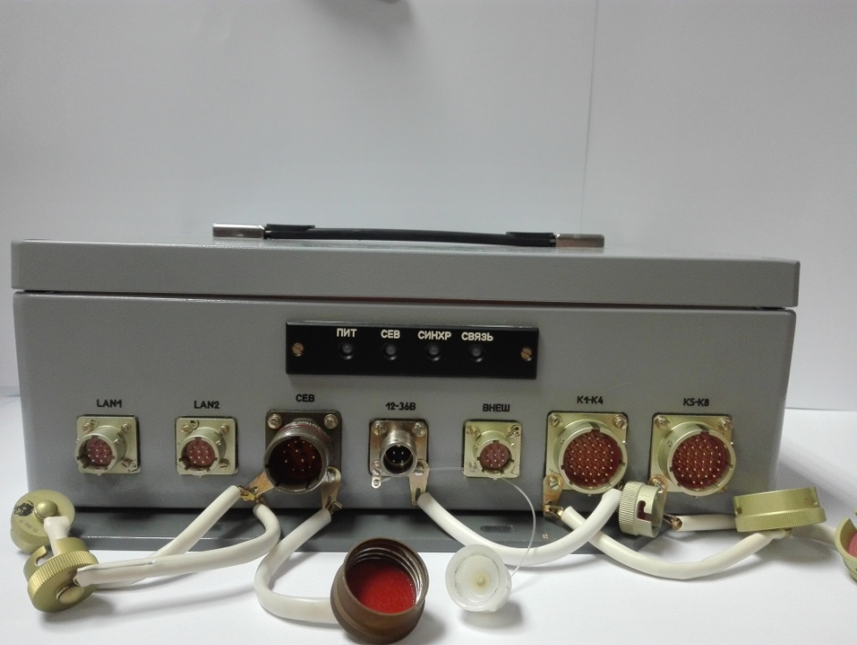
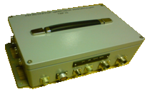
P3.1-102
VNIIA Experience in Seismometer Development
A.Yu. Eltekov., O.A. Gerasimchuk, G.S. Zasimov
VNIIA Seismometer of Type 3 (STB-B)
Self-noise
The calculated and experimental estimations of the STB-B seismometer self-noise are similar to those of the STB-P seismometer Figure 7
Geophysical Data Digitizer (DGD model)
The DGD is a 24-bit analog-to-digital digitizer designed to operate in combination with VNIIA seismometers. The digitizer can also be used with other analog seismometers or analog geophysical sensors (through the included junction box).
The DGD digitizer provides:
– continuous conversion of an alternating differential voltage from the outputs of analog seismic sensors into a digital code with the required frequency;
– synchronization of continuous digital data (CDD) with the UTC scale using the GLONASS/GPS receiver;
– generation of output data according to the CD1.1 format and protocol;
–– generation of analog test signals for testing the digitizer channels and connected sensors;
– storage of data in case of communication line failure and transmission of the saved data after communication line restore;
– power supply for connected seismometers.
The STB-B seismometer is based on the seismic sensors used in the SVS-B seismometer. The STB-B seismometer operation principle is similar to that of the STB-P seismometer.
The STB-B seismometer can be installed in steel cased wells with the internal diameter from 145 to 178 mm (up to 220 mm optional) at a depth of up to 100 m and can operate in the temperature range from minus 25 °C to 50 °C.
The STB-B seismometer weight is 47 kg (22 kg without the hole-lock), diameter is 35 mm, and length is 1.8 m. Figure 3 shows the functional diagram of the STB-B seismometer.
Parameter | DGD
Number of channels | 4 | 8
Gain | 1, 2, 4, 8
Less Significant Bit | 1.7-1.9 μV (from 0.04 to 0.05 nm/s for seismometer response – 20000 V∙s/m and gain – 2)
Sample rate | from 1 to 250 s⁻¹
Self-noise RMS value at a sample rate of 100 s⁻¹ | 1 bit of an ADC
Dynamic range | above140 dB at gain – 1
Deviation of UTS reference | 10 µs
Power consumption | 4 W
Tree-component module of broadband sensors of the STB-B seismometer (without hole-lock)
Amplitude-Frequency Characteristic
The STB-B seismometer AFC is the same as that of the STB-P seismometer shows in Figure 7.
Stability Test
The STB-B seismometer AFC stability test results are almost the same as the STB-P seismometer test results.

Slide 6
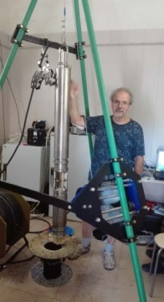
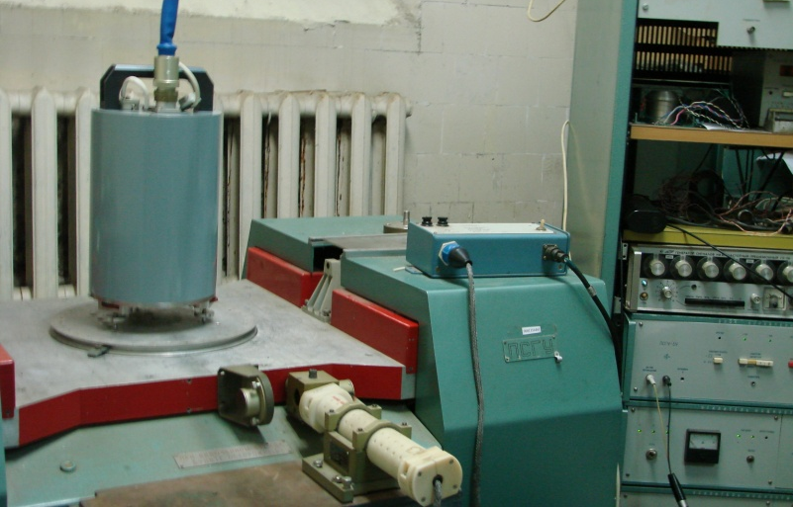
P3.1-102
VNIIA Experience in Seismometer Development
A.Yu. Eltekov., O.A. Gerasimchuk, G.S. Zasimov
VNIIA SEISMOMETERS BASIC CHARACTERISTICS
Parameter | SVS-B | STB-P, STB-B
Transducer type | magnetoelectric | capacitance
Operating frequency range | 0.5 – 100 Hz | 0.02 – above 50 Hz
Response | 2000 or 20000 V·m⁻¹·s | 2000 or 20000 V·m⁻¹·s
Self-noise RMS value in operating frequency band relative to the low noise model (LNM) | by 10 dB below the LNM level (LNM = 2 nm/s) | by 10-20 dB below the LNM level (LNM = 20 nm/s)
Dynamic range | ±5 mm/s (more than 136 dB) | ±5 mm/s (more than 130 dB)
Conversion non-linearity | not more than 0.01 % | not more than 0.1 %
Conclusion
Three types of seismometers developed by VNIIA are easy in operation, demonstrate the long-term stability, and meet the CTBT requirements for International Monitoring System seismic stations.
The VNIIA’s SVS-B seismometer can be used in small-base seismic arrays.
The VNIIA’s STB-P and STB-B seismometers can be used in the three-component seismic stations.
The DGD geophysical digitizer operates in combination with the VNIIA’s seismometers and meets the CTBT requirements. It also can be used with analog seismometers of other types or other geophysical sensors.
Bibliography
1. Eltekov А.Y., at al. (2004). On Research of Seismic Equipment Characteristics at Borovoye Experimental Base. Research and Technology Review. National nuclear center of the Republic of Kazakhstan, V.2(18), P.65-69. (In Russ.).
2. Bashilov I.P., Gerasimchuk O.A., Sleptsov V.I., Eltekov A.Y. (2023) A Short-Period Vertical Seismometer and Auxiliary Equipment for Installation in Boreholes. Seismic Instruments, 2023, V.58 (5), P.521–533. doi/:1D.31D3/ S07479239220050048.
3. Berger J., Davis P., Ekstrõm G. (2004). Ambient Earth Noise: a Survey of the Global Seismographic Network. Journal of Geophysical Research, 109, B11307, doi:10.1029/2004JB003408.
4. Eltekov A.Y., Gerasimchuk O.A,Vinogradov Y.A. (2024) Researches and Measurements of High-Sensitive Seismometers at Experimental Base “Obninsk”, Russian Journal of Seismology, V.6 (2), P. 52-69. doi/:10.35540/2686-7907.2024.2.04. EDN:RMYBBU. (In Russ.).
All seismometer models were tested on vibration tables and on a pedestal in the Obninsk tunnel in cooperation with Russian Academy of Sciences institutes [2,4]

Slide 7
Thank you for your attention!

