Slide 1
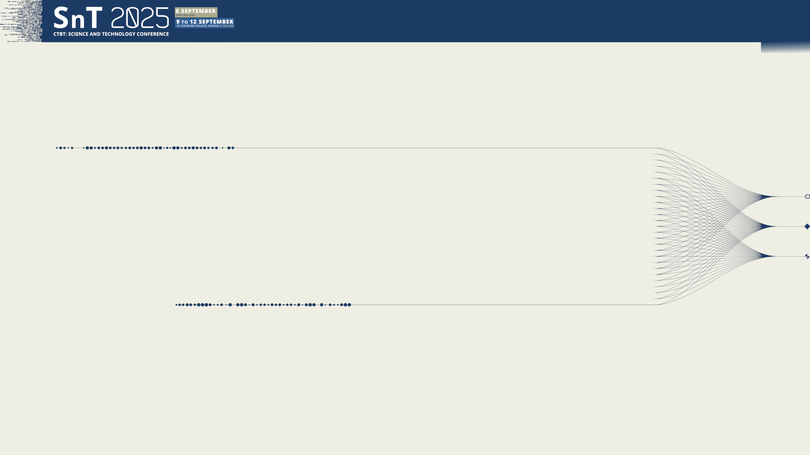

O3.1-761
Exploring the Potential of a Barometer as a Transfer Standard for Infrasound Calibration
Dominique RODRIGUES, Frédéric BOINEAU
Laboratoire National de Métrologie et d’Essais (LNE)
9th September 2025
Notes:
Speaker presentation
Today I propose to present you a study which consist on exploring the potential of a barometer to be a transfer standard for infrasound calibrations.

Slide 2
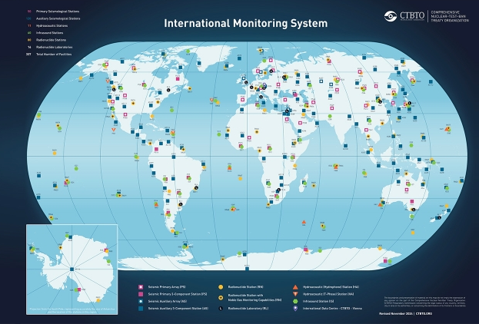
O3.1-761
Exploring the Potential of a Barometer as a Transfer Standard for Infrasound Calibration
Dominique RODRIGUES, Frédéric BOINEAU
Motivation & Context
Quality assurance for IMS measurement systems
CTBTO prepares to implement the Nuclear-Test-Ban Treaty.
The International Monitoring System (IMS) is a key part of the verification regime.
Ensuring data quality is essential:
  Operational Manual (CTBT/WGB/TL-11,17/17/REV.7).
  Quality assurance infrastructure for IMS infrasound measurements.
Requires accurate and regularly calibrated instruments.
Notes:
Our motivation arises in the context Quality assurance for IMS measurements systems.
The IMS is a key tool to enforce the Nuclear-Test-Ban-Treaty
Data quality is essential, supported by the operational manuals & Quality assurance infrastructure presented just before by Richard.
Then, in this context ensuring data quality requires accurate and regularly calibrated measurement systems.

Slide 3

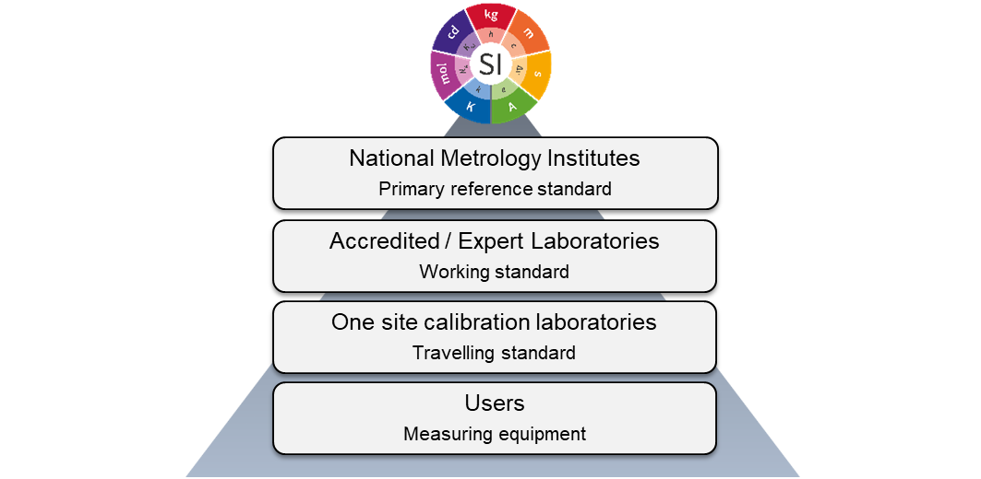
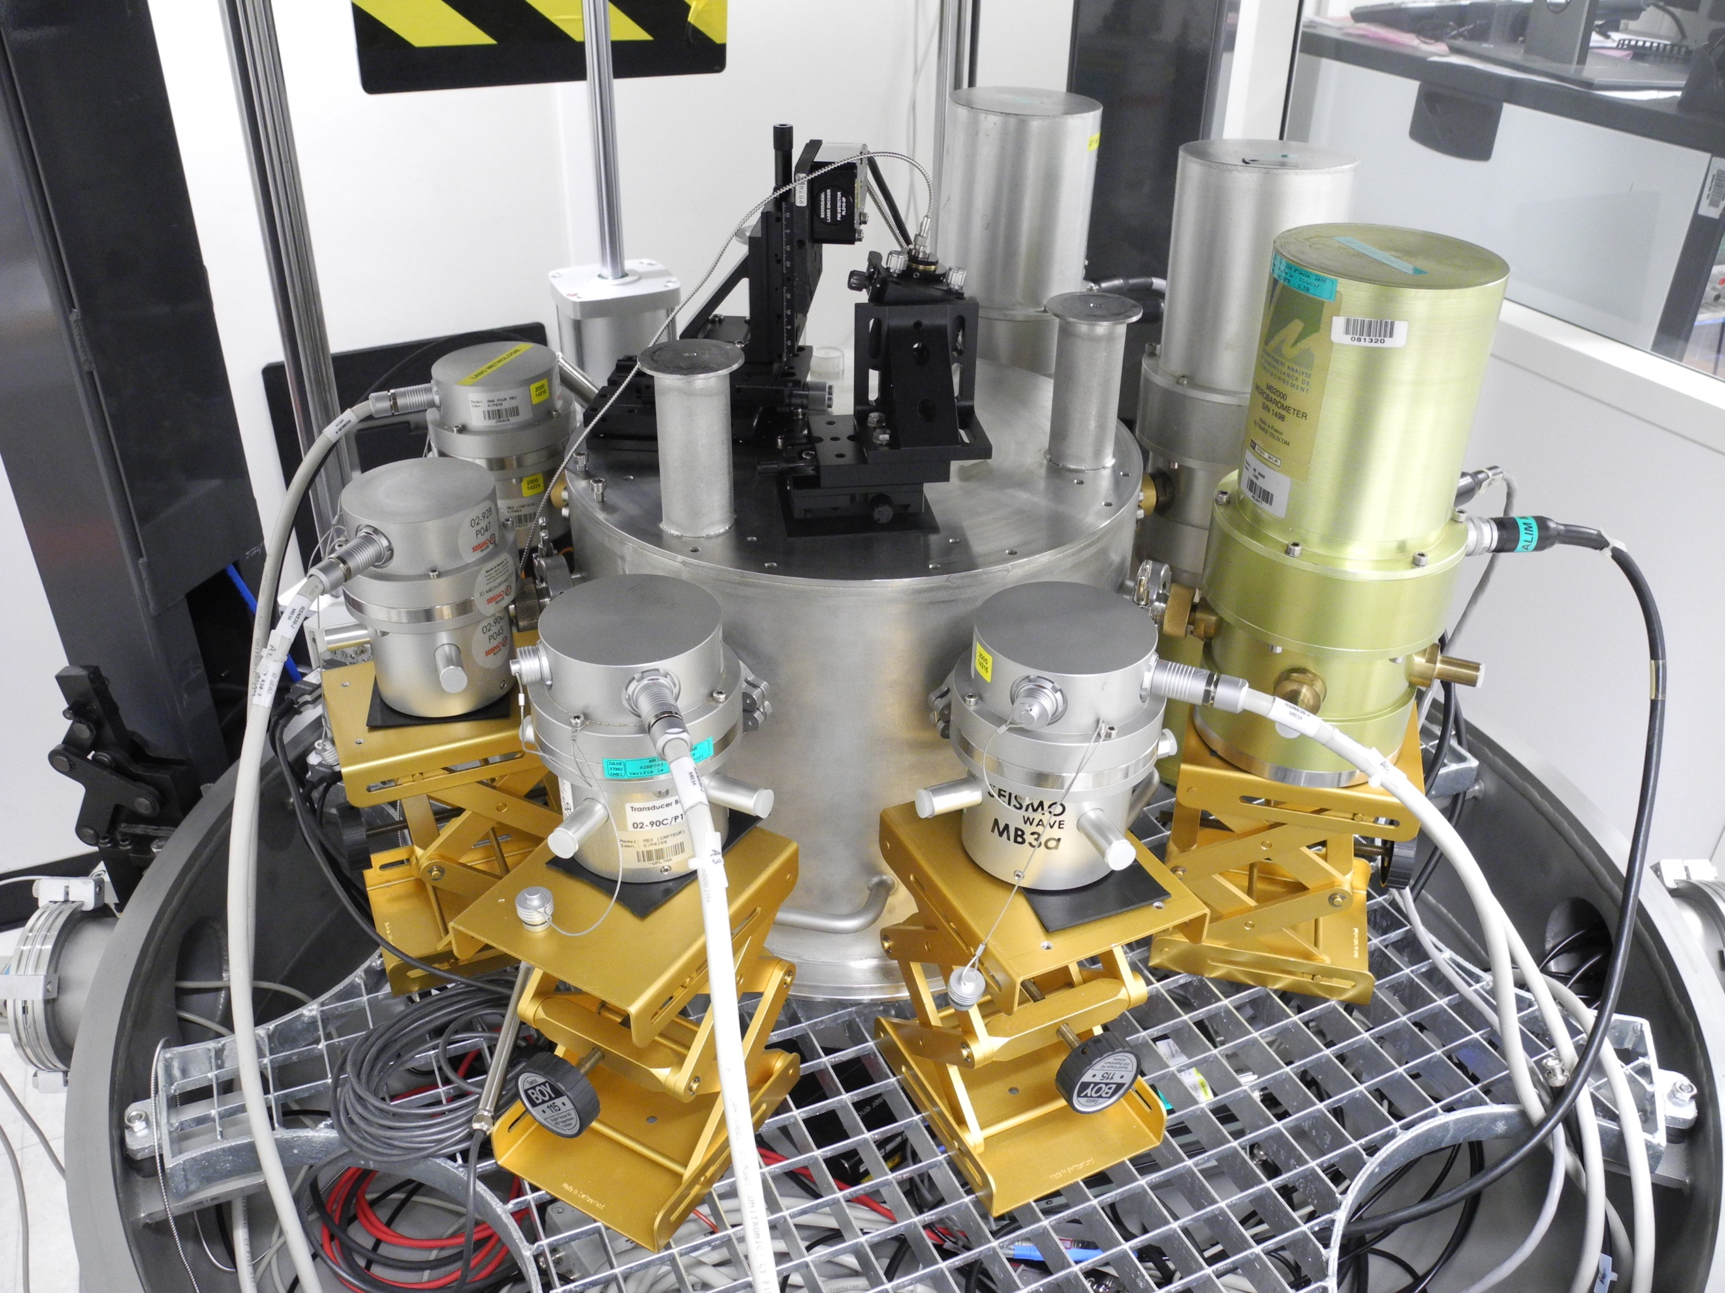
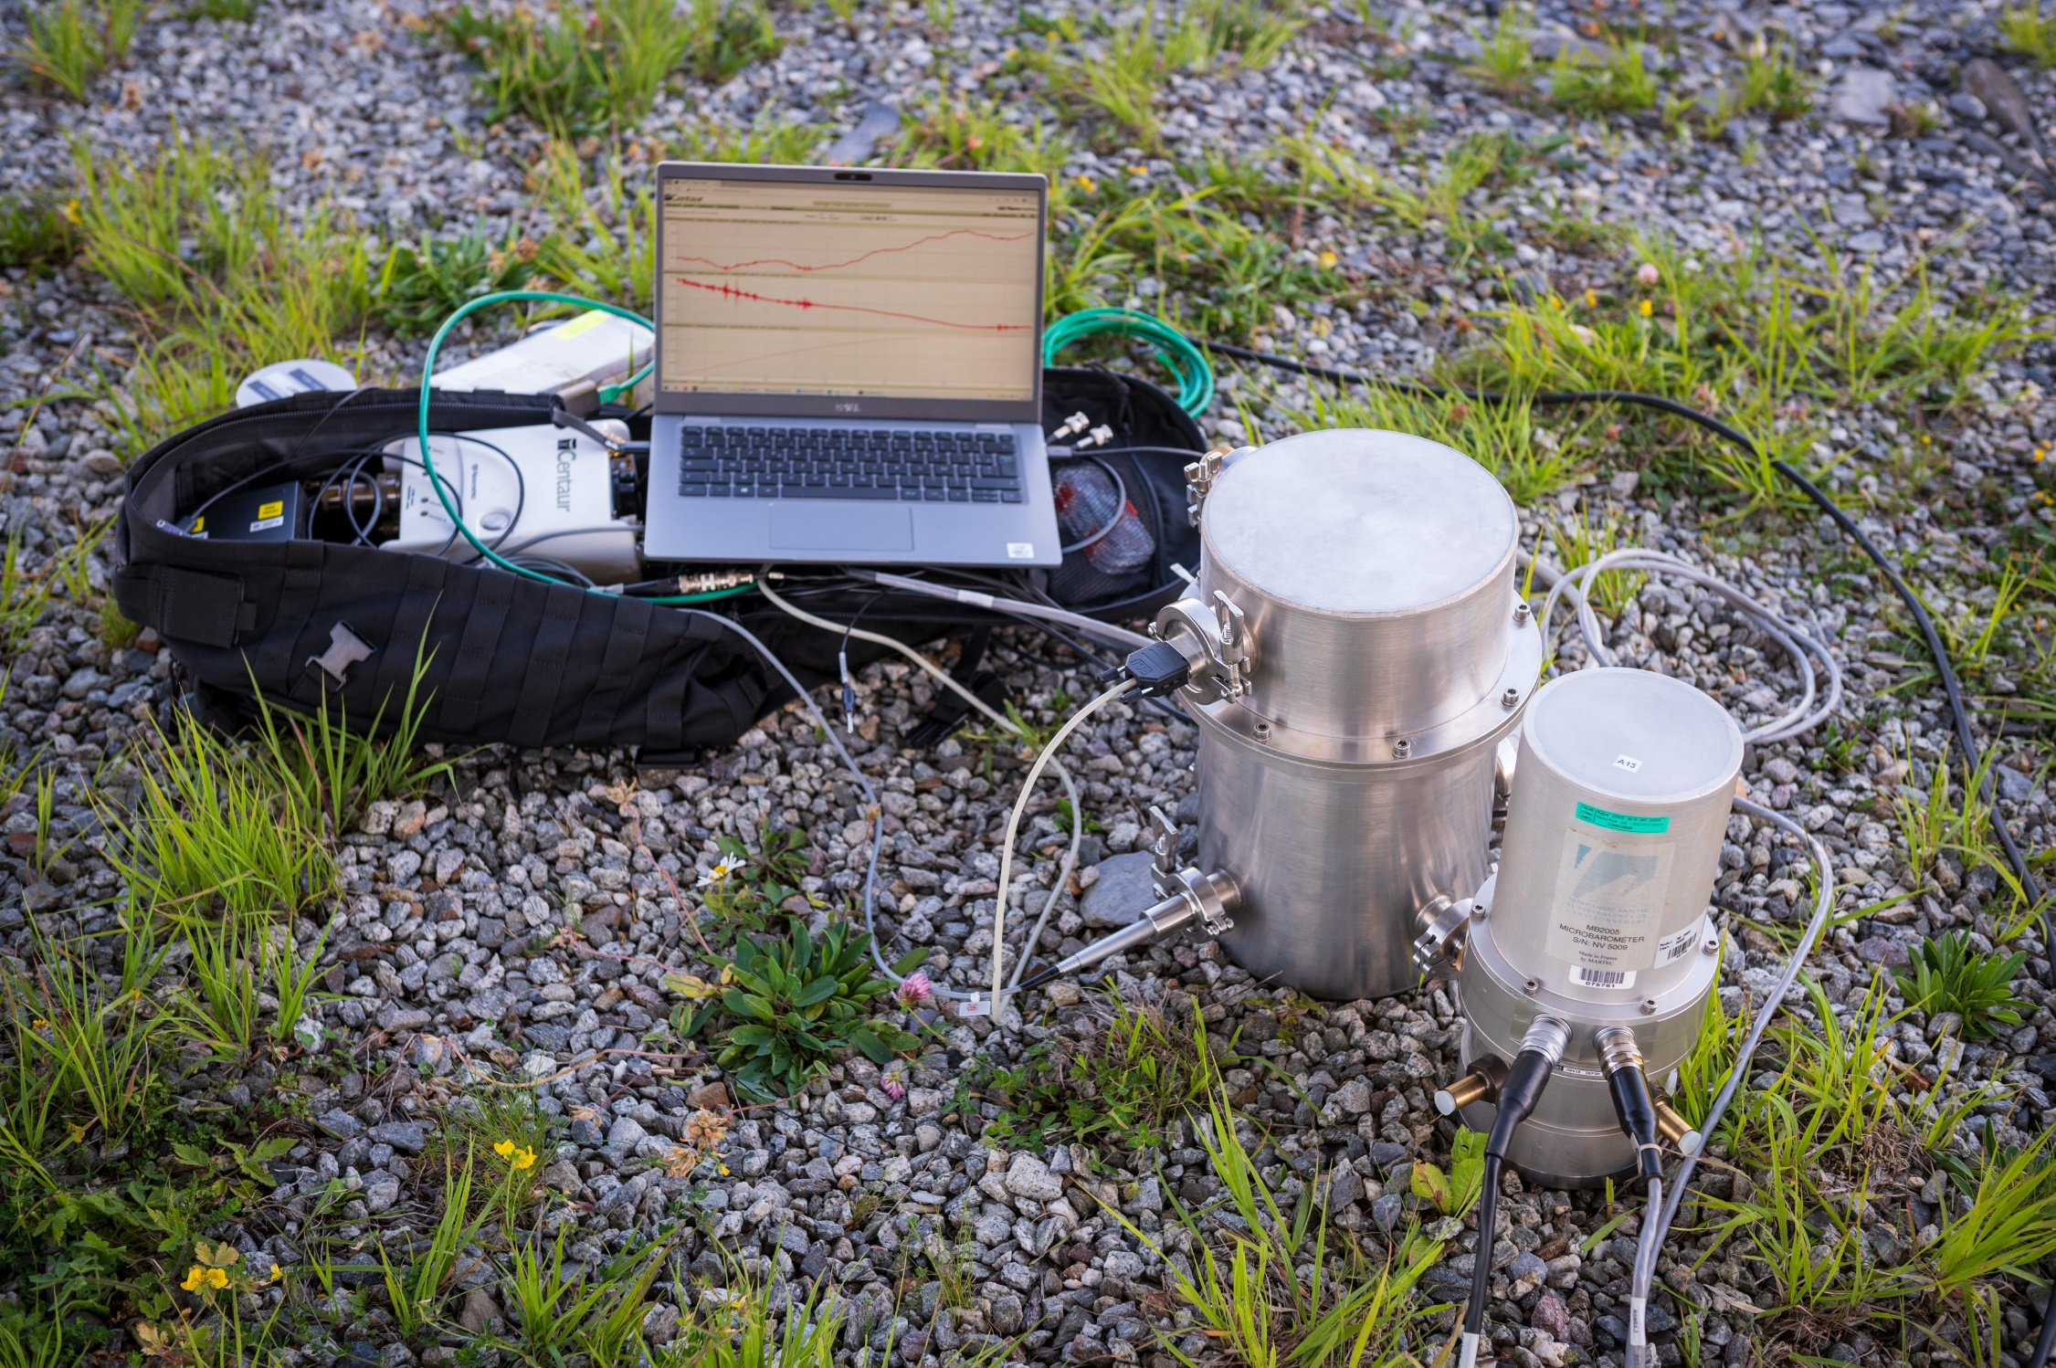

O3.1-761
Exploring the Potential of a Barometer as a Transfer Standard for Infrasound Calibration
Dominique RODRIGUES, Frédéric BOINEAU
Establishing measurement traceability for IMS infrasound measurements
Need for reliable working/transfer standards
Notes:
Infrasound measurements within the IMS must be traceable to the International System of Units.
Metrological traceability means different needs at different levels.
On the top, the primary reference standards, usually established by National Metrology Institutes.
At lower levels, accredited or expert labs need working standards to perform secondary calibrations by comparion — either in the laborator, here 2 examples at Sandia & CEA, or sometimes in the field.
In this example here, the CEA has developed a portable calibration system, which requires a reliable traveling standard for on field calibrations, performed by comparison.
This study fits directly into that need: finding an appropriate working standards for this purpose.

Slide 4
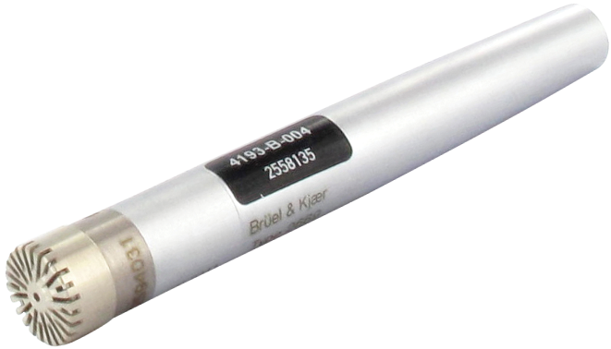
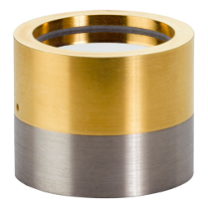
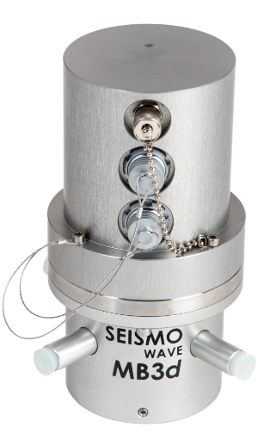
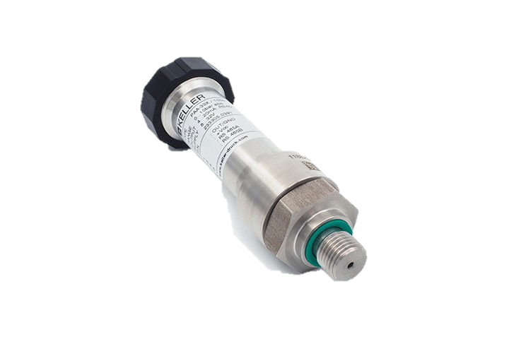
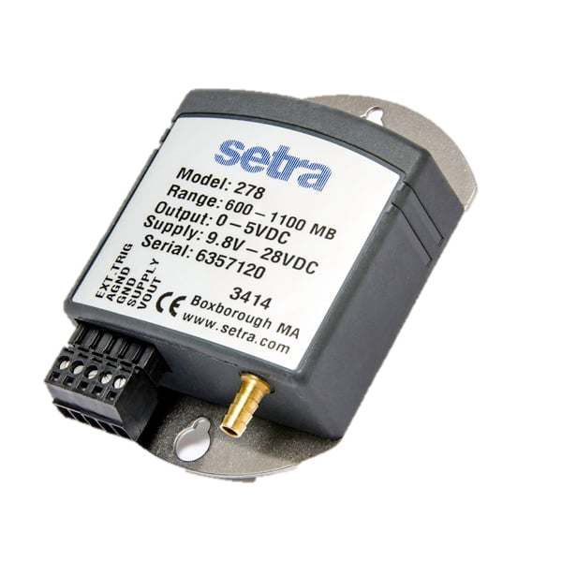
O3.1-761
Exploring the Potential of a Barometer as a Transfer Standard for Infrasound Calibration
Dominique RODRIGUES, Frédéric BOINEAU
Current Transfer Standards in Acoustics
Microphones:
  ✅ Well-established, robust, easy to deploy, traceable to primary standards
  ❌ Limited below 0.1 Hz
Micro-barometers:
  ✅ Cover low-frequency range, robust, traceable to primary standards
  ❌ Heavy and bulky, difficult to deploy
Barometers:
  ✅ Robust, stable, easy to deploy
  ✅ Can bridge static and dynamic calibration domains
Notes:
What ressources do we have for this purpose?
Traditionally, in Acoustics, microphones serve as transfer standards: they are robust, esay to deploy, but more importantly they are very well-established. We can calibrate them by different ways and they are traceable to primary standards of course. The only issue is that their performance is limited at lower frequencies as their sensitivities decreases significantly.
Micro-barometers present better frequency response over the full infrasound frequency range, but they are heavy and bulky and less practical in the context of in lab calibrations.
Finally, Barometers offer a promising alternative: robust, easy to deploy, but more interesting is they can bridge static and dynamic calibration domains.
This is what I propose to evaluate now.

Slide 5
O3.1-761
Exploring the Potential of a Barometer as a Transfer Standard for Infrasound Calibration
Dominique RODRIGUES, Frédéric BOINEAU
Objectives & Device Under Test
Investigate whether a barometer can serve as an infrasound transfer standard
  Ability to bridge static and dynamic calibration domains
  Compare static vs dynamic calibration methods
The Device Under Test
  Keller PAA33X static pressure sensor
  Piezoresistive technology
  Operating range : 800 – 1200 hPa
    Analog interface ranged to 950–1050 hPa over 0–10 V output
    Nominal sensitivity: -60 dB ref. 1V/Pa
  Expected flat response up to ~20 Hz
Notes:
The basic idea is to explore how a barometer, with its ability to bridge static and dynamic calibration domains, can be used as a dual-calibration device to establish a reliable transfer standard
The device we tested is a Keller PAA33X.
It uses piezoresistive technology, with the following operating range.
Interesting option is that the analog interface can be ranged to a smaller operating range. Here, +- 50 hPa around 1000 hPa.
The aim of this operation being to increase its sensitivity to -60 dB. But do not change anything on the sensitive transducer, it is only a gain on the analog interface.
Other argument is that the frequency response is expected to be flat up to around 20 Hz.
This is a very important specification in the context of this study, I will come back on this point.

Slide 6
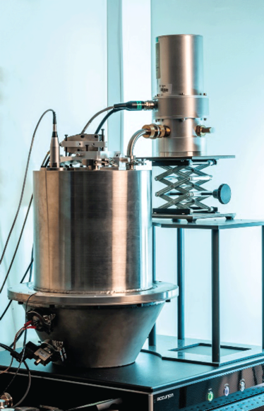
O3.1-761
Exploring the Potential of a Barometer as a Transfer Standard for Infrasound Calibration
Dominique RODRIGUES, Frédéric BOINEAU
Calibration Methods Overview
Two calibration paths (same sensor):
  Static pressure calibration – reference barometer & buffer volume
  Dynamic calibration – laser pistonphone
Two LNE laboratories involved:
  Static Pressure Lab
  Acoustics & Vibration Lab
Comparison basis:
  Cross-compare static vs dynamic results under the same pressure range (100000 ± 20 Pa).
Notes:
Here a basic description of the calibration methods.
The static calibration was performed by my colleagues, from the Primary Static Pressure Lab at LNE. It’s a method by comparison against a reference barometer and by using a buffer volume to stabilize the steps of static pressure.
The dynamic calibration was performed in my lab, the Acoustic & Vibration lab, by using a laser pistonphone, which was developed during the INFRA-AUV project.
A key point to note is that typical infrasound pressure amplitudes only reach a few pascals (about 10–20 Pa), which is very small compared with the full operating range of a barometer. To provide an accurate comparison basis, we asked the static pressure laboratory to calibrate the sensor over a similar range to that used in the laser pistonphone, namely ±20 Pa around atmospheric pressure.

Slide 7


O3.1-761
Exploring the Potential of a Barometer as a Transfer Standard for Infrasound Calibration
Dominique RODRIGUES, Frédéric BOINEAU
Static Pressure Calibration – Results
Calibration cycle (2 Pa steps)
  Simulates a sinusoidal pattern in DC
  Sequence: 100000 → 100020 → 99980 → 100000 Pa
Linear regression results:
  Sensitivity $M_{p}$: -60.034 dB re 1V/Pa
  Expanded uncertainty (k=2): 0.056 dB
Slope = sensitivity $M_{p}$
Deviation of the measured pressure from the expected pressure
Notes:
Here, the results of the static pressure calibration.
The calibration cycle was performed with a 2 Pa steps.
The sequence starts at 1000 hPa, increase up to + 20 Pa, decrease of 40 Pa, and come back to the initial static pressure..
This simulates a sinusoidal pattern, here in DC.
Then, the linear regression model lead to a sensitivity of -60,034 dB,
The expanded uncertainty is estimated to 0.056 dB.
This first result provide a reference point for the comparison.
I would like to present an additional information, of interest, here the measurement bias of the sensor that we can define as the deviation of the measured pressure from the expected or reference pressure. Presented here in dB as function of the reference pressure.
When following the calibration paths, this figure seems to indicate a possible hysteresis effect. However, at this stage it is not possible to conclude whether this effect comes from the sensor itself or from the calibration method.

Slide 8
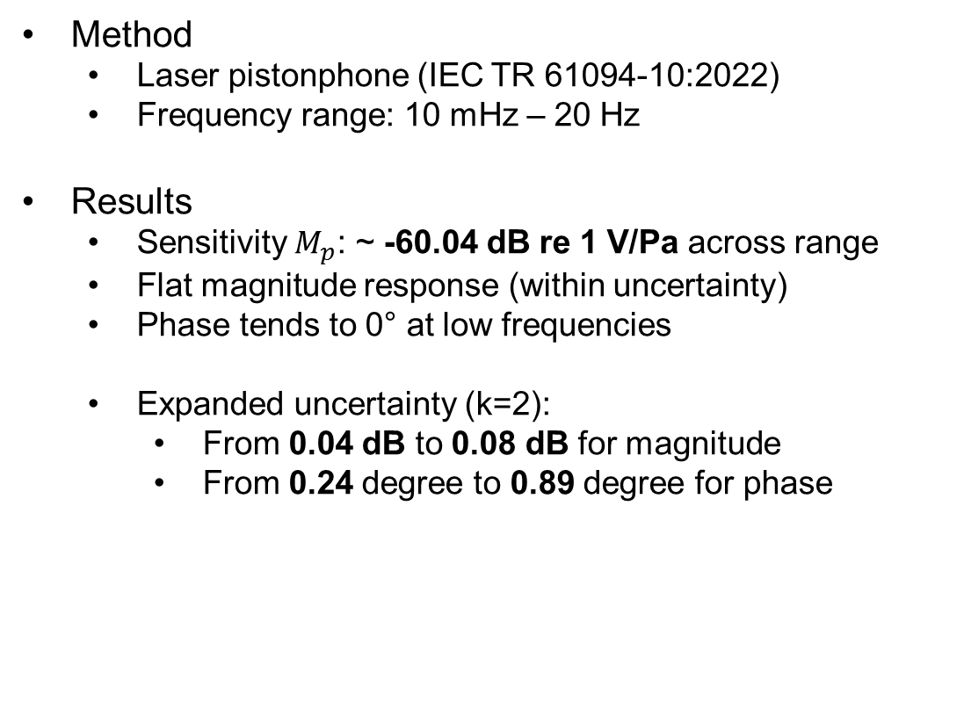
O3.1-761
Exploring the Potential of a Barometer as a Transfer Standard for Infrasound Calibration
Dominique RODRIGUES, Frédéric BOINEAU
Dynamic Calibration – Results
Method
  Laser pistonphone (IEC TR 61094-10:2022)
  Frequency range: 10 mHz – 20 Hz
Results
  Sensitivity $M_{p}$: ~ -60.04 dB re 1 V/Pa across range
  Flat magnitude response (within uncertainty)
  Phase tends to 0° at low frequencies
  Expanded uncertainty (k=2):
    From 0.04 dB to 0.08 dB for magnitude
    From 0.24 degree to 0.89 degree for phase
Notes:
Here, the results for the dynamic calibration.
The calibration was performed using the LNE’s laser pistonphone, in the frequency range 10 millihertz up to 20 Hz.
Are presented here the sensitivity results, as function of frequency in magnitude and phase.
As expected, the sensor sensitivity remains relatively flat, close to the average value of –60.04 dB for the magnitude.
The phase tends towards 0 degrees at low frequencies, as expected too.
Here the expanded uncertainties for this dynamic calibration. Typically, larger uncertainties are obtained at lower frequencies.
These results provide a second reference for the comparison.

Slide 9
O3.1-761
Exploring the Potential of a Barometer as a Transfer Standard for Infrasound Calibration
Dominique RODRIGUES, Frédéric BOINEAU
Comparison of Static vs Dynamic Results
Results
Sensitivities are in agreement within uncertainties
Normalized error E_{n}​: all values ≤ 1
Confirms good consistency between methods
Method | Sensitivity dB re 1 V/Pa | Expanded uncertainty in dB (k=2)
Static | –60.034 | 0.056 dB
Dynamic | ~ –60.04 | 0.04–0.08 dB
Notes:
This slide shows the comparison between the 2 methods.
As a reminder, here the result for the static method, and here the average value for the dynamic method.
The sensitivities are in good agreement within their respective uncertainties.
To check this more formally, we look at the normalized error. It is a usual performance criteria for bilateral comparison, the satisfactory range being that normalized error must be below unity to confirm consistency between the results.
In this graph, are presented the normalized error, as function of frequency: Considering the individual frequency results for the dynamic method and the single result for the static method.
Here, all values satisfy the satisfactory range to conclude on consistency of results, reinforcing the idea that such barometer can effectively bridge both calibration domains.

Slide 10
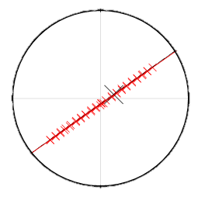

O3.1-761
Exploring the Potential of a Barometer as a Transfer Standard for Infrasound Calibration
Dominique RODRIGUES, Frédéric BOINEAU
Discussion - Limits of Static Calibration
Challenge: 2 Pa steps calibration over ~40 Pa range are difficult to achieve.
Classical approach: barometers are usually calibrated over their full range.
Extended range calibration (950 hPa – 1050 hPa):
  Sensitivity $M_{p}$​: –59.998 dB re 1 V/Pa
  Expanded uncertainty (k=2): 0.028 dB
Results seems to be consistent.
Risk: extended static calibration may underestimate uncertainty and give biased results → not fully representative of the real infrasound operating range (some tens of Pa).
-59.998 ± 0.028
-60.034 ± 0.056
-60.04 ± 0.04
Notes:
Before concluding, I would like to raise an important discussion regarding limits on static calibration.
First, it’s important to note that calibrating a barometer with steps of 2 Pa over a range of only 40 Pa is technically very challenging, so this is not an usual calibration service.
The classical approach is instead to calibrate barometers over their full operating range.
We did it for the same barometer
The results are presented here, the DC output as function of the reference static pressure, the black point.
Leading to a sensitivity of the sensor of -59,998 dB, so slightly different that the one presented previously, obtained in the specific infrasound operating range, here in red points.
Here the values seems to be consistent within the uncertainties, but I believe it’s important to keep in mind that here the sensitivity is obtained from incomplete information from the range of interest.
Just to be cautious, this could lead to biased sensitivies and/or undersestimated uncertainty.

Slide 11
O3.1-761
Exploring the Potential of a Barometer as a Transfer Standard for Infrasound Calibration
Dominique RODRIGUES, Frédéric BOINEAU
Conclusions & Perspectives
Key requirement: define a transfer standard covering DC–20 Hz
Microphones: reliable and traceable for frequencies above 0.1 Hz
Barometers: promising for very low frequencies / near DC
  Unique dual calibration paths
    Static → accurate results near DC / very low frequencies.
    Dynamic → essential at higher frequencies, when response may deviate from flat, and provides phase.
  Complementary methods → combining both = more robust calibration
Next step: extend study to other barometer models to strengthen consistency and robustness
Notes:
Let me now conclude this presentation.
The key requirement is to obtain a reliable transfer standard covering the full infrasound frequency band.
As said in the introduction, Microphones already play this role very well for frequencies above 0.1 Hz. They are reliable and traceable, and there is no debate on their performance in that range.
For the lower frequencies, close to DC, barometers appear as promising candidates.
One clear advantage is that they offer two independent calibration paths: static and dynamic.
The static method provides accurate results near DC and very low frequencies.
The dynamic method becomes essential as the frequency increases, especially when the response deviates from flat, and it also provides phase information.
And I believe that by combining these complementary methods, barometers could ensure a more robust and reliable calibration across the whole infrasound range.
Important to note that it should be interesting to extend this study to other barometer models, in order to strengthen consistency and confirm robustness.

