Slide 1

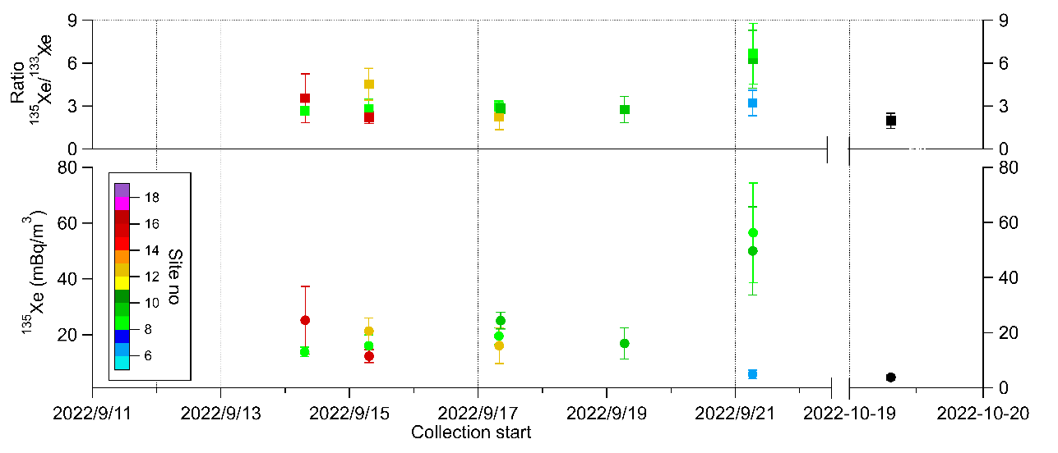
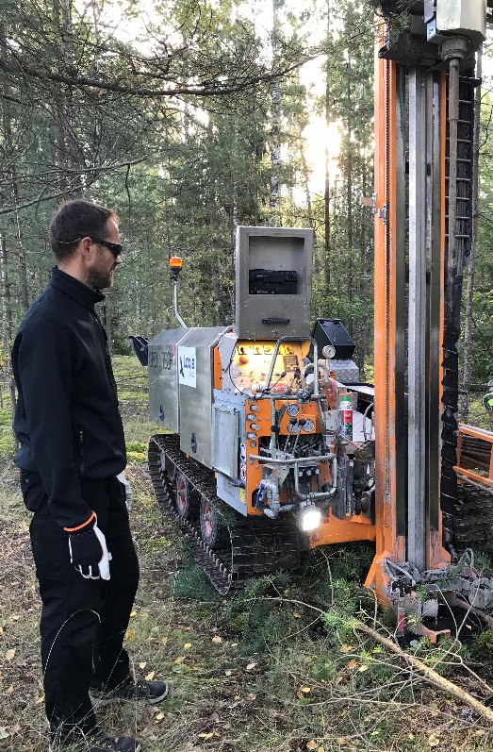
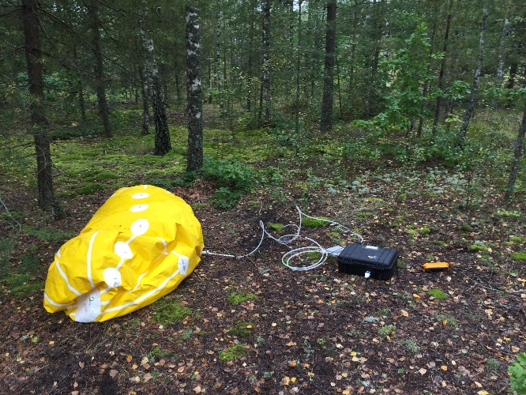
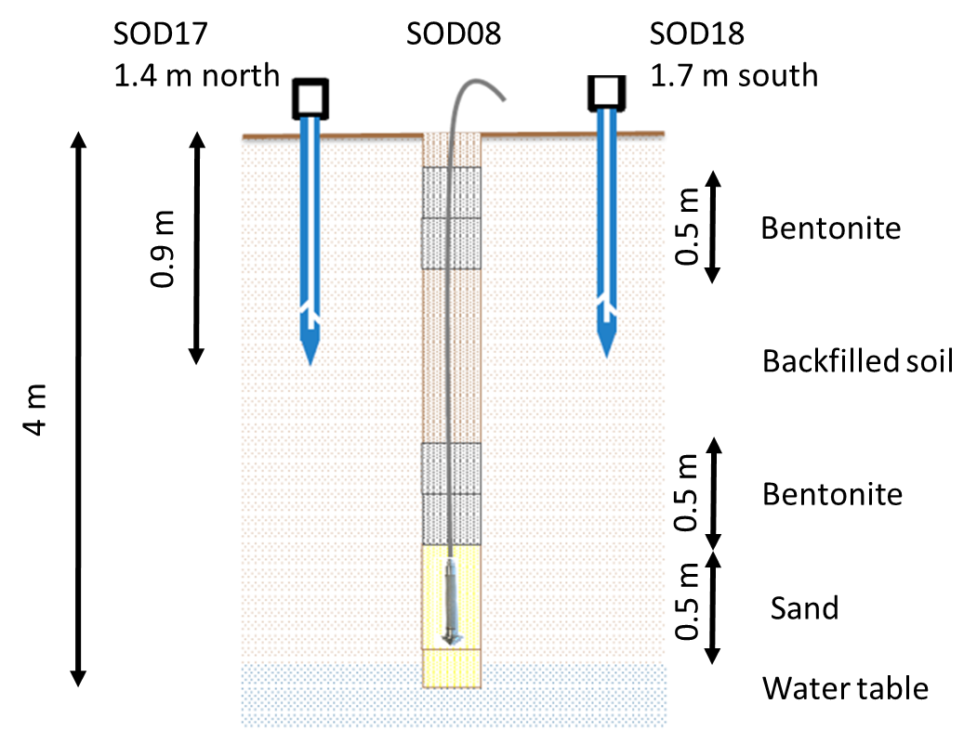
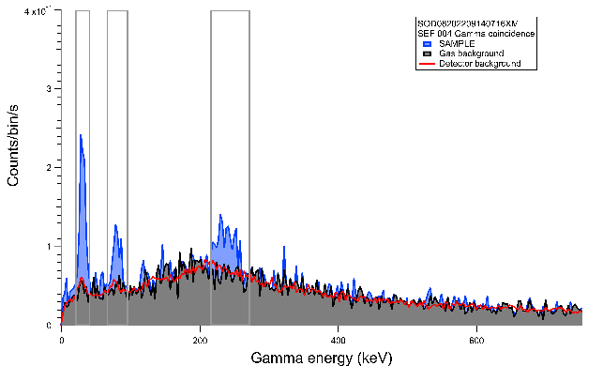
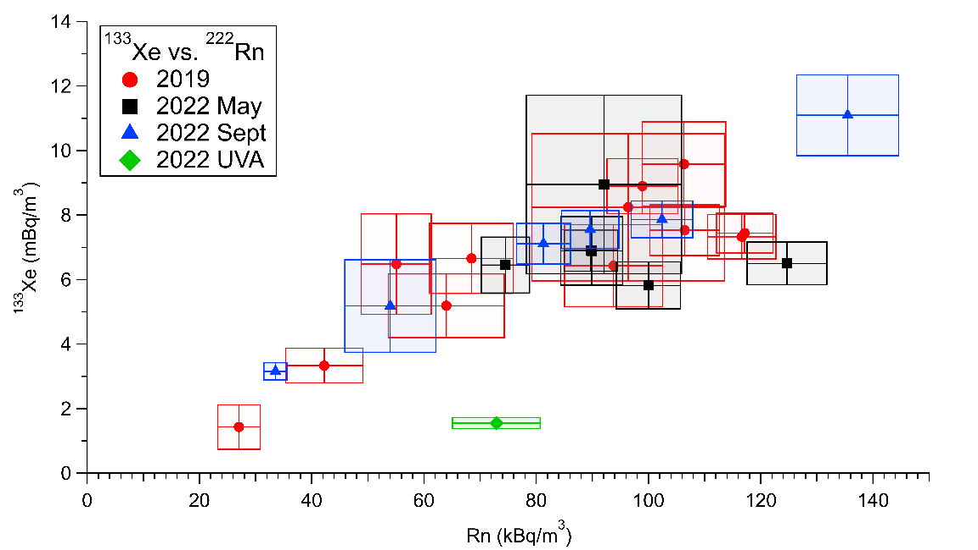
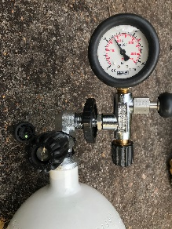
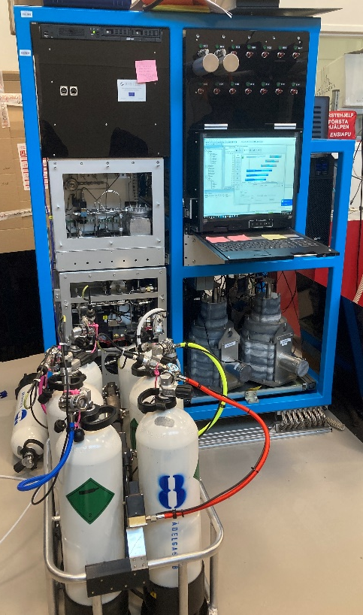
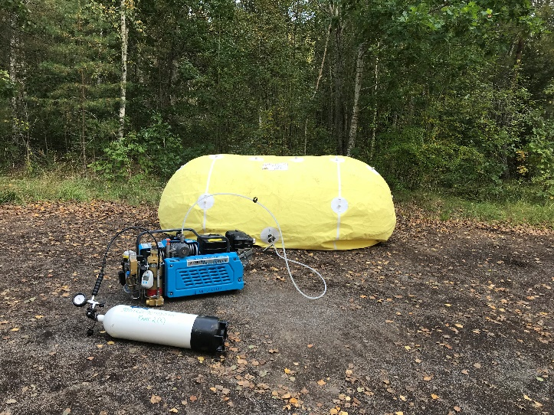

P2.3-638
Detections of the short-lived ¹³⁵Xe in the natural background of xenon isotopes in the soil
Mattias Aldener, Klas Elmgren, Tomas Fritioff, Henrik Olsson and Catharina Söderström
FOI, Swedish Defence Research Agency
Measurements of the natural background of xenon in soil
Learn about methods for noble gas sampling from the ground
See how we could collect large samples without infiltration
Improved logistics to be able to measure short lived isotopes
Results for ¹³³Xe and ¹³⁵Xe – can we model this?

