Slide 1


P2.3-638
Detections of the short-lived ¹³⁵Xe in the natural background of xenon isotopes in the soil
Mattias Aldener, Klas Elmgren, Tomas Fritioff, Henrik Olsson and Catharina Söderström
FOI, Swedish Defence Research Agency
The natural background of xenon radioisotopes in the ground is required to be able to distinguish it from any signals due to a underground nuclear explosion during an on site inspection(OSI).
The natural background of ¹³³Xe from spontaneous fission of U in soil has been studied in Sweden. The method and logistics improved resulting in the detection of the short-lived ¹³⁵Xe (t1/2=9 h) and ¹³³Xe.
Notes:
Detections of the short-lived ¹³⁵Xe in the natural background of xenon isotopes in the soil
Mattias Aldener, Klas Elmgren, Tomas Fritioff, Henrik Olsson, Catharina Söderström.
The knowledge of the natural background of xenon radioisotopes in the ground is required to be able to distinguish it from any signals due to a potential underground nuclear explosion, as would be the case during an on site inspection(OSI). The natural background of xenon isotopes from spontaneous fission in the soil has been studied during several measurement campaigns in Sweden. In most of these samples ¹³³Xe is detected. The method and logistics were improved during the latest campaign resulting in that also the short-lived isotope ¹³⁵Xe could be detected in multiple samples simultaneously with ¹³³Xe. This gives the potential to calculate the activity ratios, an important tool to distinguish between different sources. This is the first time, to our knowledge, that ¹³⁵Xe has been detected in the natural background in the soil. The method and results will be presented and compared with model predictions as well as a potential impact on noble gas collection and analysis in an OSI.
Intro 2023
The radioactive xenon isotopes ^{131m}Xe, ¹³³Xe ^{133m}Xe and ¹³⁵Xe are important indicators for an underground nuclear explosion. Knowledge about the concentrations and ratios of these isotopes that can be expected due to natural processes is important to be able to discriminate from a nuclear explosion during a CTBT on-site inspection. A series of measurements has been performed 2019 and 2022 under different weather conditions within a limited area in the region of Kvarntorp (Sweden), a location with known elevated uranium content in the ground. We have earlier published studies where samples were collected in the same area but in a wider region, 2016 and 2017.
These studies aim to understand the variation, due to e.g. meteorological conditions and radon concentrations, and try to set an upper limit on expected natural concentrations of the xenon isotopes in soil gas.

Slide 2
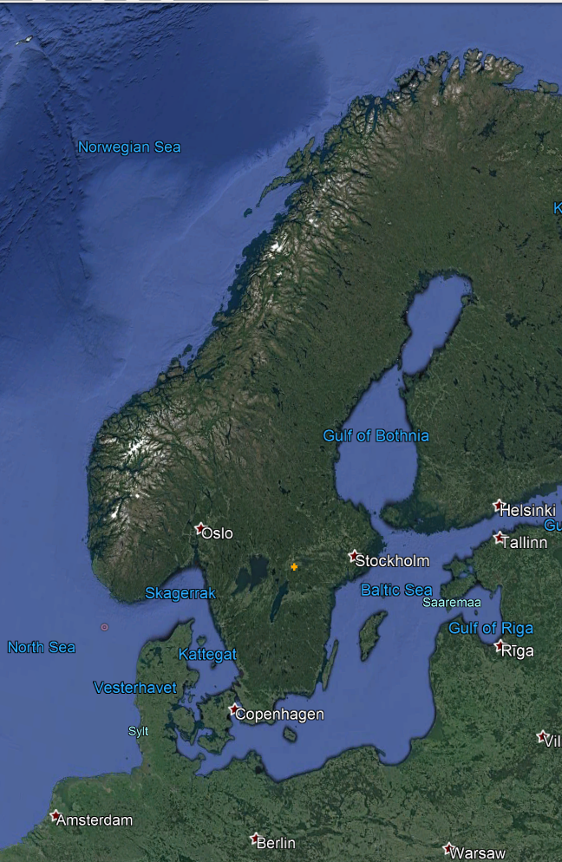
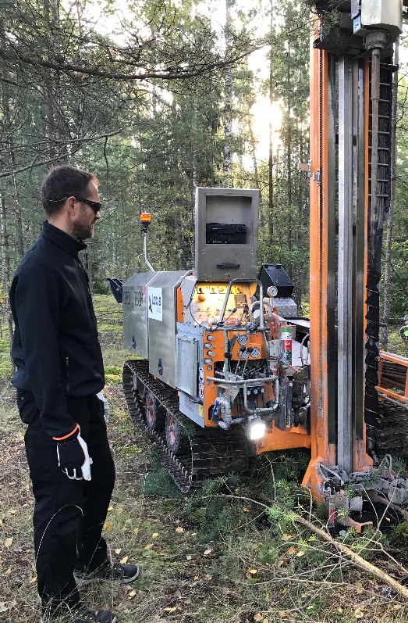
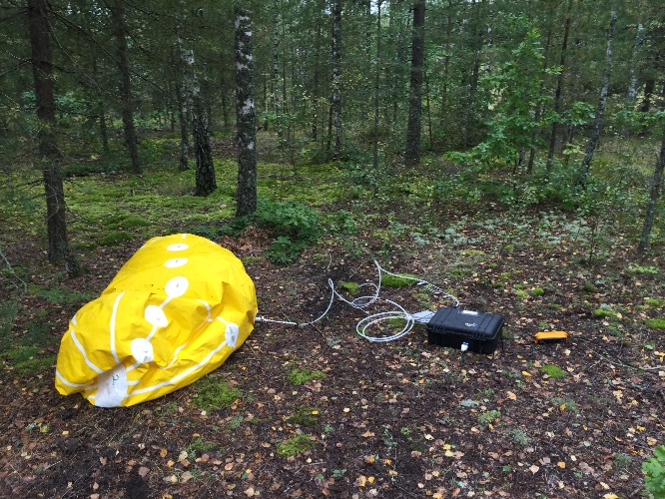
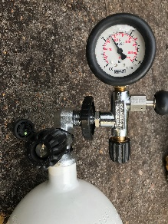
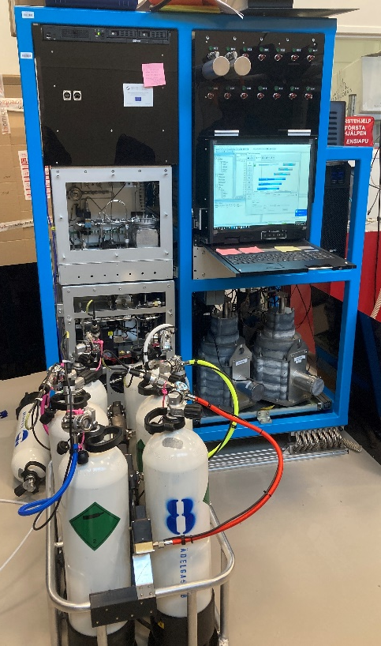
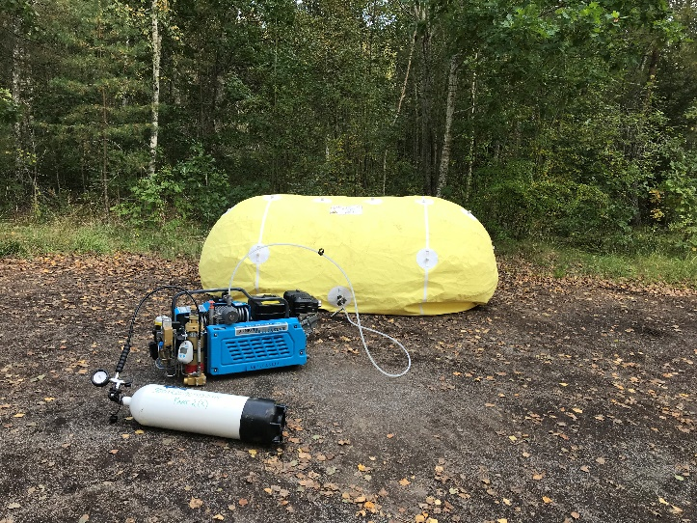
PLEASE DON‘T FORGET TO PUT THE E-POSTER TITLE AND YOUR NAME IN THE PRESENTATION HEADER.
DUPLICATE THIS SLIDE IF YOUR E-POSTER HAS MORE THAN 1 PAGE
Detections of the short-lived ¹³⁵Xe in the natural background of xenon isotopes in the soil
Mattias Aldener, Klas Elmgren, Tomas Fritioff, Henrik Olsson and Catharina Söderström
P2.3-638
Objectives
Measurement strategy
Location
Study the natural background of radioxenon in soil gas to support discrimination from underground nuclear explosion in an OSI.
Build capacity, test and develop methods and equipment.
Collect data for modelling and better understanding of production and transport mechanisms of gases in the soil.
124 samples of xenon from sub soil collected and analysed in three different campaigns in the same location in Sweden.
The periods were: two weeks in September 2019, one week in May 2022 and one week and September 2022.
Try to observe variations due to varying weather, i.e. any correlation with ambient pressure or soil moisture.
Characterising the gas in the samples by monitoring the pressure and flow as well as CO₂, O₂ and Rn concentrations while collecting the sample.
The sites were characterized by taking soil samples, measuring H₂O content and diffusion coefficients (only 2022). Soil samples evaluated for ²³⁸U and water content.
Xenon samples were collected during day time but at a few sites (in 2022) continuous sampling were performed to check for intrusion of atmospheric air.
All samples were transported (200 km) to the FOI laboratory in Stockholm for analysis.
To increase the sensitivity in 2022 some samples were merged, and processing and shipping optimised. This was especially helpful to detect the shorter lived isotopes.
The location in Sweden was chosen for its high uranium content in the soil, this area has previously been used for oil and uranium mining from oil shale.
We have earlier published studies where samples were collected in the same area but in a wider region, 2016 and 2017.
Measurements of the natural background of radioxenon isotopes in soil gas.
https://doi.org/10.1016/j.jenvrad.2025.107711

Slide 3
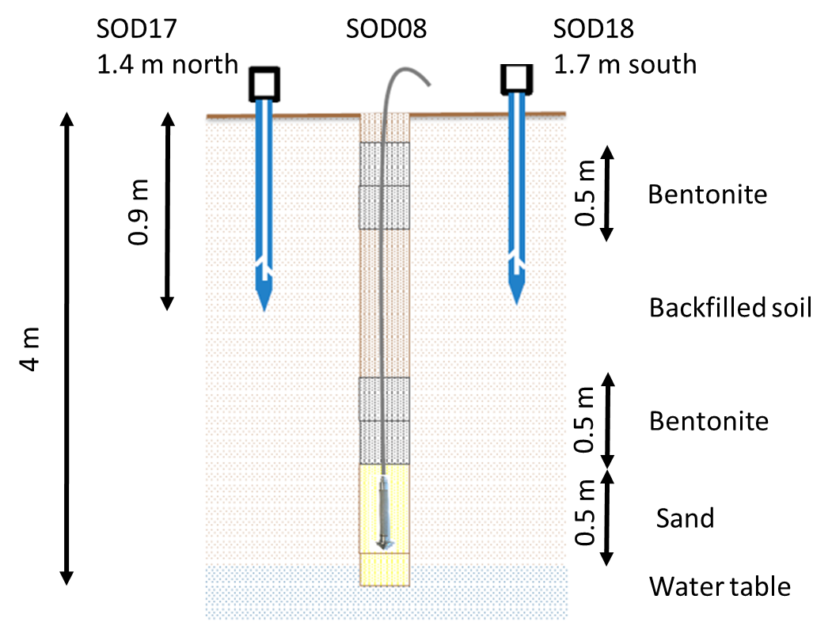
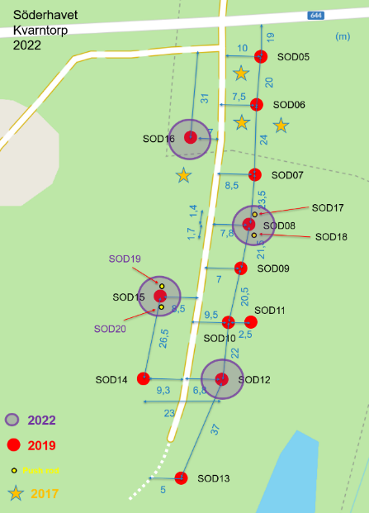
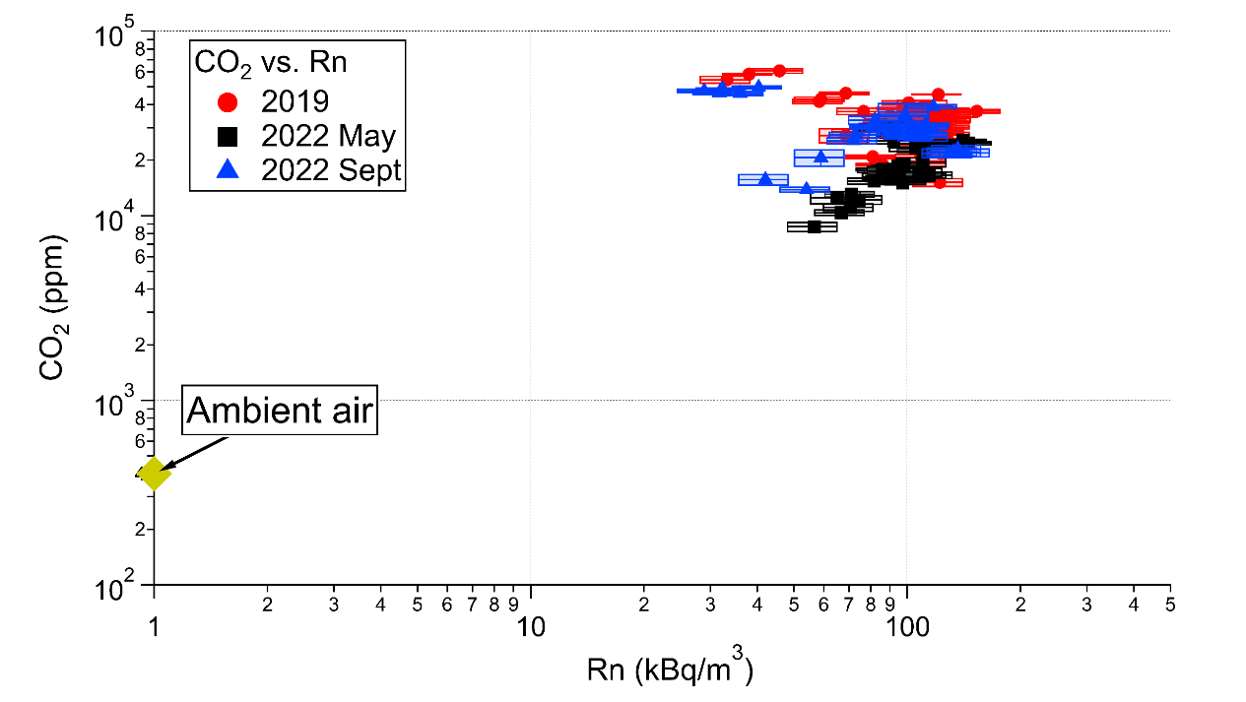
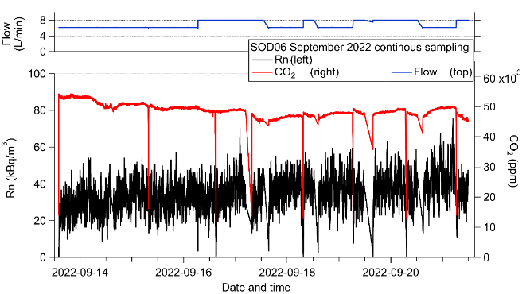
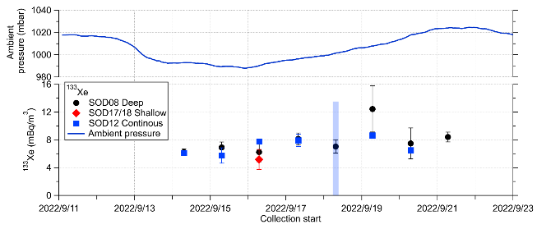
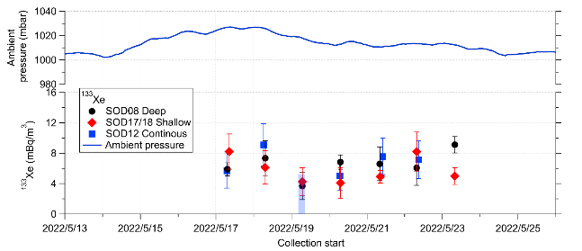
PLEASE DON‘T FORGET TO PUT THE E-POSTER TITLE AND YOUR NAME IN THE PRESENTATION HEADER.
DUPLICATE THIS SLIDE IF YOUR E-POSTER HAS MORE THAN 1 PAGE
Detections of the short-lived ¹³⁵Xe in the natural background of xenon isotopes in the soil
Mattias Aldener, Klas Elmgren, Tomas Fritioff, Henrik Olsson and Catharina Söderström
P2.3-638
Site preparation
Site characterisation
Infiltration and sampling rate
Auger almost down to water table.
Several bentonite plugs to seal towards the atmosphere.
About 3 m sampling depth at most sites.
Two shallow sampling points using push rods to 0.9 m SOD17, 18 and 19 next to SOD08.
Separation between holes ~20 m.
No degradation of installations observed over time
In-house developed automatic samplers.
Sampling to balloon (6-8 LPM) and pressuring sample at the end of the day, about 2 m³ sample size.
Pressurised bottles shipped to FOI for analysis.
Shorter processing time increases the sensitivity.
Soil gas characteristics; elevated radon and CO₂ concentrations in all samples.
Test of sample size limitations when collecting soil gas samples:
Monitor for soil gas components, CO₂ and Rn.
Infiltration test by adding rods on top of hole and comparing xenon results.
Continuous sampling during the full weeks in 2022 performed for two sites, logging CO₂ and Rn and taking xenon samples during the day to check for trends.
Only valid at this site and will likely vary with geology.
No clear trend over time while sampling.
More than 70 m³ collected at each of these sites without signs of significant infiltration by fresh atmospheric air.
An efficient gas barrier by the top soil might explain this at this site. Drops in signals are when samplers are restarted.
Similar ¹³³Xe concentration in shallow sampling points (rods) as in the holes. No trend over time, even when performing continuous sampling nor when sampling above the deeper sites.
Measurements of the natural background of radioxenon isotopes in soil gas.
https://doi.org/10.1016/j.jenvrad.2025.107711

Slide 4
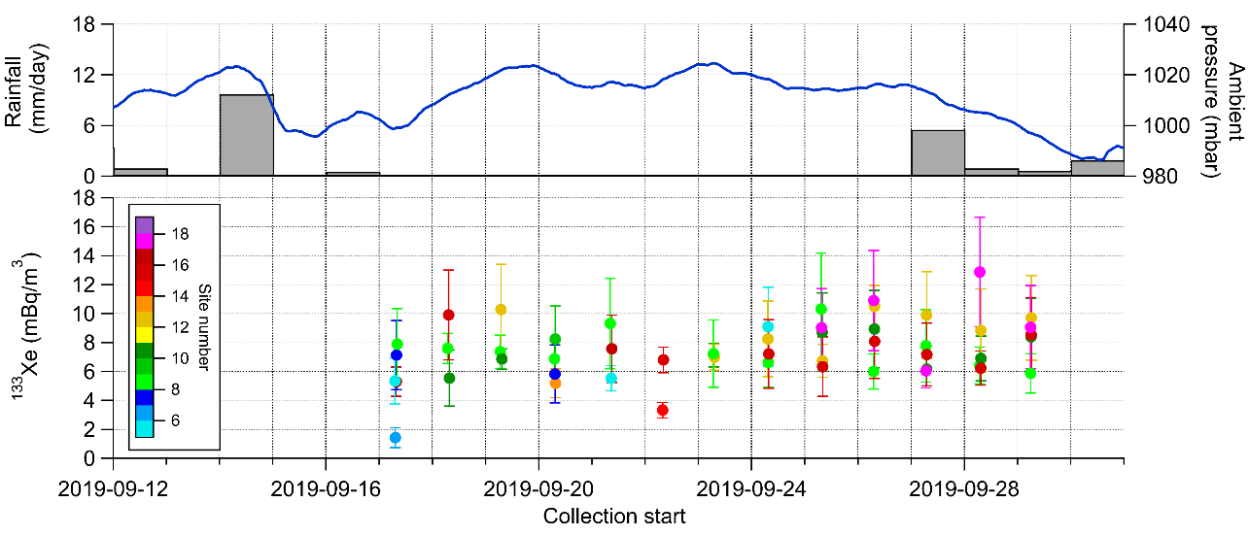
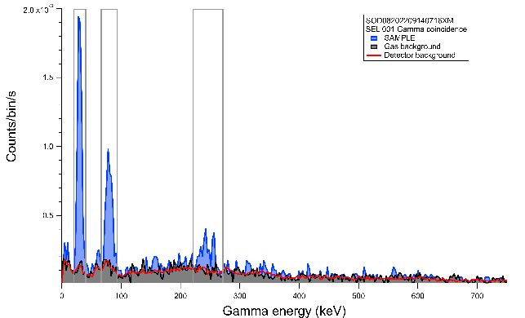
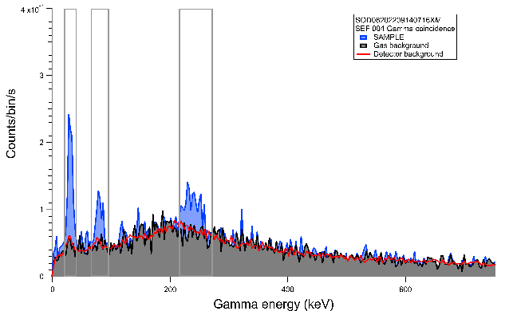
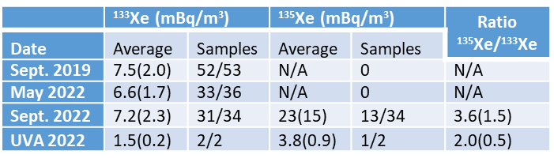
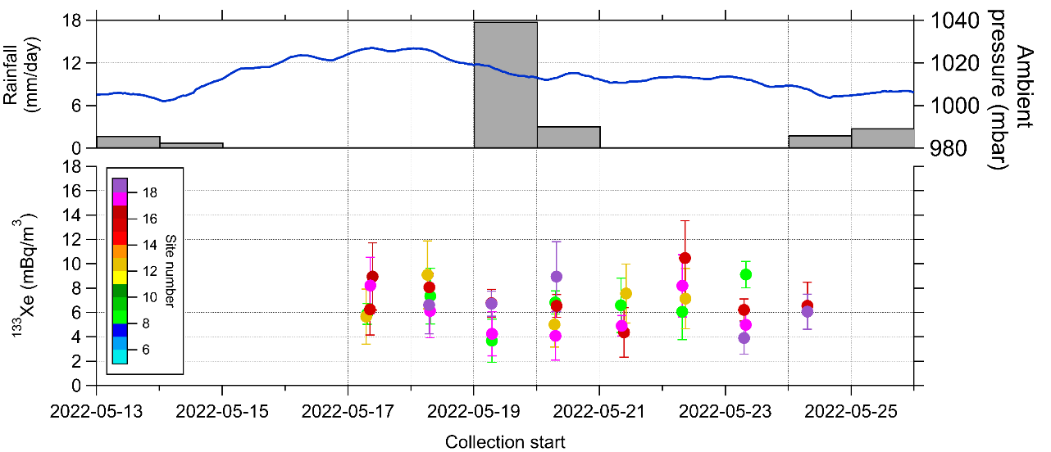
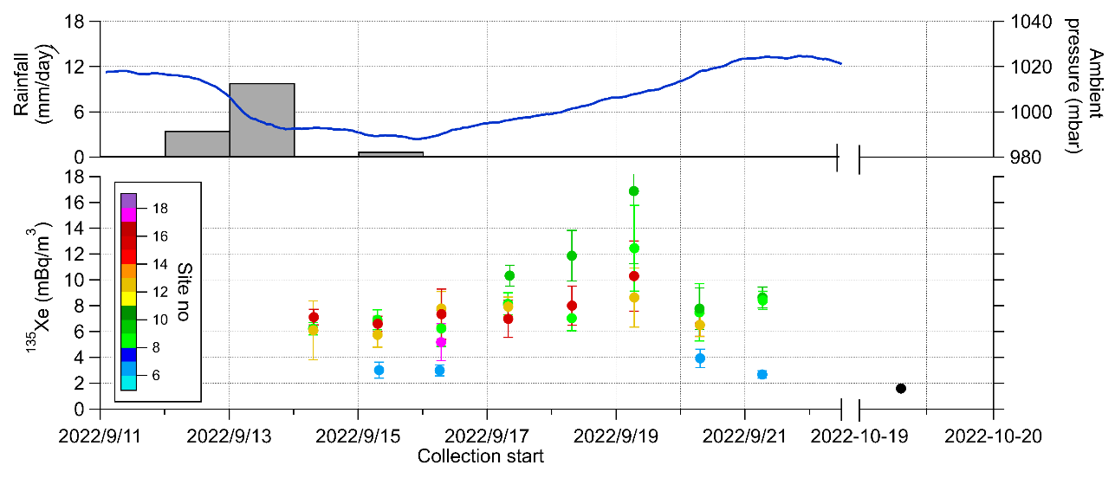
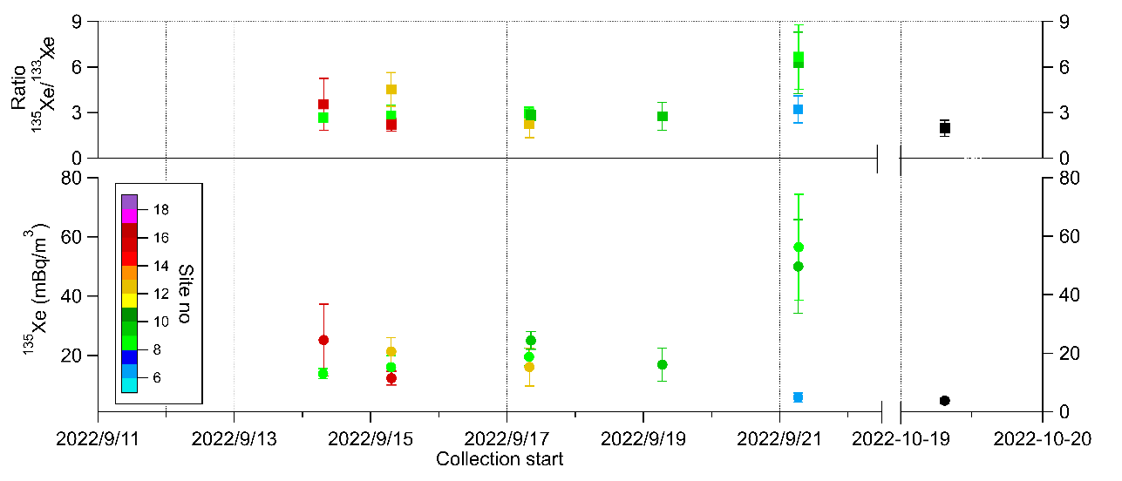
PLEASE DON‘T FORGET TO PUT THE E-POSTER TITLE AND YOUR NAME IN THE PRESENTATION HEADER.
DUPLICATE THIS SLIDE IF YOUR E-POSTER HAS MORE THAN 1 PAGE
Detections of the short-lived ¹³⁵Xe in the natural background of xenon isotopes in the soil
Mattias Aldener, Klas Elmgren, Tomas Fritioff, Henrik Olsson and Catharina Söderström
P2.3-638
¹³³Xe time series
¹³⁵Xe detections ¹³⁵Xe/¹³³Xe ratio
Concentrations and ratios
¹³³Xe were detected in almost all of the samples.
No obvious correlation with ambient pressure observed.
Similar levels of ¹³³Xe detected on all three campaigns.
Site with relatively high levels of uranium ( ~150 ppm).
SOD17, 18 and 19 shallow sites (push rods, 70cm).
Logistics improved to detect shorter lived isotopes.
¹³⁵Xe detected in multiple samples.
Scaling the theoretical calculations made by Hebel to a ²³⁸U concentration of 150 ppm and averaging over several common soil types, gives ¹³³Xe concentrations in soil gas of about 100 mBq/m³,well above what is detected.
The modelled and measured values would agree if other parameters for the soil are used, e.g. using an emanation factor of 0.1 and porosity of 0.5. Reasonable values for this type of soil.
The ratio ¹³⁵Xe/¹³³Xe is higher than theoretical values.
Hebel, Simon. 2010. “Genesis and Equilibrium of Natural Lithospheric Radioxenon and its Influence on Subsurface Noble Gas Samples for CTBT On-Site Inspections.” Pure and Applied Geophysics 167: 463-470

Slide 5
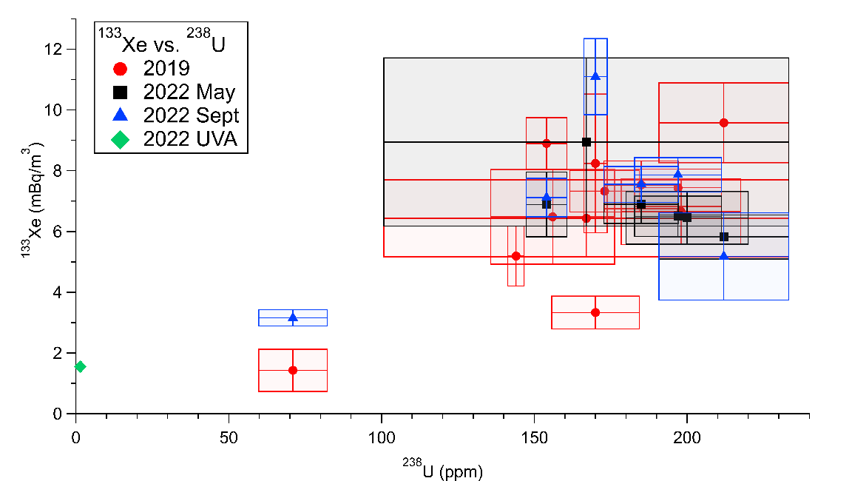
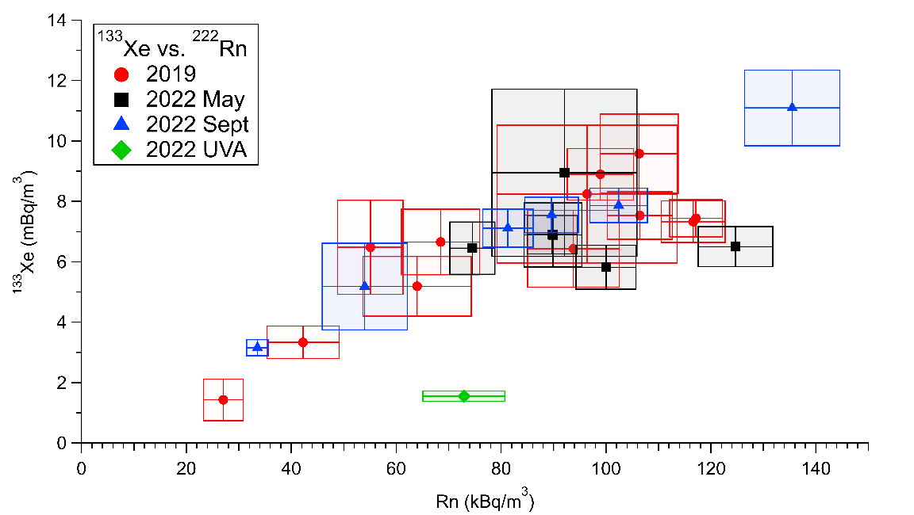
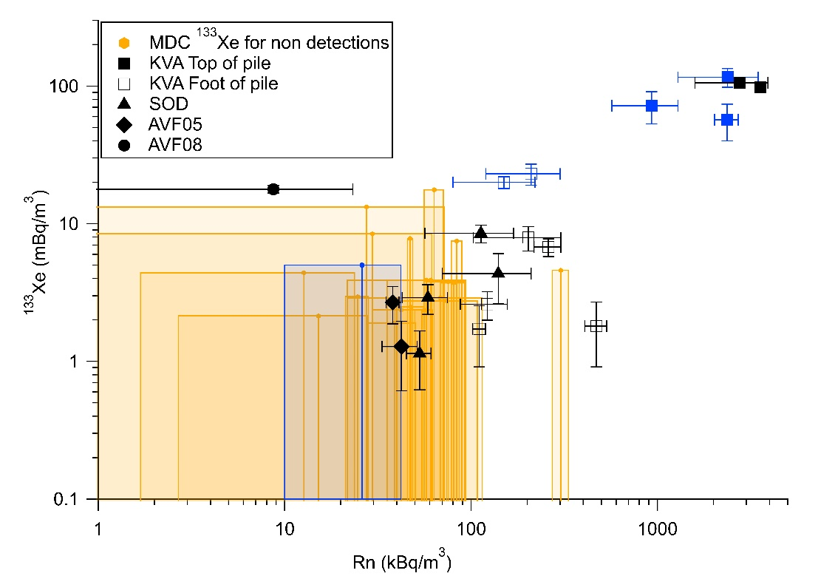
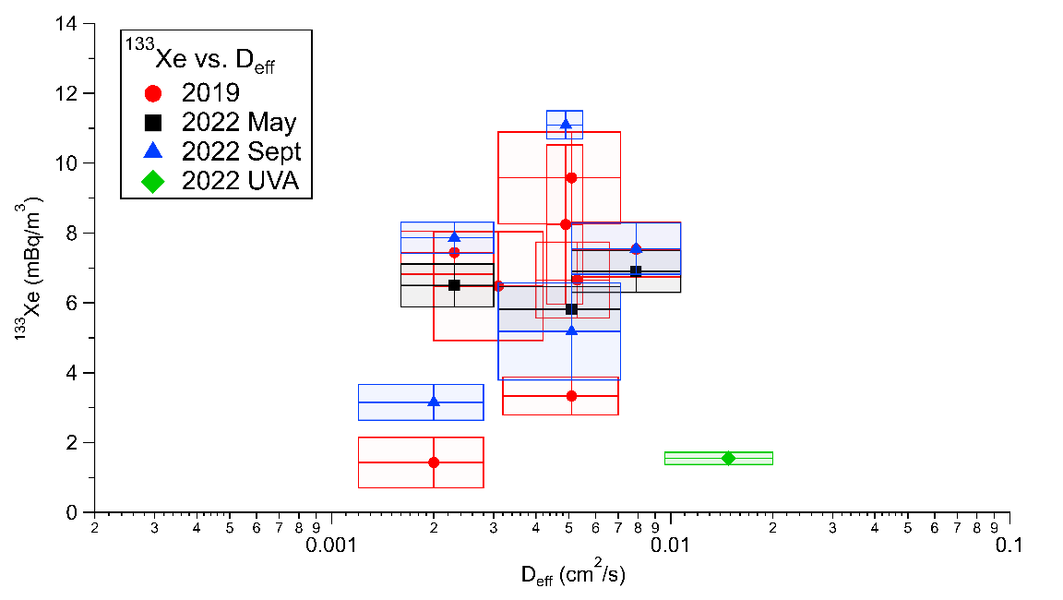
PLEASE DON‘T FORGET TO PUT THE E-POSTER TITLE AND YOUR NAME IN THE PRESENTATION HEADER.
DUPLICATE THIS SLIDE IF YOUR E-POSTER HAS MORE THAN 1 PAGE
Detections of the short-lived ¹³⁵Xe in the natural background of xenon isotopes in the soil
Mattias Aldener, Klas Elmgren, Tomas Fritioff, Henrik Olsson and Catharina Söderström
P2.3-638
Measured ¹³³Xe vs ²²²Rn and ²³⁸U
¹³⁵Xe detections ¹³⁵Xe/¹³³Xe ratio
Conclusion and outlook
All ¹³³Xe data, averaged per site and campaign, shown vs ²²²Rn, ²³⁸U. ¹³³Xe data is also shown vs the measured diffusion constants, D^{eff}.
Larger dynamic range needed to better observe potential correlations.
To check this two extra data points were collected in the vicinity of Stockholm, in a different geology with sandy moraine. Labeled UVA (green) in plots. Larger samples were collected, up to 7 m³ , by using several samplers and pushrods nearby each others.
Lower ¹³³Xe and ²³⁸U was measured, but the ²²²Rn concentration was similar to Kvarntorp.
¹³³Xe detected in most of the 124 soil samples collected.
¹³⁵Xe detected in several samples when logistics was improved.
^{131m}Xe or ^{133m}Xe was not detected, this agrees with the lower production yields.
Large sample volumes can be collected in this type of soil without impairing the quality of the sample.
More measurements in other geology needed to find correlations for modelling.
Estimate of natural background of ¹³³Xe and ¹³⁵Xe in areas with high levels of ²³⁸U, could serve as a discrimination limit during an OSI.
Measurements of the natural background of radioxenon isotopes in soil gas.
https://doi.org/10.1016/j.jenvrad.2025.107711
Notes:
Ta bort diffusion helt? Eller ha med som diskussion?
All text från 2023

