Slide 1

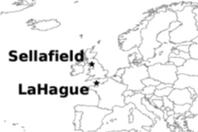
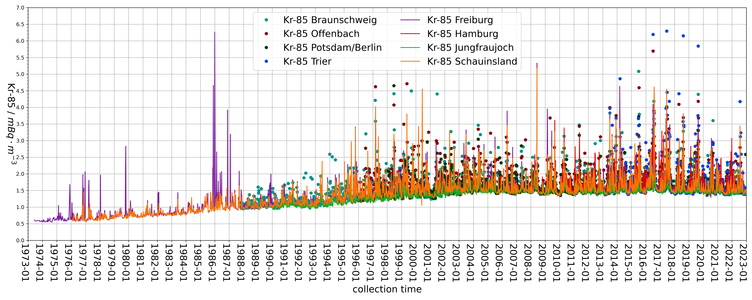
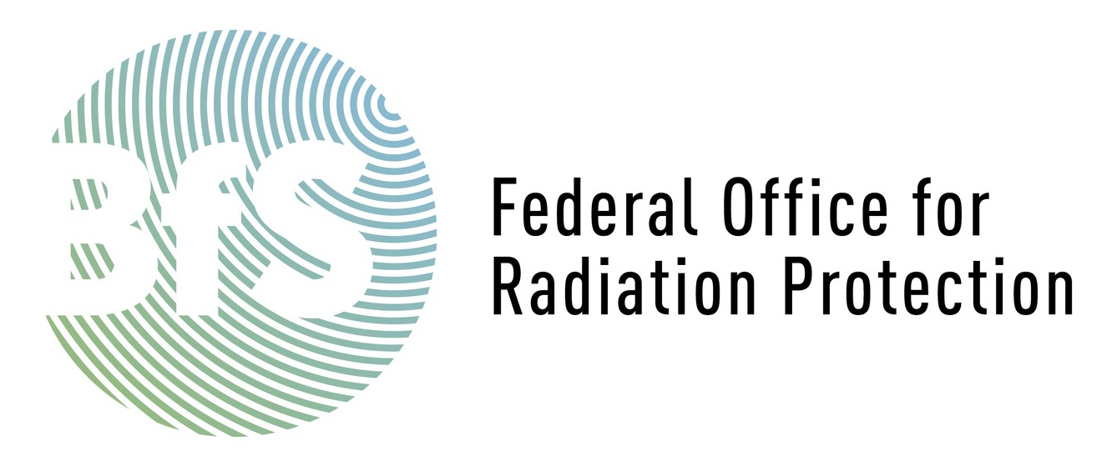
T3.6-700
20 years of Krypton-85 measurements revisited
Sofia Brander*, J. Ole Ross**, Andreas Bollhöfer*, Martina Konrad*, Sabine Schmid*
* Federal Office for Radiation Protection / ** Federal Institute for Geosciences and Natural Resources
BfS has been measuring Kr-85 for more than 50 years, in Germany and worldwide
Kr-85 is a tracer for reprocessing, i.e. for (clandestine) Pu-239 production
Deep dive into 2005-2024 data with backwards atmospheric transport modelling
Can we see the decommissioning of the Sellafield reprocessing facilities while La Hague is in operation?

