Slide 1


P2.3-290
Source term analysis of 127Xe from surface and subsurface tracer transport experiments of the PE1 series
Johnathan Slack¹, Samuel Emmons¹, Christine Johnson¹, Carl Britt¹, Martin Keillor¹, James Knox¹, Michael Moore¹, Aaron Von Morris¹, Chad Taguba¹, and the PE1 Experiment Team²
¹Pacific Northwest National Laboratory
²Please see authorship list at https://doi.org/10.2172/2345984
The development and validation of noble gas transport models through field collected data is critical in the improvement of nuclear explosion monitoring techniques. Complex surface terrain in the area of release can drastically impact the transport of the resulting plume and the subsurface geology can alter material flow to the surface, resulting in large discrepancies in release times, complicating arrival times at International Monitoring System stations and subsequent atmospheric transport modeling analysis. To better understand these effects and provide validation data for modeling, 127Xe was utilized as a radiotracer in multiple large-scale, multi-physics field experiments of the Low Yield Nuclear Monitoring (LYNM) Physics Experiment 1 (PE1) series. Aliquots were collected from both a metrological surface release experiment (REACT) and a subsurface chemical explosive experiment (PE1-A). Release systems deployed in both experiments captured gas from the source container before experiment execution and were shipped to Pacific Northwest National Laboratory (PNNL) for post-analysis. Both surface and subsurface systems collected telemetry data related to pressures, temperatures, and flow rates of the radioxenon during release operations. Through a combination of telemetry data, laboratory spectroscopy of the aliquots, and xenon concentration measurements, the total inventory in both atmospheric and subsurface releases was calculated.
The views expressed here do not necessarily reflect the opinion of the United States Government, the United States Department of Energy, or Pacific Northwest National Laboratory
This Low Yield Nuclear Monitoring (LYNM) research was funded by the National Nuclear Security Administration, Defense Nuclear Nonproliferation Research and Development (NNSA DNN R&D). The authors acknowledge important interdisciplinary collaboration with scientists and engineers from LANL, LLNL, NNSS, PNNL, and SNL.

Slide 2
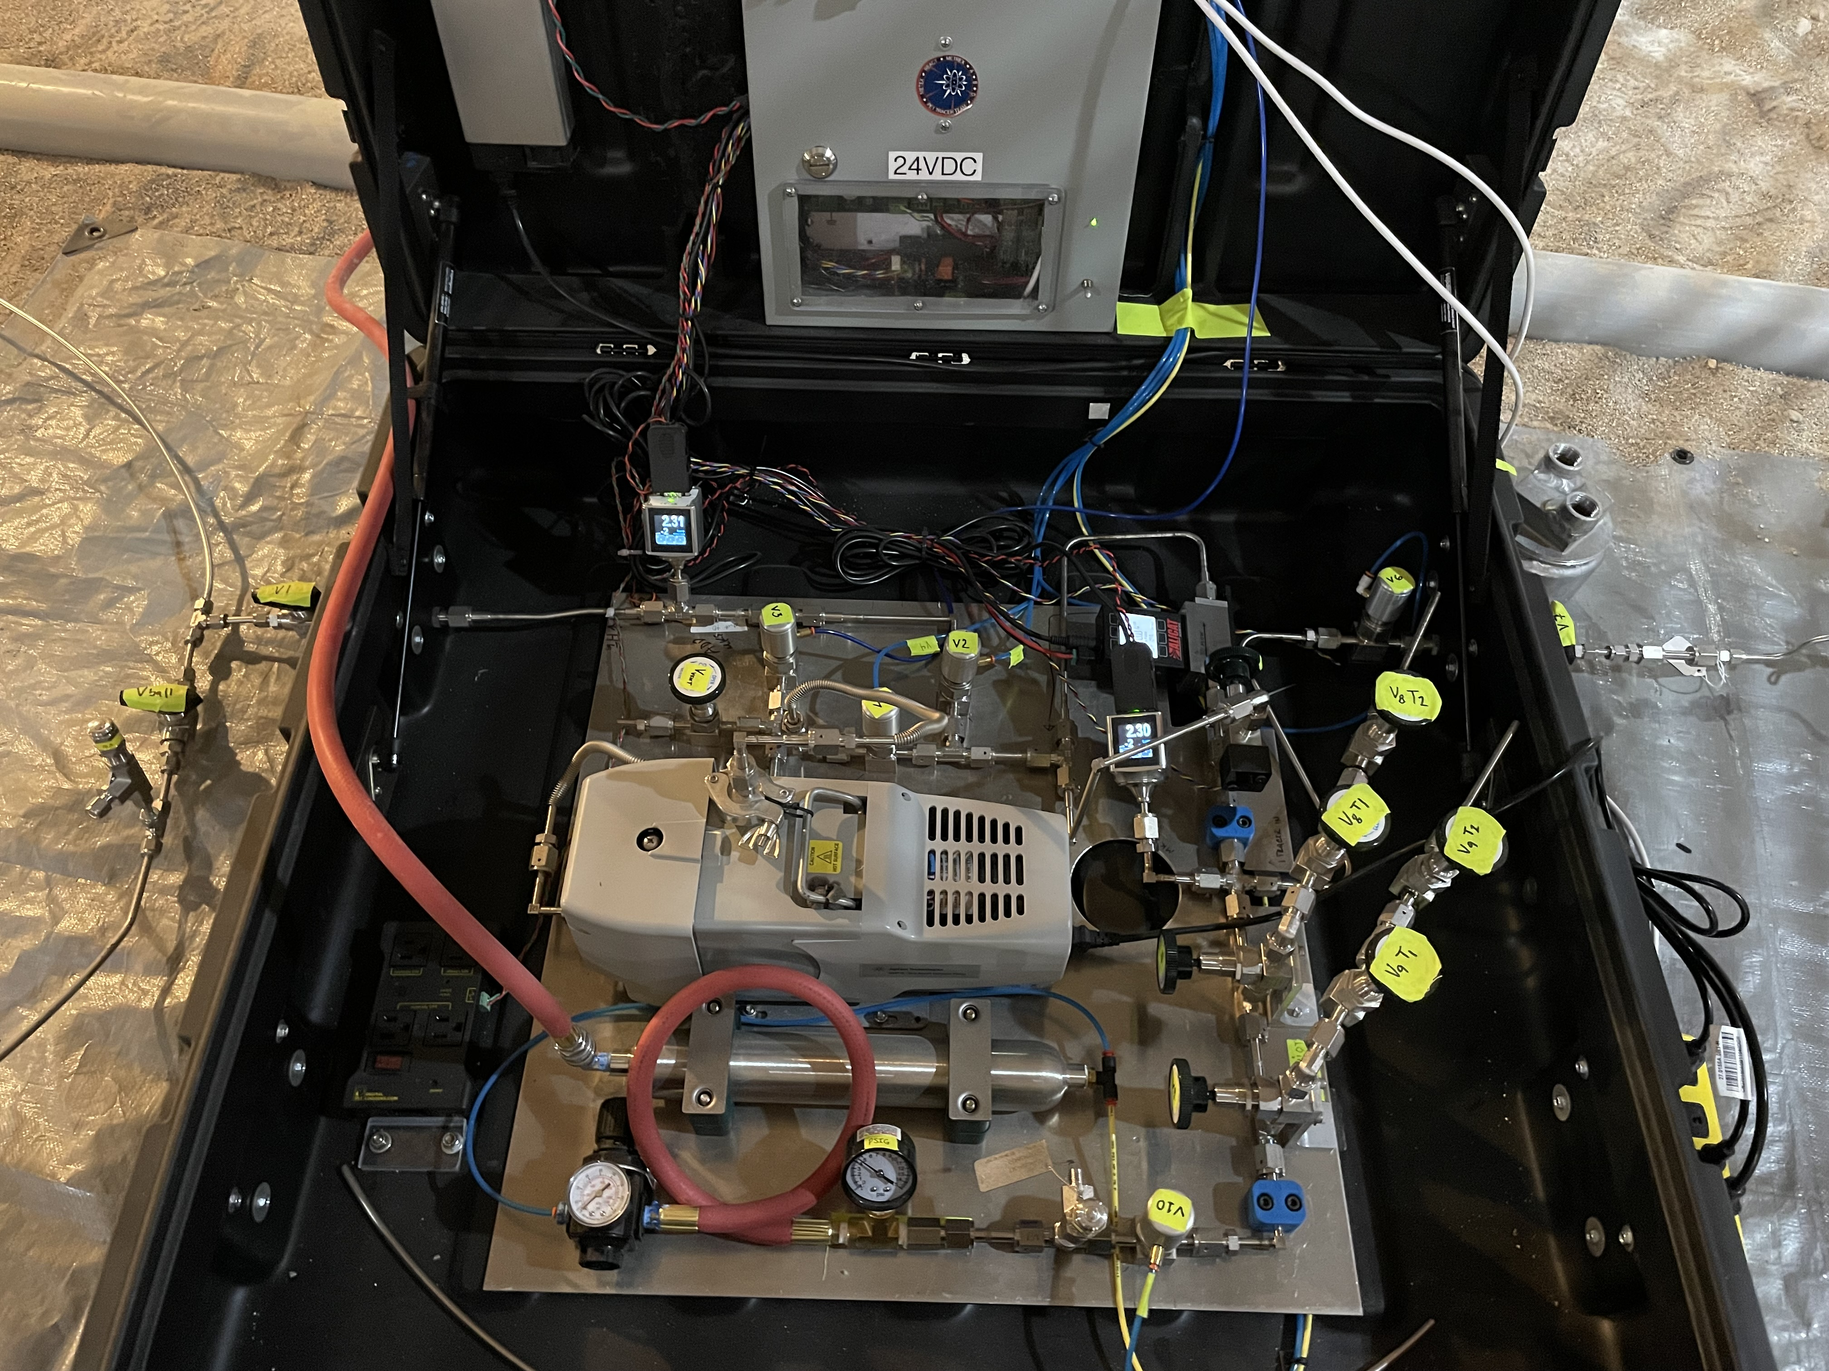
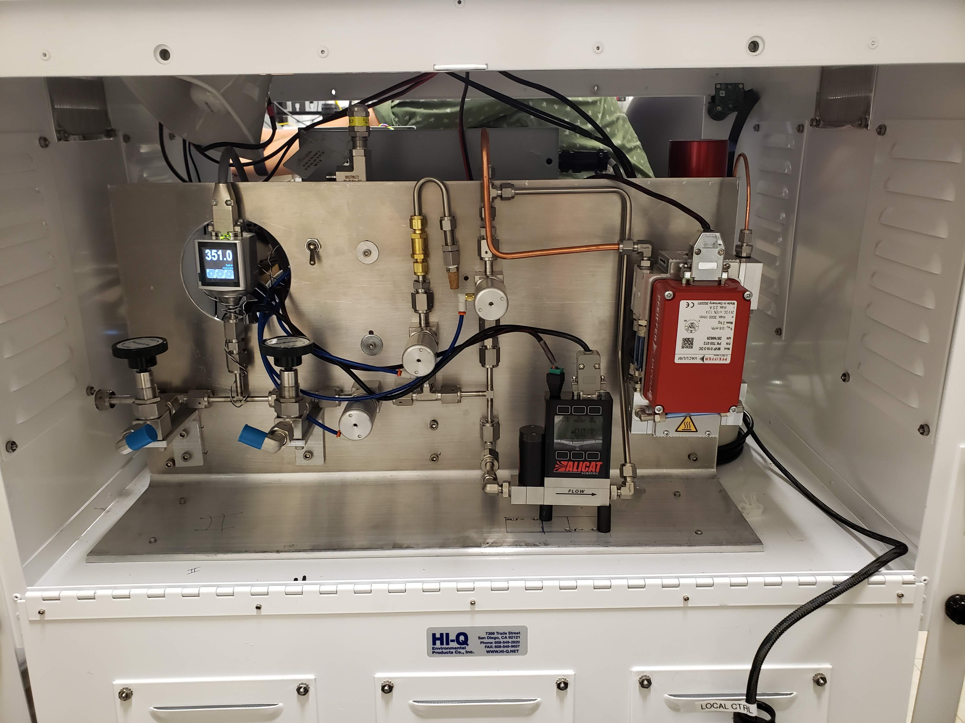
PLEASE DON‘T FORGET TO PUT THE E-POSTER TITLE AND YOUR NAME IN THE PRESENTATION HEADER.
DUPLICATE THIS SLIDE IF YOUR E-POSTER HAS MORE THAN 1 PAGE
P2.3-292
Source term analysis of 127Xe from surface and subsurface tracer transport experiments of the PE1 series
Johnathan Slack¹, Samuel Emmons¹, Christine Johnson¹, Carl Britt¹, Martin Keillor¹, James Knox¹, Michael Moore¹, Aaron Von Morris¹, Chad Taguba¹, and the PE1 Experiment Team²
Introduction
In-Field Aliquot Capture
The development and validation of noble gas transport models through field collected data is critical in the improvement of nuclear explosion monitoring techniques.
Surface and subsurface transport data is needed for model validation
Xenon-127 deployed in Physics Experiment 1 (PE1) series
Surface (REACT) and subsurface (PE1-A) experiments have been conducted
Release systems for each experiment provided data for xenon quantities and captured aliquots for activity analysis
Aliquots collected on release systems analyzed at Pacific Northwest National Laboratory (PNNL) for final determination of Xe-127 total activity
Surface Release System (ASRS) (Left)
System operations and controls:
  State of Health logger
  Smoke generation
  Telecommunications
  Gas handling
Telemetry data included:
  Temperature probes
  Pressure Transducers
  Pneumatic valving
  Mass flow controllers
  Radiation Sensor
  Aliquot tubes
Subsurface Release System (SSRS) (Right)
System operations and controls:
  State of Health logger
  Gas handling
  Grout injection
Telemetry data included:
  Temperature probes
  Pressure transducers
  Pneumatic valving
  Mass flow controllers
  Aliquot tubes
¹Pacific Northwest National Laboratory
²Please see authorship list at https://doi.org/10.2172/2345984
This Low Yield Nuclear Monitoring (LYNM) research was funded by the National Nuclear Security Administration, Defense Nuclear Nonproliferation Research and Development (NNSA DNN R&D). The authors acknowledge important interdisciplinary collaboration with scientists and engineers from LANL, LLNL, NNSS, PNNL, and SNL.

Slide 3
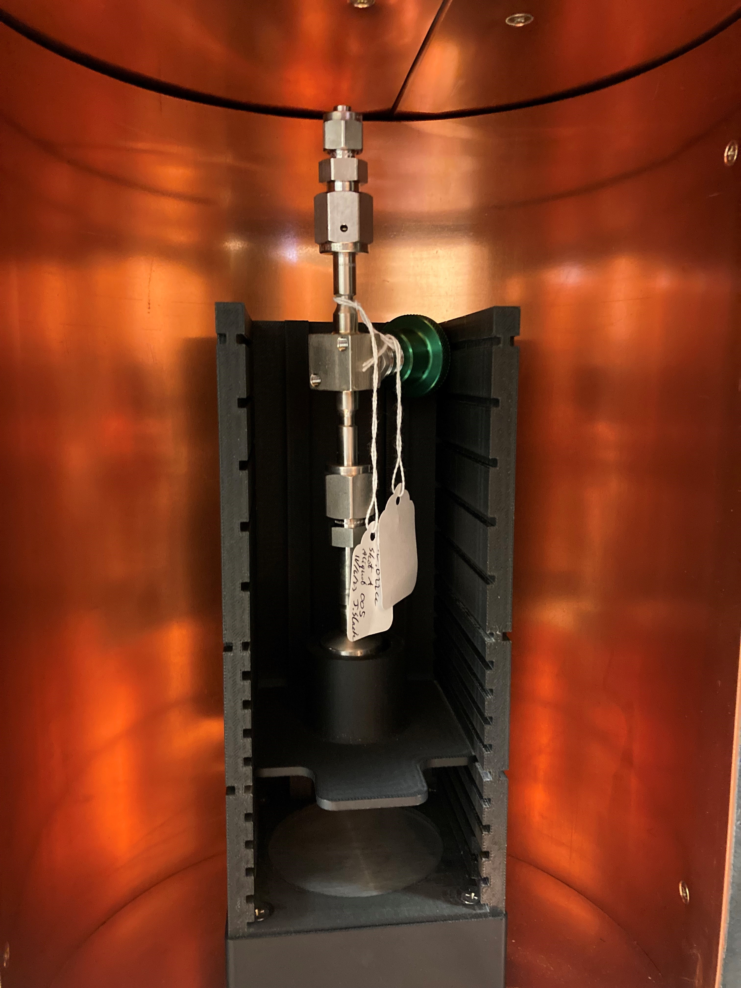
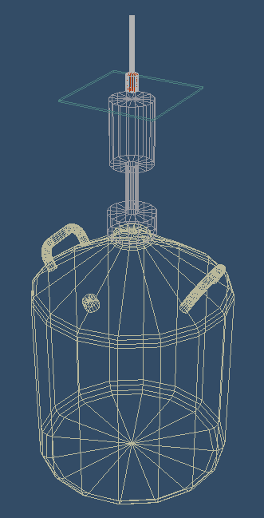
PLEASE DON‘T FORGET TO PUT THE E-POSTER TITLE AND YOUR NAME IN THE PRESENTATION HEADER.
DUPLICATE THIS SLIDE IF YOUR E-POSTER HAS MORE THAN 1 PAGE
P2.3-292
Source term analysis of 127Xe from surface and subsurface tracer transport experiments of the PE1 series
Johnathan Slack¹, Samuel Emmons¹, Christine Johnson¹, Carl Britt¹, Martin Keillor¹, James Knox¹, Michael Moore¹, Aaron Von Morris¹, Chad Taguba¹, and the PE1 Experiment Team²
Aliquot Measurements
REACT Aliquots
Aliquot container geometry complicated gamma spectroscopy measurements
Transferred to 3.4 L lecture bottles
Measurements conducted on BEGe spectrometer
Existing ISOCS model for tank geometry provided spectral peak efficiencies
Small (5cc or less) gas volumes made recovery of sample from tanks infeasible
PE1-A Aliquots
Aliquots split due to high activity into small (10mL) sample tubes
No existing calibrated ISOCS model
Peak efficiencies determined by calibration gas standard not previously available
Measurements on multiple HPGe spectrometers with standardized sample holders
Figure: (Left) Sample bottle in position above an HPGe using a configurable sample holder. (Right) Typical ISOCS modeling geometry of 10 mL sample tube and germanium detector.
¹Pacific Northwest National Laboratory
²Please see authorship list at https://doi.org/10.2172/2345984
This Low Yield Nuclear Monitoring (LYNM) research was funded by the National Nuclear Security Administration, Defense Nuclear Nonproliferation Research and Development (NNSA DNN R&D). The authors acknowledge important interdisciplinary collaboration with scientists and engineers from LANL, LLNL, NNSS, PNNL, and SNL.

Slide 4
PLEASE DON‘T FORGET TO PUT THE E-POSTER TITLE AND YOUR NAME IN THE PRESENTATION HEADER.
DUPLICATE THIS SLIDE IF YOUR E-POSTER HAS MORE THAN 1 PAGE
P2.3-292
Source term analysis of 127Xe from surface and subsurface tracer transport experiments of the PE1 series
Johnathan Slack¹, Samuel Emmons¹, Christine Johnson¹, Carl Britt¹, Martin Keillor¹, James Knox¹, Michael Moore¹, Aaron Von Morris¹, Chad Taguba¹, and the PE1 Experiment Team²
Analysis
REACT Aliquots
Spectral data analyzed via GENIE2K
Background, decay, efficiency, and cascade summing corrected
Volume of xenon in aliquot tubes calculated from averaging multiple ASRS pressure readings
Total atmospheric release volumes calculated from integrating ASRS gas flow data (Top)
PE1-A Aliquots
Spectral data analyzed via GENIE2K
Background, decay, efficiency, and cascade summing corrected
Weighted average of duplicate aliquot activities
Volume of xenon in aliquot tubes calculated from SSRS pressures and laboratory concentration determinations
Total subsurface release volume calculated from xenon injection pressure data (Bottom) and residual in SSRS
¹Pacific Northwest National Laboratory
²Please see authorship list at https://doi.org/10.2172/2345984
Figure 4: (Top) Pressure, flow, and timing of REACT-04 release. (Bottom) Pressure profile of PE1-A xenon injection from cask to cavity
This Low Yield Nuclear Monitoring (LYNM) research was funded by the National Nuclear Security Administration, Defense Nuclear Nonproliferation Research and Development (NNSA DNN R&D). The authors acknowledge important interdisciplinary collaboration with scientists and engineers from LANL, LLNL, NNSS, PNNL, and SNL.

Slide 5
PLEASE DON‘T FORGET TO PUT THE E-POSTER TITLE AND YOUR NAME IN THE PRESENTATION HEADER.
DUPLICATE THIS SLIDE IF YOUR E-POSTER HAS MORE THAN 1 PAGE
P2.3-292
Source term analysis of 127Xe from surface and subsurface tracer transport experiments of the PE1 series
Johnathan Slack¹, Samuel Emmons¹, Christine Johnson¹, Carl Britt¹, Martin Keillor¹, James Knox¹, Michael Moore¹, Aaron Von Morris¹, Chad Taguba¹, and the PE1 Experiment Team²
Xe-127 Total Activities
Final combination of activities, concentrations, and xenon volumes to calculate total release activities.
REACT and PE1-A aliquot activities and activity concentrations (Table Left)
Decay and xenon volume corrected total activities (Table Right)
Release activities provide validation basis for gas transport models with field detection data
Aliquot ID | Activity (x10⁴ Bq) | Act. Conc. (x10⁶ Bq/cc)
REACT-01 | 2.08(4) | 1.03(10)
REACT-02 | 1.92(3) | 0.94(9)
REACT-03 | 5.65(10) | 1.11(9)
REACT-04 | 5.15(9) | 1.01(9)
PE1A-01 | 10.43(49) | 6.901(3)
PE1A-02 | 10.73(50) | 2.783(1)
Release ID | Activity (mCi)
REACT-01 | 14.20(136)
REACT-02 | 15.32(129)
REACT-03 | 15.86(152)
REACT-04 | 16.80(142)
PE1-A | 1,139(41)
Table Right: Total release activities of Xe-127 for each of the four REACT releases. Total activity for PE1-A decay corrected to experiment execution.
Table Left: Activity and concentration for REACT aliquots at time of release. PE1-A aliquots decay corrected to measurement acquisition time. PE1A-02 required stable gas additions to validate aliquot concentrations, which decreased the overall activity concentration.
¹Pacific Northwest National Laboratory
²Please see authorship list at https://doi.org/10.2172/2345984
This Low Yield Nuclear Monitoring (LYNM) research was funded by the National Nuclear Security Administration, Defense Nuclear Nonproliferation Research and Development (NNSA DNN R&D). The authors acknowledge important interdisciplinary collaboration with scientists and engineers from LANL, LLNL, NNSS, PNNL, and SNL.

