Slide 1


P2.3-840
Exploring bounding parameters for modeling subsurface transport of radioxenon
Carolyn E. Seifert, Christine Johnson, Jana Simo, Paul Eslinger
Pacific Northwest National Laboratory
In this work, we use an analytical toy model to explore the phase space of viable subsurface transport conditions that can result in detectable radioxenon from underground nuclear explosions at downwind stations. This analysis demonstrates that a minimum release ~10⁸ Bq of ¹³³Xe is needed for downwind detection at 50 km, and that quantity increases to ~10¹¹ Bq for 2000 km. We calculate that effective permeabilities less than 10⁻¹⁴ m² are not likely to result in detectable ¹³³Xe for a 1-kt explosion at 100-m and 200-m depths of burial. Smaller downwind distances, more favorable wind conditions, and the presence of fast subsurface pathways would broaden the range of subsurface conditions that lead to detectable downwind signals.
This Low-Yield Nuclear Monitoring (LYNM) research was funded by the National Nuclear Security Administration, Defense Nuclear Nonproliferation Research and Development (NNSA DNN R&D). The authors acknowledge important interdisciplinary collaboration with scientists and engineers from LANL, LLNL, NNSS, PNNL, and SNL. The views expressed here do not necessarily reflect the opinion of the United States Government, the United States Department of Energy, or Pacific Northwest National Laboratory.

Slide 2
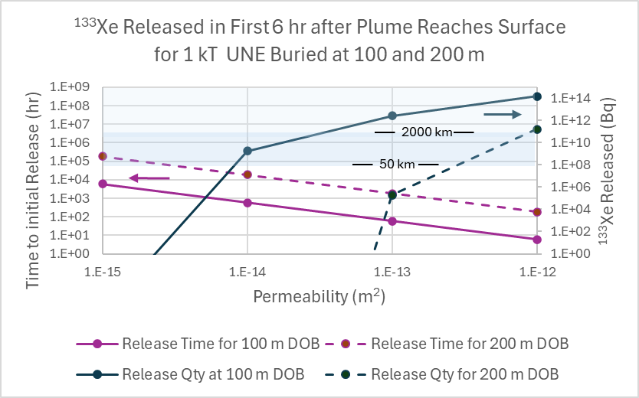
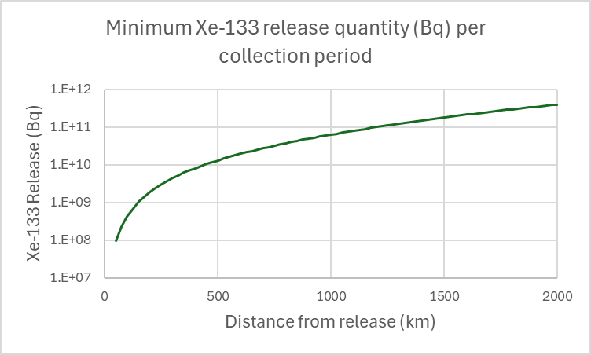
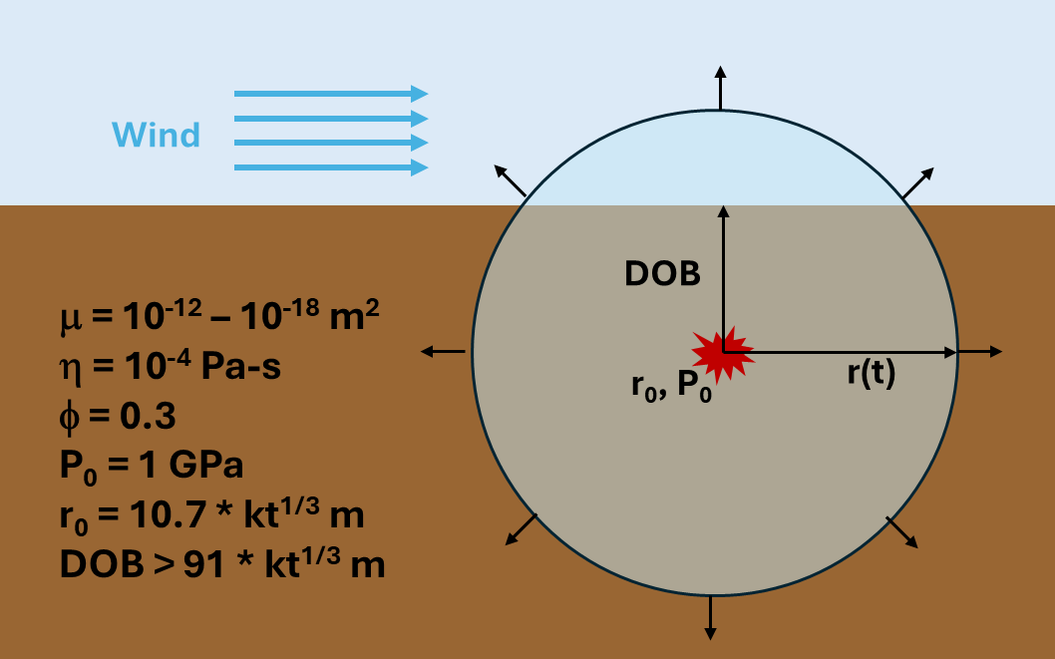
P2.3-840
Exploring bounding parameters for modeling subsurface transport of radioxenon
Carolyn E. Seifert, Christine Johnson, Jana Simo, Paul Eslinger
Estimated Minimum ¹³³Xe Release Quantities Required for Downwind Detection
An Analytical Toy Model for Estimating ¹³³Xe Release Quantities from Underground Nuclear Explosions
Results and Implications for Subsurface Transport Modeling and Simulations
Using the median analytical dilution factors with radioactive decay from Eslinger, et al.[1], and the stated sensitivity of the Xenon International radioxenon collection and analysis system (0.15 mBq/m³) [2], we calculate the minimum required ¹³³Xe release from an underground nuclear explosion that would result in downwind concentrations above the expected minimum detectable concentration (MDC).
Here we use the median dilution factor, but these factors are observed to vary by several orders of magnitude depending on wind conditions.[1] We also assume that background conditions are such that any measured quantity over the expected MDC is detectable. The required minimum release quantities are used to bound the viable range of subsurface transport conditions.
Calculation steps:
Determine initial pressure and radius of cavity based on 1 kt yield [3, 4], assuming sufficiently deep burial.
Calculate increased subsurface plume volume and pressure for a fixed step change in plume radius, assuming instantaneous equilibrium conditions.
Calculate velocity of pressure front based on 1-D Darcy’s Law (constants derived from ref. [5-6]).
Calculate time needed for this expansion to occur, given the calculated velocity of the pressure front.
Repeat Steps 2-5 until the plume extends beyond the surface for at least one downwind collection period.
Calculate the fraction of the plume above the ground in the first collection period after it reaches the surface, estimate total ¹³³Xe release in that period, assuming no subsurface fractionation, and correct for decay during subsurface transport.
Key relationships:
Time to surface ∝ permeability⁻¹
Emission rate without decay ∝ permeability⁻²
Emission rate with decay
~ exp(- C / permeability) / permeability²
This analysis assumes homogeneous permeability and porosity in the subsurface with no fast fracture pathways. Any subsurface conditions that combine to exhibit the same effective permeability would produce similar results. Atmospheric pumping is also neglected, but will be an important contributor to late-time seepage.
With this analytical toy model, we find that subsurface permeabilities below 10⁻¹⁴ m² do not likely yield sufficient ¹³³Xe to be detected between 50-2000 km downwind.

Slide 3
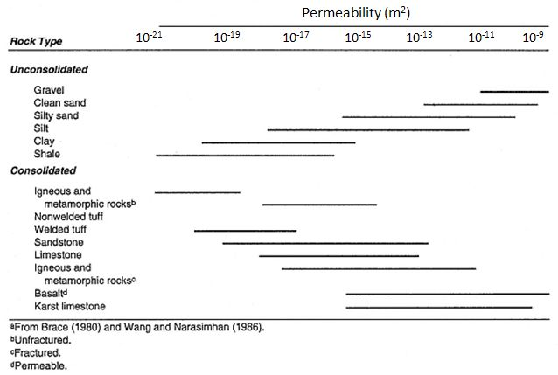
P2.3-840
Exploring bounding parameters for modeling subsurface transport of radioxenon
Carolyn E. Seifert, Christine Johnson, Jana Simo, Paul Eslinger
REFERENCES
Permeability in Various Geologic Media [7]
[1] P.W. Eslinger, et al., “Atmospheric plume progression as a function of time and distance from the release point for radioactive isotopes,” JER 148, October 2015, pp. 123-129. https://doi.org/10.1016/j.envrad.2015.06.022.
[2] “Xenon International,” Teledyne Brown Engineering. Available at: https://www.tbe.com/energy/xenon-international.
[3] T.R. Butkovich, “Cavities Produced by Underground Nuclear Explosions,” UCRL-52097, 1976.
[4] S. Glasstone and P.J. Dolan, “Effects of Nuclear Weapons,” 1977. Available at: https://atomicarchive.com/resources/documents/effects/glasstone-dolan.
[5] D.D. Lucero, et al., “Permeability scaling relationships of volcanic tuff from core to field scale measurements,” Sci Rep 15, 12938 (2025). https://doi.org/10.1038/s41598-025-96835-5.
[6] “Air Viscosity: Dynamic and Kinematic Viscosity at Various Temperatures and Pressures,” The Engineering Toolbox. Available at: https://www.engineeringtoolbox.com/air-absolute-kinematic-viscosity-d_601.html.
NNSS P-Tunnel [5]
[7] A. Jefferson, “Geology is destiny: globally mapping permeability by rock type,” Available at: https://all-geo.org/highlyallochthonous/2011/01/geology-is-destiny-globally-mapping-permeability-by-rock-type/.

