Slide 1

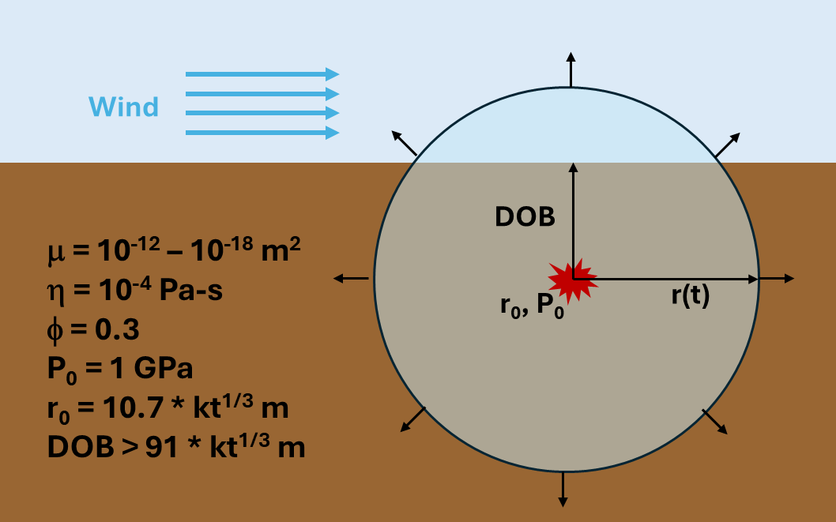

P2.3-840
Exploring bounding parameters for modeling subsurface transport of radioxenon
Carolyn E. Seifert, Christine Johnson, Jana Simo, Paul Eslinger
Pacific Northwest National Laboratory
We use a simple analytical toy model to estimate bounding parameters for subsurface transport, neglecting fast fracture pathways and atmospheric pumping.
We find that for a 1-kt underground nuclear explosion at 100-m and 200-m depths of burial, geologic permeabilities below 10⁻¹⁴ m² did not release sufficient quantities of ¹³³Xe at the surface to be detected by a Xenon International station 50 km downwind.
This Low-Yield Nuclear Monitoring (LYNM) research was funded by the National Nuclear Security Administration, Defense Nuclear Nonproliferation Research and Development (NNSA DNN R&D). The authors acknowledge important interdisciplinary collaboration with scientists and engineers from LANL, LLNL, NNSS, PNNL, and SNL. The views expressed here do not necessarily reflect the opinion of the United States Government, the United States Department of Energy, or Pacific Northwest National Laboratory.

