Slide 1


Rapid and versatile radionuclide source term estimation,
including host rock seepage and atmospheric venting
Pierre M. Adler¹, Eric Pili²
[
¹Sorbonne Université, Metis, 4 place Jussieu, 75252 Paris Cedex 05, France.
²CEA, DAM, DIF, F-91297, Arpajon, France
Objective: to obtain a rapid estimation of a radionuclide source term (including radioxenon) potentially released to the atmosphere from an underground nuclear cavity by replacing the real situation by a simplified one which nevertheless includes all the physical phenomena and the orders of magnitude of the major parameters.
Results:
Objective fulfilled
Further simplification proposed: convection plays a major role and diffusion processes can be often neglected.
.

Slide 2
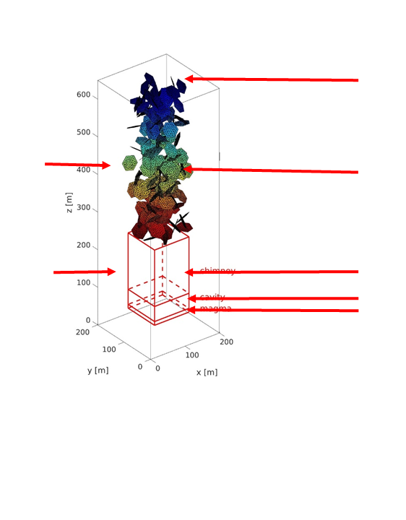
PLEASE DON‘T FORGET TO PUT THE E-POSTER TITLE AND YOUR NAME IN THE PRESENTATION HEADER.
DUPLICATE THIS SLIDE IF YOUR E-POSTER HAS MORE THAN 1 PAGE
Rapid and versatile radionuclide source term estimation,
including host rock seepage and atmospheric venting
Pierre M. Adler, Eric Pili
The real configuration and its modelization
Nuclear test site: inspired by what could be
the Punggye-Ri nuclear test site (DPRK)
a parallelipipedon of size 200×200×650 m
Embedding porous medium:
Permeability K_{m}=10⁻¹⁶ m²
porosity ε_{m} = 0.01 or 0.05
Simplified structure:
Permeability: K=10⁻¹⁴ m²
porosity ε= 0.29
T=802.15 K
3 initial pressures:
P₀ =50, 100, 200 bars
Ground surface
Fluctuating atmospheric pressure
period 10⁵ s; amplitude 1000 Pa.
Fracture network
192 or 384 fractures
aperture b = 1 mm
hexagons of radius R=20m
Chimney
Cavity
Magma
X’ (m)

Slide 3
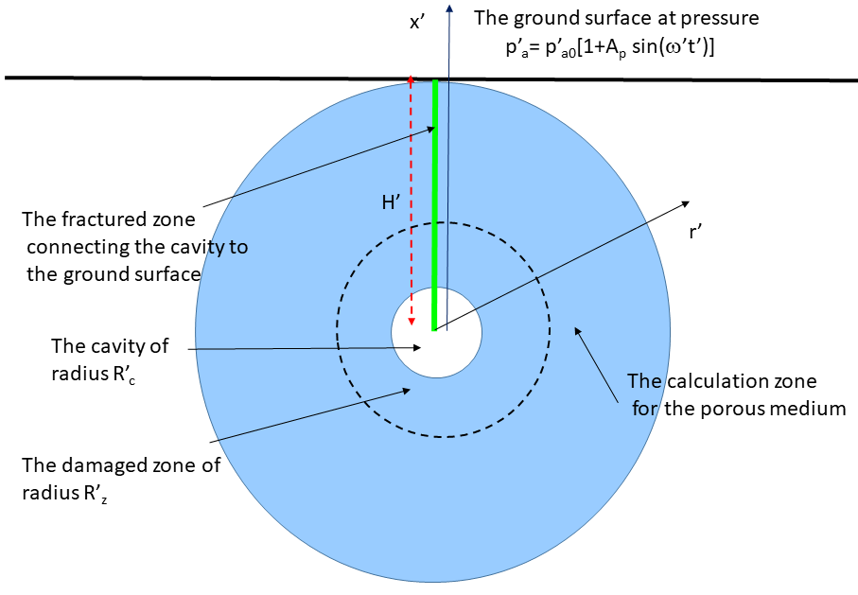
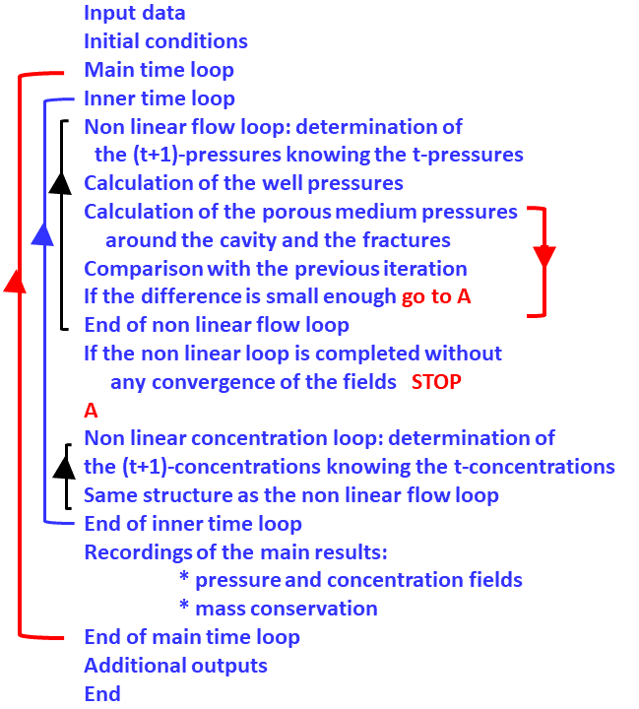
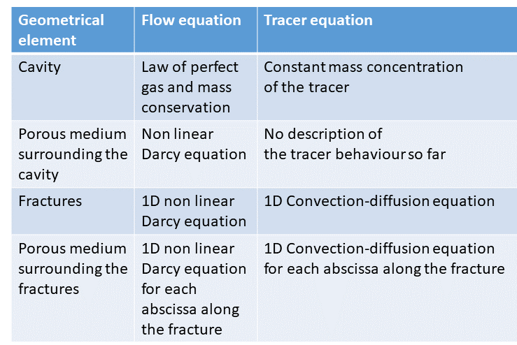
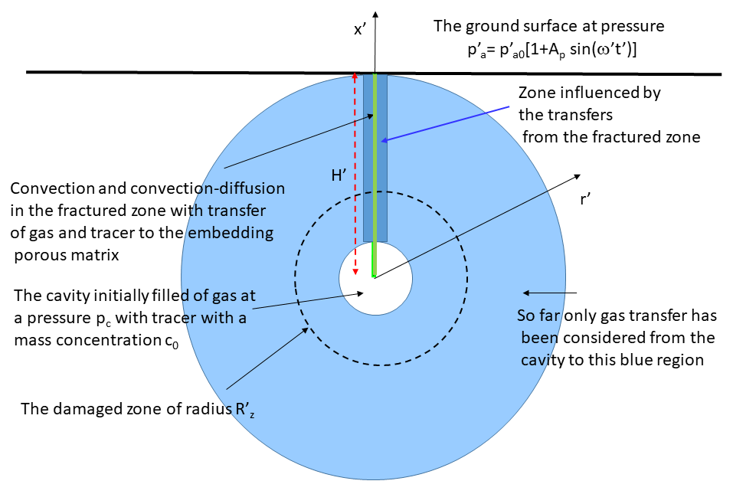
PLEASE DON‘T FORGET TO PUT THE E-POSTER TITLE AND YOUR NAME IN THE PRESENTATION HEADER.
DUPLICATE THIS SLIDE IF YOUR E-POSTER HAS MORE THAN 1 PAGE
Rapid and versatile radionuclide source term estimation,
including host rock seepage and atmospheric venting
Pierre M. Adler, Eric Pili
The simplified configuration
Summary
Chart
Modelization
The pressurized cavity feeds the spherical medium around it and the fractures. Since the pressure variations are large,
the Darcy equations which describe fluid motion are
non linear.
Major technical features in the resolution scheme:
Non-linear fluid flow equations: iterative approach based on the Picard iterative method.
Convection–diffusion equations discretized with a flux limiting scheme based on a SuperBee function.
Each equation reduces to a tridiagonal system which is solved by the Thomas algorithm.
However, overall non linear loops are needed in order to take into account the interactions between the various
geometrical elements.
Physical parameters
The cavity is about 600 m below the ground surface.
Cavity radius = 20 m
Initial cavity pressure between 3 and 20 bars
Porous medium: porosity = 0.01, permeability = 6.5 10⁻¹³ m²
Fracture modeled as rectangles of apertures between 0.25 and 1 mm. Width equal to the cavity diameter.
Atmospheric pressure: p_{a} = p_{a0} + A_{p} sin wt
with p_{a0} = 10⁵ Pa, A_{p} =1000 Pa
:

Slide 4
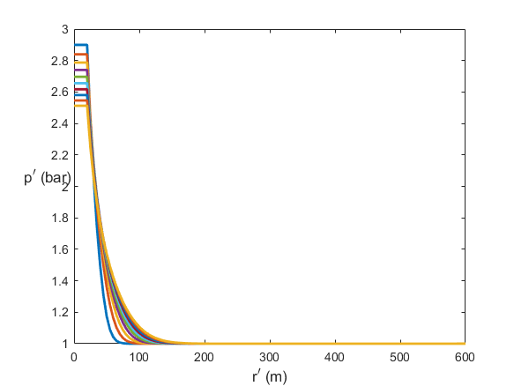
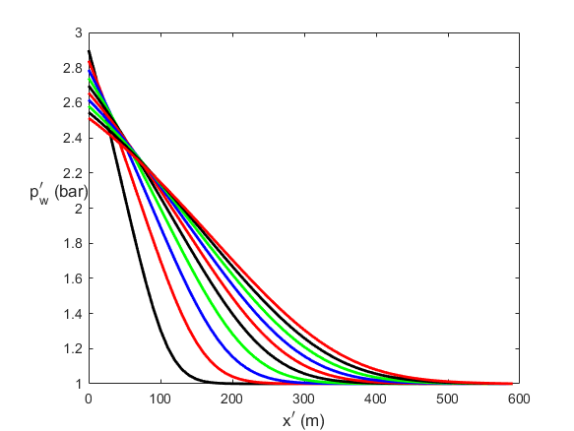
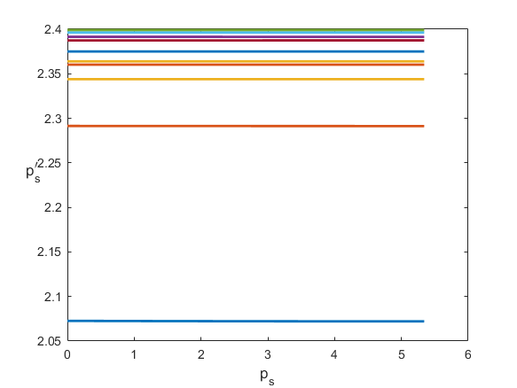
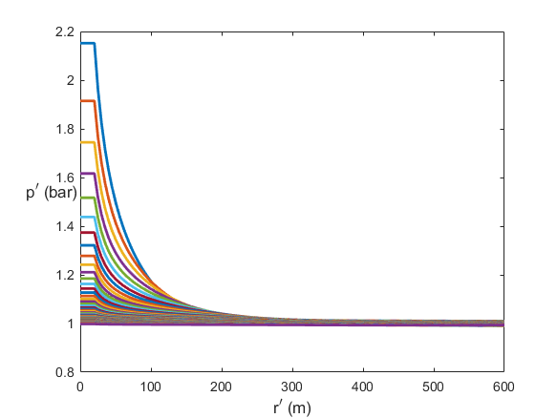
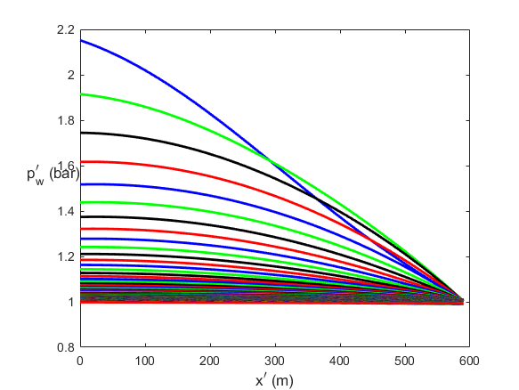
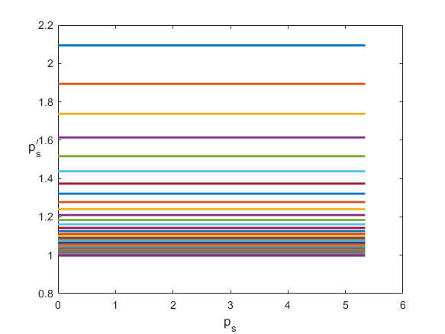
PLEASE DON‘T FORGET TO PUT THE E-POSTER TITLE AND YOUR NAME IN THE PRESENTATION HEADER.
DUPLICATE THIS SLIDE IF YOUR E-POSTER HAS MORE THAN 1 PAGE
Rapid and versatile radionuclide source term estimation,
including host rock seepage and atmospheric venting
Pierre M. Adler, Eric Pili
Evolution of the pressure field in the spherical porous medium p_{c0}=3 bars
Evolution of the pressure field in the fracture p_{c0}=3 bars
Evolution of the pressure field in the porous medium surrounding the fracture p_{c0}=3 bars
From t=0 to 4444 s
From t=4444 to 563170 s
From t=0 to 4444 s
From t=4444 to 563170 s
From t=0 to 4444 s
From t=4444 to 563170 s
time
time
time
time

Slide 5
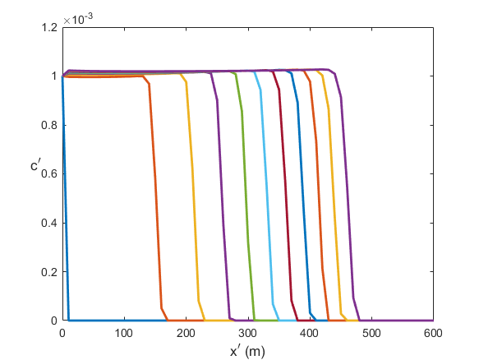
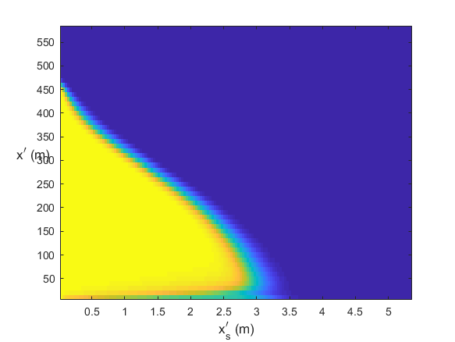
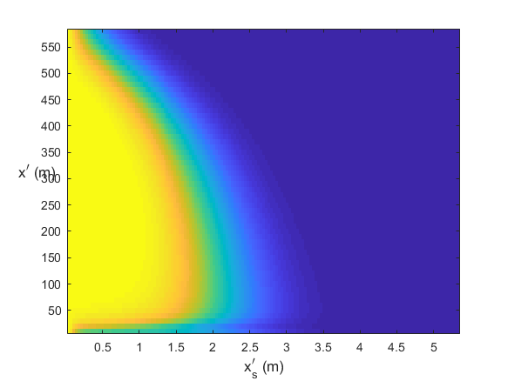
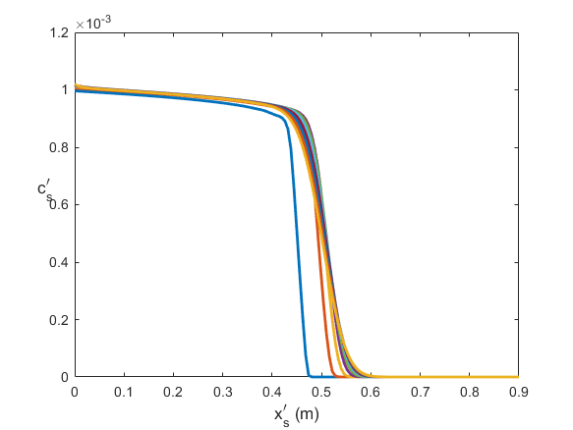
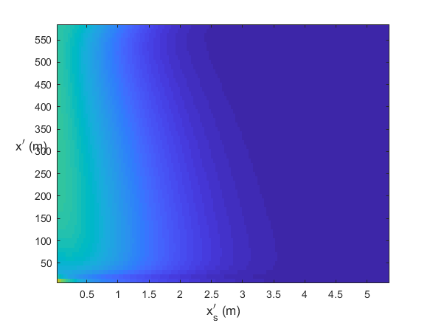
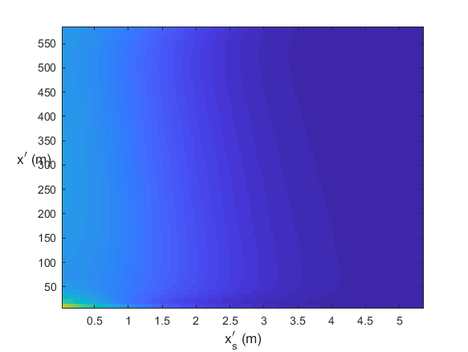
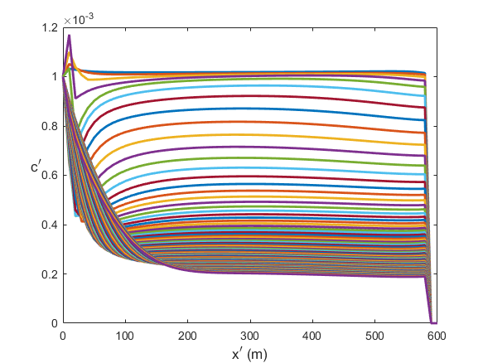
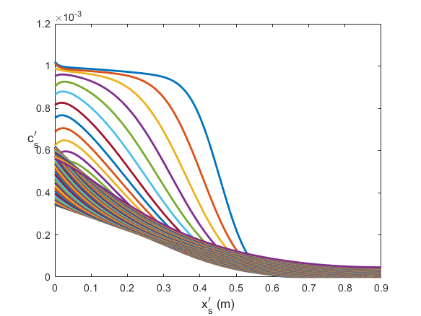
PLEASE DON‘T FORGET TO PUT THE E-POSTER TITLE AND YOUR NAME IN THE PRESENTATION HEADER.
DUPLICATE THIS SLIDE IF YOUR E-POSTER HAS MORE THAN 1 PAGE
Rapid and versatile radionuclide source term estimation,
including host rock seepage and atmospheric venting
Pierre M. Adler, Eric Pili
Evolution of the concentration field in the fracture p_{c0}=3 bars
Massic concentration in the porous medium surrounding the fracture
Initial arbitrary massic concentration c₀=0.001
Massic concentration in the porous medium surrounding the fracture
From t=0 to 4444 s
From t=4444 to 563170 s
From t=0 to 4444 s
From t=4444 to 563170 s
time
time
t’= 4444s
t’= 17142 s
t’= 80684 s
t’= 239365 s
time
time

Slide 6
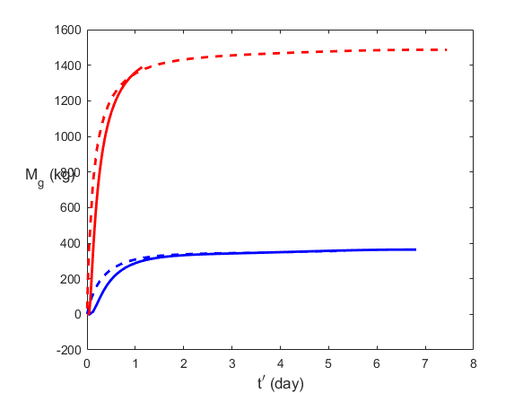
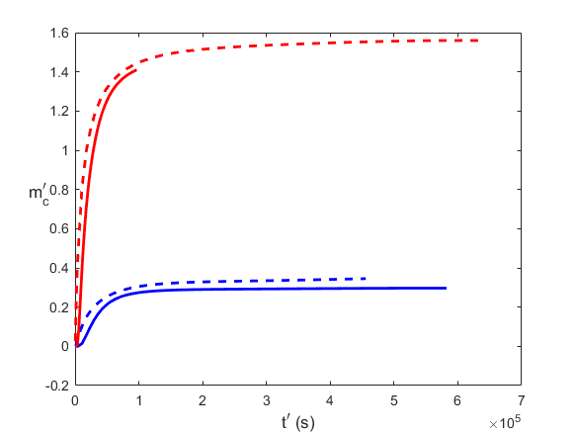
PLEASE DON‘T FORGET TO PUT THE E-POSTER TITLE AND YOUR NAME IN THE PRESENTATION HEADER.
DUPLICATE THIS SLIDE IF YOUR E-POSTER HAS MORE THAN 1 PAGE
Rapid and versatile radionuclide source term estimation,
including host rock seepage and atmospheric venting
Pierre M. Adler, Eric Pili
Mass of gas out of the fracture at the ground level for 2 initial pressures of the cavity:
The corresponding mass of tracer going of the fracture at the ground level for 2 initial pressures of the cavity:
Practical orders of magnitude for ¹³³Xe
Blue p_{c0}=3 bars
Red p_{c0}=10 bars
Broken line: no gas and tracer transfer to the porous medium surrounding the cavity
Solid line: gas and tracer transfer to the porous medium surrounding the cavity
Blue p_{c0}=3 bars
Red p_{c0}=10 bars
Same line convention
Recall that the arbitrary initial mass concentration is equal to 0.001
Therefore, a good approximation is to multiply the gas mass out of the fracture at the ground level by c₀
Assume that the initial mass of produced by the explosion is 0.2 kg (for an explosion of 150 kt).
Therefore, for a cavity of radius 20 m, the initial mass concentration is:
p_{c0}=3 bars c₀= 1.63 10⁻⁶ p_{c0}=10 bars c₀= 4.90 10⁻⁷
According to the previous graph obtained for
c₀= 0.001, the mass of tracer which goes out of the fracture is equal to
p_{c0}=3 bars 0.49 g p_{c0}=10 bars 0.69 g
The radioactive decay constant is 1.528 10-6:
Therefore after 6 days, these numbers should be multiplied by exp(-1.528 10-6 x 86400 x6) = 0.45
Concluding remarks
1. The basic objective of an estimation more faster by a factor of about 30 than the one obtained by the modelization of the real configuration (cf Pazdniakou et al, 2022 and 2024) basically fulfilled.
2. However, the code still needs to be improved in several ways:
- improvement of the stability. At the moment it requires small time intervals to converge safely.
- parallelization of the main calculations.
3. Extend the calculations to a concentration c₀ which depends on time.

