Slide 1

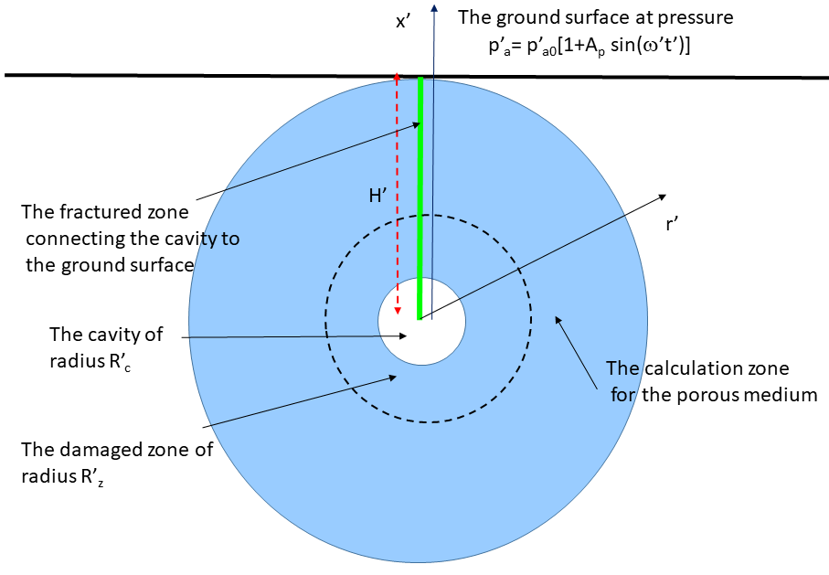
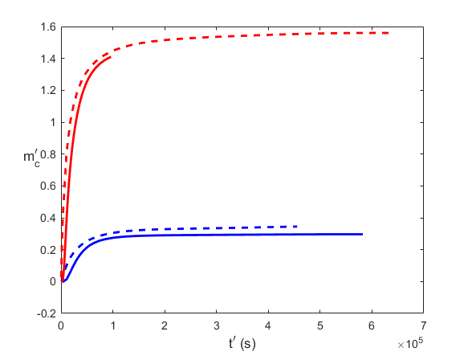


Rapid and versatile radionuclide source term estimation,
including host rock seepage and atmospheric venting
Pierre M. Adler¹, Eric Pili²
Sorbonne University and CEA-DAM
P2.4-123
Come over to see our poster if you would like to find out more about:
a rapid estimation of a radionuclide source term (including radioxenon) potentially released to the atmosphere from an underground nuclear cavity
the methodology including the simplified configuration
Some preliminary results such as the mass of tracer

