Slide 1

Introduction Slide Title goes here [Font: Arial Bold/Size: 16]
P2.3-058
Nuclear research reactors as source of radioxenon from neutron activation of stable xenon
Pouneh Tayyebi¹, Martin Kalinowski²
1 Nuclear Science and Technology Research Institute
2 Peace Science Collaboration
This poster investigates whether neutron activation in nuclear research reactors can be a significant source of radioxenon, using HFIR as a case study. Multi-isotope activity ratio plots and simulations highlight the role of activation versus fission.
DISCLAIMER: This presentation has been generated for illustration purposes only.

Slide 2
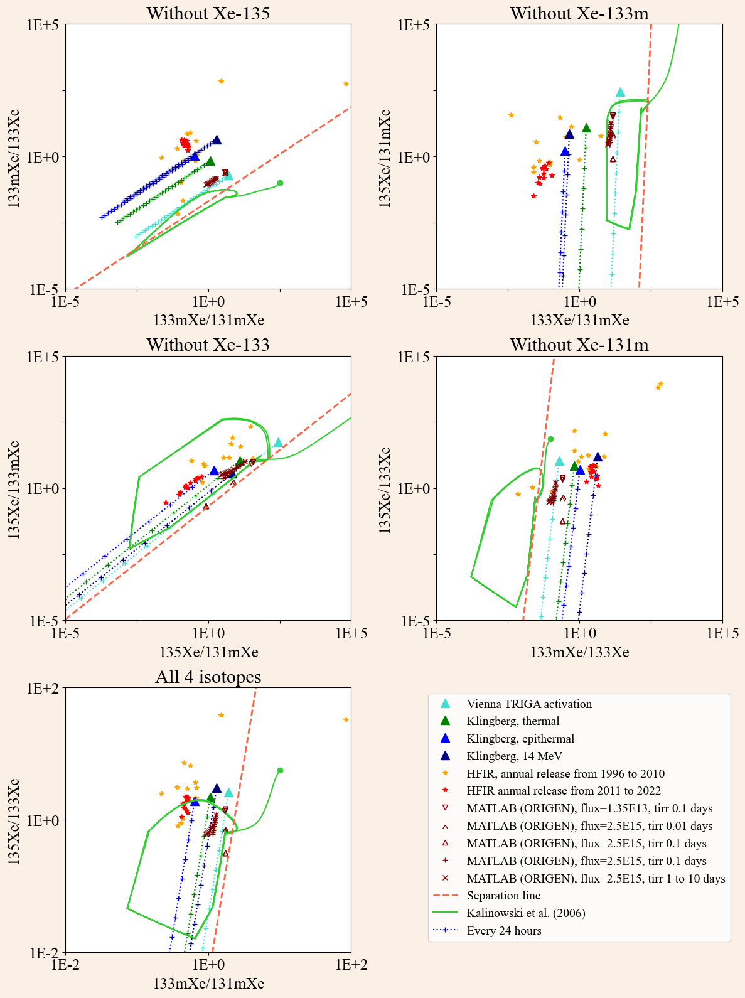
Nuclear research reactors as source of radioxenon from neutron activation of stable xenon?
Pouneh Tayyebi, Martin Kalinowski
Introduction
Results
P2.3-058
Strong evidence suggests that nuclear research reactors (NRRs) may be a potential source of radioxenon emissions generated via neutron activation of stable xenon [1, 2, 3]. This source is highly relevant to nuclear explosion monitoring for two main reasons. First, the resulting isotopic activity ratios can be confused with those produced by nuclear explosions. Second, neutron activation also generates additional radioxenon isotopes that may interfere with the spectral analysis of IMS samples. However, whether neutron activation may be a significant source is still not generally accepted in the expert’s community.
This observation is inconsistent with Dion et al., who concluded that the Xe isotopes measured at HFIR originate mainly from neutron-induced fission rather than air activation [4].
Conclusions
Our analysis of HFIR data indicates that neutron activation is a significant source of the observed radioxenon emissions, while fission plays a comparatively minor role. These findings highlight the importance of considering activation contributions when interpreting IMS measurements and assessing potential nuclear explosion signatures. Moreover, the improved consistency of post-2011 data suggests that enhanced measurement and reporting procedures can provide more reliable isotopic activity ratios for monitoring purposes.
Methods
All relevant data from NRRs reported in the literature were compiled into multi-isotope activity ratio plots and compared with our own simulations performed using ORIGEN and MATLAB.
Results
References
[1] Kalinowski, M.B., Tayyebi, P., Lechermann, M., et al., 2021. Global radioxenon emission inventory from nuclear research reactors. Pure Appl. Geophys. 178, 2711–2739 .
[2] Klingberg, F., Biegalski, S., Fay, A., 2013. Radioxenon signatures from activation of environmental xenon. J. Radioanal. Nucl. Chem. 296.
[3] P. Tayyebi, M. Kalinowski, Mismatch between simulations and reported releases of radioxenon from research reactors; a discussion on the origin of radioxenon released from NRRs: fission, activation or both, INGE 2024.
[4] M.P. Dion et al., Short-lived noble gas effluent trends from a research reactor, Journal of Environmental Radioactivity 270 (2023) 107281
Our findings indicate that:
HFIR data prior to 2011 are widely scattered, whereas data from 2011 onwards are more consistent, suggesting improvements in measurement and reporting procedures.
Certain plots, such as those excluding Xe-131m, provide clear evidence that HFIR acts as a neutron activation source and that fission is not the primary contributor to the radioxenon emissions.
DISCLAIMER: This presentation has been generated for illustration purposes only.

