Slide 1

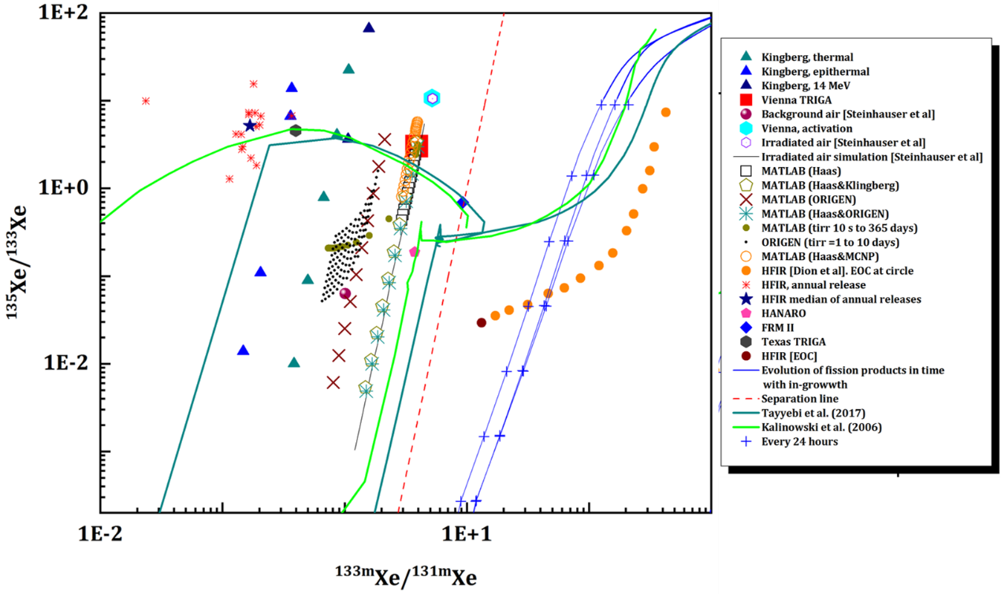

P2.3-058
Nuclear research reactors as source of radioxenon from neutron activation of stable xenon
Pouneh Tayyebi¹, Martin Kalinowski²
1- Nuclear science and technology research institute
2- Peace Science Collaboration
Can activation be a source of radioxenon in nuclear research reactors? The case of HFIR.
Our analysis begins with the plot shown below.
If you would like to review further evidence, please refer to poster P2.3-058.
DISCLAIMER: This presentation has been generated for illustration purposes only

