Slide 1

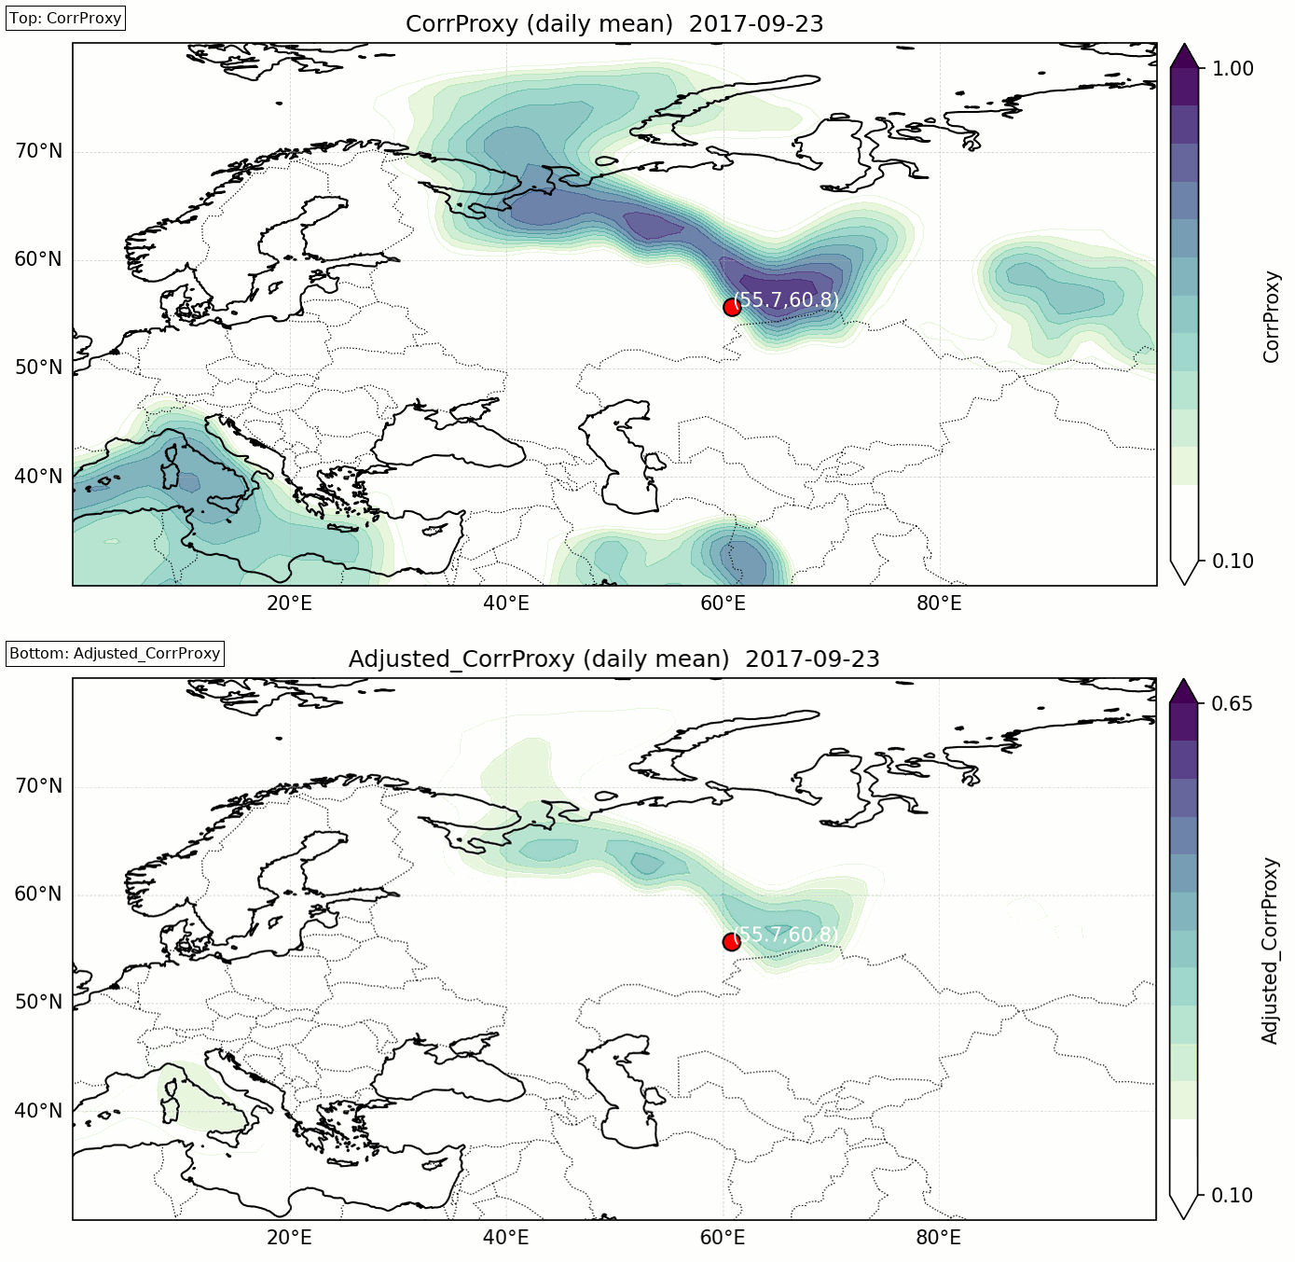


P2.3-434
Enhancing Source Estimation in CTBTO Web-Grape
Sayed Mekhaimer
National Research Institute of Astronomy and Geophysics (NRIAG))
The estimation of a source in the CTBT context is an ill-posed problem that is highly sensitive to small variations in data, whether meteorological information or radionuclide concentration values. The current version of the Web-Grape software includes three methods for identifying possible source regions. The first two methods rely on the correlation between measured concentration values and corresponding modeled values, employing two distinct correlation measures: Spearman and Pearson. The third method uses the number of source-receptor sensitivities (SRS) exceeding a threshold value as an indicator of potential source areas. Notably, while Spearman correlation is more robust than Pearson correlation, the robustness of both depends on the number of data points used for estimation. To address this, we propose a new statistical method that combines correlation and SRS counts to improve the accuracy of identifying possible source regions.
DISCLAIMER: The opinions expressed are those of the author and are not necessarily representative of NRIAG or any other entity.

