Slide 1
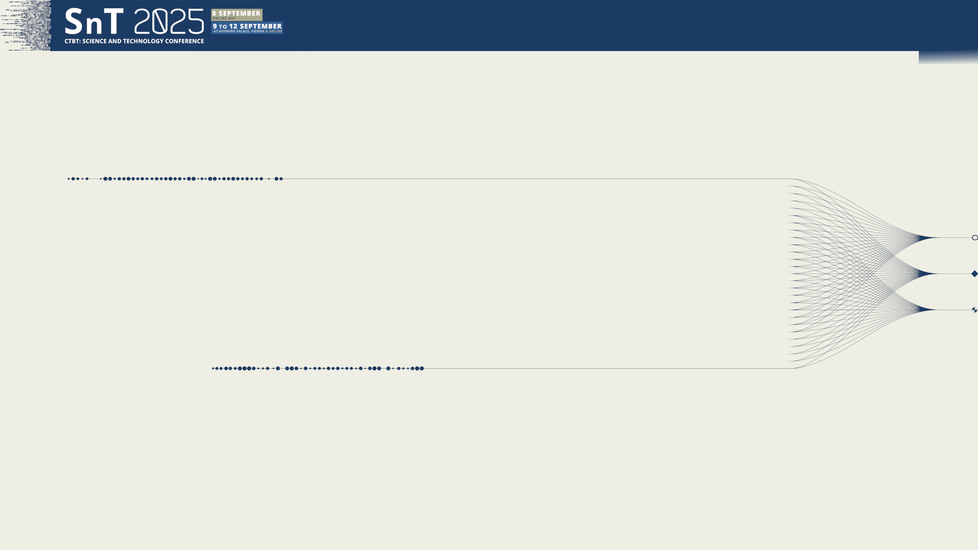

O2.3-704
Molten Salt Reactor (MSR) Off-Gas System Efficiency and Its Possible Impact on Radioxenon Release Trajectory Estimations
Sri Sundari Retnoasih
National Research and Innovation Agency of Republic of Indonesia (BRIN)
10 September 2025

Slide 2
O2.3-704
Molten Salt Reactor (MSR) Off-Gas System Efficiency and Its Possible Impact on Radioxenon Release Trajectory Estimations
Sri Sundari Retnoasih
Background
The recent development of Molten Salt Reactor (MSR) revealed that the potential Radioxenon release from a single MSR might be larger than that from a conventional NPP, reaching around 133Xe 1010 Bq/day. A previous study of the possible impact on global radioxenon emission in the recent development of the MSR concluded that the first increase in global Radioxenon emissions due to the MSR's operation could be expected in the early 2030s from the Thorium Molten Salt Reactor Liquid Fuel 1 (TMSR-LF1).

Slide 3
O2.3-704
Molten Salt Reactor (MSR) Off-Gas System Efficiency and Its Possible Impact on Radioxenon Release Trajectory Estimations
Sri Sundari Retnoasih
Background
Country / Org | Project | MSR type & size | Stage / recent milestones (as of Aug 2025) | What’s next
China / SINAP (CAS) | TMSR-LF1 (Wuwei) | Liquid-fuel fluoride thorium MSR, 2 MWt | Operating: first criticality Oct 11, 2023; reached full power Jun 17, 2024; demonstrated online refuelling Oct 2024 (continuous reload) — a world-first for thorium MSR prototypes. | Scale-up program: 60 MWt pilot plant targeted by 2029 at Wuwei (heat + 10 MWe + H₂ demo).
Canada / Terrestrial Energy | IMSR (Integral Molten Salt Reactor) | Fluoride salt, ~400 MWt / 195–300 MWe class (plant) | CNSC Vendor Design Review Phase-2 completed (no fundamental barriers); U.S. NRC pre-application interactions ongoing. | Move from pre-licensing to site-specific licensing & FOAK deployment (utilities under discussion).
Canada (NB) / Moltex Energy | SSR-W (“Stable Salt Reactor – Wasteburner”) | Chloride salt, waste-burning | Ongoing development with NB Power; 2025 R&D updates on WATSS fuel-cycle steps; Canada press reporting continued support but notes funding challenges. | Advance licensing & demonstration for Point Lepreau site; continue fuel-cycle validation.
Denmark/Korea / Seaborg + Samsung/KHNP | CMSR Power Barge (floating NPP) | Fluoride salt CMSR, modular (barge) | Class AIP granted for power barge design; industrial consortium formed with Samsung Heavy Industries & KHNP to develop deployment pathway. | Detailed design, site/customer selection, regulatory approach for first barge.
USA / INL + Southern Co + TerraPower | MCRE (Molten Chloride Reactor Experiment) | Chloride fast-spectrum critical experiment | DOE-authorized experiment under development at INL; 2025 milestones in fuel-salt production/process; program materials emphasize operations in the 2030s at LOTUS testbed. | Complete fabrication, safety reviews, and execute short experimental run to generate data for commercial MCFR.
Indonesia / ThorCon (PT TPI) | TMSR-500 (proposed) | Shipyard-built liquid-fuel fluoride MSR, ~500 MWe | 2025: BAPETEN approved ThorCon’s Site Evaluation Plan & System for Kelasa Island; licensing dossier submitted Mar 2025; next steps: site licence & design approval (first NPP licence in ID still pending). | Complete licensing; potential construction start ~2027 (company target) with early-2030s operation.

Slide 4
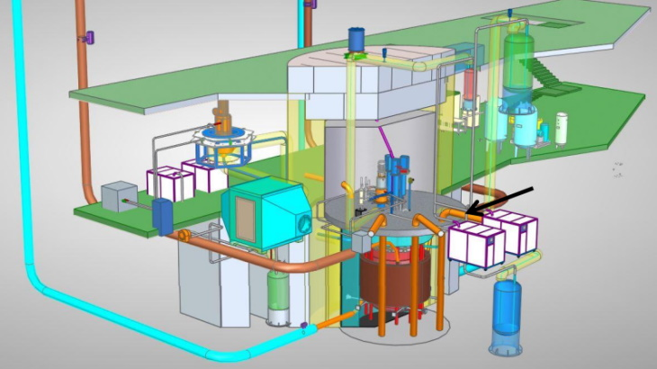
O2.3-704
Molten Salt Reactor (MSR) Off-Gas System Efficiency and Its Possible Impact on Radioxenon Release Trajectory Estimations
Sri Sundari Retnoasih
TMSR-LF1
China’s thorium molten-salt, liquid-fuel experimental reactor (2 MWt) developed by SINAP / Chinese Academy of Sciences in Wuwei, Gansu.
Fuel & salt system: UF₄ (driver, <20% U-235) dissolved in FLiBe; thorium inventory ~50 kg; fertile Li-7–enriched FLiBe blanket; conversion ratio ≈ 0.1.
Site / coordinates: Hongshagang, Minqin (Wuwei), Gansu — approx 38.57°N, 102.36°E
Continuous fission-gas handling:strip xenon/kryptonoff-gas linehow much radioxenon escapes
IMS relevance:larger Xe-133 / Xe-131m emissionsIMS station detections, where transport exists, off-gas efficiency becomes the key control for the detection
A cutaway of the TMSR-LF1 reactor (Image: SINAP)

Slide 5
O2.3-704
Molten Salt Reactor (MSR) Off-Gas System Efficiency and Its Possible Impact on Radioxenon Release Trajectory Estimations
Sri Sundari Retnoasih
Objectives
TMSR-LF1
Trajectory Plots in Full Power Operation
RN IMS impacted
Efficiency of the Off Gas System Impact
Probability of Detection
The study provides a preliminary estimation of radioxenon transport from the TMSR-LF1 molten salt reactor in Gansu Province, China, following its first full-power operation on 17 June 2024. Trajectory analyses are applied to approximate the atmospheric dispersion of xenon releases and their potential arrival at nearby IMS radionuclide monitoring stations (RN20, RN21, RN38). The role of off-gas system efficiency is also examined, as it critically influences both the scale of xenon emissions and the probability of detection.

Slide 6
O2.3-704
Molten Salt Reactor (MSR) Off-Gas System Efficiency and Its Possible Impact on Radioxenon Release Trajectory Estimations
Sri Sundari Retnoasih
Methodology
TMSR-LF1 Source
Trajectory Modeling
HYSPLIT Forward & Backward
Period:
17-22 June 2024
Stations Analyzed
RN20, RN21, RN38
RDI formula.
Integration: 120h
Wfreq​=0.25
Xe-133 half-life = 126 h

Slide 7
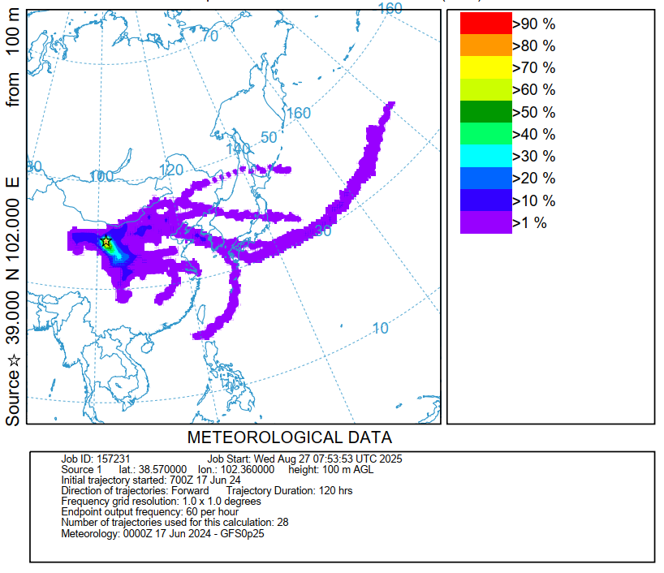
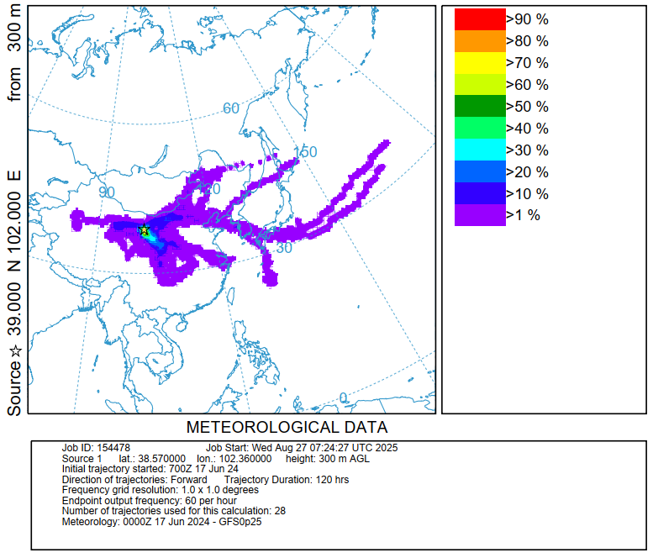
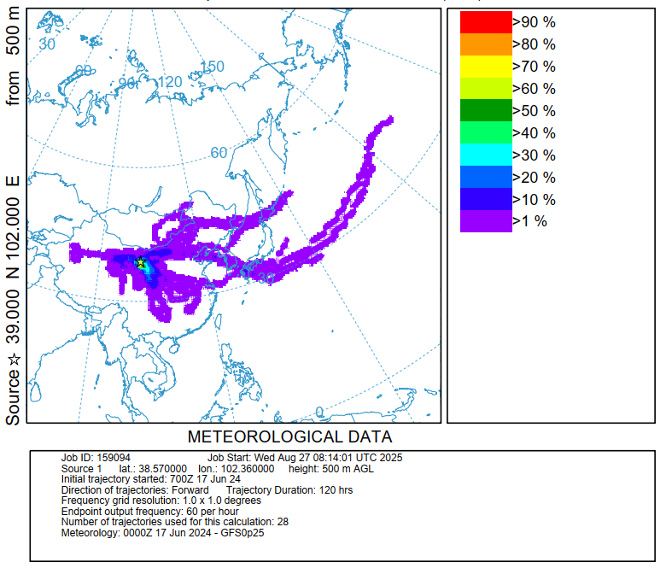
O2.3-704
Molten Salt Reactor (MSR) Off-Gas System Efficiency and Its Possible Impact on Radioxenon Release Trajectory Estimations
Sri Sundari Retnoasih
Results
HYSPLIT Trajectory Plots (Forward)

Slide 8
O2.3-704
Molten Salt Reactor (MSR) Off-Gas System Efficiency and Its Possible Impact on Radioxenon Release Trajectory Estimations
Sri Sundari Retnoasih
Results
Possible Impact of the Radioxenon Trajectory Plots to their potential arrival at nearby IMS radionuclide monitoring stations (RN20, RN21, RN38)
Height (AGL) | RN21 (36N,104E) | RN20 (40N,116.4E) | RN38 (36.3N,139.1E) | Notes
100 m | Unlikely | Possible (weaker) | Unlikely | Localized, short-range eastward flow
300 m | Unlikely | Likely | Possible (occasional) | Stronger eastward reach, mid-transport
500 m | Unlikely | Likely | Possible → higher than at 300 m | Long-range reach toward Japan within 120 h

Slide 9
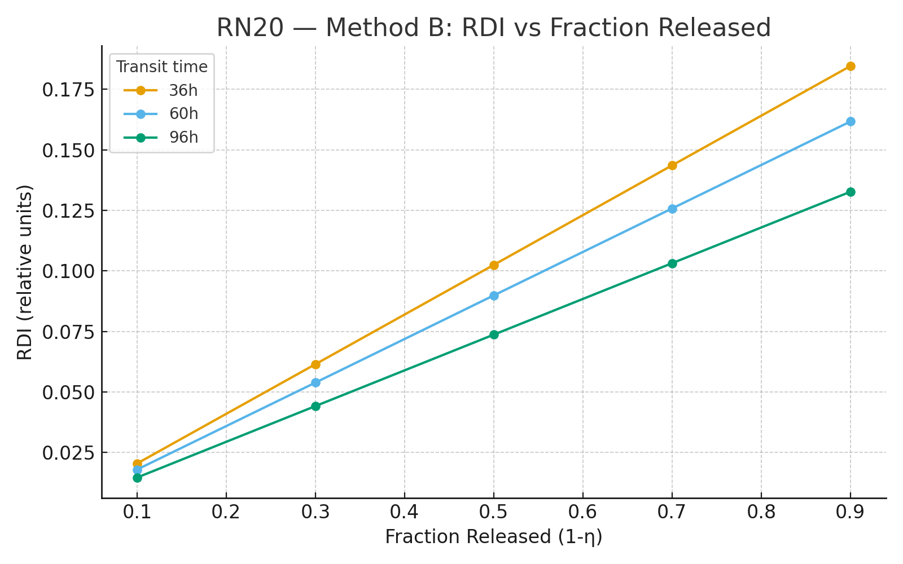

O2.3-704
Molten Salt Reactor (MSR) Off-Gas System Efficiency and Its Possible Impact on Radioxenon Release Trajectory Estimations
Sri Sundari Retnoasih
Results
Efficiency of the Off-Gas System and Relative Detection Index
RN20: RDI vs Fraction release
$$RDI=\left(1−η\right) x \%freq x e^{−λt}$$
RDI = Relative Detection Index
= efficiency
For RN20:
%freq​=0.25
Xe-133 half-life = 126 h

Slide 10
O2.3-704
Molten Salt Reactor (MSR) Off-Gas System Efficiency and Its Possible Impact on Radioxenon Release Trajectory Estimations
Sri Sundari Retnoasih
Conclusions
Off-gas efficiency = key factor
Higher efficiency → minimal xenon escape; low efficiency → stronger IMS detection potential.
RN20 most impacted
HYSPLIT shows highest transport probability to RN20; RN38 only occasional, RN21 minimal.
Relative Detection Index (RDI)
By combining off-gas release fraction, transport frequency, and Xe-133 decay survival, RDI offers a dimensionless measure of relative detectability. Results show that RN20 consistently yields higher RDI values across efficiency scenarios, particularly under longer release durations and low off-gas efficiency.
Verification relevance
Results highlight how MSR off-gas systems affect IMS background and CTBT monitoring confidence.

Slide 11
O2.3-704
Molten Salt Reactor (MSR) Off-Gas System Efficiency and Its Possible Impact on Radioxenon Release Trajectory Estimations
Sri Sundari Retnoasih
Limitation and Further Research
Source strength (1×10¹⁰ Bq/d)
A more accurate source term for a 2 MW TMSR prototype would require reactor-specific fission yield data, which is not yet publicly available.
First day of full power
June 17, 2024 (first full power) demonstrates the worst-case timing of plume transport. Xenon inventory builds up during operation; future work should extend to equilibrium conditions.
Release heights
The chosen heights (100–1000 m) are sensitivity tests. The actual TMSR-LF1 stack height is likely much lower (~30–50 m). More robust simulations should use the real design parameters once available.
Transport times + decay factors
Transport times to IMS stations (RN20, RN21, RN38) not explicitly shown; future work should quantify decay correction (Xe-133 half-life 126 h) for each station transit time.

Slide 12
O2.3-704
Molten Salt Reactor (MSR) Off-Gas System Efficiency and Its Possible Impact on Radioxenon Release Trajectory Estimations
Sri Sundari Retnoasih
References
Turner, D. B. (1994). Workbook of Atmospheric Dispersion Estimates: An Introduction to Dispersion Modeling. CRC Press.
Beychok, M. R. (2005). Fundamentals of Stack Gas Dispersion. 4th ed. Milton R. Beychok.
Arya, S. P. (1999). Air Pollution Meteorology and Dispersion. Oxford University Press.
Stein, A. F., Draxler, R. R., Rolph, G. D., Stunder, B. J. B., Cohen, M., & Ngan, F. (2015). NOAA’s HYSPLIT Atmospheric Transport and Dispersion Modeling System. Bulletin of the American Meteorological Society, 96(12), 2059–2077.
Stohl, A., et al. (2005). Technical note: The Lagrangian particle dispersion model FLEXPART version 6.2. Atmospheric Chemistry and Physics, 5, 2461–2474.
Maurer, C., et al. (2018). Long-range transport of CTBT-relevant radioxenon isotopes by ensemble modeling. Journal of Environmental Radioactivity, 192, 635–647.
Tinker, R., et al. (2010). Evaluation of radioxenon releases in Australia using trajectory modeling. Journal of Environmental Radioactivity, 101(10), 798–803.
Kalinowski, M. B., & Pistner, C. (2006). Isotopic signature of xenon in reactor releases and atmospheric background. Pure and Applied Geophysics, 163, 351–364.
Ringbom, A., et al. (2009). Radioxenon detection for verification of the CTBT. Nuclear Instruments and Methods in Physics Research A, 607, 266–273.
Becker, A., et al. (2007). Analysis of atmospheric radioxenon data in support of CTBT verification. Pure and Applied Geophysics, 164, 1893–1908.
Bowyer, T. W., et al. (2002). Detection and analysis of xenon isotopes for CTBT verification. Journal of Environmental Radioactivity, 59(2), 139–151.
International Atomic Energy Agency (IAEA). (2005). Status of Molten Salt Reactor Research and Technology. IAEA-TECDOC-1450.
LeBlanc, D. (2010). Molten salt reactors: A new beginning for an old idea. Nuclear Engineering and Design, 240(6), 1644–1656.
Retnoasih, T. (2023). Radioxenon dispersion from the TMSR-LF1 reactor in China. [Conference contribution / CTBTO SnT 2023].
NRC (1987). MELCOR Accident Consequence Code System (MACCS): Model Description. NUREG/CR-4691, U.S. Nuclear Regulatory Commission.

Slide 13
O2.3-704
Molten Salt Reactor (MSR) Off-Gas System Efficiency and Its Possible Impact on Radioxenon Release Trajectory Estimations
Sri Sundari Retnoasih
Thank you!
Do you have any questions?
sundari.nosi@gmail.com;
sris014@brin.go.id
https://www.linkedin.com/in/sundari-r-467680196/;

