Slide 1
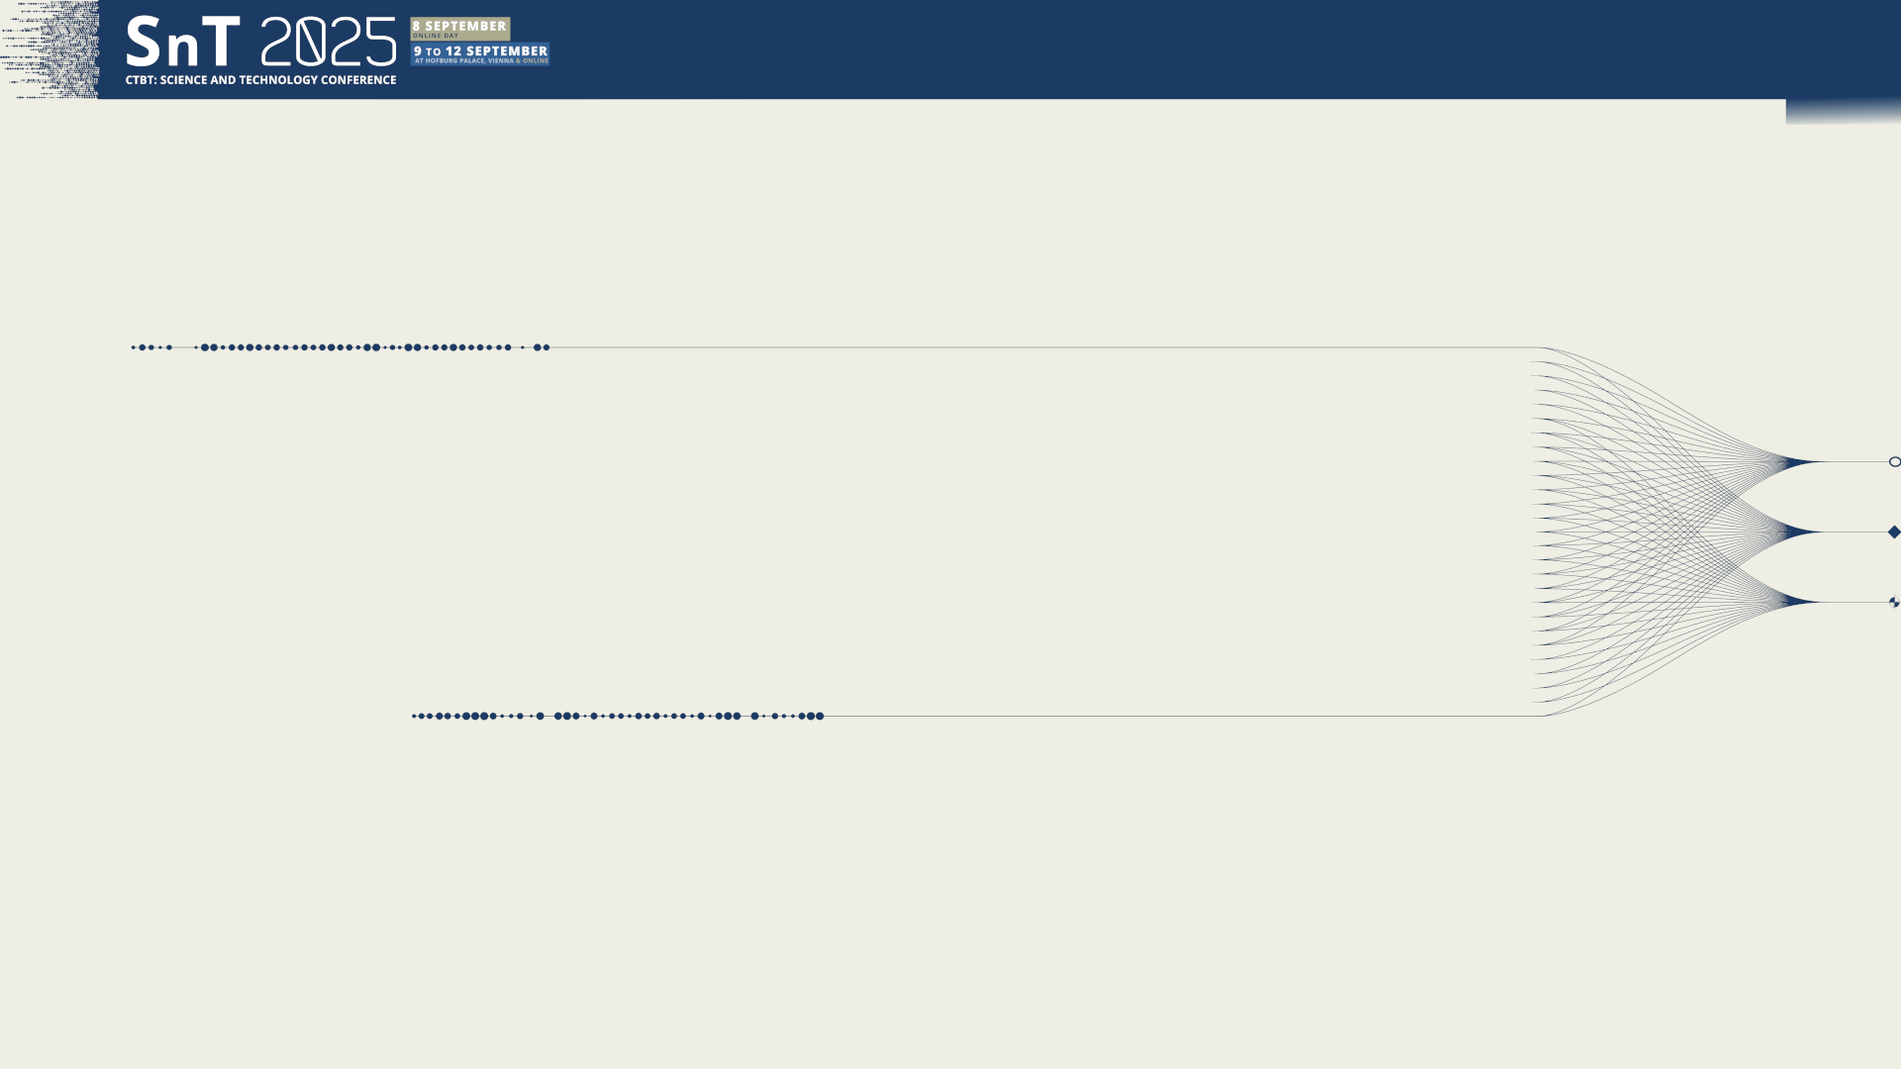

O2.3-715
Impact of Nuisance Background on Source Location
Paul W. Eslinger
Ramesh Sarathi
Brian Schrom
Cari Siefert
Pacific Northwest National Laboratory
Richland, WA USA
Presentation Date: 10 Sep. 2025

Slide 2
O2.3-715
Impact of Nuisance Background on Source Location Models
Paul W. Eslinger, Ramesh Sarathi, Brian Schrom, Cari Siefert
Motivation
Most source-term algorithms for atmospheric releases assume there is no influence from nuisance sources
Industrial sources result in a world-wide background of xenon isotopes that are also useful for detecting nuclear explosions
A source-location algorithm has been developed that explicitly accounts for nuisance sources
This work evaluates algorithm performance using a data set with 384 synthetic release events containing ¹³³Xe
  Can we identify a small release of ¹³³Xe in the presence of background sources?
  Is there a threshold below which the release is masked by the nuisance sources?

Slide 3
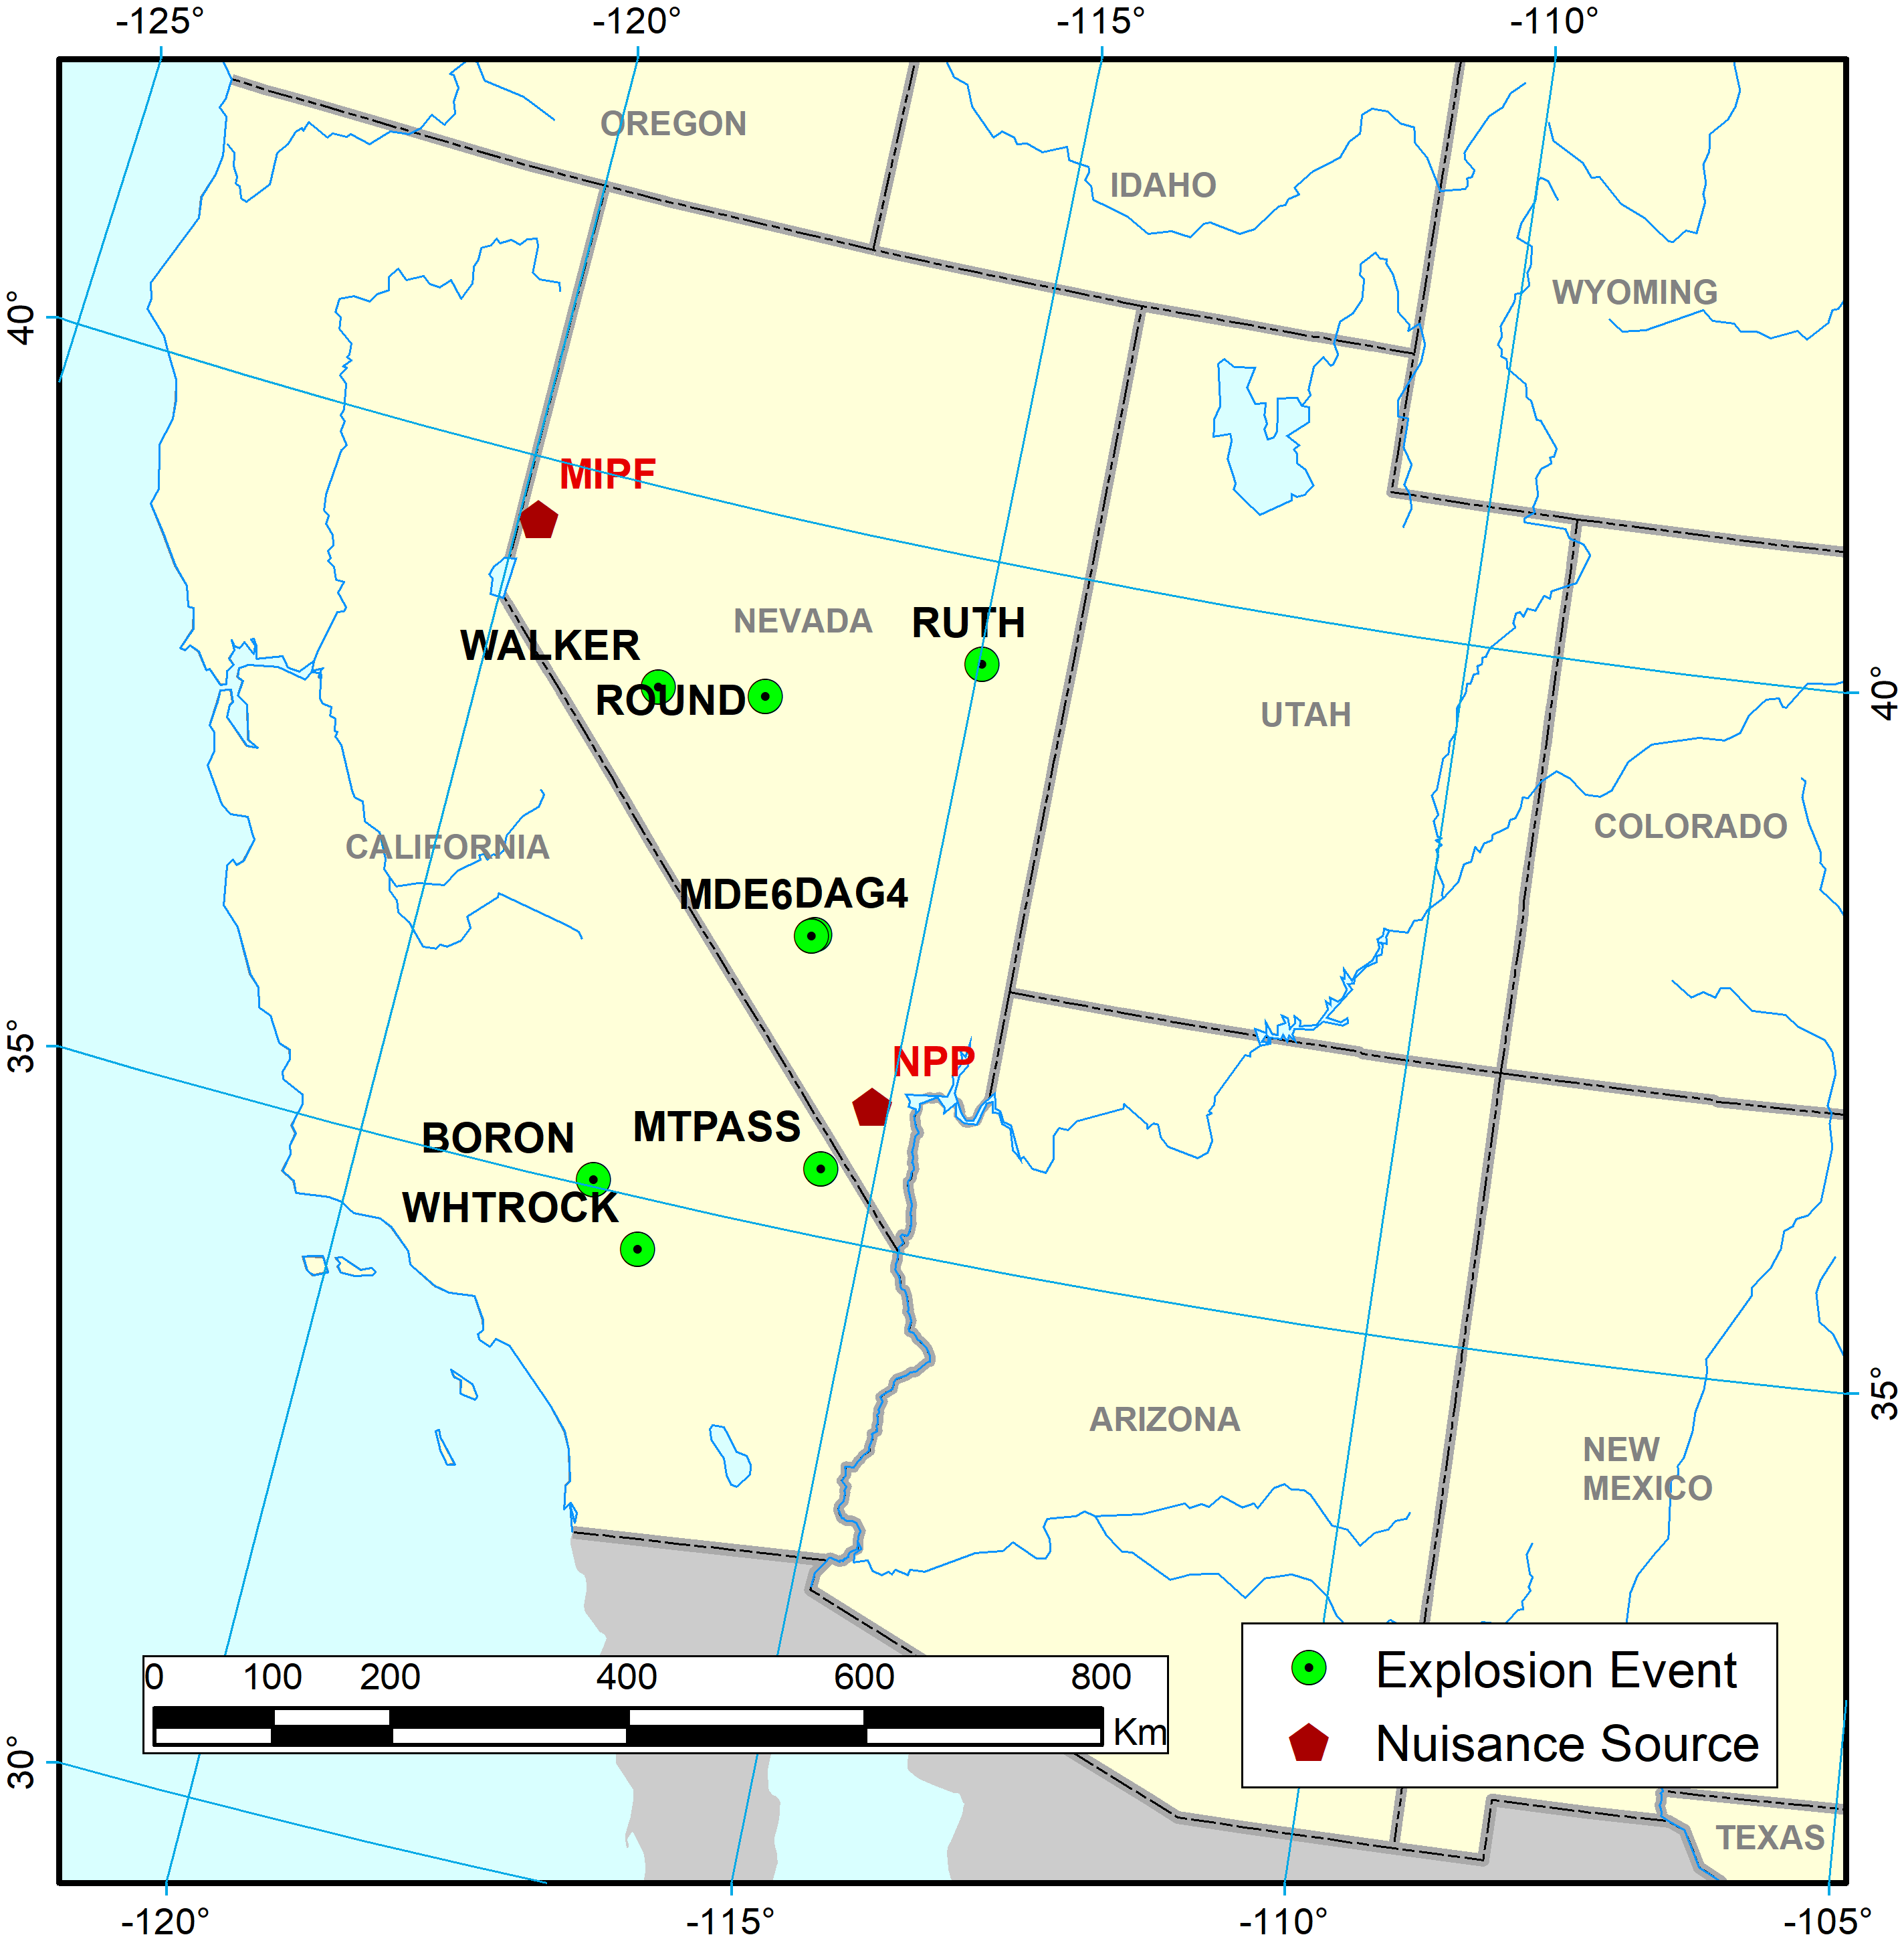
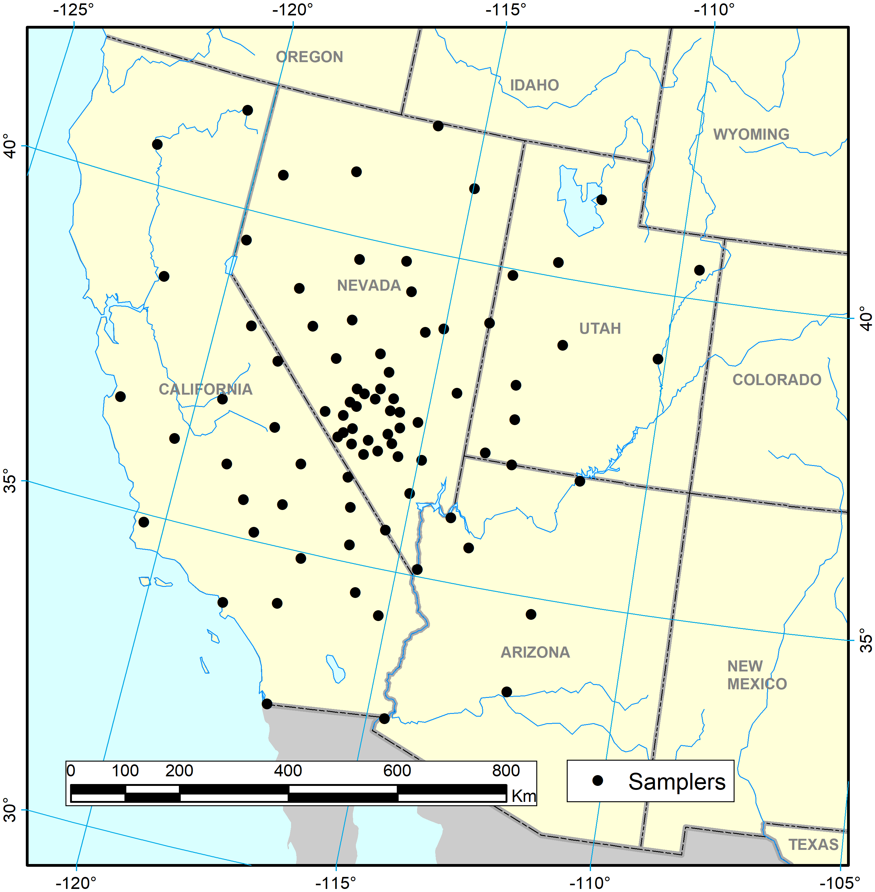
O2.3-715
Impact of Nuisance Background on Source Location Models
Paul W. Eslinger, Ramesh Sarathi, Brian Schrom, Cari Siefert
Release and Sampling Locations
Sampler Characteristics: Brander, S., Baur, S., et al., 2022. J. Environ. Radioact. doi:10.1016/j.jenvrad.2022.107034

Slide 4
O2.3-715
Impact of Nuisance Background on Source Location Models
Paul W. Eslinger, Ramesh Sarathi, Brian Schrom, Cari Siefert
Release Setting
384 synthetic “explosion” release cases
Two nuisance sources with continuous releases
  Nuclear power plant (NPP): 10¹⁰ Bq per day
  Medical isotope production facility (MIPF): 10¹⁰ Bq per day
Atmospheric conditions
  Use 4 ten-day periods spaced over 18 months (summer and winter)
Sample concentrations developed using Hysplit based on high resolution WRF runs (900 m spatial resolution, 15 minute outputs) in time-forward mode
Source-term estimation done using Hysplit and NOAA’s High Resolution Rapid Refresh (HRRR) meteorological data (3 km spatial resolution, 1 hour outputs) in time-reversed mode

Slide 5
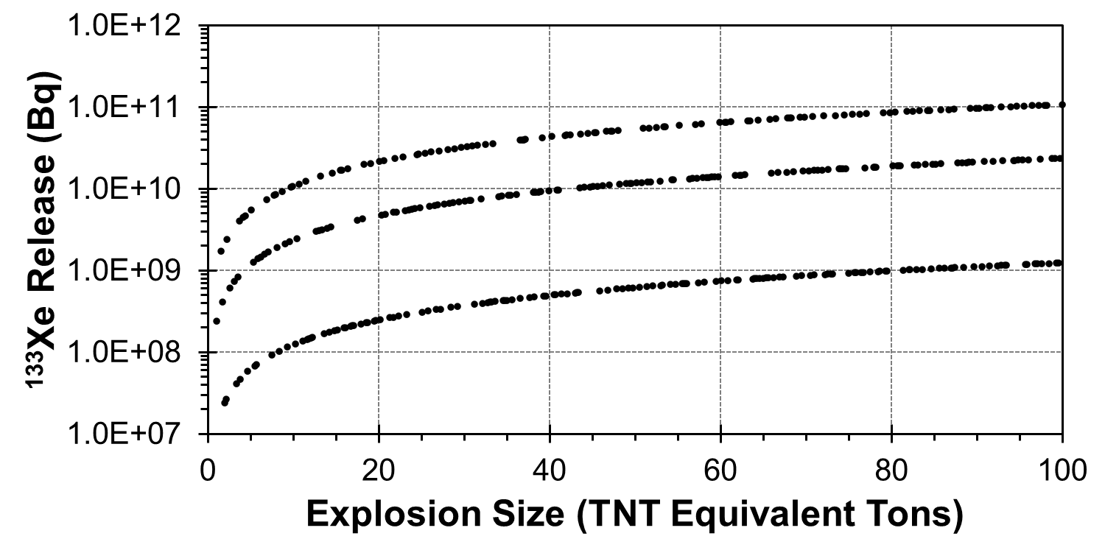
O2.3-715
Impact of Nuisance Background on Source Location Models
Paul W. Eslinger, Ramesh Sarathi, Brian Schrom, Cari Siefert
Releases of ¹³³Xe from Fission Events
Delayed release (30 h)
Delayed release (6 h)
Prompt release (no delay)
Releases are a 10⁻⁴ fraction of the ¹³³Xe that was produced.

Slide 6
O2.3-715
Impact of Nuisance Background on Source Location Models
Paul W. Eslinger, Ramesh Sarathi, Brian Schrom, Cari Siefert
Estimation Model Overview
Uses a Bayesian framework
Can estimate releases from two nuisance facilities
  Known locations
  Unknown release rates (allowed to change every 3 h)
Searches for a single release event with unknown release time, duration, location, and magnitude
Use samples spanning about a week in time
Eslinger, P.W., J.M. Mendez, and B.T. Schrom. 2019. "Source Term Estimation in the Presence of Nuisance Signals." J Environ Radioact 203:220-225. doi:10.1016/j.jenvrad.2019.03.022

Slide 7
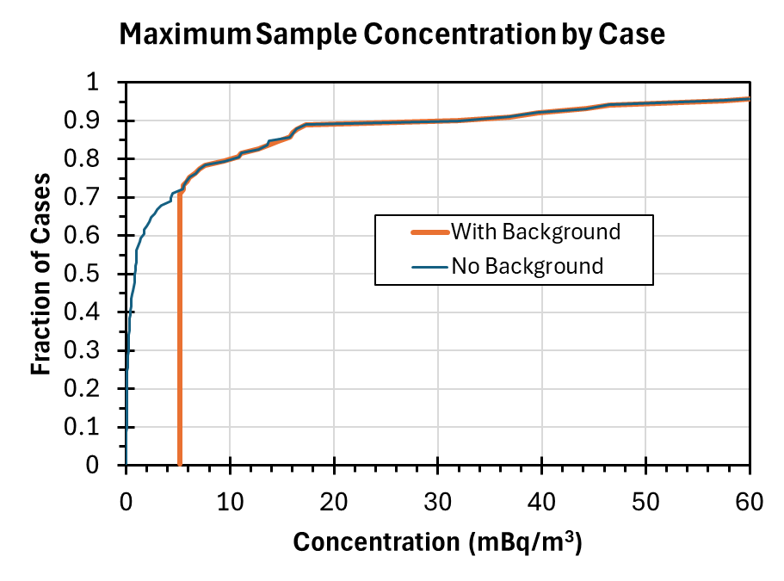
O2.3-715
Impact of Nuisance Background on Source Location Models
Paul W. Eslinger, Ramesh Sarathi, Brian Schrom, Cari Siefert
Comments on Samples (¹³³Xe)
Explosion emissions (no background)
  384 release cases (84 samplers)
  254 cases can be estimated (have detections)
    7 cases with all zero concentrations
    123 cases with all concentrations less than MDC
    40 cases with 1 detection
    214 cases with 2 or more detections
Combined with background emissions
  All 384 cases can be estimated
  123 of the cases have an “explosion” term that is greater than 0 but less than the MDC
  Nuisance sources contribute from 5 to 28 mBq/m³ to maximum samples (depending on the week)
The explosion caused the largest sample in only about 30% of the cases during this week.
Maximum sample concentrations for a one-week time period (96 cases)
Use samples for an entire week in the estimation
All release cases are superimposed on the same background (for that time period)
The nuisance sources dominate the sample concentrations for about 70% of the cases

Slide 8
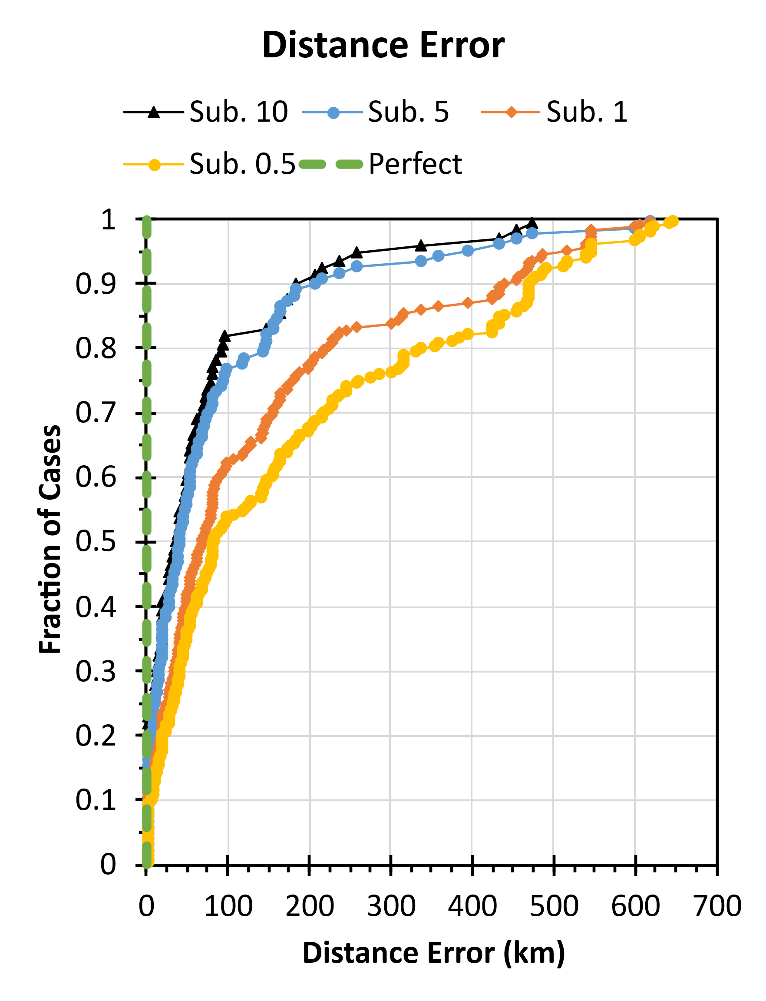
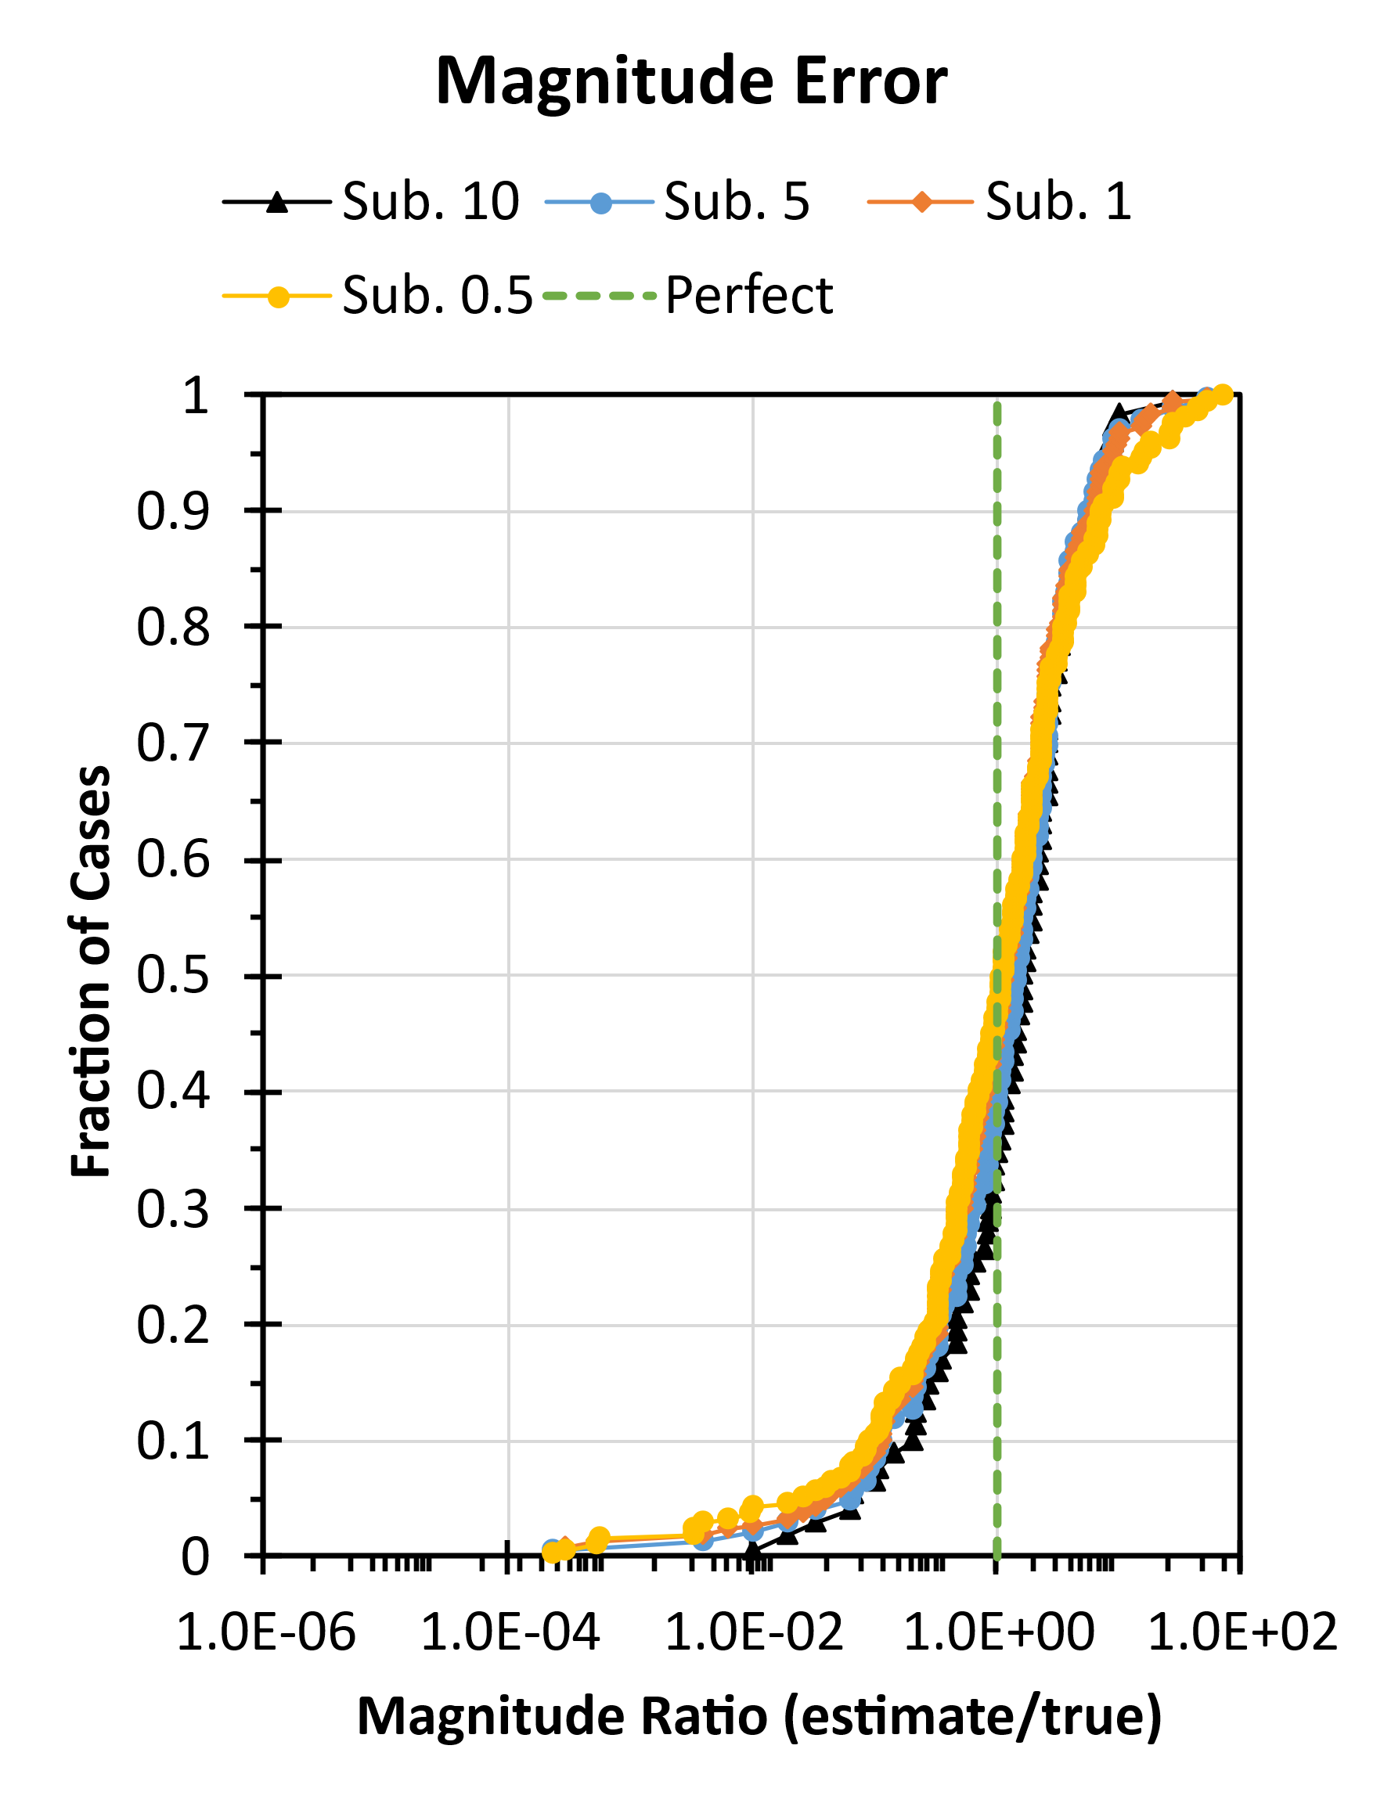
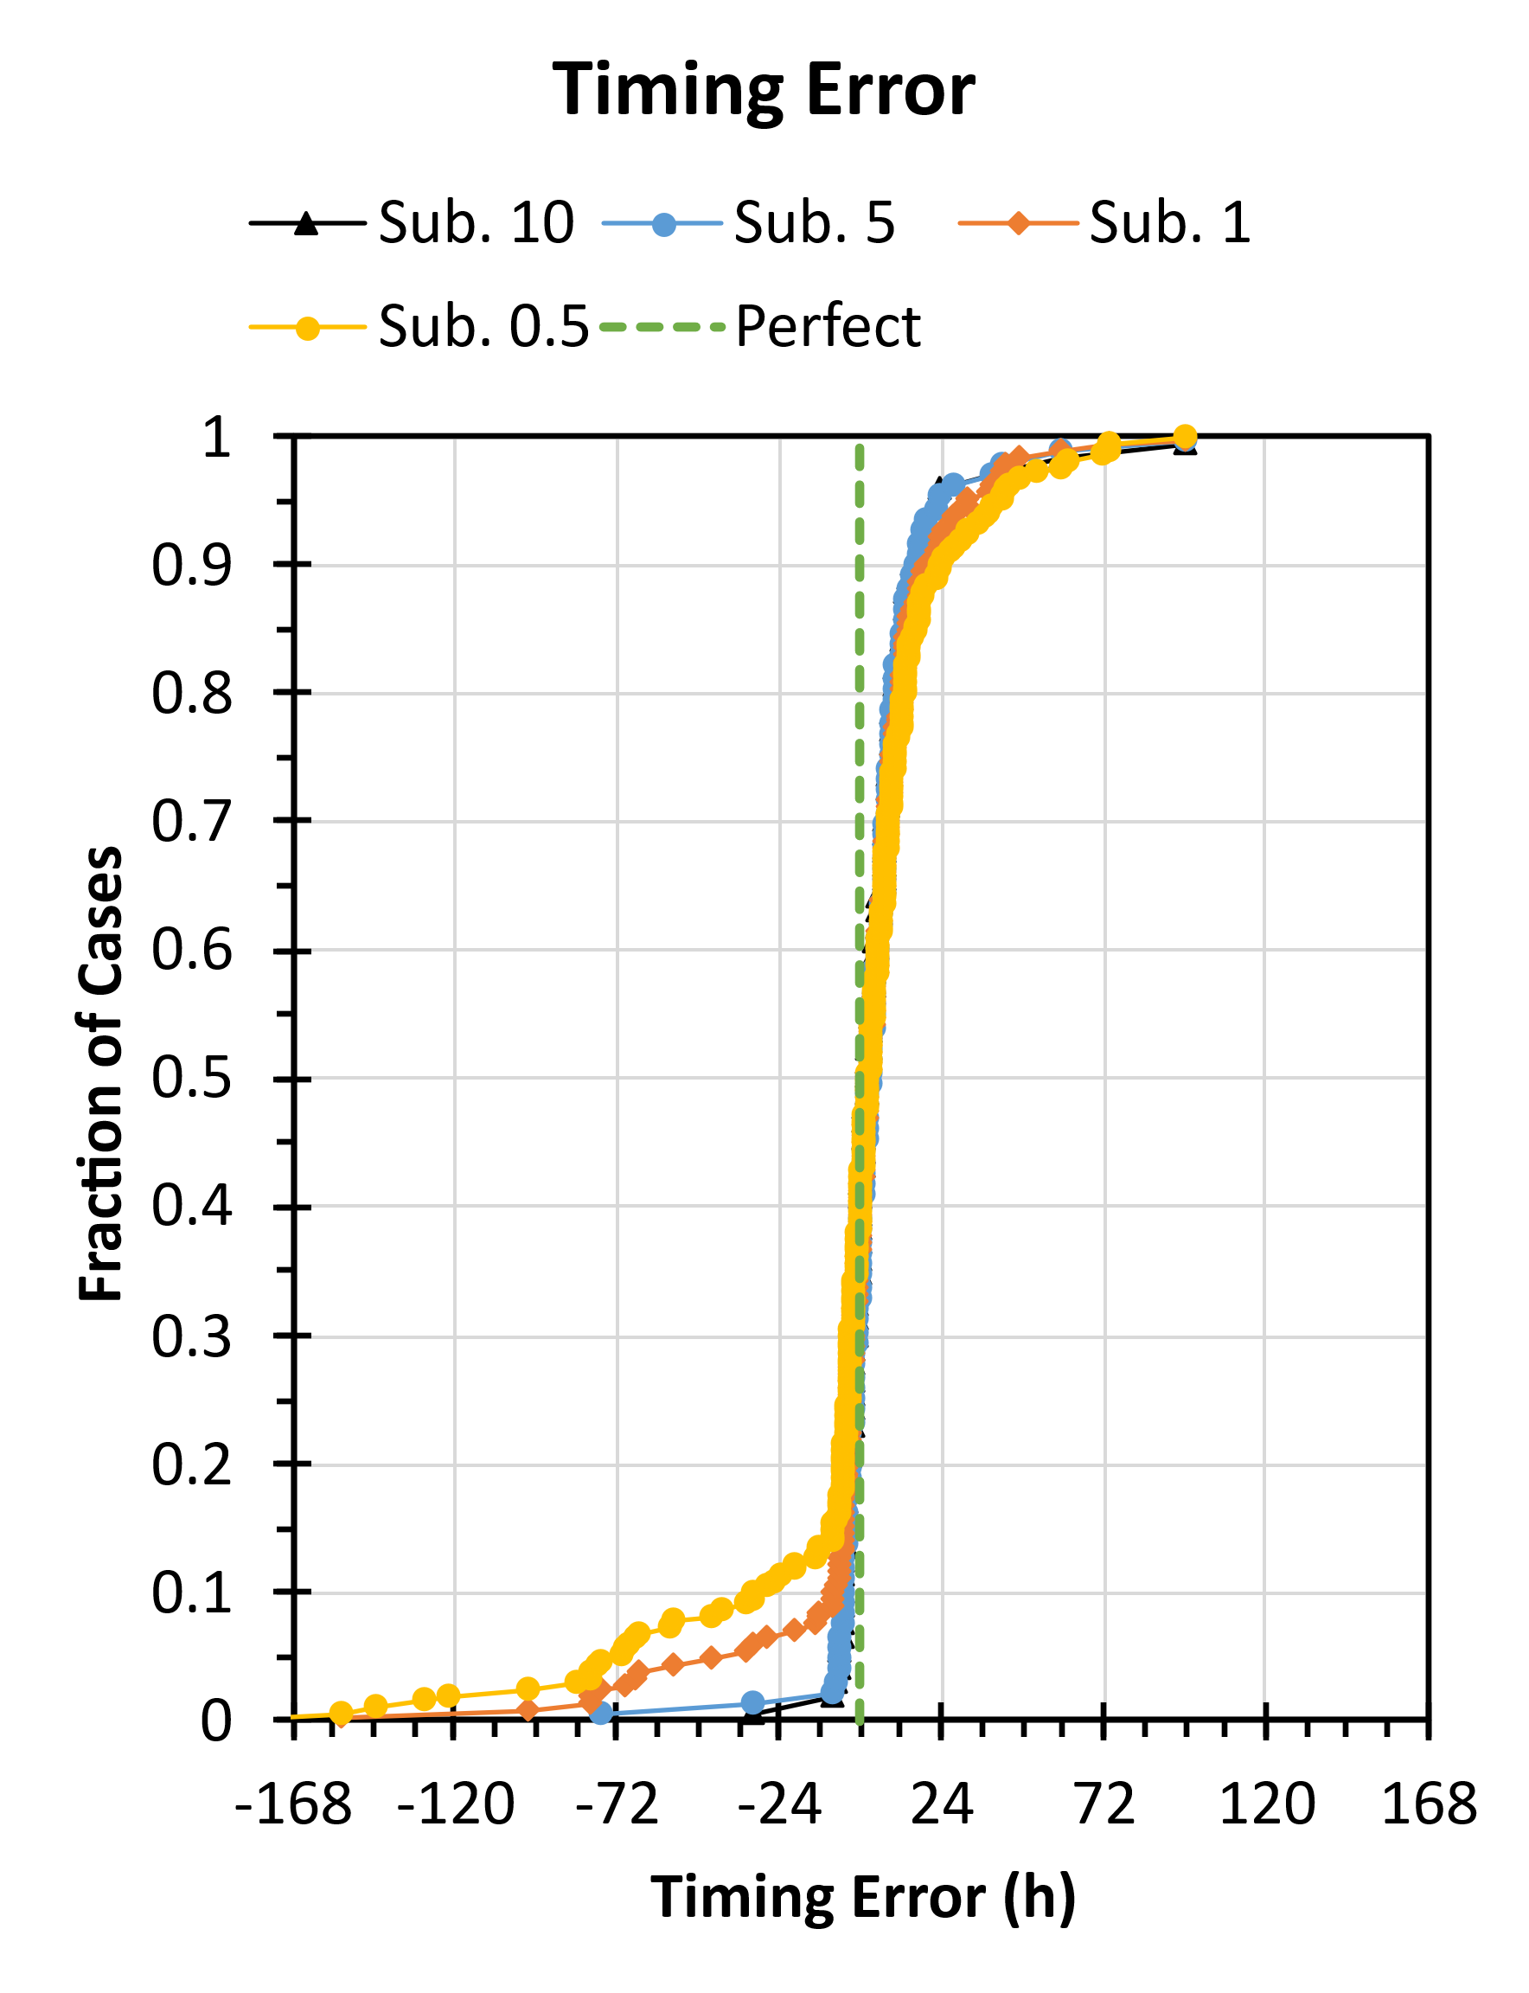
O2.3-715
Impact of Nuisance Background on Source Location Models
Paul W. Eslinger, Ramesh Sarathi, Brian Schrom, Cari Siefert
When do nuisance sources mask the release from a short-duration explosion?
Results
Subset the release cases so the explosion causes increases at least one ¹³³Xe sample by:
  0.5 mBq/m³ : 226 cases
  1.0 mBq/m³ : 195 cases
  5.0 mBq/m³ : 114 cases
  10 mBq/m³ : 85 cases
The major source of estimation error is using one atmospheric model to generate sample concentrations (forward-time runs) and a different model in the source-term estimation (reversed-time runs).
At least one sample with an increment of 1 to 5 mBq/m³ is needed to overcome most of the obfuscation from background sources.

Slide 9
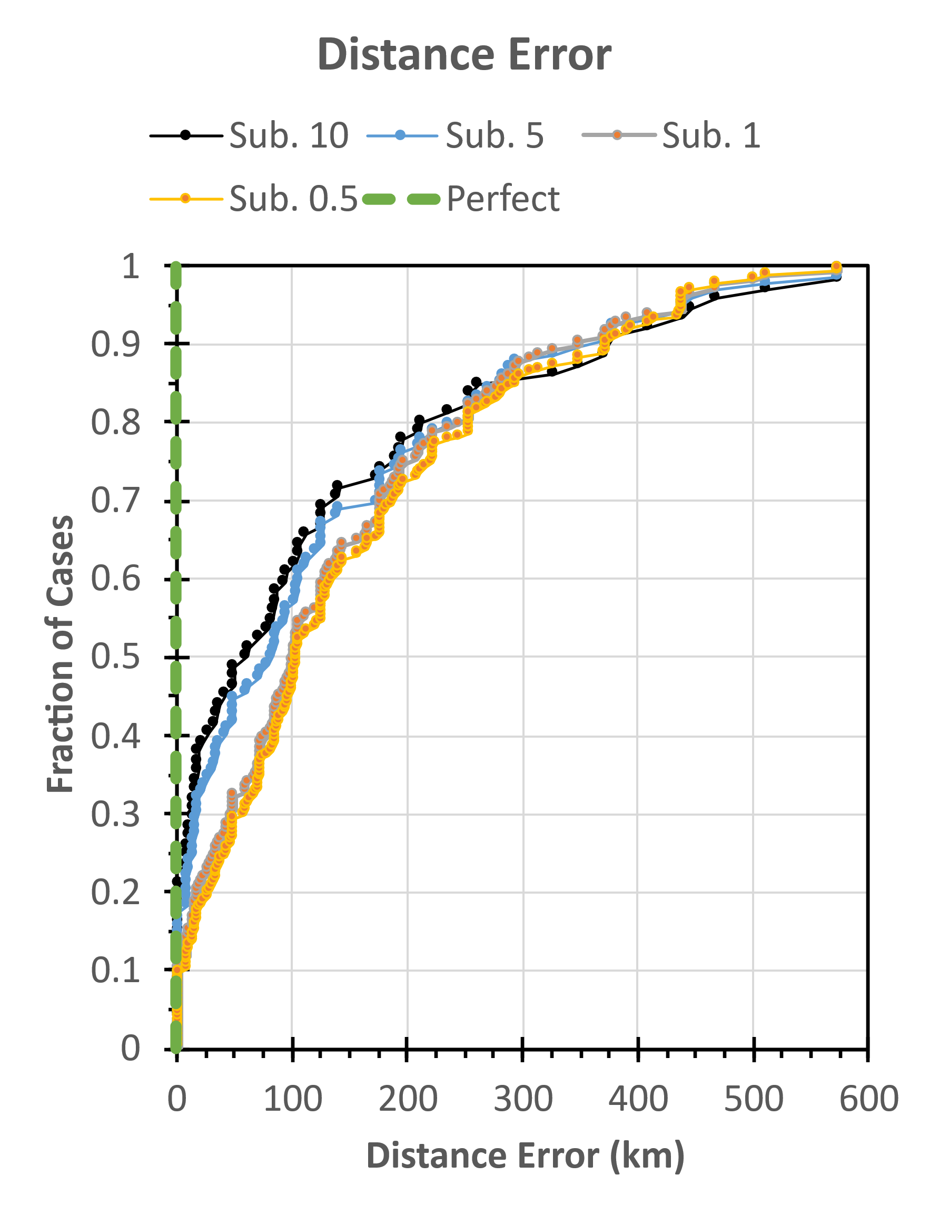
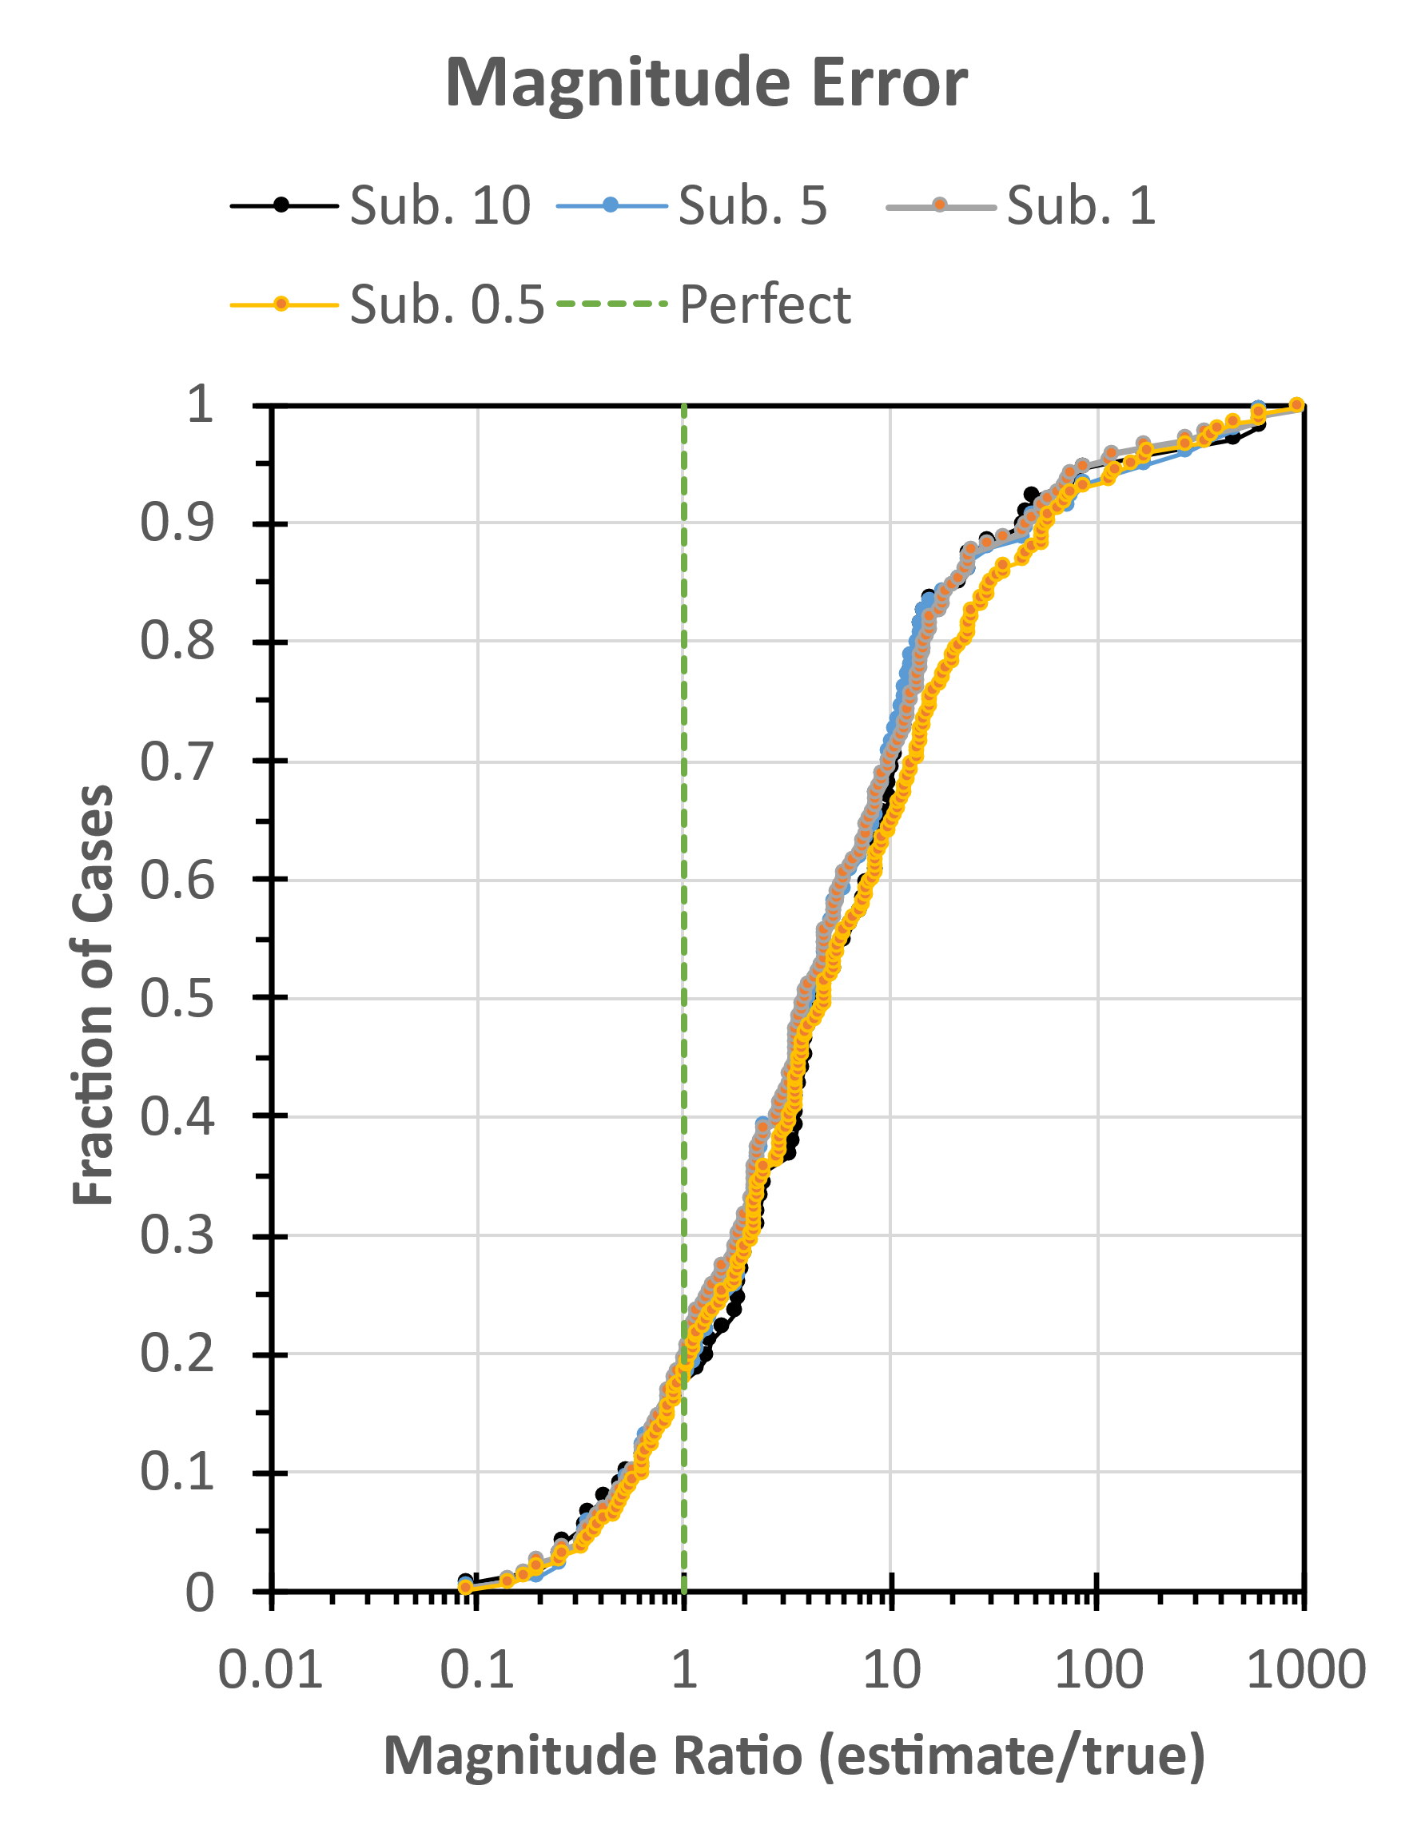
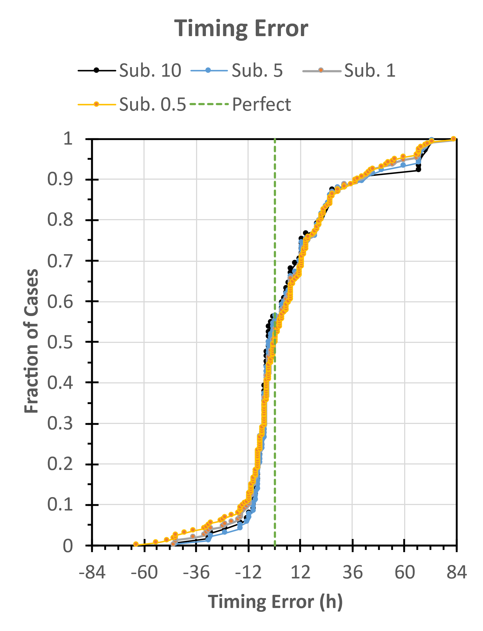
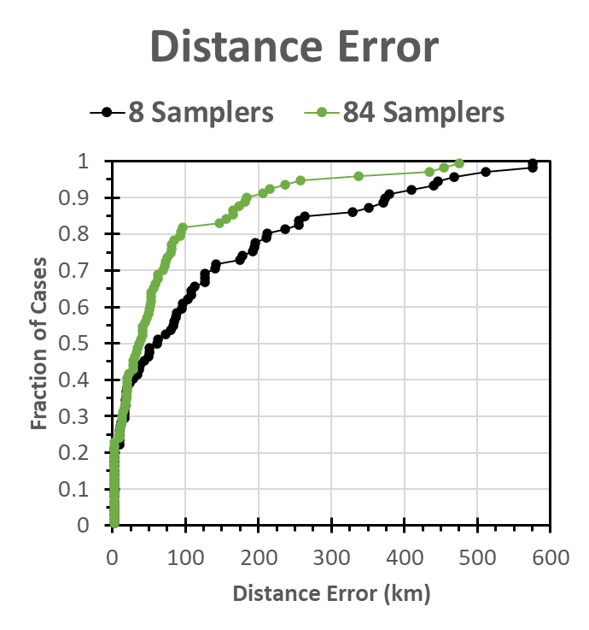
O2.3-715
Impact of Nuisance Background on Source Location Models
Paul W. Eslinger, Ramesh Sarathi, Brian Schrom, Cari Siefert
Results Using Only 8 Samplers
Subset the release cases so the explosion causes increases at least one ¹³³Xe sample by:
  0.5 mBq/m³ : 209 cases
  1.0 mBq/m³ : 181 cases
  5.0 mBq/m³ : 111 cases
  10 mBq/m³ : 83 cases
Lose 40 more cases with no explosion contribution relative to 84 samplers. Magnitude estimates are biased high. Timing error is mostly unchanged.
10 mBq/m³ cases
Location accuracy degrades significantly.
At least one sample with an increment 5 mBq/m³ helps overcome the obfuscation from background sources.

Slide 10
O2.3-715
Impact of Nuisance Background on Source Location Models
Paul W. Eslinger, Ramesh Sarathi, Brian Schrom, Cari Siefert
In Summary
As expected:
  In some cases, it is possible to estimate release characteristics even in the presence of background emissions (especially for large releases)
  Release events resulting in small sample concentrations may be hidden by the background emissions
However:
  In some situations, the release can be detected even when the sample increments caused by the release event are much smaller than the largest sample concentrations caused by the nuisance sources

Slide 11
O2.3-715
Impact of Nuisance Background on Source Location Models
Paul W. Eslinger, Ramesh Sarathi, Brian Schrom, Cari Siefert
Questions?
Questions?
This Low-Yield Nuclear Monitoring (LYNM) research was funded by the National Nuclear Security Administration, Defense Nuclear Nonproliferation Research and Development (NNSA DNN R&D). The authors acknowledge important interdisciplinary collaboration with scientists and engineers from LANL, LLNL, NNSS, PNNL, and SNL. The views expressed here do not necessarily reflect the opinion of the United States Government, the United States Department of Energy, or Pacific Northwest National Laboratory.

