Slide 1

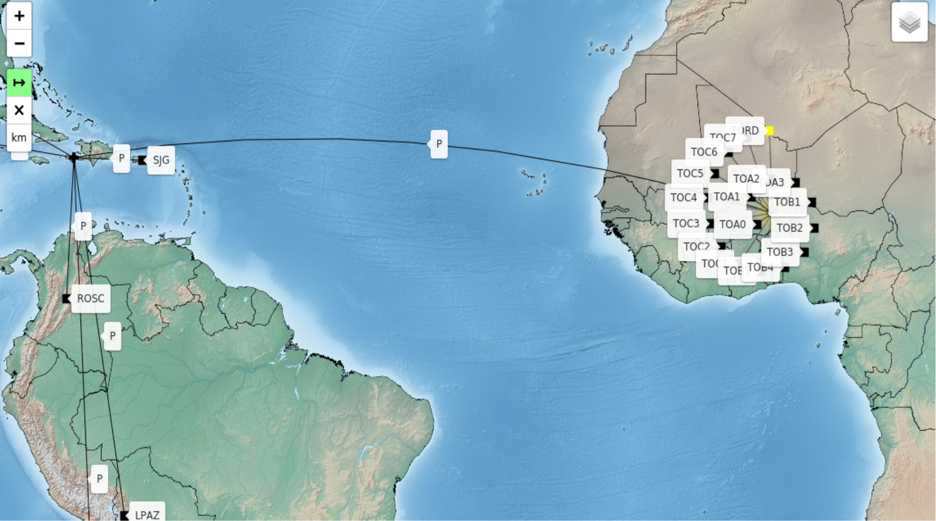
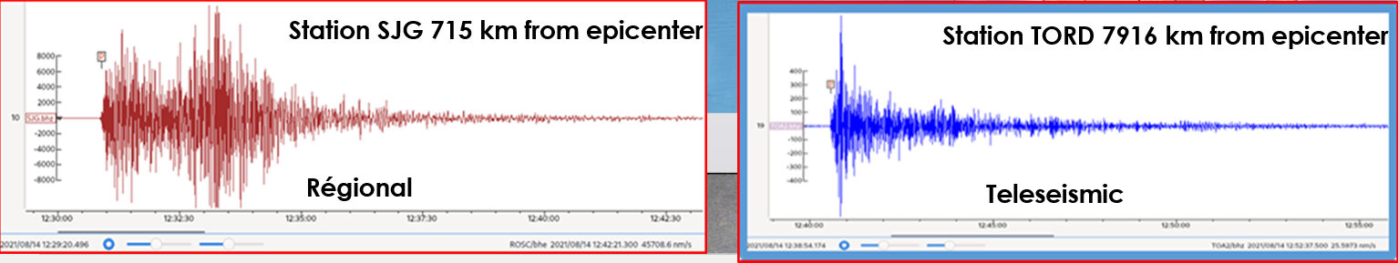
Delineation of Nuclear test event from Earthquake based on Teleseismic data of ps26
Idé Alpha Djibrilla
P2.2-350
Come over to see our poster if you would like to find out more about:
PS26 data Related to Earthquake and DPRK Nuclear test.
  The Difference of SNR from regional and Teleseismic data related such events
DISCLAIMER: This presentation has been generated for illustration purposes only

