Slide 1

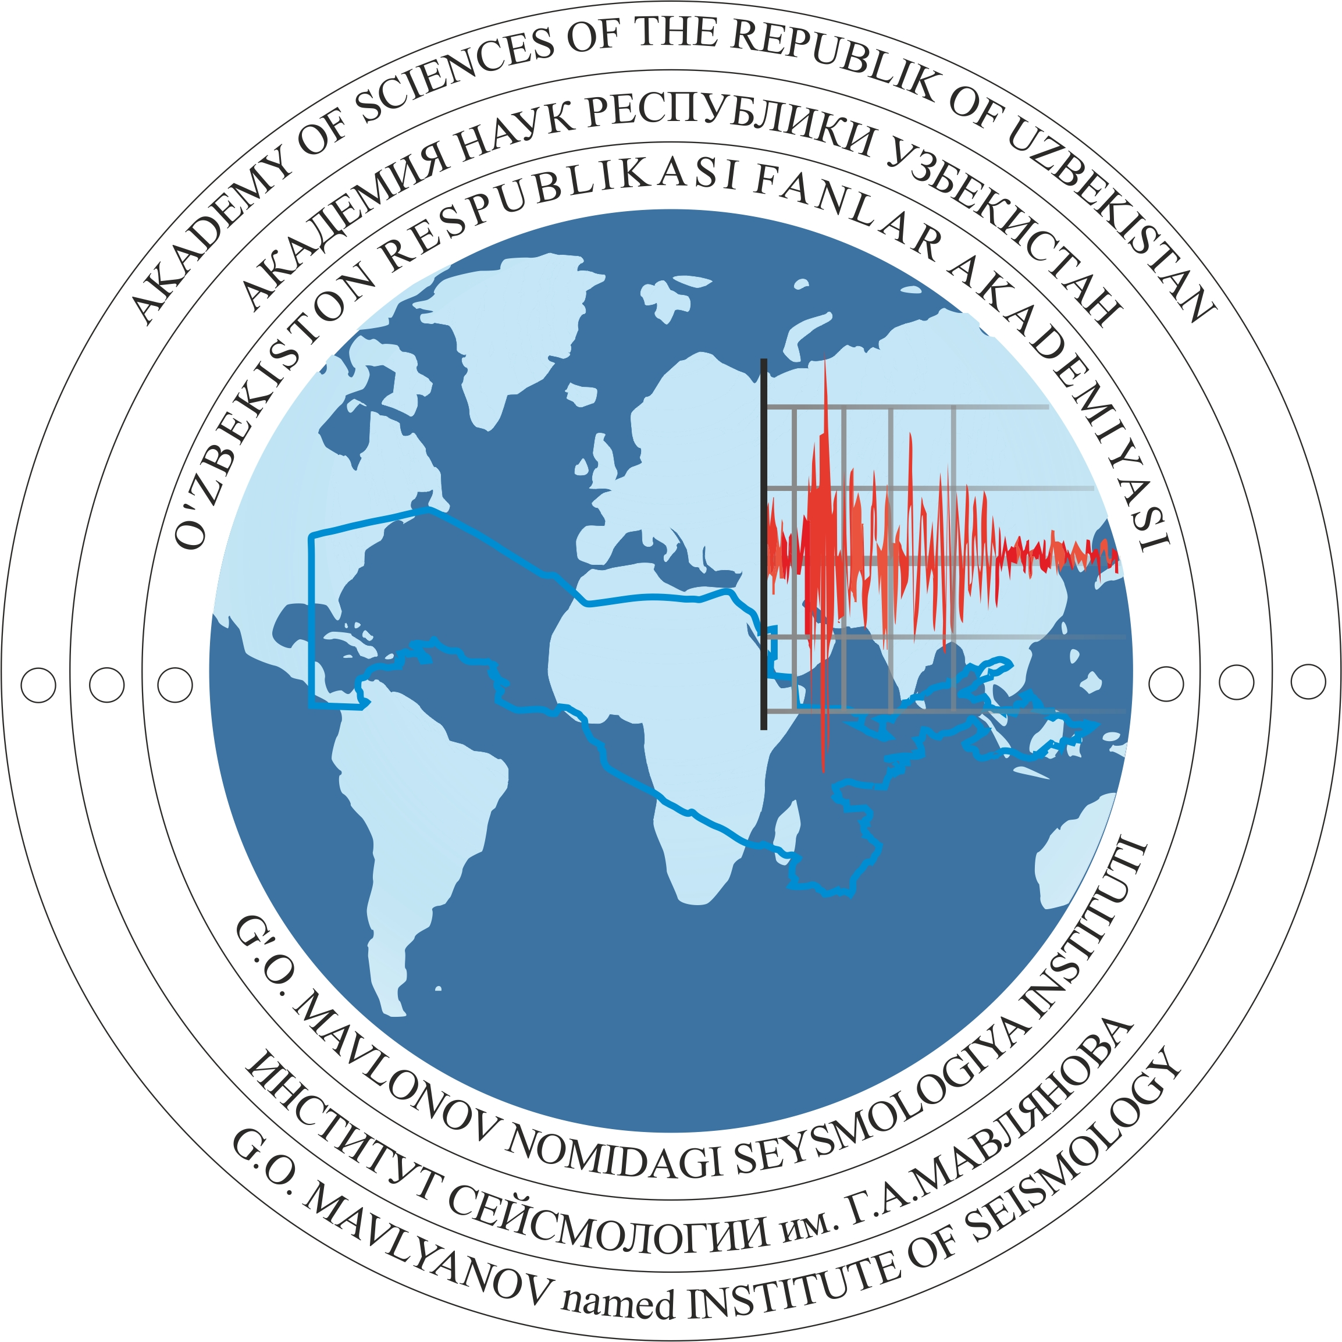
P2.2-086
Presence of an acoustic signal on seismograms after a man-made event
Bakhodir Alimov, Timur Kurbanov.
Institute of Seismology at the Academy of Sciences of the Republic of Uzbekistan
This poster presents the detection of acoustic signals on seismograms following a man-made explosion.
I will explain why this is important: identifying acoustic phases helps distinguish explosions from natural earthquakes and improves the reliability of monitoring systems.
I analyzed seismograms from several broadband stations after industrial explosions. Delayed low-frequency signals matching acoustic-wave characteristics were observed, with velocities between 0.27 and 0.41 km/s.
I also examined how temperature affects propagation velocity and performed spectral analysis. The most important result of our work is that acoustic waves were consistently observed and can serve as a clear indicator of anthropogenic origin, supported by velocity–distance regression and a frequency peak.
For more details, please visit our poster.

