Slide 1


Introduction Slide Title goes here [Font: Arial Bold/Size: 16]
P2.2-620
Revisiting the Democratic People's Republic of Korea nuclear tests
Raluca Dinescu¹, Iulia Armeanu¹, Daniela Ghica¹, Raluca Molea¹
1 National Institute for Earth Physics
This presentation provides insights to the nuclear tests in DPRK with focus on seismic analysis. It applies discrimination methods as mb-Ms, seismic waveform analysis, SNR on seismic recordings to improve event classification and source characterization.

Slide 2
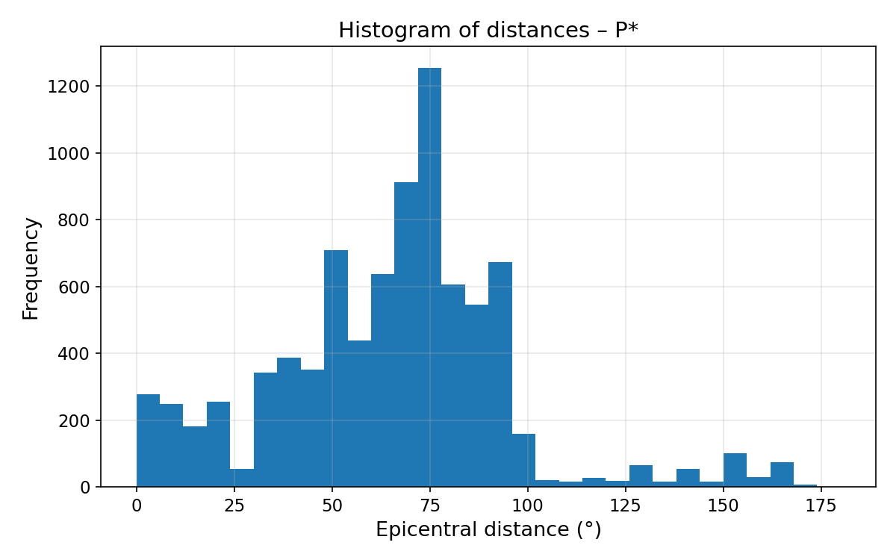
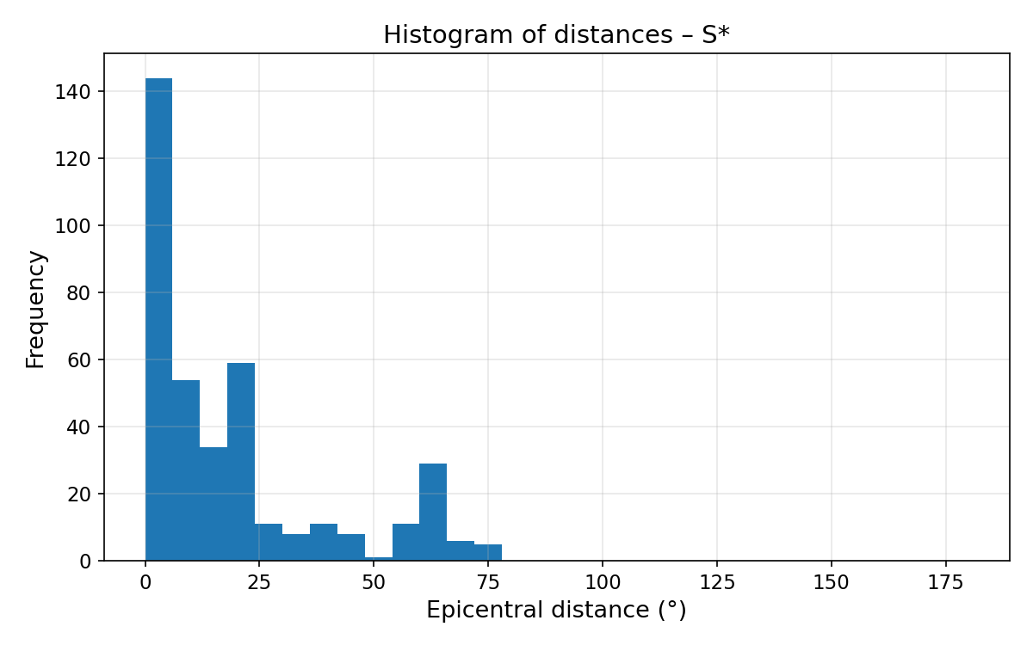
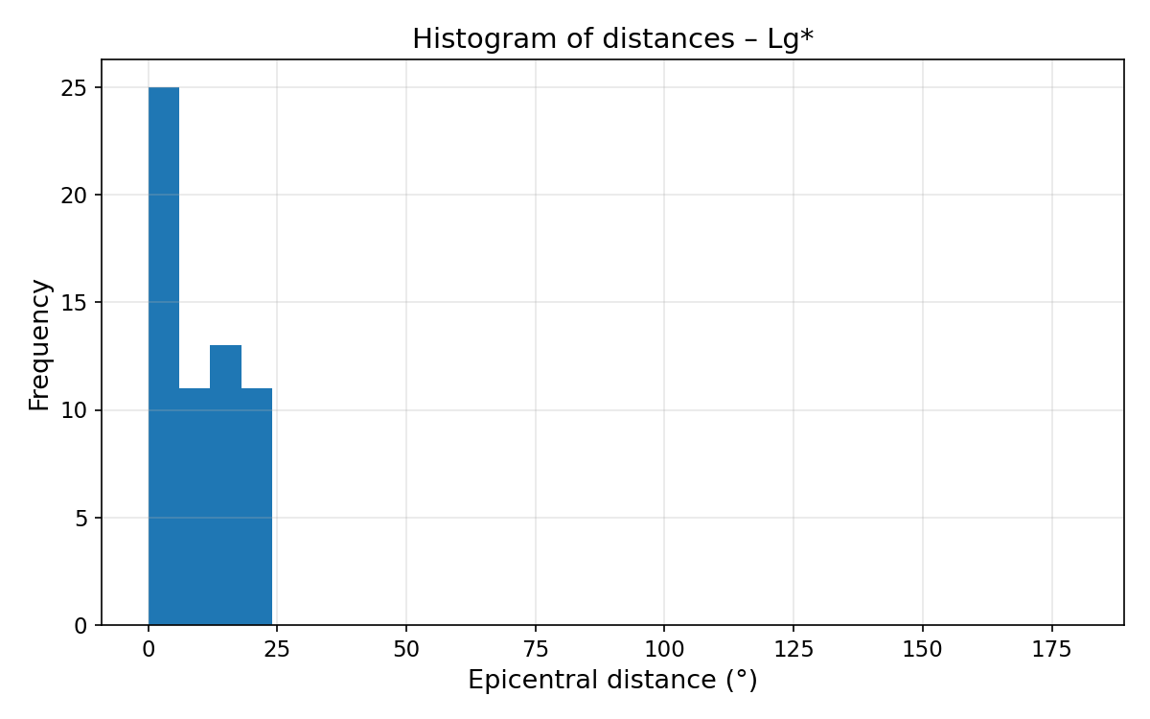
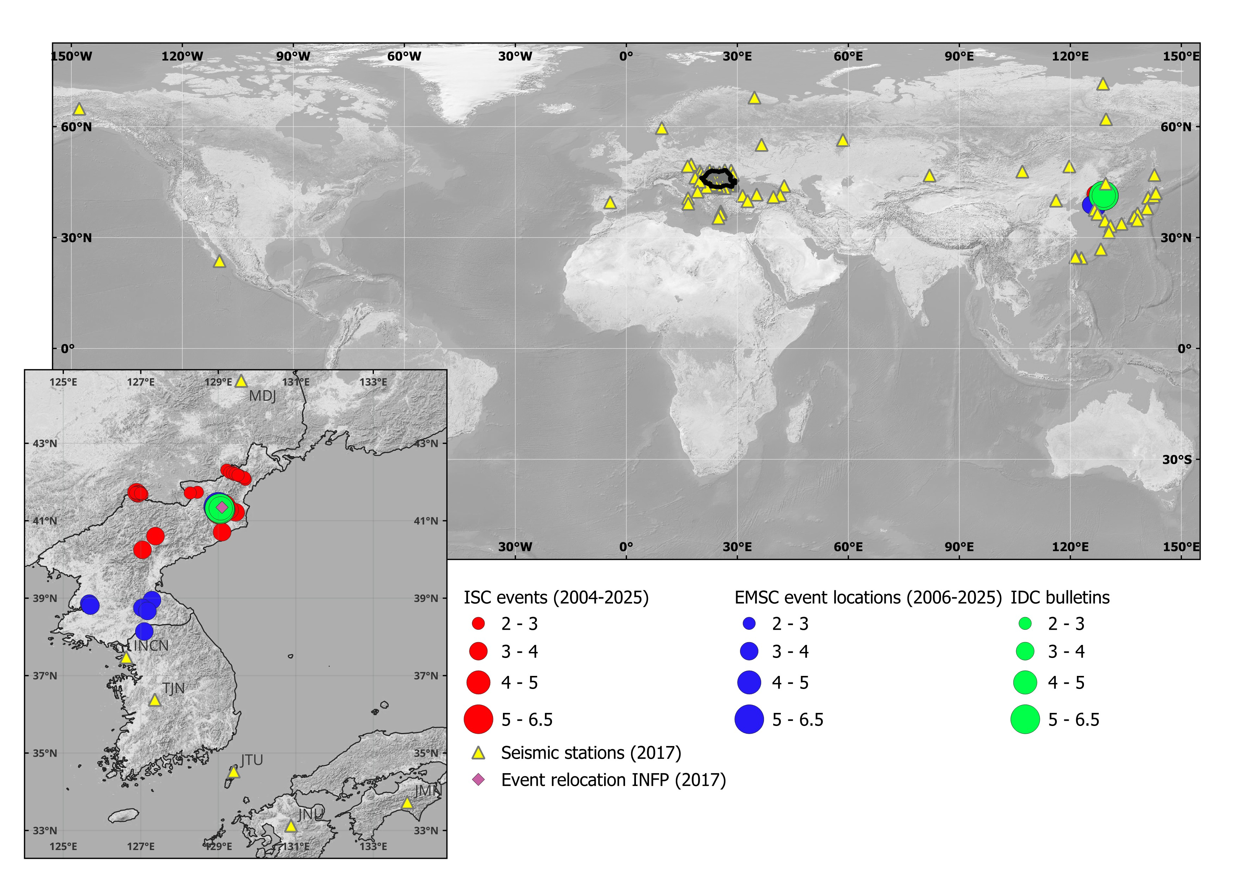
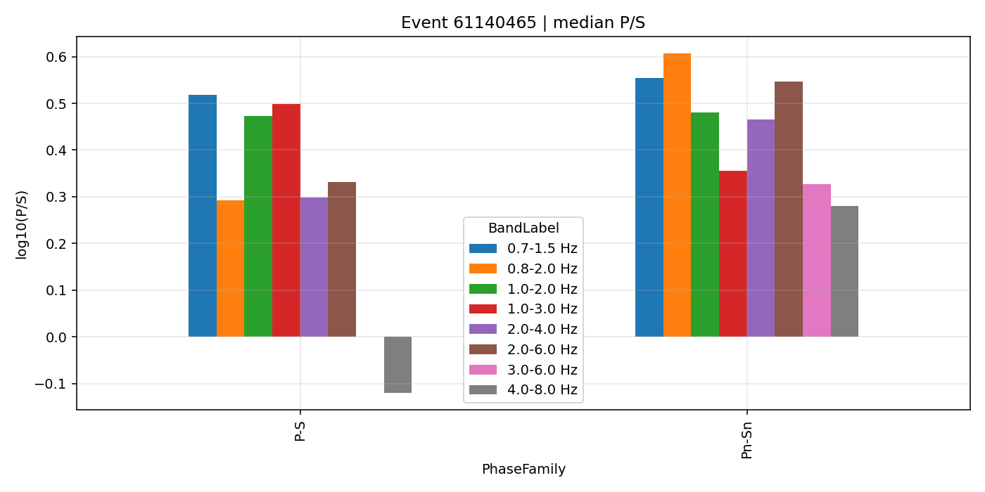
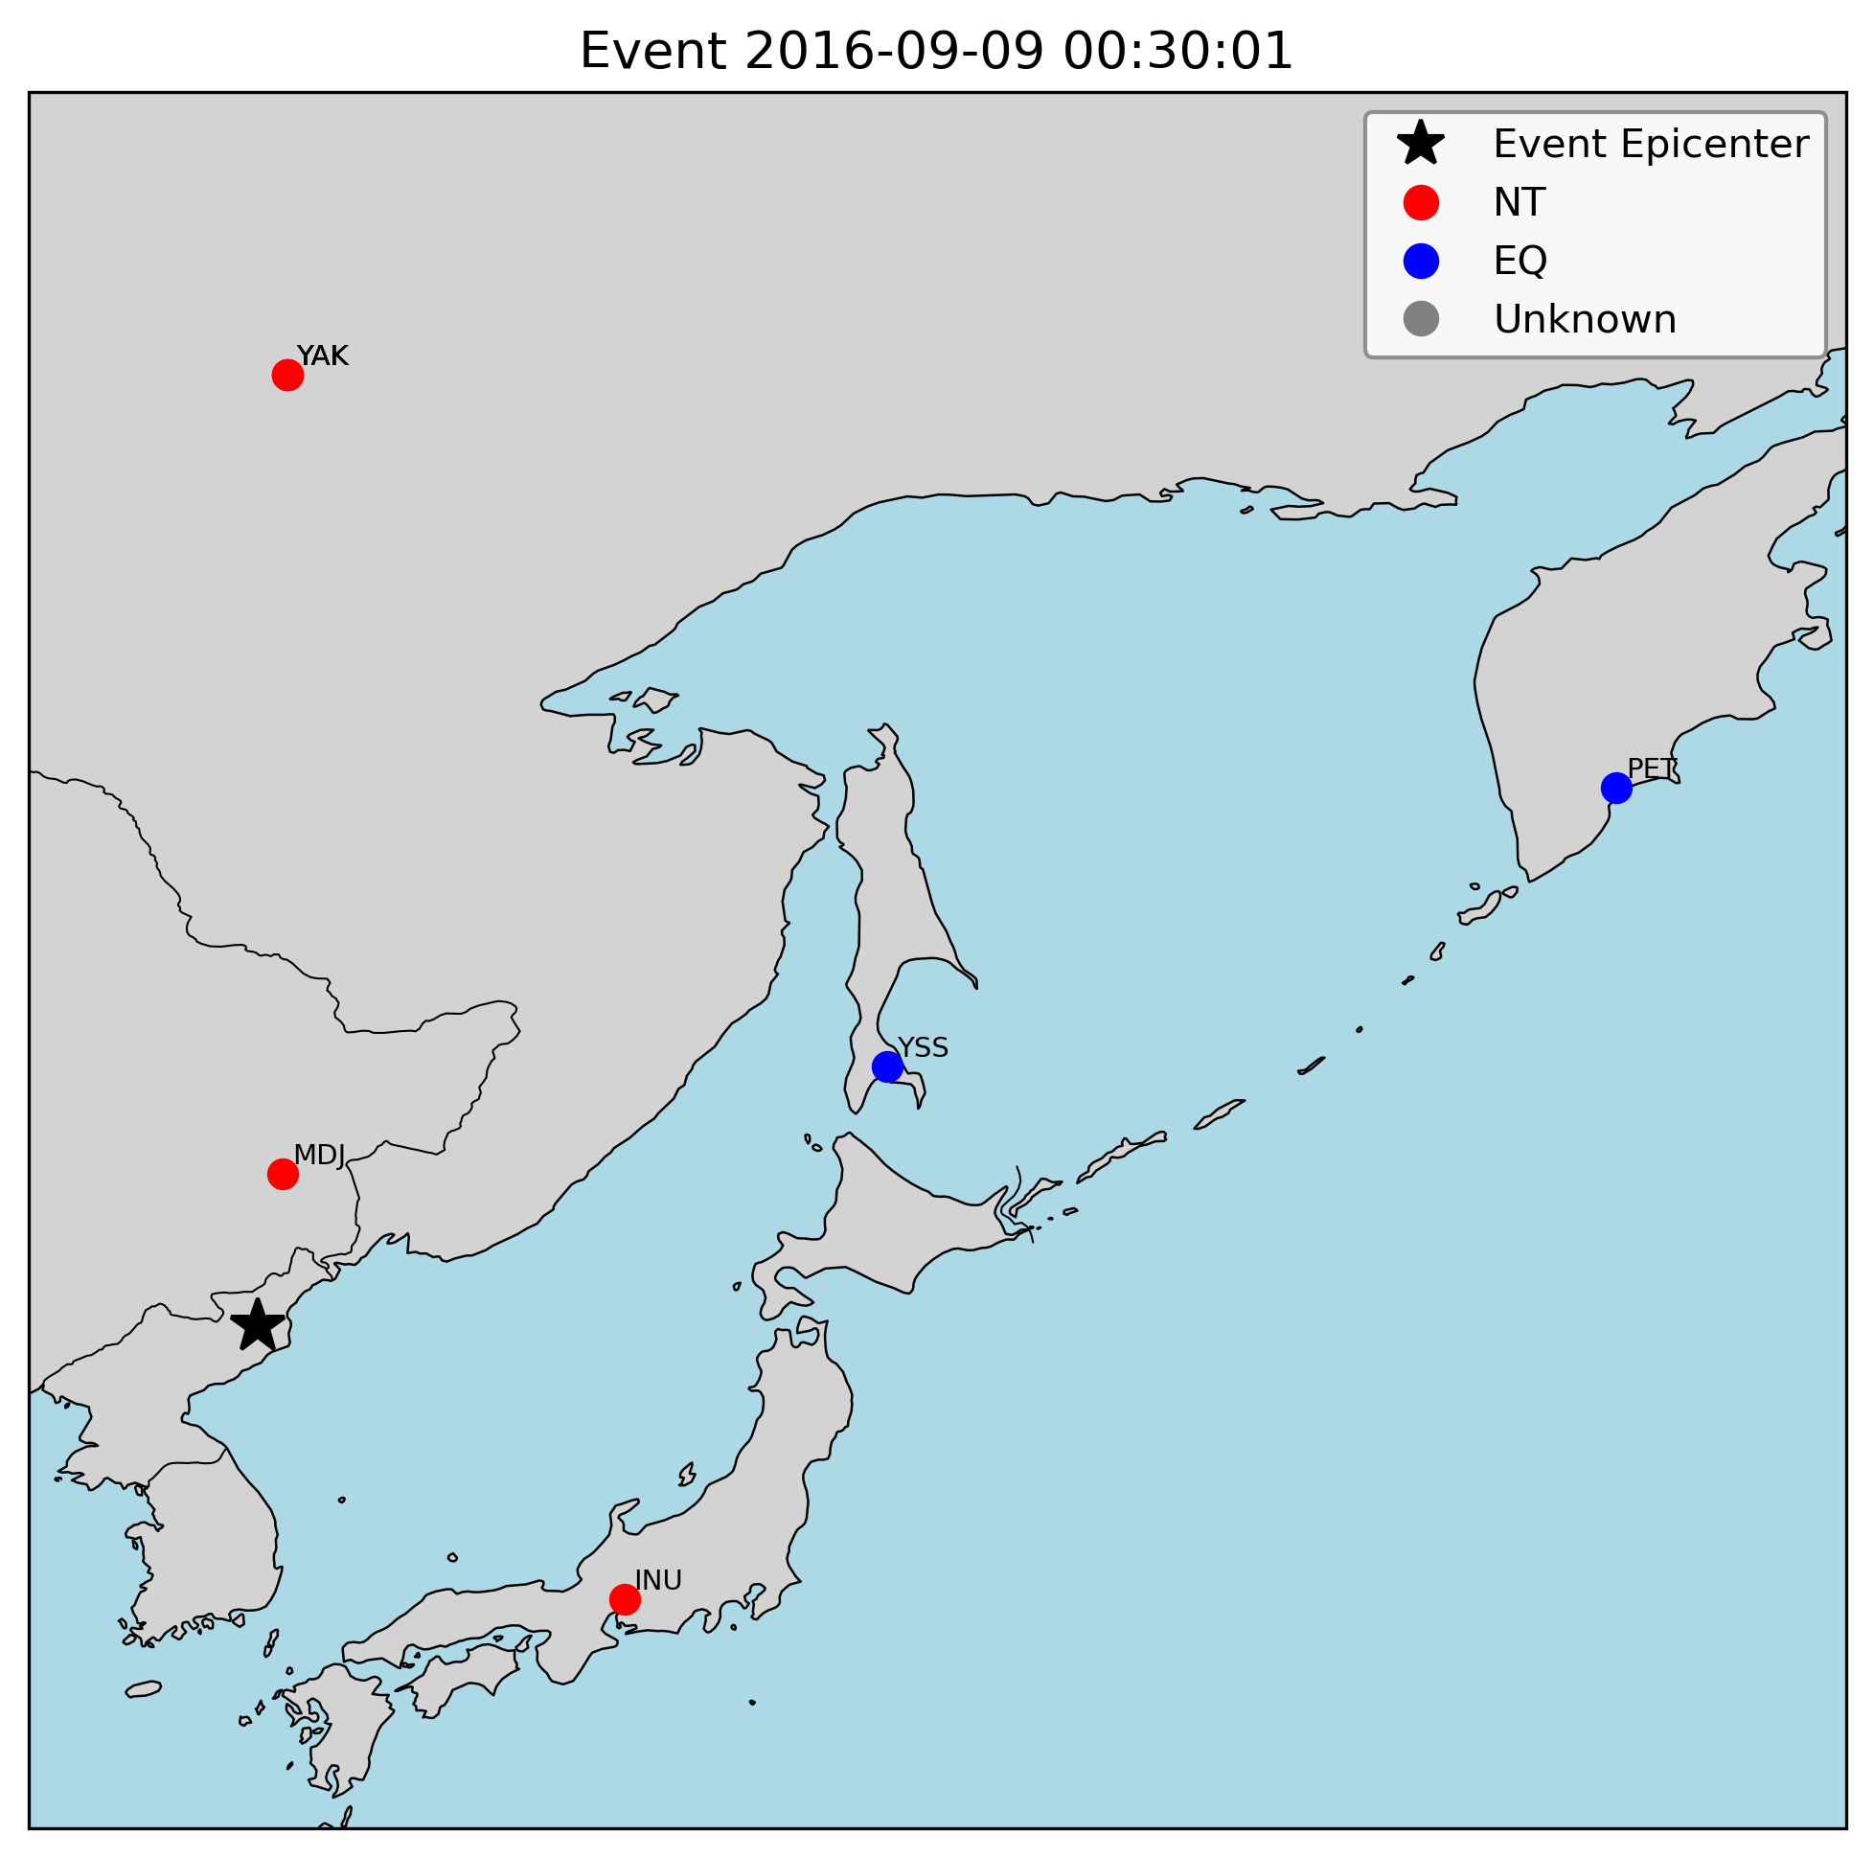
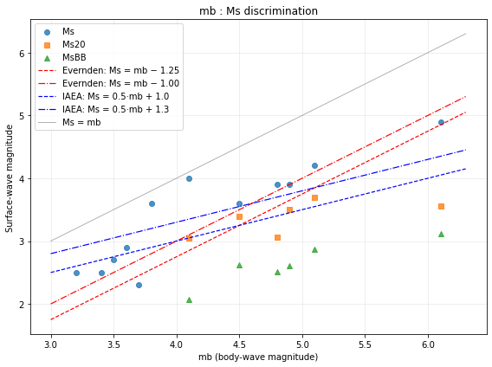
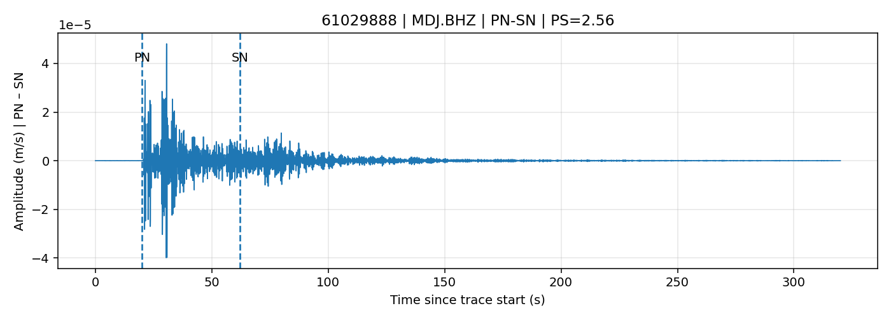
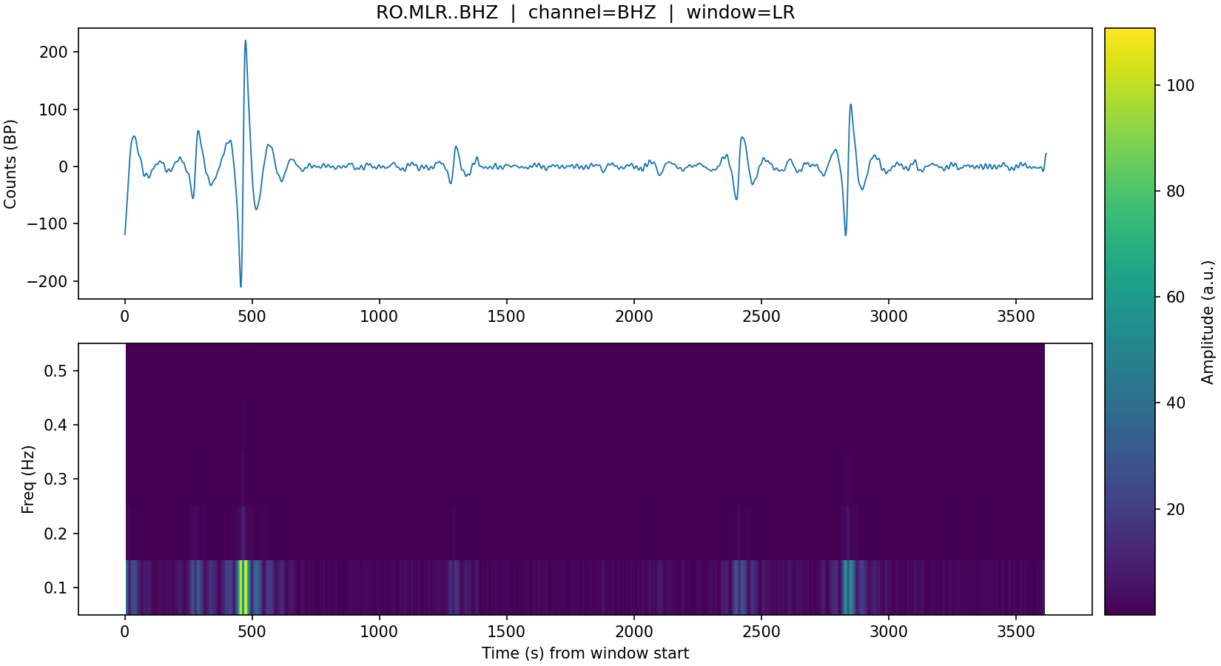
Revisiting the Democratic People's Republic of Korea nuclear tests
Raluca Dinescu¹, Iulia Armeanu¹, Daniela Ghica¹, Raluca Molea¹
1 National Institute for Earth Physics
P2.2-620
Introduction
Methods/Data
Results
The nuclear tests for DPRK were studied through several studies since. The importance of these tests was considered also by the specialists of NDC Romania and we were focused on correlate the data from the international agencies such as IDC, EMSC, USGS, IRIS and the local recordings at the seismic and infrasound stations.
The actual study is focussed on the DPRK nuclear tests through seismic analysis.
The methods applied on this study are the following:
P/S amplitude ratio calculated for the nuclear tests
The analysis shows that the P/S amplitude ratios are systematically higher than those measured for tectonic earthquakes, with the degree of separation depending on the frequency band used and the epicentral distance. In parallel, the Ms calculated directly from the available waveform data, for various station–phase combinations, are consistently smaller than the values reported by international agencies, in the range 3.0–3.7. This discrepancy reflects the effect of station, phase, and period band on magnitude estimates and supports using P/S ratios together with recalculated Ms as complementary discriminants.
Histograms of P, S and Lg phases versus epicentral distance, showing their propagation ranges and differences relevant for earthquake–explosion discrimination.
Map showing the location of DPRK events and the seismic stations used for the relocation of the 2017 nuclear test.
Comparison of mb with Ms, Ms20, and MsBB for the studied events. Red lines show the Evernden (1975) criteria, and blue lines the IAEA/CTBT screening criteria. The plot illustrates the separation between earthquake-like and explosion-like populations using mb–Ms discrimination
(left) Comparison of event profile families: log10(P/S) ratios are plotted for multiple frequency bands. Each profile illustrates how different bands emphasize the relative strength of P and S phases, supporting discrimination between explosions and earthquakes (right) Regional distribution of the stations based on P/S ratios
mb-Ms magnitude calibration: calculated Ms(20s) and Ms(BB) from the waveform data and compared them with the catalog Ms values to evaluate consistency and improve the mb–Ms discrimination analysis.
Conclusions
The analysis confirms that P/S amplitude ratios are higher for nuclear tests than for tectonic earthquakes, with a clear dependence on frequency band and distance. Recalculated Ms values are smaller than bulletin magnitudes, reflecting the effect of station and phase selection. Together, P/S ratios and recalculated Ms provide robust complementary tools for discriminating explosions from earthquakes.
Spectrogram for
MLR station.
Waveform recorded at station MDJ with P and S arrivals marked. The P/S amplitude ratio was computed from these windows for event discrimination

