Slide 1

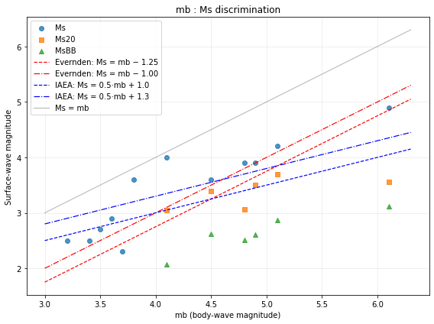
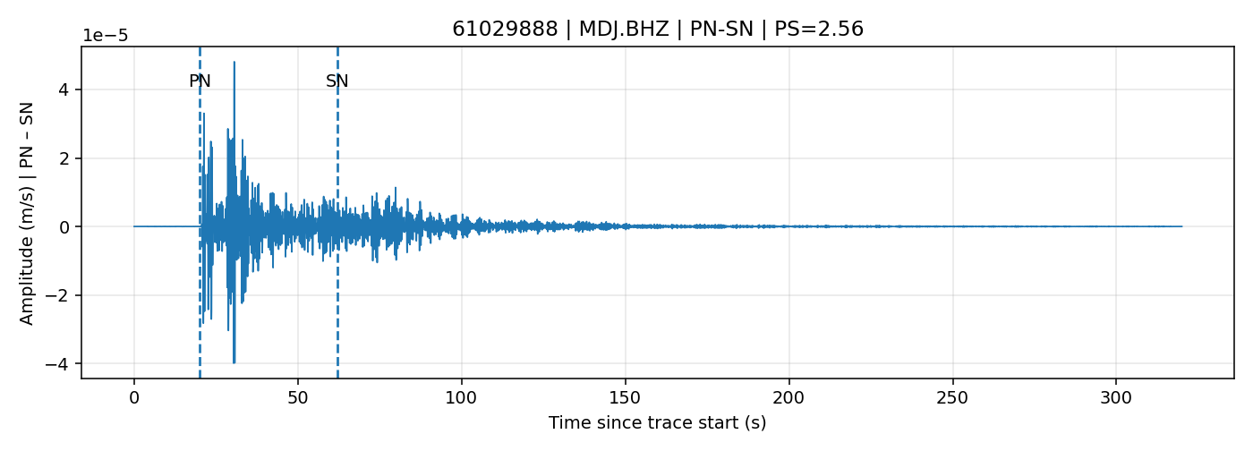


Revisiting the Democratic People's Republic of Korea nuclear tests
Raluca Dinescu¹, Iulia Armeanu¹, Daniela Ghica¹, Raluca Molea¹
1 National Institute for Earth Physics
P2.2-620
In this study we focused on the nuclear tests from DPRK and apply several methods such as:
P/S amplitude ratios computed across multiple frequency bands, including RMS, SNR, and noise windows.
Waveform analysis with focus on Ms(20s), Ms(BB), and frequency-dependent amplitude ratios.
Comparison plots (mb vs Ms, mb vs Ms20 median, mb vs MsBB) for nuclear test identification.

