Slide 1
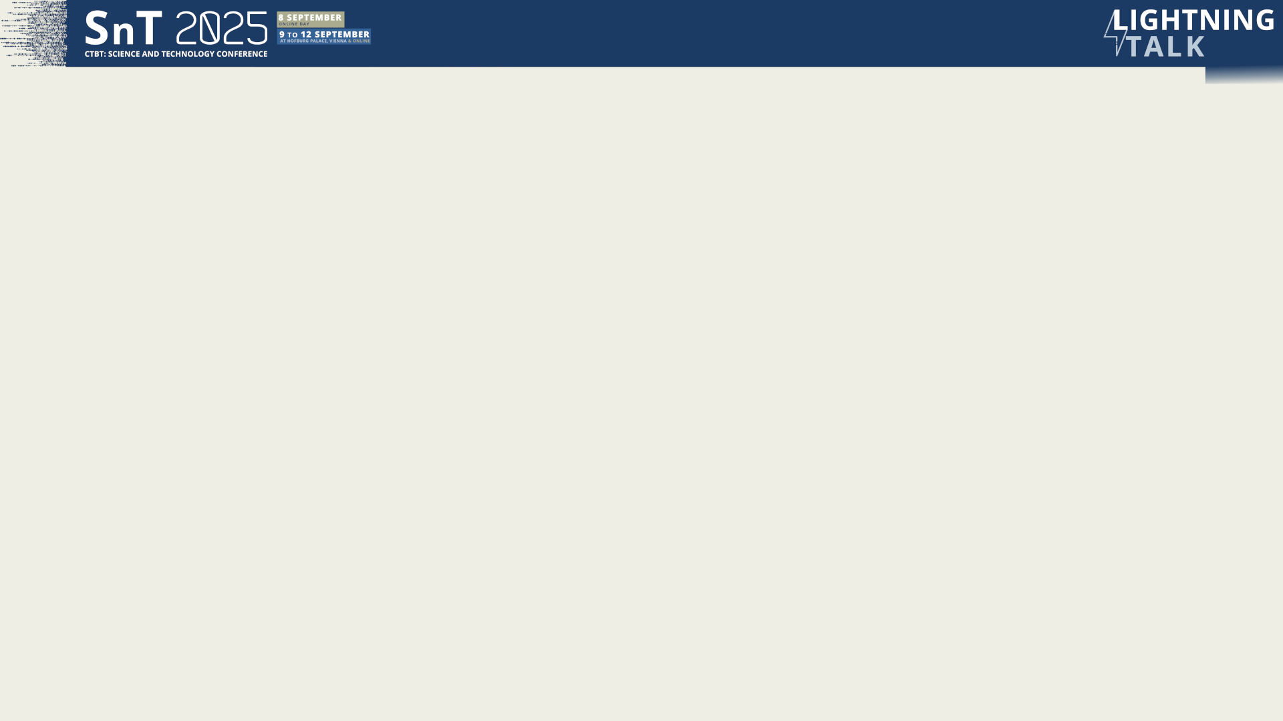

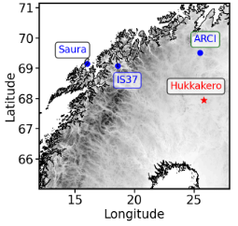
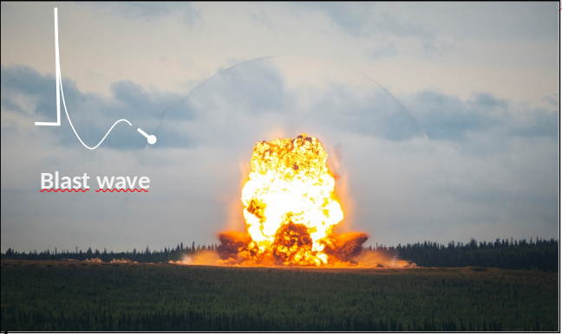

Estimating Explosion Yields Using Fourier Neural Operators and Long-Range Infrasound Observations
Elodie Noëlé^{1,2}, Christophe Millet^{1,3}, Fanny Lehmann⁴
¹CEA, DAM, DIF, F-91297, Arpajon, France, ²AMIAD, France, ³ENS Paris-Saclay, ⁴ETH AI Center, ETH Zurich, Switzerland
P2.1-716
Our poster presents a physics-informed Bayesian framework for estimating explosive yield from IMS infrasound for CTBT decisions. It accounts for atmospheric variability including gravity waves, as observed during the 2014-2024 Hukkakero military explosions (15–30 t at IS37, 321 km).
Our methodology and data set under consideration comprise approx. 20,000 effective-celerity profiles (with and without gravity waves) along with the associated transmission losses to train a Fourier Neural Operator achieving ~4 dB MAE and ~4 ms inference. Near-source likelihood from TL-shaped spectra vs Reed/Friedlander; MCMC for credible intervals over yields.
From the methodology employed in this study has yielded reliable estimates, accompanied by a quantification of the associated uncertainty.
DISCLAIMER: This presentation has been generated for illustration purposes only

