Slide 1

Introduction Slide Title goes here [Font: Arial Bold/Size: 16]
P2.1-716
Estimating Explosion Yields Using Fourier Neural Operators and Long-Range Infrasound Observations
Elodie Noëlé^{1,2}, Christophe Millet^{1,3}, Fanny Lehmann⁴
¹CEA, DAM, DIF, F-91297, Arpajon, France, ²AMIAD, France, ³ENS Paris-Saclay, 91190 Gif-sur-Yvette, France
⁴ETH AI Center, ETH Zurich, Switzerland
This poster presents a physics-informed Bayesian framework—powered by a fast Fourier Neural Operator surrogate—uses IMS infrasound to estimate explosive yield under realistic (gravity-wave) atmospheric variability for CTBT decision support.
On decade-scale Hukkakero events (IS37, 321 km), we achieve ~4 dB TL MAE and ~4 ms inference, recover yields in the 15–30 t range with tight 95% credible intervals via MLE+MCMC, enabling reliable yield estimations.
DISCLAIMER: This presentation has been generated for illustration purposes only.
Notes:
1

Slide 2
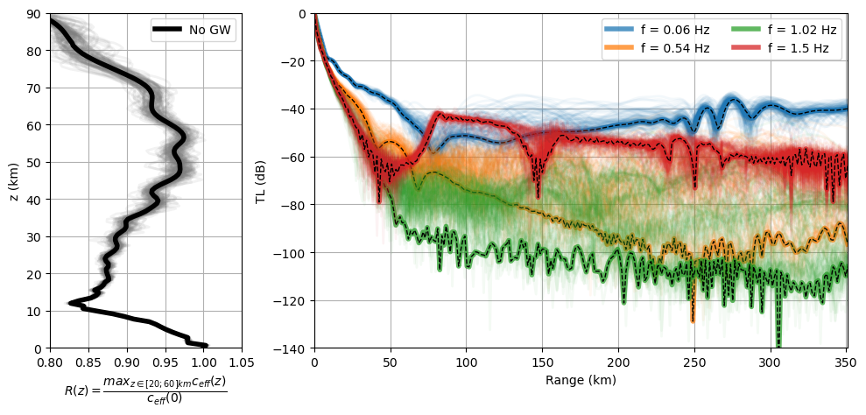

Estimating Explosion Yields Using Fourier Neural Operators and Long-Range Infrasound Observations
Elodie Noëlé^{1,2}, Christophe Millet^{1,3}, Fanny Lehmann⁴
¹CEA, DAM, DIF, F-91297, Arpajon, France, ²AMIAD, France, ³ENS Paris-Saclay, ⁴ETH AI Center, ETH Zurich, Switzerland
P2.1-716
Problem & Motivation
Dataset
Methodology
We aim to characterize explosive yield from IMS infrasound so that CTBT analysts can decide whether an event is consistent with non-nuclear activity or merits escalation. As a controlled case, we use the long-running Hukkakero chemical explosions in Finland—reliably recorded at IS37 (≈321 km)—whose yields W are in the 15–30 t range.
The main obstacle is atmospheric variability, especially gravity-wave–driven wind/temperature fluctuations in the stratosphere that refract sound ducts and alter effective celerity, making propagation both uncertain and expensive to simulate numerically due to statistical dispersion. Our approach combines a fast, physics-informed surrogate for propagation with a Bayesian inference scheme that turns station recordings into yield estimates with credible intervals. The scientific question is straightforward: can we reliably separate nuclear-scale from non-nuclear-scale yields under realistic atmospheric variability using Bayesian analysis of infrasound?
We synthesize a training corpus of ~20,000 effective-celerity profiles a representing ten years of Hukkakero-like conditions, with and without gravity-wave perturbations. For each profile, a normal-mode solver (FLOWS) provides 1D transmission loss u across 25 frequencies between 0.06 and 1.5 Hz and ranges from 1 to 351 km.
❶ Surrogate Fourier Neural Operator for infrasound propagation
A one-dimensional, eight-layer FNO (~3 M parameters) learns the mapping from atmosphere to TL and achieves ≈4 dB MAE while evaluating a full TL field in ~4 ms (256 ranges r × 25 frequencies f).
❷Yield estimation with Maximum Likelihood Estimation and Markov Chain Monte-Carlo
Source parameters comes from numerical fits​, which parameterize Reed or Friedlander spectra. For a candidate yield, we use the surrogate to obtain TL-shaped near-source spectra (~ 2 km) and define a likelihood from the absolute spectral difference to the corresponding source model. We first locate the maximum via MLE, then quantify uncertainty with a simple Metropolis–Hastings sampler (2,000 warm-up, 10,000 draws), which produces stable, narrow posteriors around the expected tens-of-tons range.
Hukkakero #96 (19 Aug 2022). Gravity-wave perturbations drive strong dispersion in transmission-loss across selected frequencies, with gains up to ~20 dB; the bold black curve is the no-GW baseline.
DISCLAIMER: This presentation has been generated for illustration purposes only.
Notes:
2

Slide 3
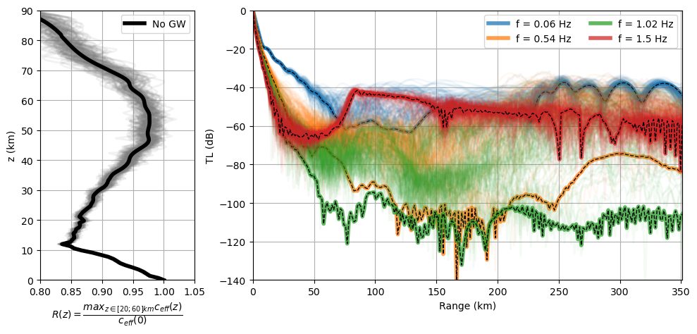
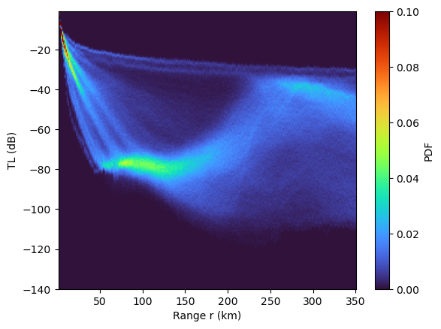
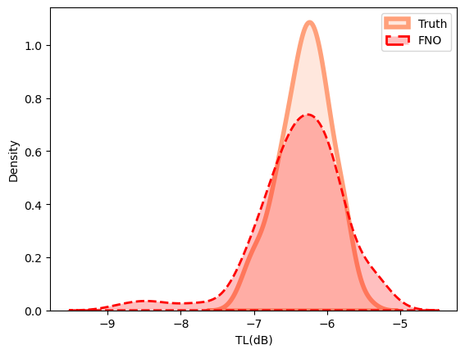
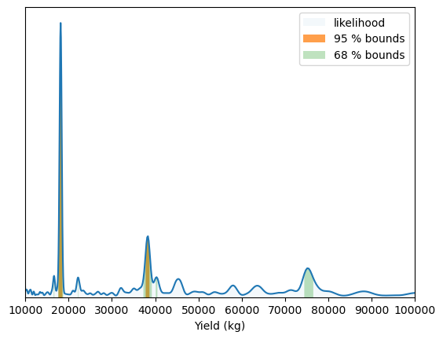
Estimating Explosion Yields Using Fourier Neural Operators and Long-Range Infrasound Observations
Elodie Noëlé^{1,2}, Christophe Millet^{1,3}, Fanny Lehmann⁴
¹CEA, DAM, DIF, F-91297, Arpajon, France, ²AMIAD, France, ³ENS Paris-Saclay, ⁴ETH AI Center, ETH Zurich, Switzerland
P2.1-716
Results for Hukkakero event of 08/19/22
Conclusion & Future Directions
❶ Inference with surrogate FNO for 132 profiles
Under realistic atmospheric variability, a physics-informed ML surrogate coupled with Bayesian inference reliably estimates yields in the 15–30 t regime from IMS infrasound, providing transparent uncertainty and supporting characterization of non-nuclear and nuclear-scale events for CTBT decision-making. We will extend to 2D waveform propagation and seismo-acoustic coupling, and harden a real-time pipeline with adaptive frequency selection for operational deployment.
û = FNO(a)
References
Dellaportas, P., Roberts, G.O. (2003). An Introduction to MCMC. In Spatial Statistics & Computational Methods, LNS 173, Springer. Blom, P.S., Dannemann, F.K., Marcillo, O.E. (2018). Bayesian characterization of explosive sources using infrasonic signals. GJI 215(1):240–251. doi:10.1093/gji/ggy258.
Bertin, M., Millet, C., Bouche, D. (2014). A low-order reduced model for the long-range propagation of infrasound in the atmosphere. JASA 136(1):37–52. doi:10.1121/1.4883388.
Lehmann, F., Gatti, F., Bertin, M., Clouteau, D. (2023). Fourier Neural Operator surrogate model to predict 3D seismic waves propagation. arXiv:2304.10242.
Li, Z., Kovachki, N., Azizzadenesheli, K., et al. (2021). Fourier Neural Operator for Parametric PDEs. ICLR; arXiv:2010.08895.
a
û
TL PDF û for 131 w/ GW + 1 w/o GW profiles of event 96
❷ MLE + MCMC
Likelihood for each W
Single-frequency TL density and yield likelihood (W = 1–100 t). The Friedlander source model produces multi-modal structure: a dominant peak near ~18 t and a surface-burst alias close to ~36 t (≈2×), reflecting amplitude–duration ambiguity.
Notes:
3

