Slide 1



P2.1-797
On the use of metamodels for Bayesian localization and characterization of infrasound events
Alexandre Goupy^{1*}, Christophe Millet^{1,2}, Pierre Sochala¹
¹CEA, DAM, DIF, F-91297, Arpajon, France
²ENS Paris-Saclay, F-91190 Gif-sur-Yvette, France
*Actually at EDF Lab, F-91120 Palaiseau, France
This work investigates the use of generalized Polynomial Chaos (gPC)-based metamodels, embedded in a Bayesian framework, to achieve more robust and cost-efficient source localization. Application to the 2018 Bering Sea bolide event:
(1) reduced localization error from ~220 km (IDC estimate) to less than 50 km, consistent with NASA satellite observations; (2) highlighted the critical impact of arrival-time extraction uncertainty, comparable to atmospheric uncertainties; (3) revealed the ambivalent role of station IS59, whose contribution improves localization but also introduces significant uncertainty, illustrating the need of adaptive station weighting.
This work has been reviewed and approved by CEA for presentation at the conference SnT2025. No confidentiality restrictions apply to the material contained in this document.

Slide 2
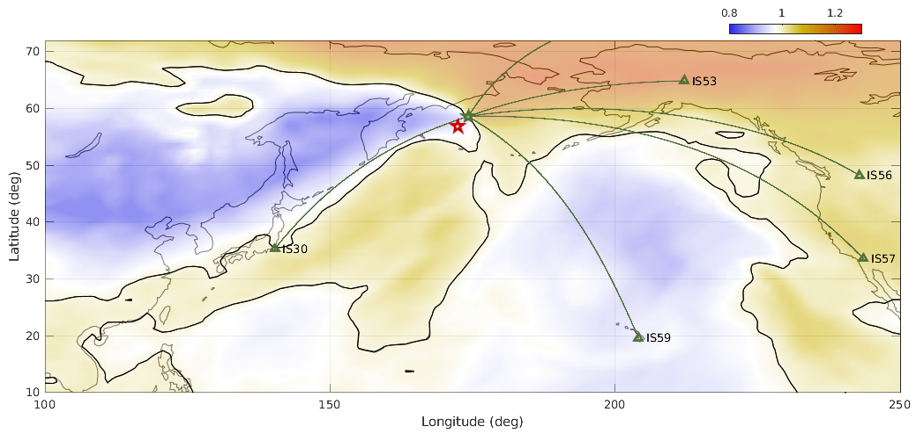
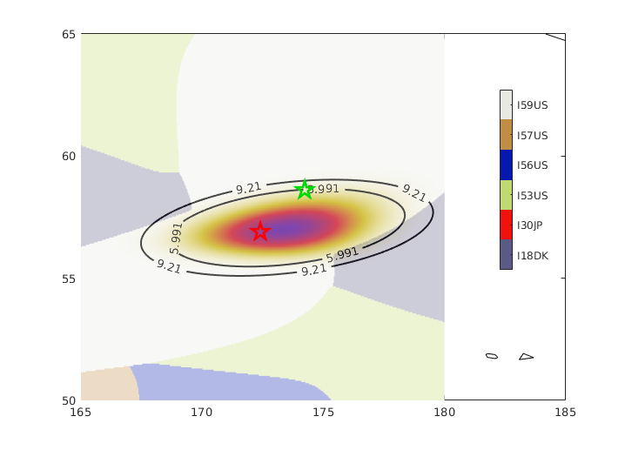
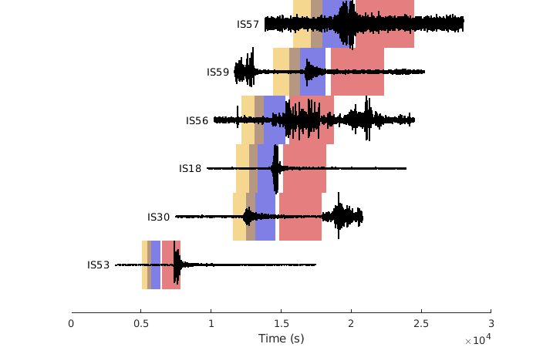

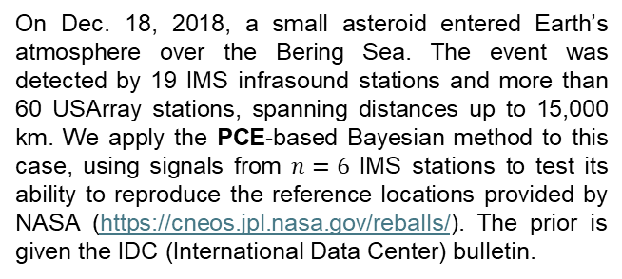
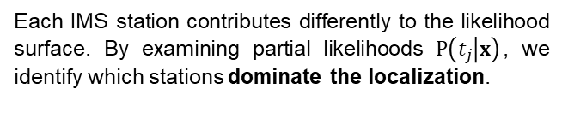
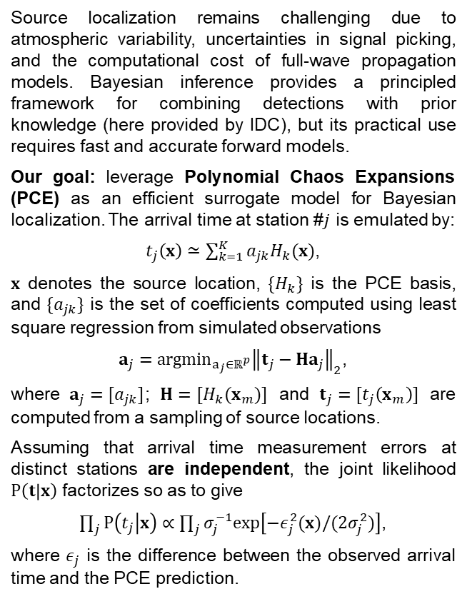

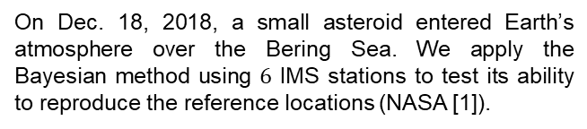
PLEASE DON‘T FORGET TO PUT THE E-POSTER TITLE AND YOUR NAME IN THE PRESENTATION HEADER.
DUPLICATE THIS SLIDE IF YOUR E-POSTER HAS MORE THAN 1 PAGE
P2.1-797
On the use of metamodels for Bayesian localization and characterization of infrasound events
Alexandre Goupy¹, Christophe Millet^{2,3}, Pierre Sochala²
¹EDF Lab, F-91120 Palaiseau, ²CEA, DAM, DIF, F-91297, Arpajon, ³ENS Paris-Saclay, F-91190 Gif-sur-Yvette
From forward modelling to inference
Application to the Bering sea bolide
On the role of each station in the localization: likelihoods & posteriors
Source localization remains challenging due to atmospheric variability, uncertainties in signal picking, and the computational cost of full-wave propagation models. Bayesian inference provides a principled framework for combining detections with prior knowledge (here provided by IDC), but its practical use requires fast and accurate forward models.
Our goal: leverage Polynomial Chaos Expansions (PCE) as an efficient surrogate model for Bayesian localization. The arrival time at station #$j$ is emulated by:
$t_{j}\left(x\right)≃\sum_{k=1}^{K}{a_{jk}H_{k}(x)}$,
$x$ denotes the source location, $\{H_{k}\}$ is the PCE basis, and $\{a_{jk}\}$ is the set of coefficients computed using least square regression from simulated observations
$a_{j}={argmin}_{a_{j}∈ℝ^{p}}{{\left\|t_{j}−Ha_{j}\right\|}_{2}}$,
where $a_{j}=[a_{jk}]$; $H=[H_{k}(x_{m})]$ and $t_{j}=[t_{j}\left(x_{m}\right)]$ are computed from a sampling of source locations.
Assuming that arrival time measurement errors at distinct stations are independent, the joint likelihood $P\left(t | x\right)$ factorizes so as to give
$\prod_{j}{P\left(t_{j} | x\right)∝\prod_{j}{σ_{j}^{−1}exp\left[−ε_{j}^{2}(x)/(2σ_{j}^{2})\right]}}$,
where $ε_{j}$ is the difference between the observed arrival time and the PCE prediction.
On Dec. 18, 2018, a small asteroid entered Earth’s atmosphere over the Bering Sea. We apply the Bayesian method using $6$ IMS stations to test its ability to reproduce the reference locations (NASA [1]).
Each IMS station contributes differently to the likelihood surface. By examining partial likelihoods $P\left(t_{j} | x\right)$, we identify which stations dominate the localization.
Dominance of IS59 and its limitations: posterior map shows that IS59 apparently dominates the localization, but using the Eff. Sound speed profile at source level (see Fig. 2), which overestimates the efficiency of ducting.
Fig. 1 : Eff. sound speed ratio; source locations, IDC: ★, NASA: ★.
Fig.3 : Dominant station - $t_{j}$’s are extracted from waveforms as the times for which the amplitudes of the rms first exceed a fixed threshold of 30%.
Future work
Accurate uncertainty estimation using MCMC will target both arrival time extraction and the impact of background atmospheric variability. The MCMC scheme should adaptively downweight stations whose contributions are uninformative.
[1] https://cneos.jpl.nasa.gov/reballs/
[2] Blom et al., Improved Bayesian Infrasonic Source Localization for regional infrasoundGJI, 2015.
Fig. 2 : Signals; W, S, and T phases using an empirical model [2]. Eff. sound speed ratios: source-level and path-averaged profiles [3].
[3] A. Goupy, A Spectral Approach of Multi-Scale Metamodelling Applied to Acoustic Propagation, PhD these, ENS Paris-Saclay, 2021.

