Slide 1


P2.1-674
Signals of Explosions in Earthquakes: Case Studies with Spotlight Detectors
Joshua D Carmichael; Brent G. Delbridge; and Richard A. Alfaro-Diaz
LA-UR-22-24224
EES-17 (GEM Team), Los Alamos National Laboratory, Los Alamos NM (USA)
LA-UR-22-24224
Introduction: Our study measures how signals from earthquakes that trigger F-detectors may interfere with correlators and reduce the rate they trigger against test site explosions, as well as nearby earthquakes. We use a special “augmented” dataset that includes explosion-sourced waveforms that we amplitude scaled to mimic smaller explosions and then injected back into the natural earthquake seismicity.
Main Results: Earthquake seismicity that triggers energy detectors can mask explosion sourced signals from correlators that operate at IMS arrays, with several caveats. Example: A 1.7-ton explosion at a test site that is reliably detectable by a correlator in seismic noise (at a 0.97 detection rate) is difficult to detect (at a 0.37 rate) when it interferes with low-magnitude background seismicity and occurs within 100s of another event’s origin time. This results is even more extreme with earthquake-sourced templates.
Notes:
Signals of Explosions in Earthquakes: Case Studies with Spotlight Detectors

Slide 2
Signals of Explosions in Earthquakes: Case Studies with Spotlight Detectors (1/2)
P2.1-674
Joshua D Carmichael, Brent G. Delbridge, Richard Aflaro-Diaz
Spotlight Detectors that Target Explosions
An Explosion + Earthquake Dataset
Reduced Detection Rates
Problem: Explosion monitoring with seismic arrays relies on spotlight detectors. Spotlight detector algorithms trigger against events within a geographical region. They include F-detectors and correlators. Our study measures how signals from earthquakes that trigger F-detectors may interfere with correlators and reduce the rate they trigger against test site explosions (Fig. 1).
Fig. 3
Fig. 1
Fig. 2
Results: Earthquakes reduced correlator TPR from 0.97 to 0.37 for explosions of ~1.7 tons, and when origin times were within 100s of each other (Fig. 4).
Data: We used an IMS array, a 10-ton chemical explosion (DAG-4), and seismicity assembled from F-detectors (Fig. 2a) to augment an existing dataset. We amplitude-scaled explosion-sourced waveforms to mimic smaller events and added the scaled signals back into the data at times we declared seismicity (Fig. 2b). We then repeated this process but avoided seismicity. This produced two datasets.
Method: We scanned a template sourced by DAG-4 against the two target datasets. This scan searched for signal matches that (1) interfered with background seismicity and that (2) avoided it. We then counted the true positive rate (TPR) and averaged over time. Then, we binned these averages over scaling yield (Fig 3).
Fig. 4
LA-UR-22-24224

Slide 3
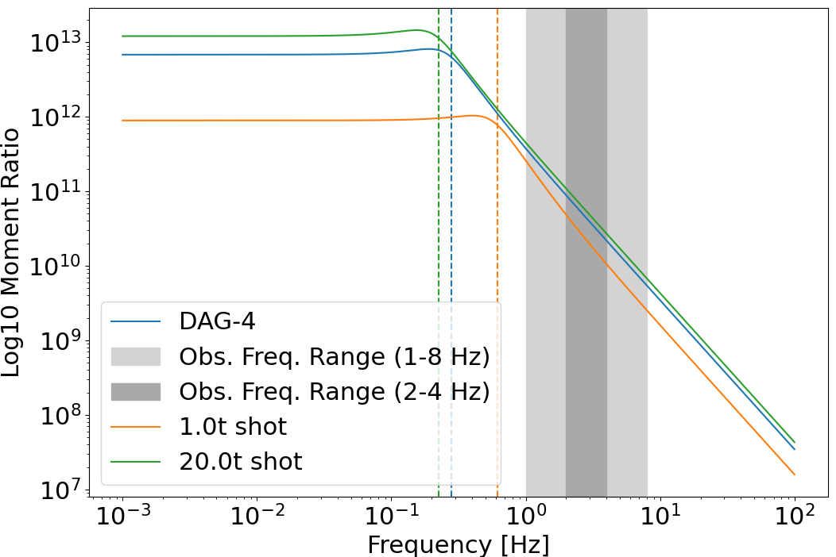
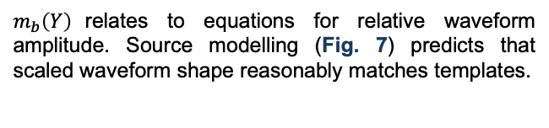
Signals of Explosions in Earthquakes: Case Studies with Spotlight Detectors (2/2)
P2.1-674
Joshua D Carmichael, Brent G. Delbridge, Richard Aflaro-Diaz
Reduced Earthquake Detection Rates
Conclusions and Future Work
Appendix
Extensions: We also applied our experiment with an earthquake templates (Fig. 5) that we deliberately contaminated with the same earthquake seismicity. Our correlator then showed an even more reduced TPR, from 0.97 to 0.16 (Fig. 6).
Conclusions: Earthquake seismicity that triggers energy detectors can mask explosion sourced signals from correlators that operate at IMS arrays, with several caveats:
Seismicity is low magnitude, and equivalent to explosions with yields of less that two tons.
Earthquake seismicity is sourced within about 100s of the explosion source.
Signals are only detectable at a single IMS array within about 250km of the source.
Earthquake sources need not locate near the template event.
Earthquake seismicity also reduces detection rates of correlators that use earthquake-sourced templates. This reduction is more pronounced. We conclude:
Correlators likely miss low magnitude repeaters in earthquake swarms.
Catalogs may substantially undercount seismicity in such swarms.
Future Work: We will build additional augmented datasets of explosion sourced waveforms that we amplitude scale and inject back into natural data to mimic larger populations of explosion sourced waveforms. We will use this data to build performance curves like that in Fig. 3 and Fig. 6 at more IMS arrays.
Scaling: We amplitude scaled seismic waveforms according to yield-to-magnitude relations that historical work developed at the Nevada National Security Site:
$m_{b}\left(Y\right)=−0.083{\left(\log_{10}\left(Y\right)\right)}^{2}+1.112$ $\log_{10}\left(Y\right)+3.94.$
$m_{b}\left(Y\right)$relates to equations for relative waveform amplitude. Source modelling (Fig. 7) predicts that scaled waveform shape reasonably matches templates.
Fig. 5
Fig. 7
Fig. 6
Publications and References
Carmichael, J. D., Delbridge, B. G., & Alfaro‐Diaz, R. (2025). The Reduced Detection Rate of Signals That Are Hidden by Earthquakes: Case Studies with Spotlight Detectors That Operate at Seismic Arrays. Bulletin of the Seismological Society of America.
U.S. Congress, Office of Technology Assessment, Seismic Verification of Nuclear Testing Treaties, OTA-ISC-361 (Washington, DC: U.S. Government Printing Office, May 1988)
LA-UR-22-24224

