Slide 1


P1.1-229
Assessing energy estimation methods for bolides in atmospheric monitoring
Elizabeth A. Silber¹, Christoph Pilger², Iyare Oseghae^{3,*}, Miro Ronac Giannone¹, Patrick Hupe², Vedant Sawal¹
¹Sandia National Laboratories, Albuquerque, NM, 87123; ²Federal Institute for Geosciences and Natural Resources (BGR), Hannover, Germany; ³University of Texas at San Antonio, San Antonio, Texas, 78249, USA
Infrasound signals generated by bolides can be used to estimate their energy deposition. Using 362 high-quality infrasound detections from 138 events, we derived new empirical period–yield relations, explicitly accounting for entry geometry and fragmentation processes. These refinements improve yield estimation accuracy, bolide characterization, and atmospheric monitoring.
*work performed during summer internship at Sandia
SNL is managed and operated by NTESS under DOE NNSA contract DE-NA0003525. The views expressed here do not necessarily reflect the opinion of the United States Government, the United States Department of Energy, or NTESS. SAND2025-11112C

Slide 2
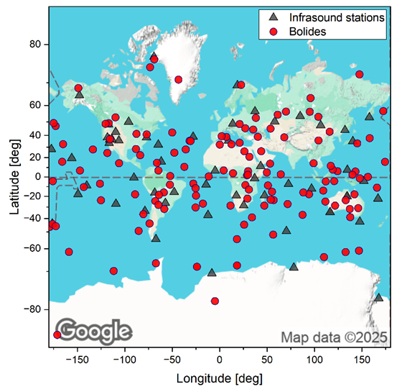
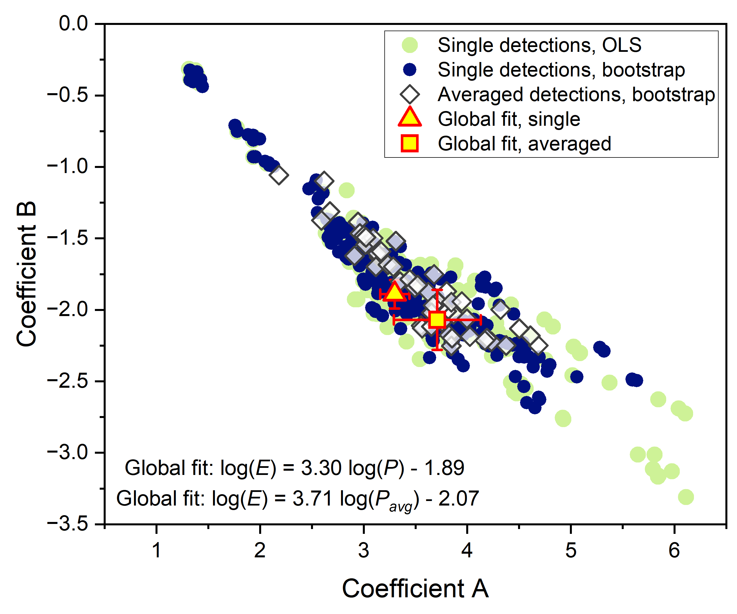
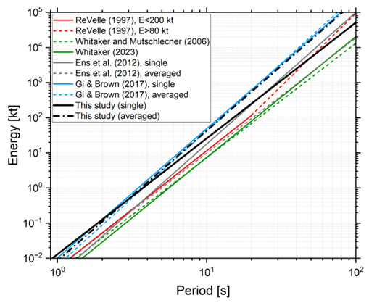

P1.1-229
Assessing energy estimation methods for bolides in atmospheric monitoring
Elizabeth A. Silber, Christoph Pilger, Iyare Oseghae, Miro Ronac Giannone, Patrick Hupe, Vedant Sawal
Background and Motivation
Methods
Results
Bolides entering Earth's atmosphere produce distinctive low-frequency infrasound signals, offering a direct and measurable proxy for their atmospheric energy deposition.
Existing empirical infrasound-based energy relations were initially developed for stationary anthropogenic explosions, not specifically for bolide-generated shock waves, potentially limiting their accuracy.
Previous studies (e.g., 1) developed global empirical relations for bolide energy estimation, but these did not fully account for the variability introduced by diverse bolide entry conditions and fragmentation behavior.
Observed infrasound signal periods from bolides exhibit substantial variability [2], influenced by factors such as atmospheric entry angle, fragmentation behavior, burst altitude, and propagation effects.
Developing refined period–yield relations tailored explicitly to bolide characteristics and dynamics is essential for improving atmospheric monitoring accuracy, bolide energy estimation, and planetary defense assessments.
We compiled a comprehensive dataset of bolide infrasound signals, totalling 362 high-quality detections from 138 bolide events observed by 59 infrasound stations globally (see map below).
Bolide parameters, including velocity, entry angle, peak-brightness altitude, and light-curve data, were obtained from the NASA JPL CNEOS database [3].
We systematically analyzed infrasound periods, applying statistical regression and bootstrap resampling techniques to derive robust empirical period–yield relations.
Bolide fragmentation behavior and entry geometry were explicitly incorporated into our analysis to refine period–yield models and evaluate parameter-specific variability.
Our analysis produced new, robust empirical period–yield relations explicitly tailored to bolide events, improving on previously published models.
SNL is managed and operated by NTESS under DOE NNSA contract DE-NA0003525. The views expressed here do not necessarily reflect the opinion of the United States Government, the United States Department of Energy, or NTESS. SAND2025-11112C

Slide 3
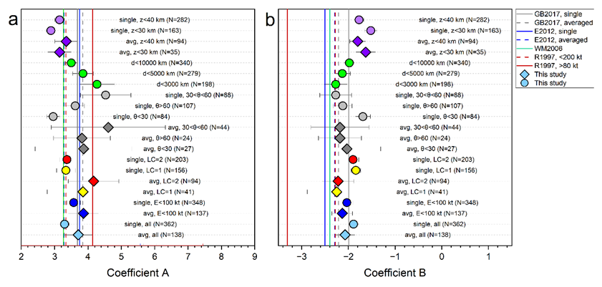
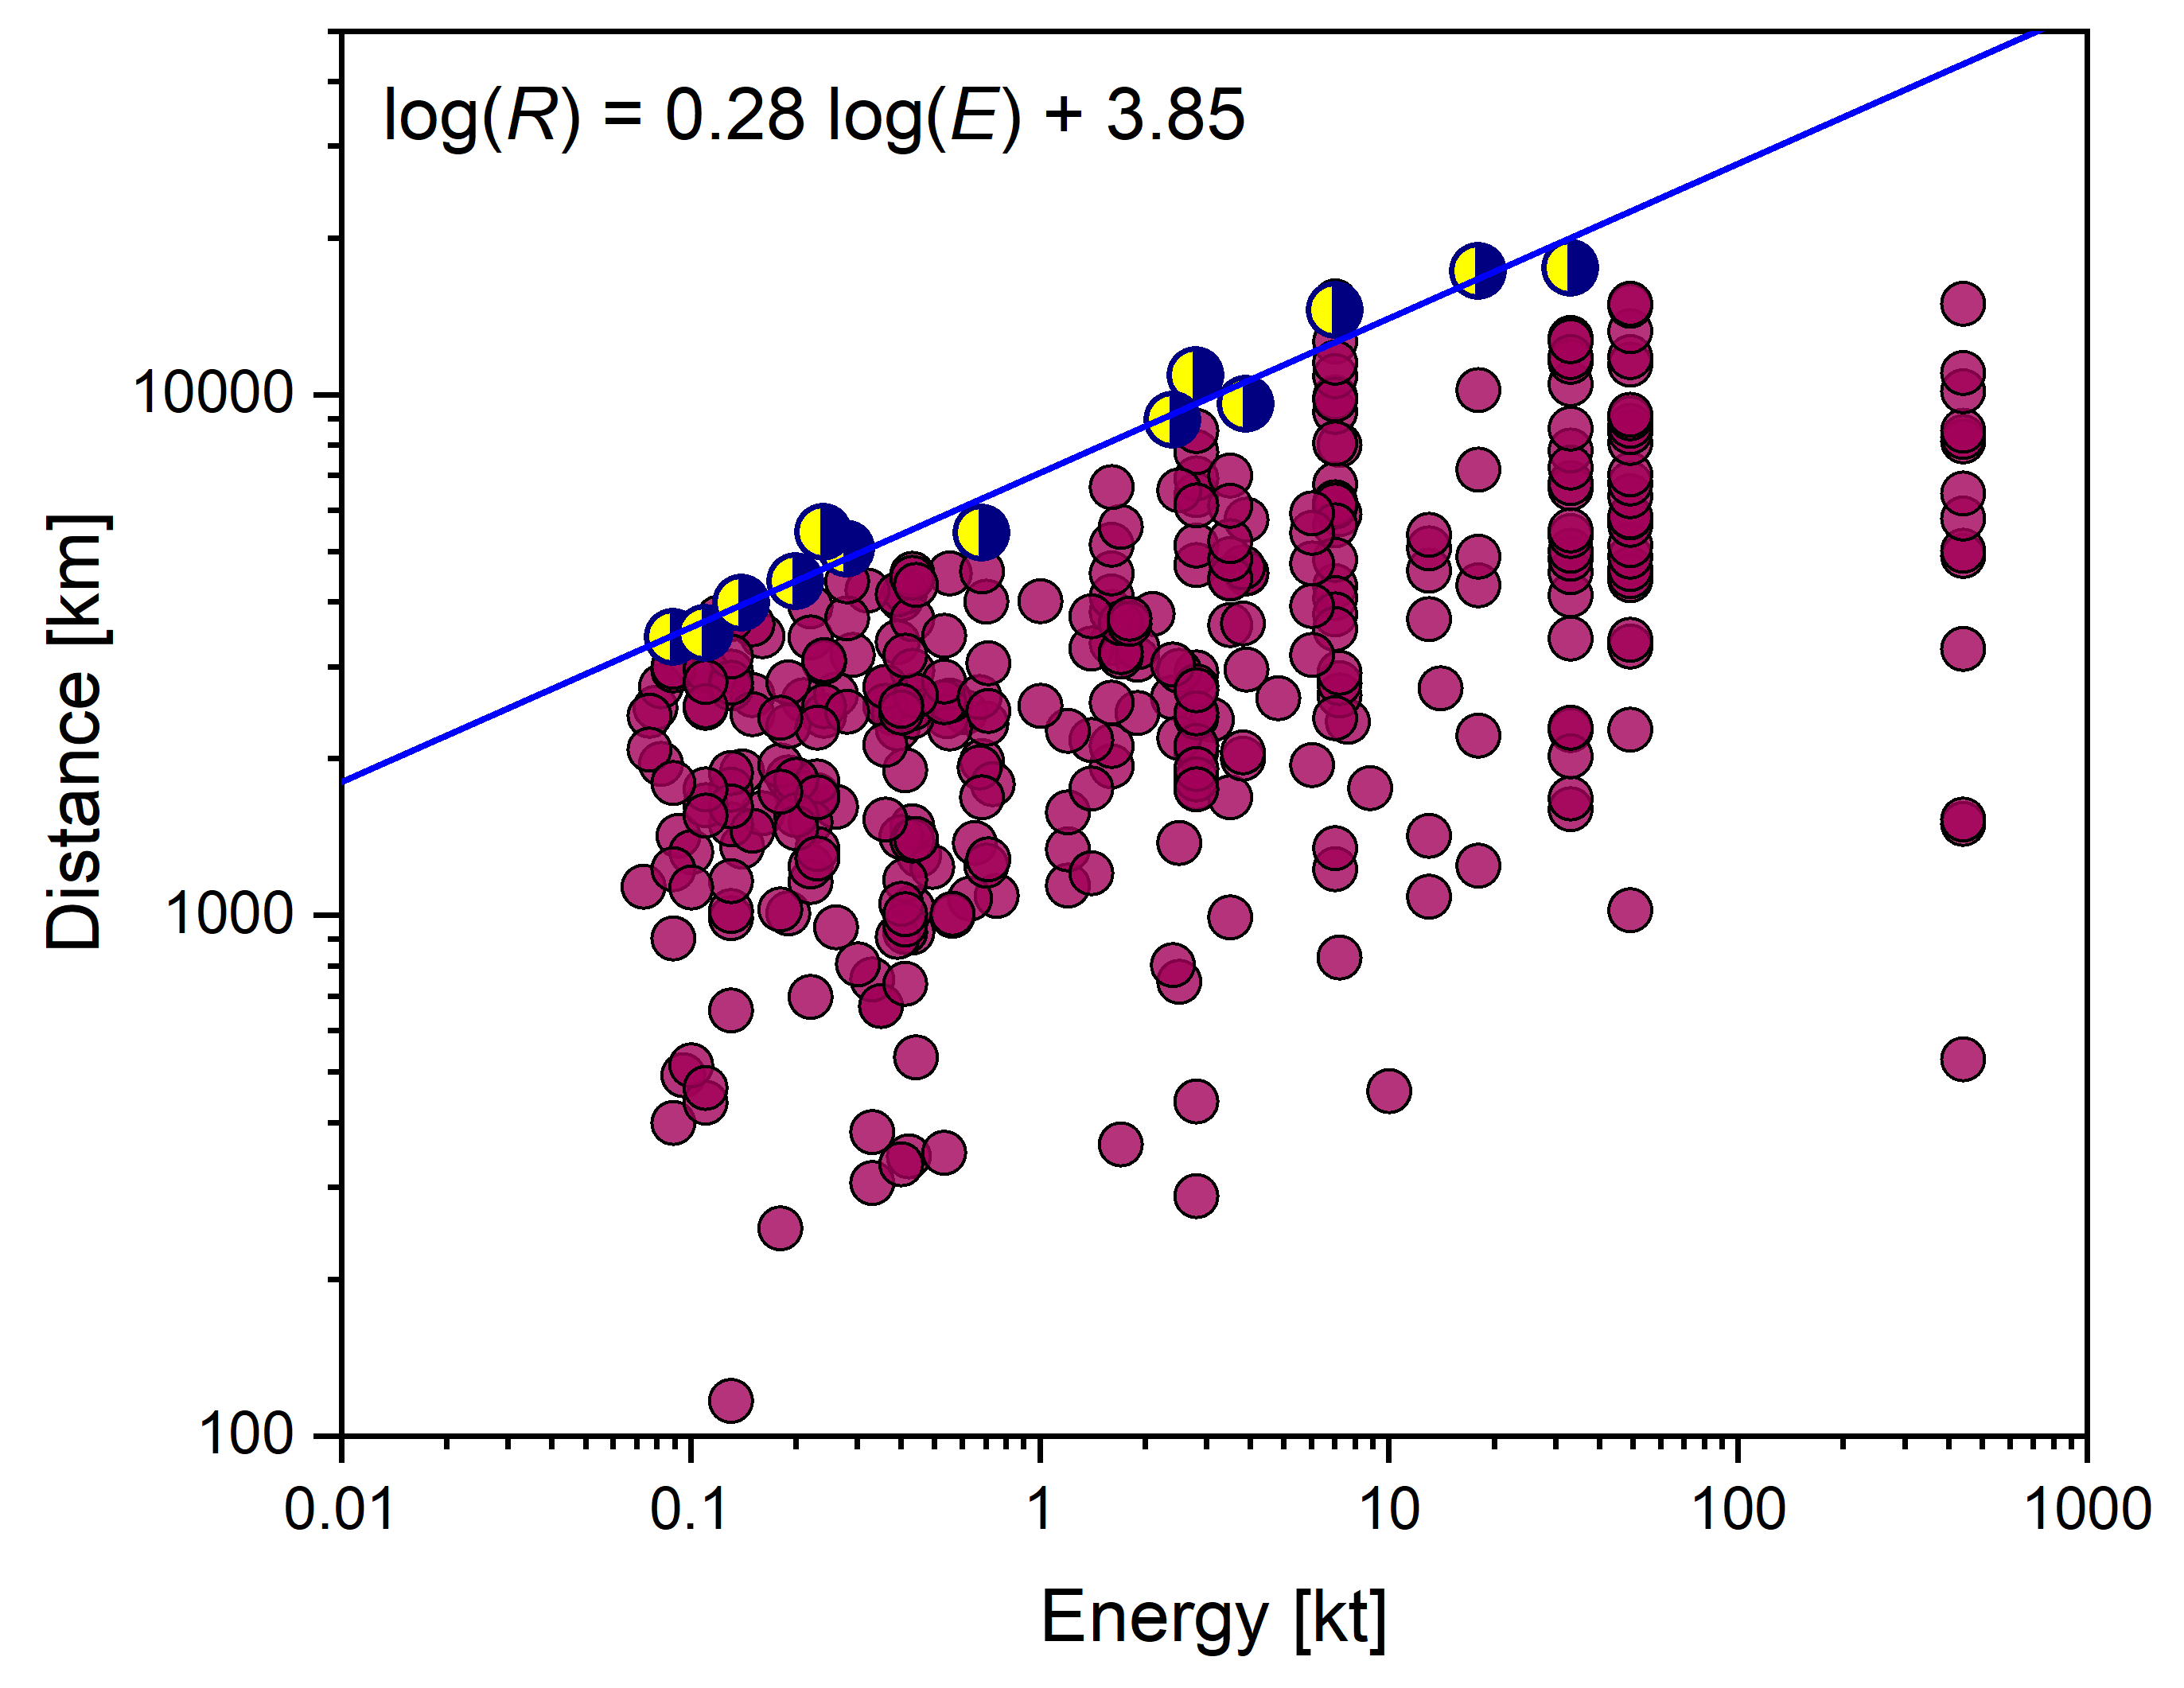
P1.1-229
Assessing energy estimation methods for bolides in atmospheric monitoring
Elizabeth A. Silber, Christoph Pilger, Iyare Oseghae, Miro Ronac Giannone, Patrick Hupe, Vedant Sawal
Results (cont’d)
Discussion
Conclusions
Bolide entry geometry and fragmentation strongly influence the period–yield relationship; steeper entries and single-burst events exhibit distinct slopes compared to shallow-entry or multifragmentation cases.
We also derived a refined, well-constrained empirical range–energy relationship.
Our analysis demonstrates the significant influence of bolide-specific parameters, such as fragmentation type, entry geometry, and burst altitude, on infrasound signal characteristics, demonstrating why generalized period–yield relations can yield inaccurate results.
Partitioning the dataset into parameter-defined subsets revealed systematic variations in period–yield slopes, emphasizing that single universal relations are inadequate for accurately capturing the physical complexity of bolide-generated shocks.
The minimal effect of Doppler corrections across the global dataset confirms earlier findings; however, notable deviations in individual events indicate that atmospheric wind profiles remain important for accurate event-specific analyses.
The marked correlation between bolide energy and maximum detection range illustrates the effectiveness of infrasound as a remote-sensing tool, facilitating the discrimination of bolide signals from other atmospheric acoustic sources.
Our newly derived, bolide-specific empirical period–yield relations improve energy estimation accuracy by explicitly incorporating the effects of bolide entry geometry, altitude, and fragmentation behavior.
These refined infrasound-based models significantly enhance capabilities in global atmospheric monitoring, bolide characterization, and planetary defense, overcoming key limitations of previous generalized explosion-based methods.
The broader implication is that tailored, multiparametric models are essential not only for improved scientific understanding of atmospheric entry dynamics but also for strengthening observational strategies and risk assessments
References:
[1] Revelle, D.O., 1997. Historical Detection of Atmospheric Impacts by Large Bolides Using Acoustic-Gravity Wavesa. Annals of the New York Academy of Sciences 822, 284-302; [2] Silber et al. 2025. Multiparameter constraints on empirical infrasound period–yield relations for bolides and implications for planetary defense. AJ, doi: 10.3847/1538-3881/add47d.
SNL is managed and operated by NTESS under DOE NNSA contract DE-NA0003525. The views expressed here do not necessarily reflect the opinion of the United States Government, the United States Department of Energy, or NTESS. SAND2025-11112C

Slide 4

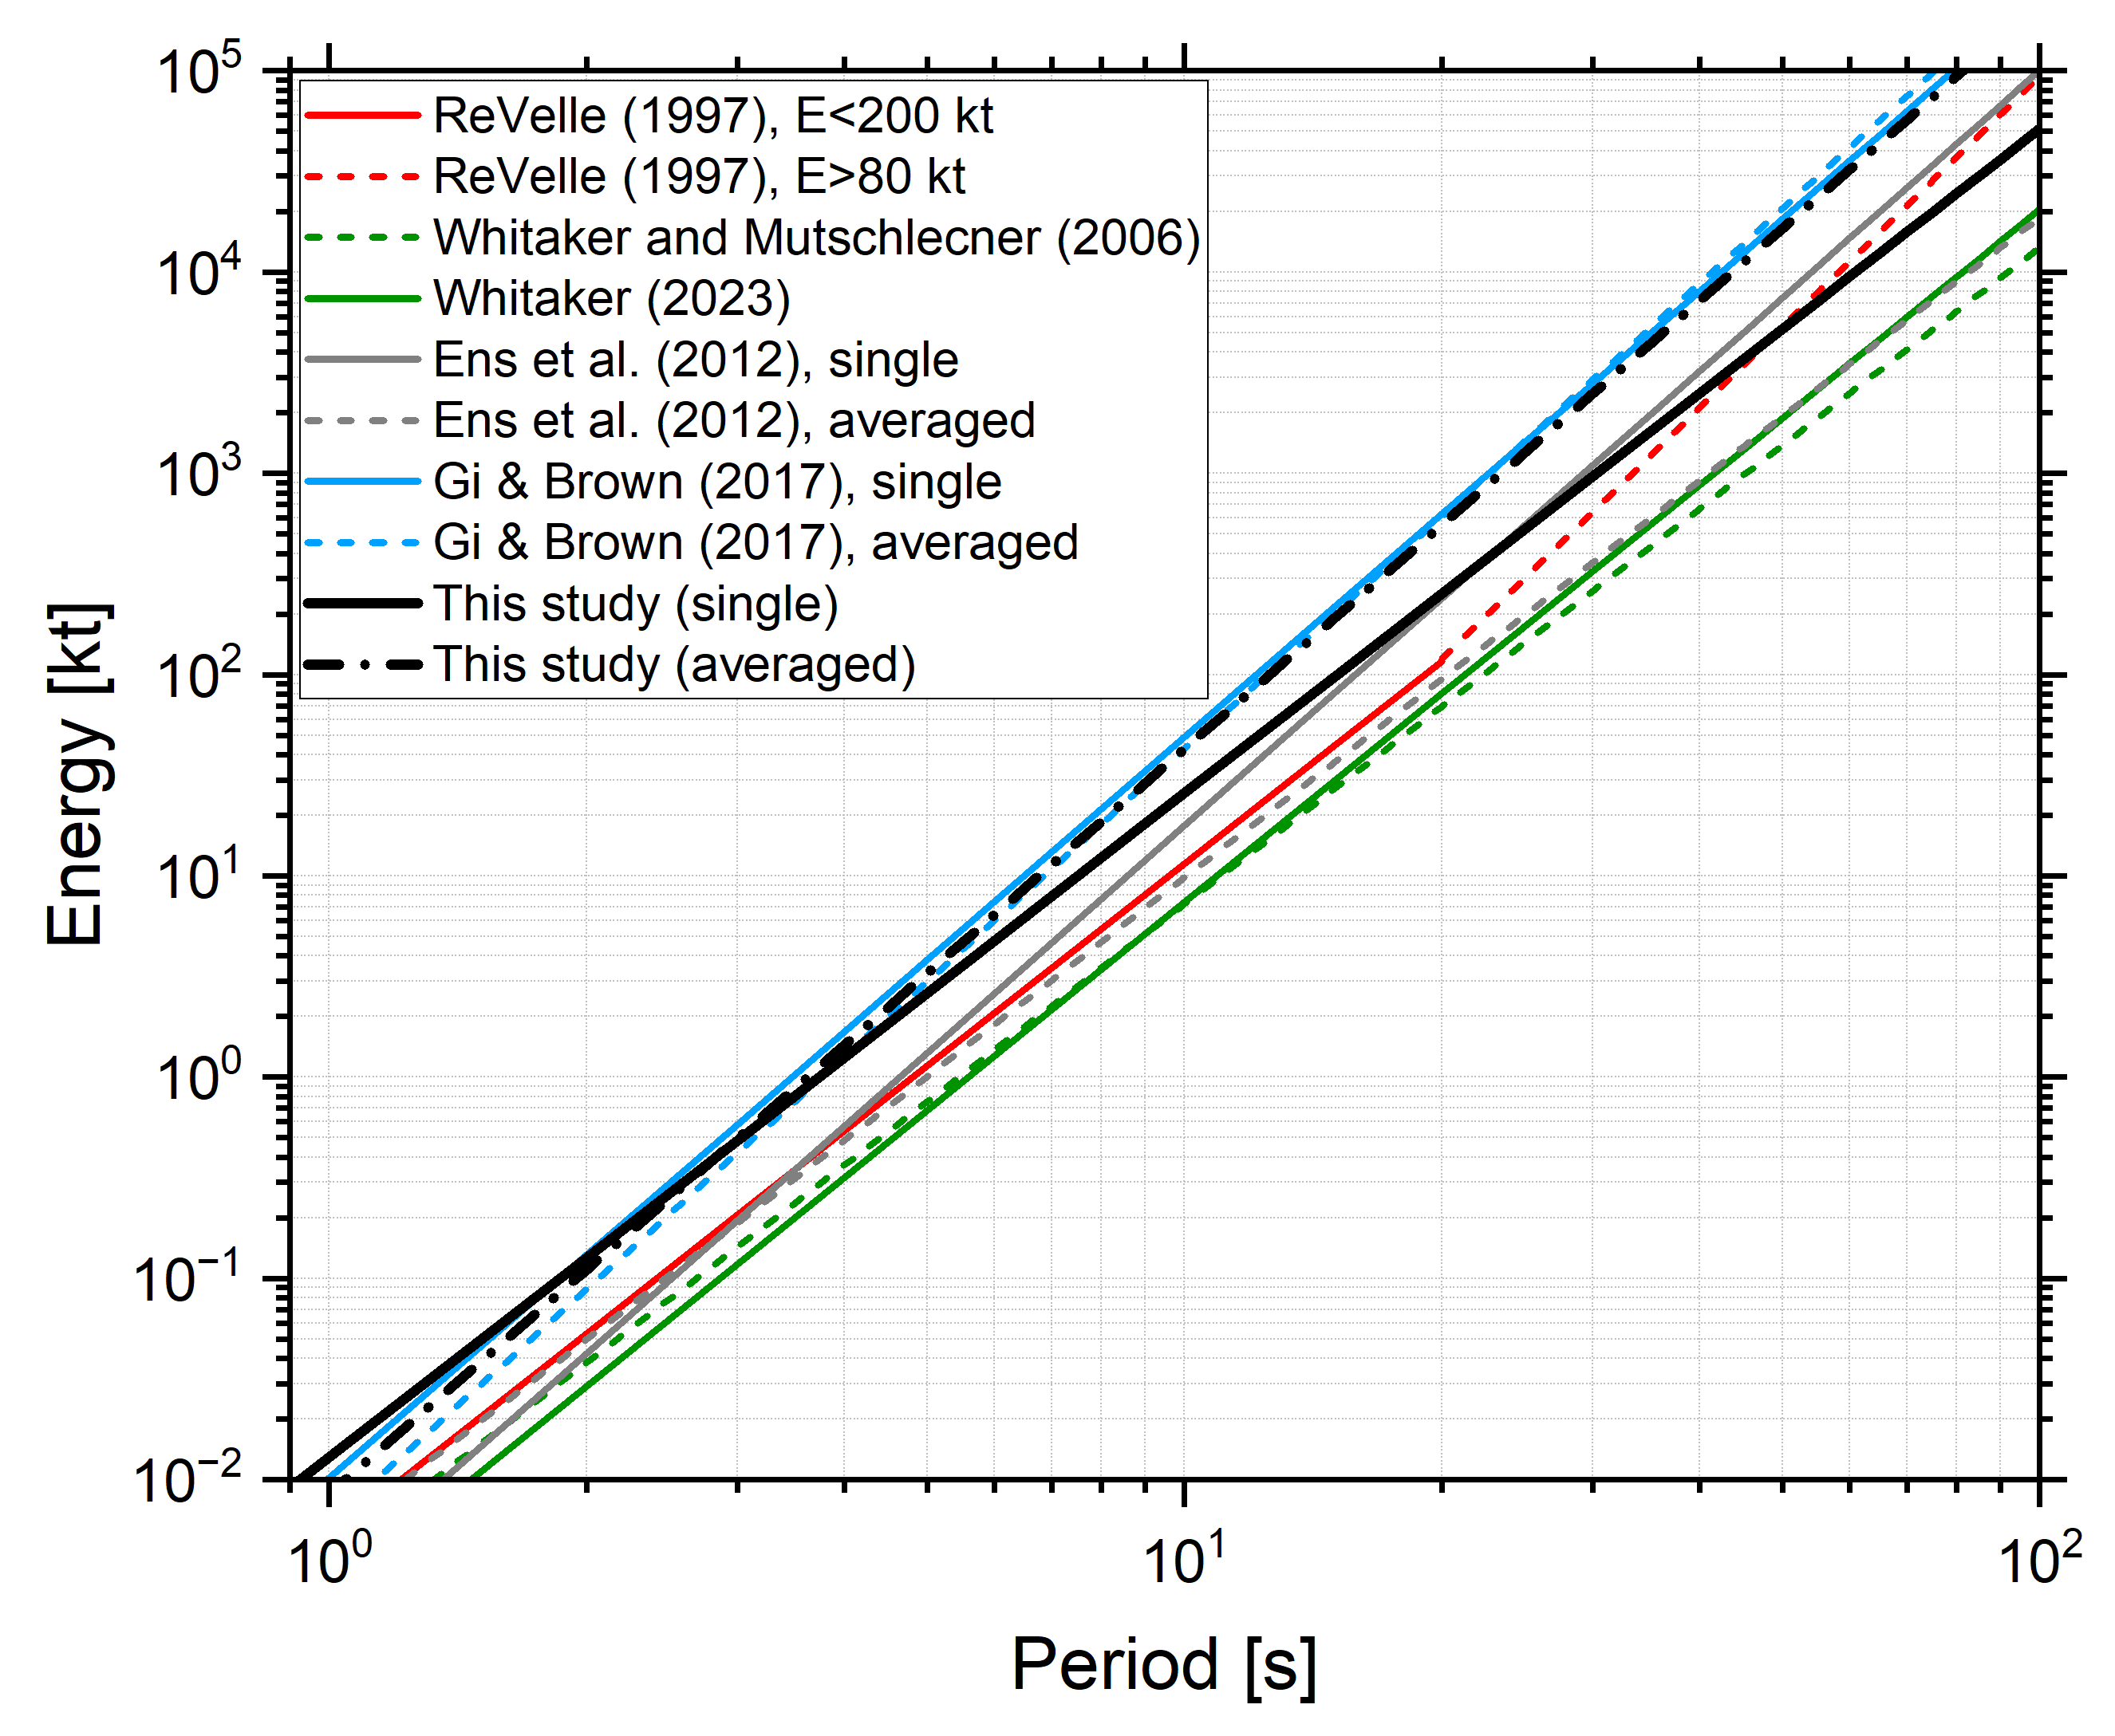
P1.1-229
Assessing energy estimation methods for bolides in atmospheric monitoring
Elizabeth A. Silber¹, Christoph Pilger², Iyare Oseghae^{3,*}, Miro Ronac Giannone¹, Patrick Hupe², Vedant Sawal¹
¹Sandia National Laboratories, Albuquerque, NM, 87123; ²Federal Institute for Geosciences and Natural Resources (BGR), Hannover, Germany; ³University of Texas at San Antonio, San Antonio, Texas, 78249, USA
We derived a new set of empirical infrasound period–yield relations for bolides.
Accurate energy estimation of bolides is critical for global atmospheric monitoring and impact risk assessment.
Our refined relations improve the accuracy of bolide energy characterization
Come over for a chat in front of our poster to find out more!
*work performed during summer internship at Sandia
SNL is managed and operated by NTESS under DOE NNSA contract DE-NA0003525. The views expressed here do not necessarily reflect the opinion of the United States Government, the United States Department of Energy, or NTESS. SAND2025-11112C

