Slide 1

P.2.1-471
Applying Radioxenon Isotopic Ratios for Nuclear Explosion Monitoring:
Determining the Origin Time
Idrissa Ouedraogo :Burkina Faso; Martin B Kalinowski: Peace science collaboration,Vienna,Austria
PAX NUCLEUS
This study is to estimate the origin time of nuclear explosions using radioxenon isotopic ratios from IMS stations.
Decay modeling with violin plots from Xe-135/Xe133 and Xe-131m/Xe-133 improves accuracy and detects anomalies.
Results agree with seismic data, confirming the method’s reliability.
The views expressed in this presentation are solely those of the authors and do not necessarily reflect the views of any organization with which the authors are currently or have previously been affiliated.

Slide 2
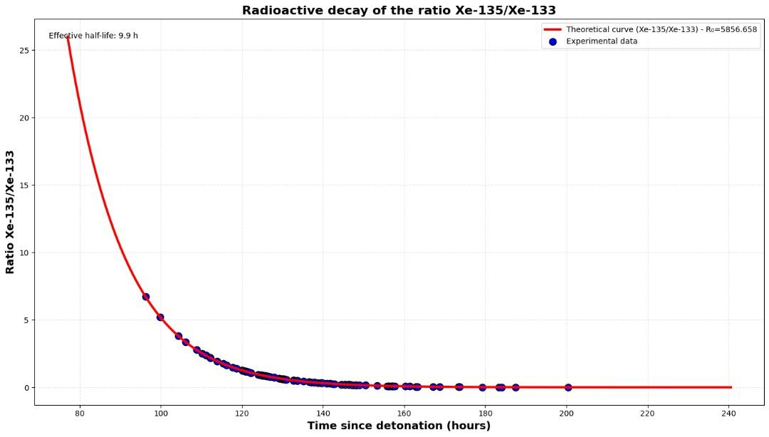
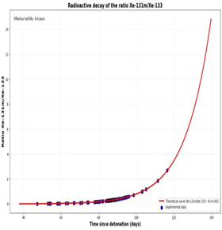
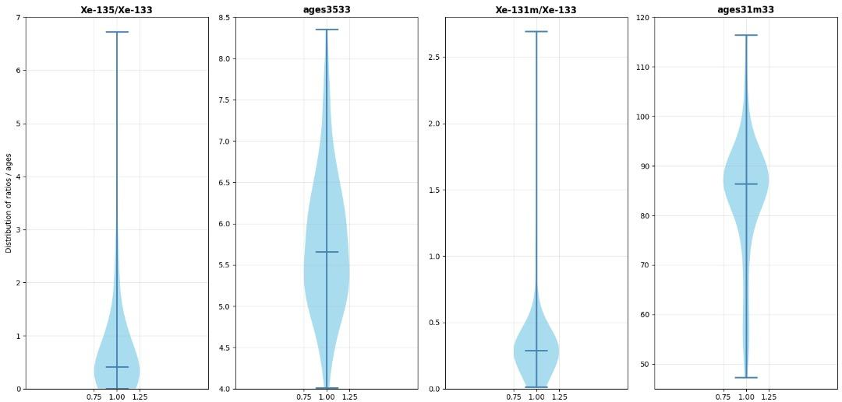
PLEASE DON‘T FORGET TO PUT THE E-POSTER TITLE AND YOUR NAME IN THE PRESENTATION HEADER.
DUPLICATE THIS SLIDE IF YOUR E-POSTER HAS MORE THAN 1 PAGE
P2.1-471
Applying Radioxenon Isotopic Ratio for Nuclear Explosion Monitoring:
Determining of Origin Time
Idrissa Ouedraogo , Martin B Kalinowski
Introduction
Methods/Data
Results/Conclusion
Estimating the origin time of a nuclear explosion is key for verifying compliance with the CTBT.
Radioxenon isotopes (¹³¹mXe, ¹³³Xe, ¹³³mXe, ¹³⁵Xe) are produced during fission and detected by the IMS network.
Their isotopic ratios change over time because of radioactive decay, revealing the time since detonation.
The Xe-135/Xe-133 ratio decreases steadily due to the shorter half-life of Xe-135.
The Xe-131m/Xe-133 ratio provides an additional time marker.
Decay models applied to these ratios, combined with violin plots, improve origin time estimates.
This approach helps detect anomalies and is validated by sismic data .
Use of real IMS network data from the DPRK nuclear tests in 2013.
Simulation of isotopic ratios Xe-135/Xe-133 and Xe-131m/Xe-133.
Radioactive decay modeling to back-calculate the elapsed time since detonation
Statistical validation using violon plots to show median, spread and detect outliers.
Cross-validation with seismic data
Results/Conclusion
Results
Radioactive decay curves
Conclusion
violon plots show consistent median ages across stations with some outliers.
Combining decay modeling and statistical visualization refines the estimation of origin time.
Results align with independent seismic data, confirming the method’s reliability.
Remaining challenges include modeling atmospheric transport and station network coverage.

