Slide 1


P1.4-630
Tectonic stress field in the Valley of Mexico from local seismicity
Author
Delia Iresine Bello-Segura
Co-author
Dr Luis Quintanar Robles
(Universidad Nacional Autonoma de Mexico (UNAM))
The Basin of Mexico, the most populated region of Mexico, is in the central part of the Trans Mexican Volcanic Belt (TMVB). This region (Figure 1) is a continental arc resulting from the subduction of the Rivera and Cocos plates beneath the North American plate. The main volcanic activity occurred during the Pliocene and Quaternary periods (Arce et al., 2019). We performed a comprehensive analysis of the seismic activity in the Valley of Mexico using the records of the nearby seismic stations. We determine the focal mechanisms of earthquakes (M > 2.5) in the Mexico Basin from 2010-2024. We grouped the resulting events according to their epicentral location into five families that we will call: a) Sierra de las Cruces (SC) b) Central area (C) c) Southeastern area (SE) d) Lake-bed area (LB) and e) Sierra Chichinautzin (CH). With these five events groups, we performed a local stress field analysis to detect variations that allow us to infer how these stresses affect the activation of previously mapped faults.

Slide 2
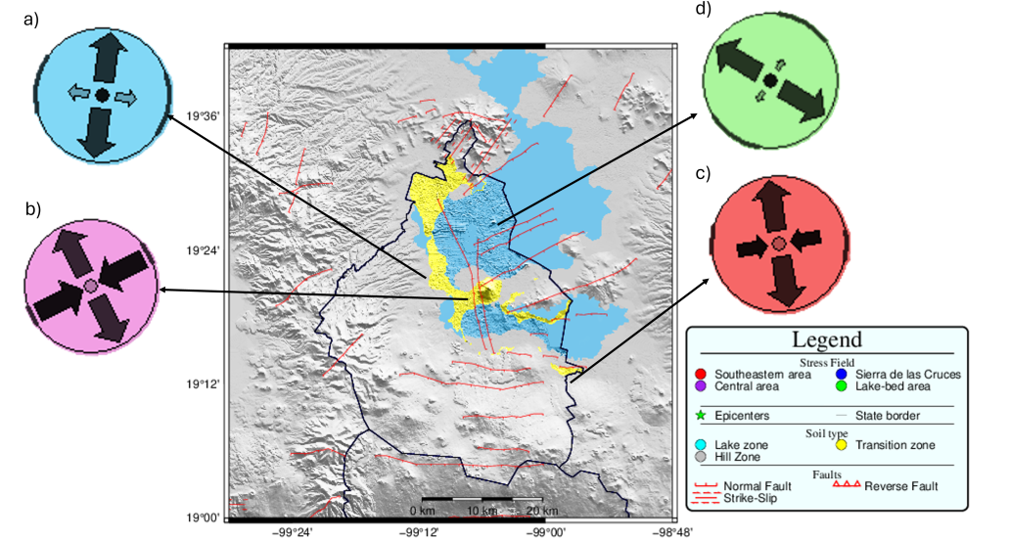
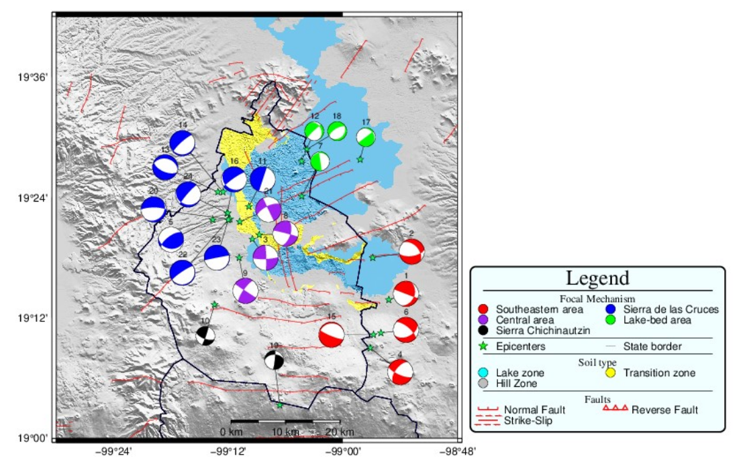

PLEASE DON‘T FORGET TO PUT THE E-POSTER TITLE AND YOUR NAME IN THE PRESENTATION HEADER.
DUPLICATE THIS SLIDE IF YOUR E-POSTER HAS MORE THAN 1 PAGE
Tectonic stress field in the Valley of Mexico from local seismicity
P1.4-630
Author: Delia Iresine Bello-Segura; Co-autor: Dr Luis Quintanar Robles
METHODS AND MATERIALS
RESULTS
Results obtained for every area in Mexico basin a) Las Cruces Hills, b) Central area, c) Southeastern area and d) Lake-bed areas in Mexico basin.
Based on the distribution of seismicity within the Valley of Mexico, we grouped them into five families that we will name: a) Sierra de las Cruces, b) Central area, c) Southeastern area, d) Lake-bed area and e) Sierra Chichinautzin. We extracted the events from the National Seismological Service database for the period ranging 2010 - 2024.
We perform a Moment Tensor inversion using the ISOLA software, for which the event must meet the following conditions:
*Station Coverage: The earthquake must be recorded by at least five stations within a distance less than 15 km. The stations should be adequately distributed in Azimuth.
*Magnitude: The minimum magnitude for the inversion should be 2.5 for regions with a good coverage station such as the western and central areas of Mexico City. For regions like Milpa Alta, the South, and the Northeast, the minimum magnitude should be 3 due to the scarcity stations distribution.
*Signal-Noise Ratio (SNR): Defined as SNR=A_signal/A_noise , where A in the amplitude, this value should be SNR≥20.
The results of our analysis show that the type faulting within the Mexico Basin is not uniform, which reflects a complexity in the geological structures of the region. Although there is a preponderance of normal faults and some Strike-Slip faults, we observe a great diversity in the azimuth value of these faults. (Figure 1)
Figure 1. Results of the analysis of 24 events. focal mechanisms are classified by their location. Colors of beach-balls represent the families of events.
With these focal mechanism solutions, we performed a local stress field analysis to detect variations that allow us to infer how these stresses affect the activation of previously mapped faults. Figure 5 shows the stress field direction along the four areas: a) Sierra de Las Cruces, b) Central area, c) Southeastern area, and d) Lake-bed area in Mexico basin
CONCLUSIONS
We obtained moment tensors for 24 earthquakes in different places in the Valley of Mexico. In most cases, we found an agreement between the strikes and type of faults reported at the epicentral zone, and the results of the focal mechanism solutions obtained. This seismicity has developed mainly in the Central Block of the Sierra de las Cruces fault system, where García-Palomo et al., 2008 reported regional subsidence of this geological feature. We also emphasize here a strike-slip faulting in the central part of Mexico City that does not correspond to any identified fault. We also identified five areas where the seismicity is concentrated: Sierra de las Cruces, Central area, Southeastern area, Lake-bed area, and Sierra Chichinautzin; the five regions are correlated with local tectonic faults or by type of soil. . We recommend that future work should prioritize increasing broadband sensors and the number of instruments in the northeastern part of Mexico City.

