Slide 1



P1.4-380
Evolution of signals of aerosol variations, rock temperature, and crustal deformation in the far tunnel of the Baksan Neutrino Observatory during strong earthquakes In Turkey on 02/06/2023
Gravirov V.¹, Pershin S.²
1. The Schmidt Institute of Physics of the Earth of the Russian Academy of Sciences (IPE RAS)
2. The Prokhorov Institute of General Physics of the Russian Academy of Sciences (IGP RAS)
Recently, we have discovered a correlation between the signals of a laser strainmeter, a laser lidar measuring the density of aerosol variations, and temperature values inside the rock base in the dead-end tunnel of the Baksan Neutrino Observatory (BNO), at the time of the first and second strong earthquakes in Turkey (02/06/2023), having almost identical magnitudes. An estimate of the radius of the stress zone from the epicenters gives a value of the order of 2000 km, which exceeds the distance to the BNO tunnels (about 900 km) and, thus, allows for the manifestation of variations in the stress-strain state in the signals of the strainmeter, thermometer and lidar.

Slide 2
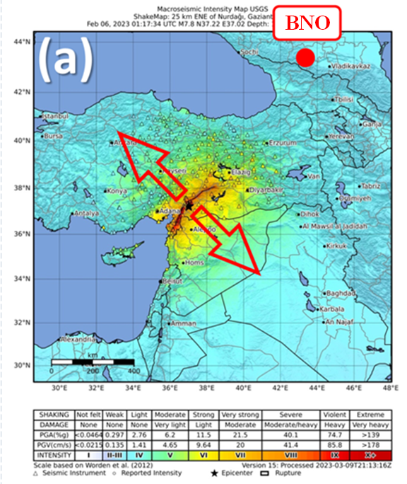
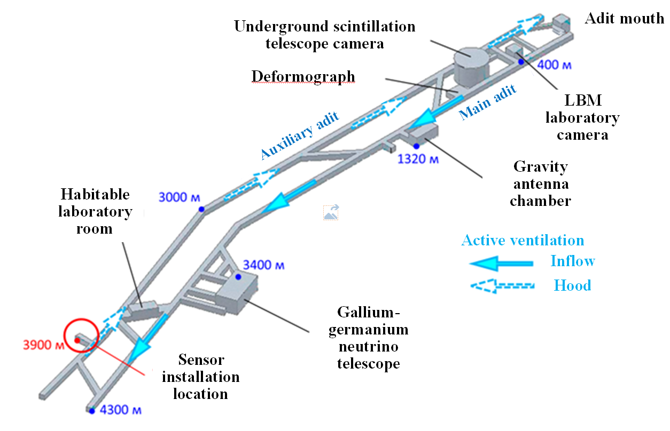
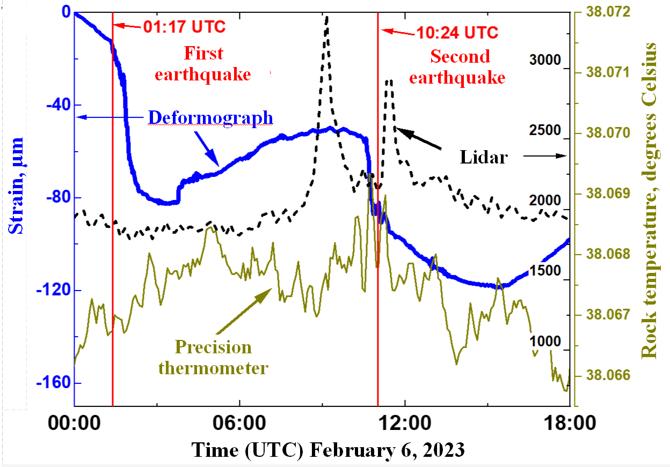
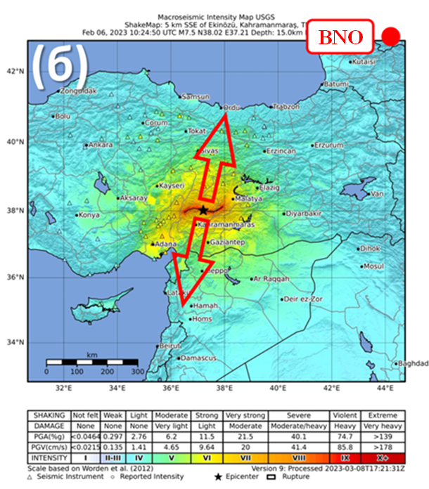

PLEASE DON‘T FORGET TO PUT THE E-POSTER TITLE AND YOUR NAME IN THE PRESENTATION HEADER.
DUPLICATE THIS SLIDE IF YOUR E-POSTER HAS MORE THAN 1 PAGE
P1.4-380
Evolution of signals of aerosol variations, rock temperature, and crustal deformation in the far tunnel of the Baksan Neutrino Observatory during strong earthquakes In Turkey on 02/06/2023
Gravirov V., Pershin S.
Fault pattern at the time of the earthquakes
BNO structure and recorded signals
Results
We paid special attention to two unique earthquakes with magnitudes 7.8 and 7.7 that occurred in Turkey on 02/06/2023. It can be seen that the compression wave from the second earthquake (10:24 UTC) is noticeably shorter than from the first, despite the fact that the power of the first earthquake was higher. Perhaps this difference is due to the orientation of the fault lines of the first (at an angle to the meridian) and second earthquake (at 90° to the meridian) and deformation waves. A comparison of the lidar thermometers and the strainmeter shows that the increase in temperature inside the rock wall of the tunnel practically coincides with the compression wave of the strainmeter at the time of the earthquake. This is most likely caused by warm gases moving upward as the rock below compresses. In contrast, one lidar signal leads the event, while the other lags. The nature of this difference is not yet completely clear and may be due to the release of ions as centers of aerosol formation, which sometimes precede earthquakes. Let us note small disturbances in the strainmeter signal when the lidar scattering signal on aerosols reaches an extremum.
The work was carried out within the framework of state assignments of Schmidt Institute of Physics of the Earth and Prokhorov Institute of General Physics Russian Academy of Sciences.
Fault pattern at the time of the earthquakes in Turkey on 02/06/2023: (a) the first earthquake at 01:17 UTC and (b) the second earthquake at 10:24 UTC.
Diagram of the BNO tunnels located under Mount Andyrchi at an altitude of 1700 m above sea level.
Variations in strainmeter (blue thick line), lidar (dotted line) and rock temperature (dark green thin line) signals during both earthquakes in Turkey on 02/06/2023. Vertical lines mark the moments of the 1st and 2nd earthquakes at 01:17 and 10:24 UTC.

