Slide 1


P1.3-815
Comparative analysis of recent and historic low-frequency acoustic propagation from the island of Kauai to hydrophones at Wake Island: implications for accurate localization of impulsive signals
David R. Dall’Osto
Applied Physics Laboratory at the University of Washington, Seattle
A cabled 75-Hz source North of the Hawaiian Islands to measure ocean temperature across the North Pacific Basin transmits a 27.28 second long ‘maximum length sequence’ pseudo noise signal which correlates to an unambiguous impulse.
Receptions at Wake Island hydrophones during the Prototype International Data Centre (PIDC) and the modern IDC era demonstrate seasonal and climatic shifts in propagation time with implications on accuracy of event localization.

Slide 2
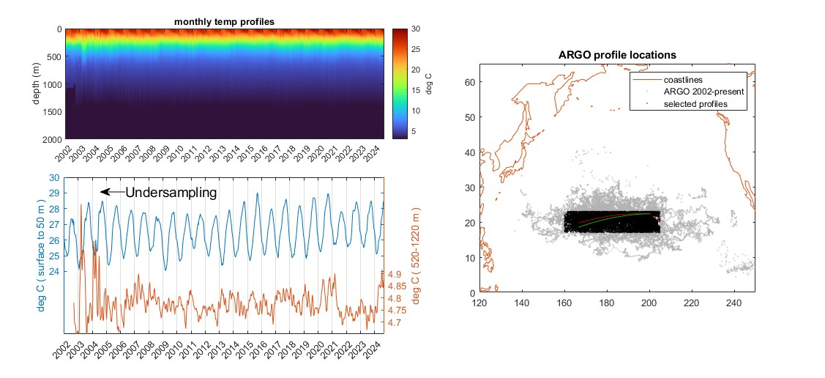
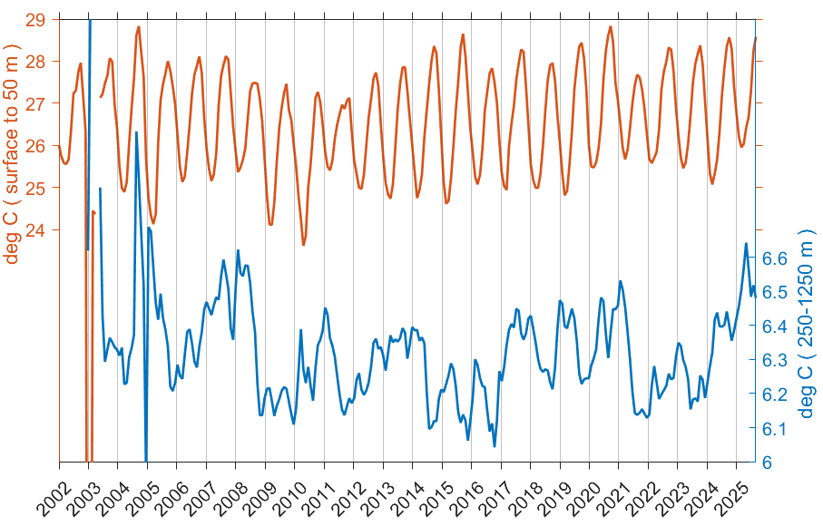
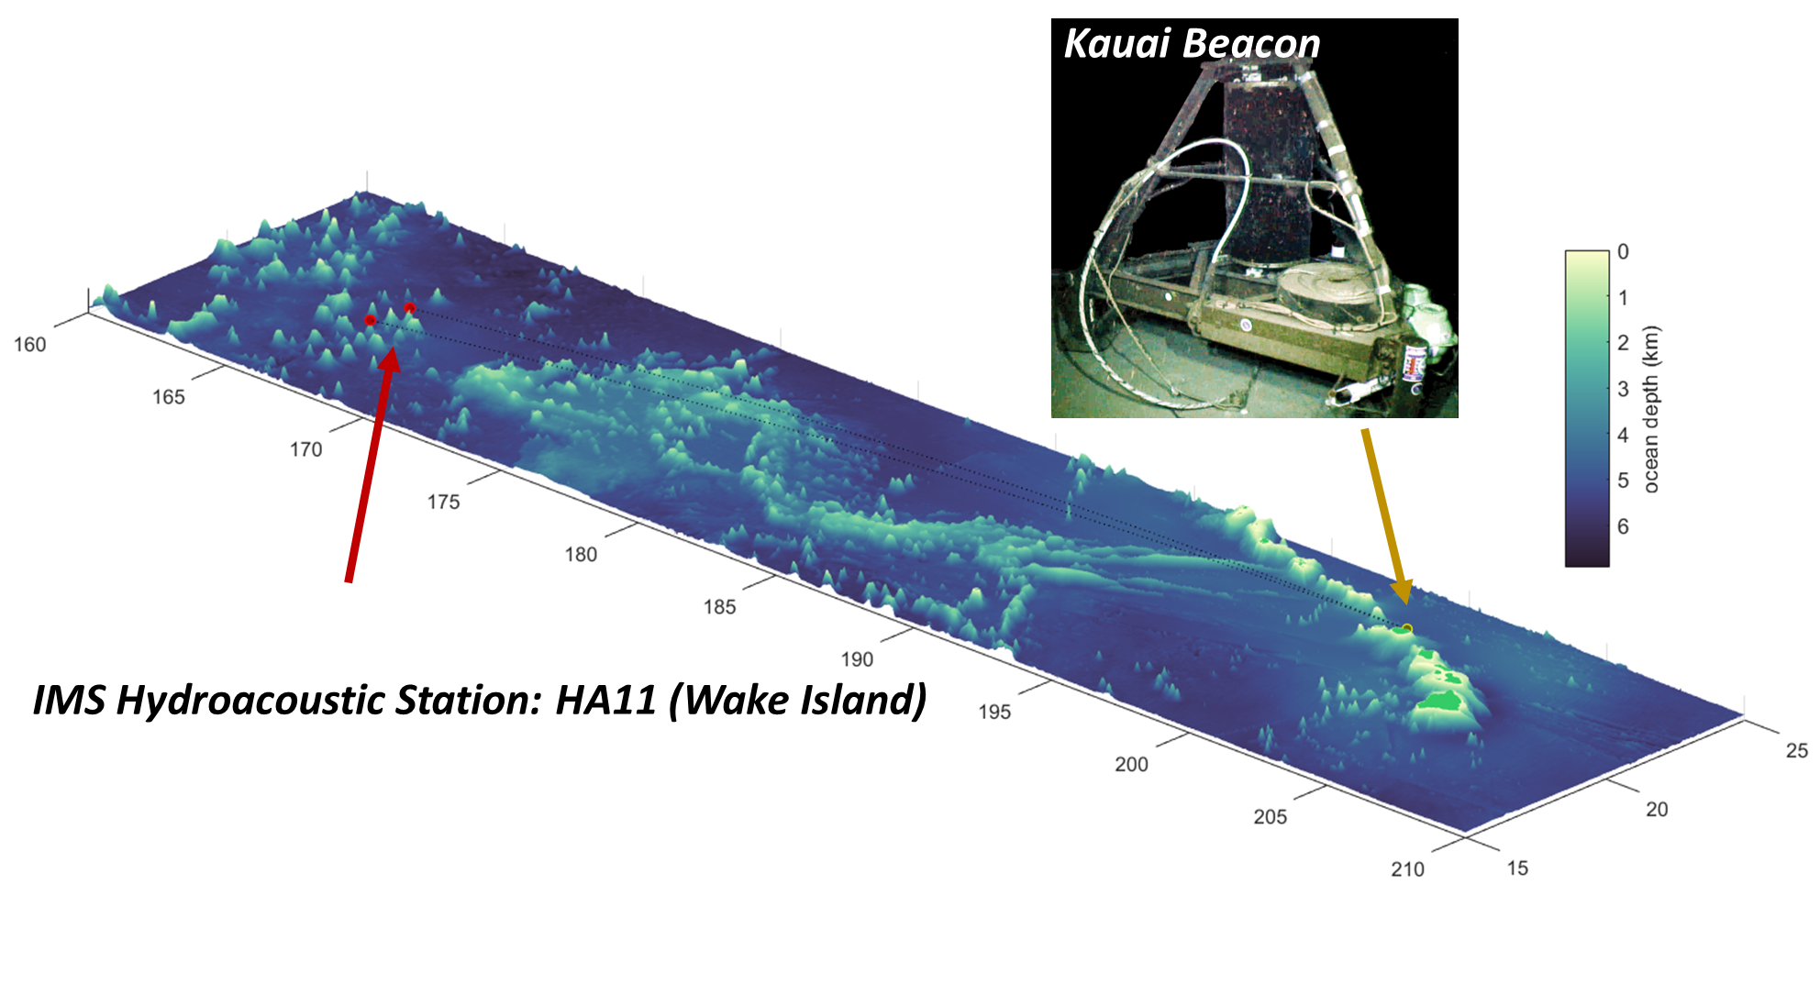
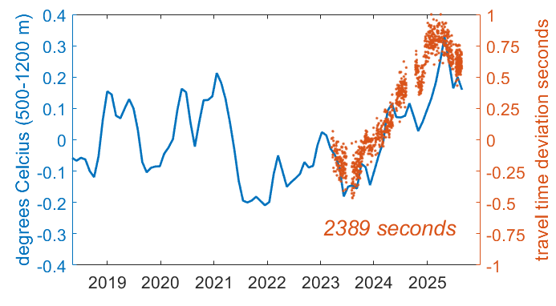
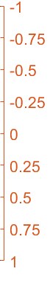
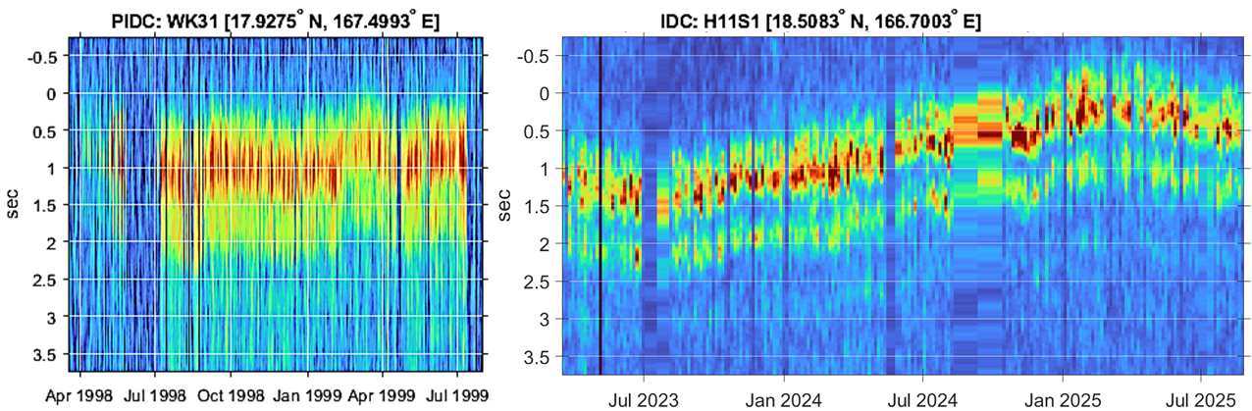
P1.3-815
Comparative analysis of recent and historic low-frequency acoustic propagation from the island of Kauai to hydrophones at Wake Island: implications for accurate localization of impulsive signals
David R. Dall’Osto
The Kauai Beacon
Propagation to Wake Island
DSC Temperature vs Measured Travel Times
The Kauai Beacon (KB) source transmits a series of 27.28 s duration pseudo noise sequences, a ‘maximum-length sequence’ encoded as the signal phase of a 75-Hz carrier tone. This band-limited noise signal correlates to an impulse, which provides a direct measurement of the travel time from Kauai to Wake Island.
The KB is positioned 50 km north of the Hawaiian Island of Kauai, on the seafloor at a depth of 800 m. The propagation path to Wake covers 3,500 km of the Pacific Basin and passes over the undersea Mid-Pacific Mountains, which rise to within 1 km of the sea surface. The impulse energy arrives over roughly 1 second and has a characteristic twin peak arrival structure – a convenient consistent signal envelope to directly estimate the deviations in hydroacoustic travel time.
Propagation from Kauai to Wake Island was first measured during the Prototype International Data Centre (PIDC) period, corresponding to its the initial use in the Acoustic Thermometry of Ocean Climate (ATOC) program. For the PIDC, the Wake Island stations WK30 and WK31 used a single hydrophone suspended at roughly 1000 m. At the conclusion of the ATOC program, the KB was silent until repairs were completed and regular tomographic signals were reinstated in March of 2023. Receptions continue to be collected at all six hydrophones of the HA11 station, with arrival time fluctuating with deep ocean temperature.
KAUAI
WAKE ISLAND
PIDC (pre-ARGO)
IDC
The now mature ARGO (deep-profiling floats) program provides measurement of Deep Sound Channel (DSC) temperature to constrain ocean state climate estimates. Along the propagation path from Kauai to Wake Island seasonal Ocean Atlases track the average surface layer temperature (0-50 m : red line); the temperature of the DSC (250-1250 m : blue line) corresponds to multi-year climatic events, i.e. deviations from the Ocean Atlases.
Acoustic travel time from Kauai to Wake Island, H11S (IDC) and WK31 (PIDC), deviate by as much as 1-s from seasonal Atlas prediction, but follow the average DSC temperature (250-1250 m) during the recent climatic event. A 1-second uncertainty in propagation time at 3,500 km distance corresponds to ~2 km error in ranging. Across the Pacific Basin, ranging errors from Ocean Atlas predictions may be
greater than 10 km.

