Slide 1
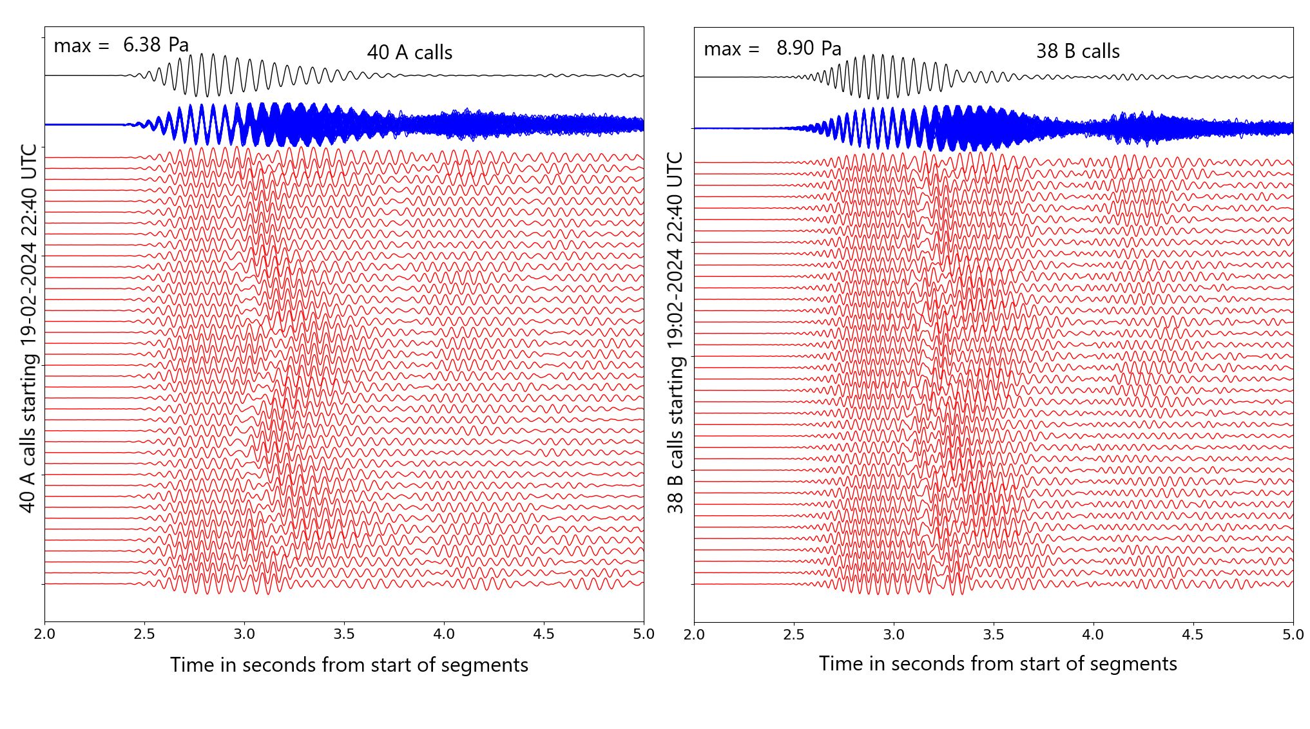
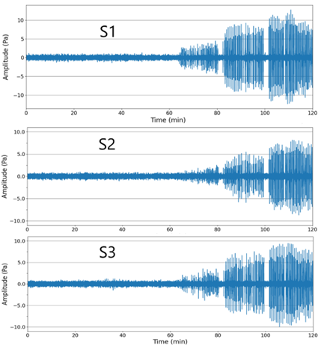
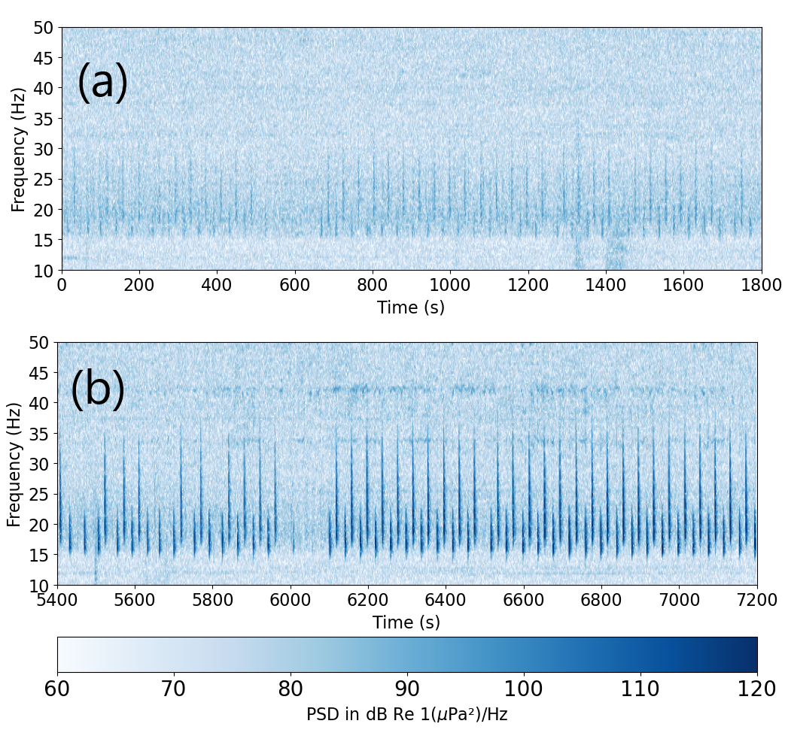
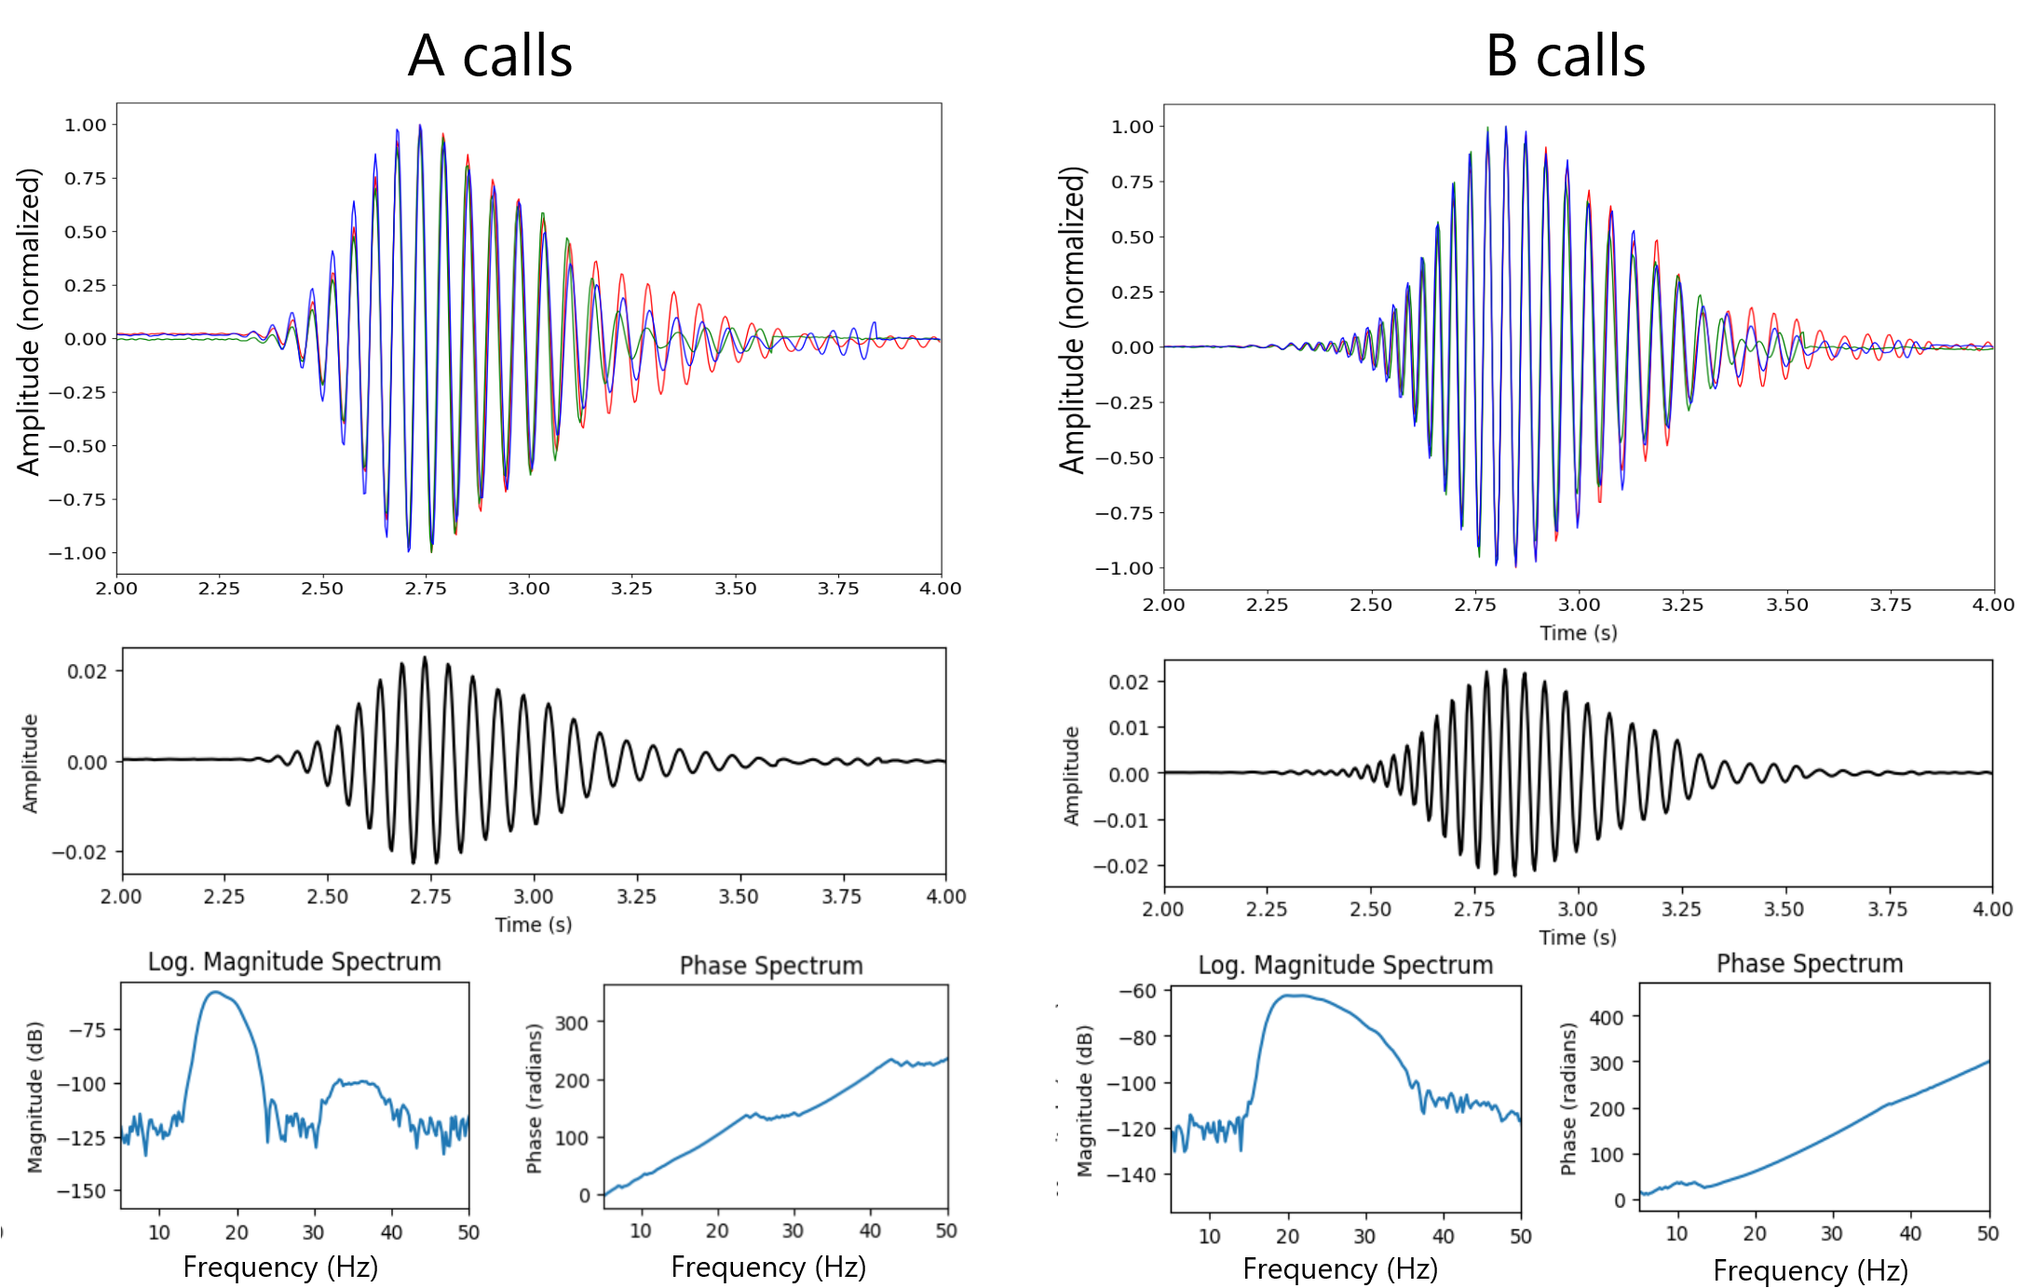
PLEASE DON‘T FORGET TO PUT THE E-POSTER TITLE AND YOUR NAME IN THE PRESENTATION HEADER.
DUPLICATE THIS SLIDE IF YOUR E-POSTER HAS MORE THAN 1 PAGE
P1.3-851
Interpretation of whales diving behaviour in the vicinity of IMS hydrophone triplet.
Time Domain Observations
Ronan Le Bras, Peter Nielsen, and Paulina Bittner
Spectrograms
Source Wavelet Extraction
Calibrated hydrophone data starting at 21:00 UTC on 19 February 2024 for, respectively, the S1, S2, and S3 hydrophones at IMS triplet H11S. Around the one-hour mark, frequent (approximately once every 25 s) impulsive signals are visible and increasing in amplitude towards the end of the section.
Two types of calls are clearly visible on the spectrogram. One type (B) has a broader frequency bandwidth of [17–40] Hz and higher center frequency than the other one type A ([15–25]) Hz.
Interruptions in the call patterns may correspond to times or surfacing. First call at the time of a dive is usually an A call, and the last as B call, if we assume the signals originate from a single individual.
The source wavelet for both A and B types of calls were extracted, using simple techniques of STA/LTA picking, aligning the first arrivals via cross-correlations, and stacking.
DISCLAIMER. The statements, opinions and data contained in this publication are solely those of the individual author(s) and contributor(s).

Slide 2
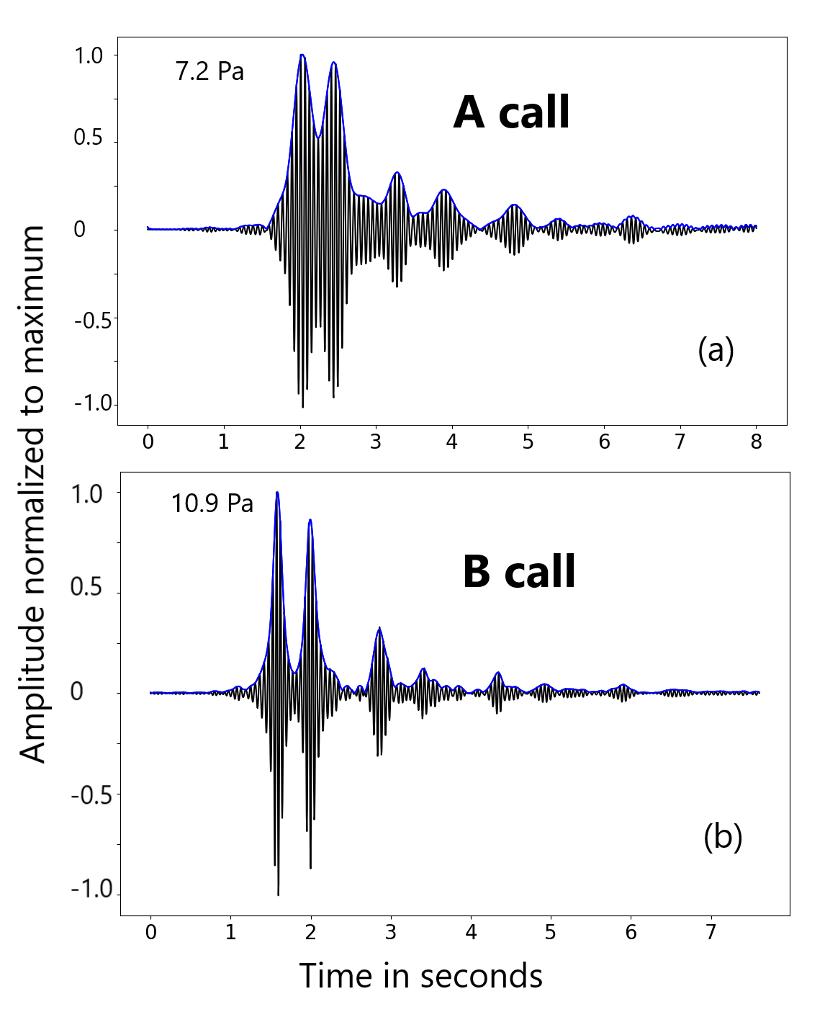
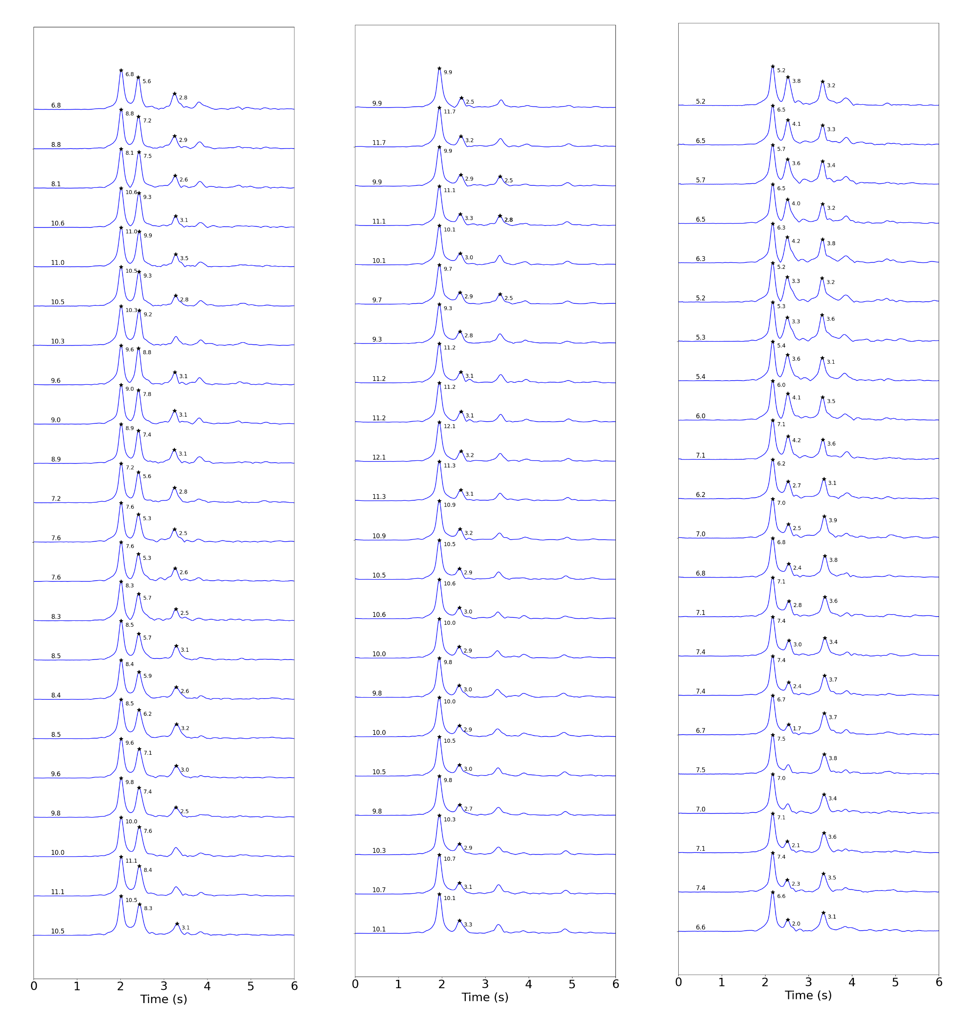
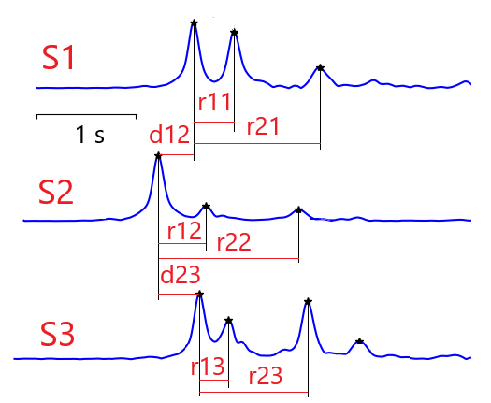
PLEASE DON‘T FORGET TO PUT THE E-POSTER TITLE AND YOUR NAME IN THE PRESENTATION HEADER.
DUPLICATE THIS SLIDE IF YOUR E-POSTER HAS MORE THAN 1 PAGE
P1.3-851
Interpretation of whales diving behaviour in the vicinity of IMS hydrophone triplet.
B Calls Time Picks
Ronan Le Bras, Peter Nielsen, and Paulina Bittner
Picking of TDOAs
Cross-correlation of source wavelets with the signals, a series of picks can be made at all three hydrophones for direct arrivals and reflected arrivals.
Two types of time differences of arrivals (TDOAs) are used as input to the geographic location method (track computation). The first one involves the differences in time of arrivals at two different hydrophones for the direct waves. The second type of delays used is the difference between the first and second reflected waves at each hydrophone.
18-minute interval
19 February 2024 23:02 UTC
The figure above shows the cross-correlation for an example of an A call and the following B call. Note that, as expected, the B calls allows a better time localization of picks, thanks to its broader frequency content than the A calls. This is applied on multiple calls for each hydrophone
The picking method shown on the middle panel was applied to all calls in the 18-minute interval starting on 18 February 2014 at 23:02 UTC, and the TDOAs used to derive the track of the whale emitting the B calls within that interval. The data set is complete for the delays between direct arrivals at the three hydrophones. The reflections provide additional constraints to the location. For this interval, all picks for the direct arrivals, and the two largest reflections were available (not all picks used are shown as black stars on the above figure).
Time differences of direct arrivals between hydrophones of the direct arrivals and between two identifiable reflections and the direct arrivals are used to constrain the geographic location of the calls during an 18-minute interval. Not shown is the d31 delay.
DISCLAIMER. The statements, opinions and data contained in this publication are solely those of the individual author(s) and contributor(s).

Slide 3
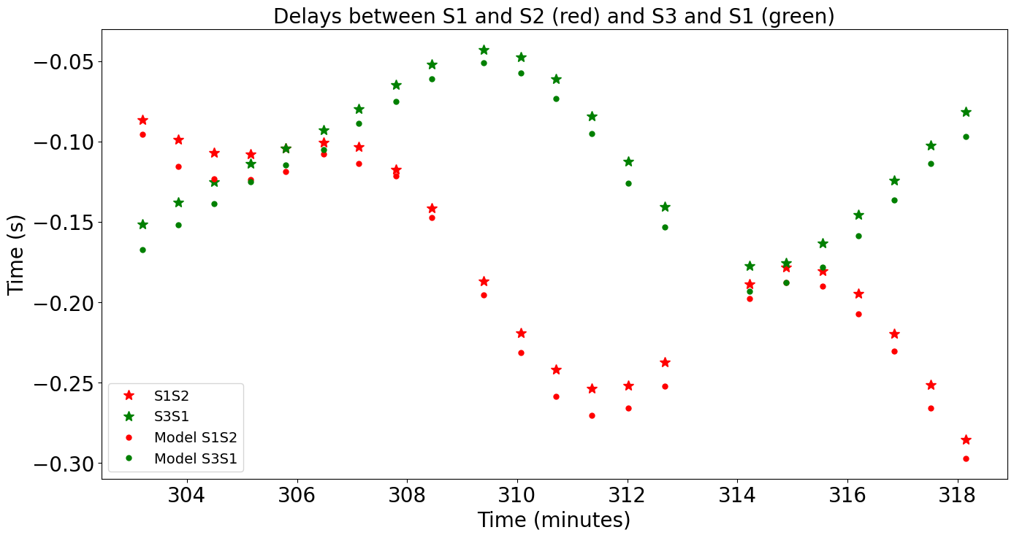
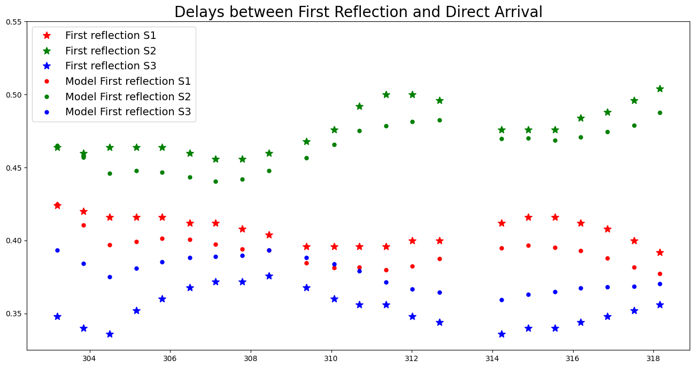
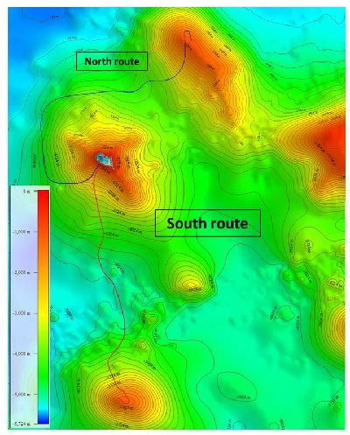
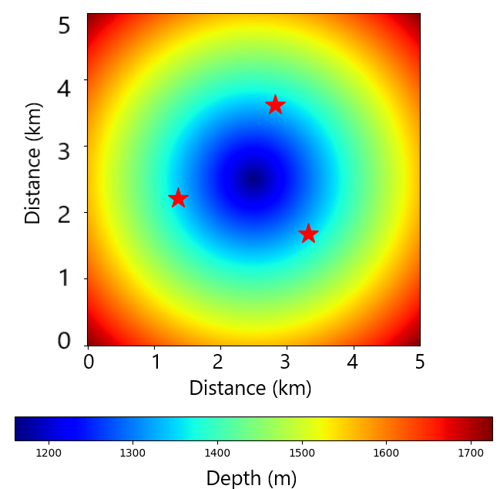
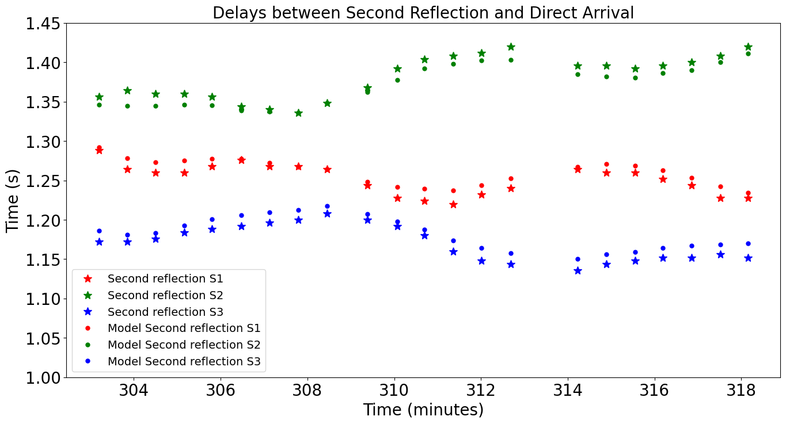
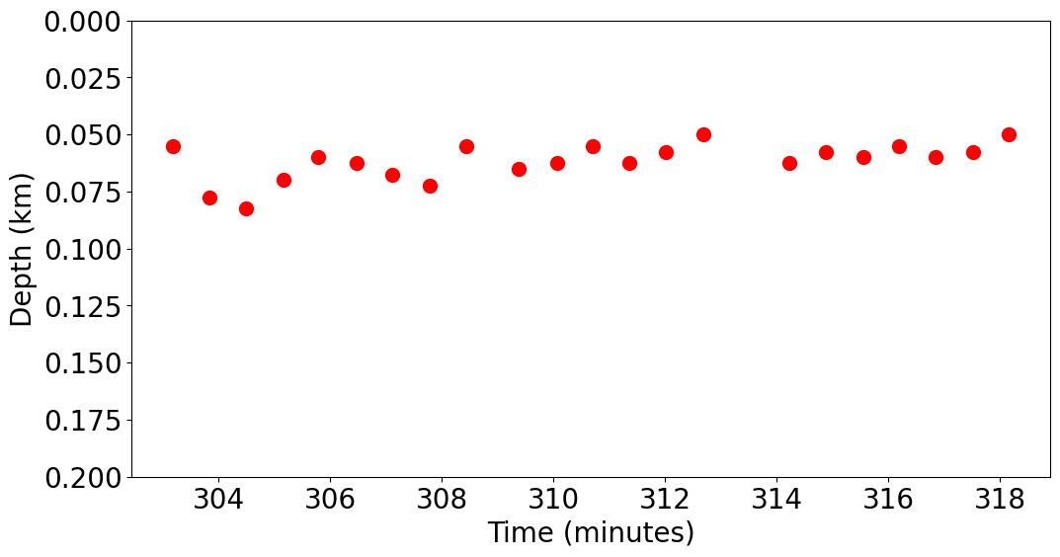
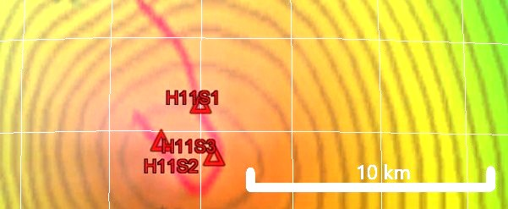
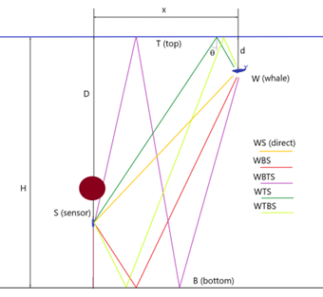
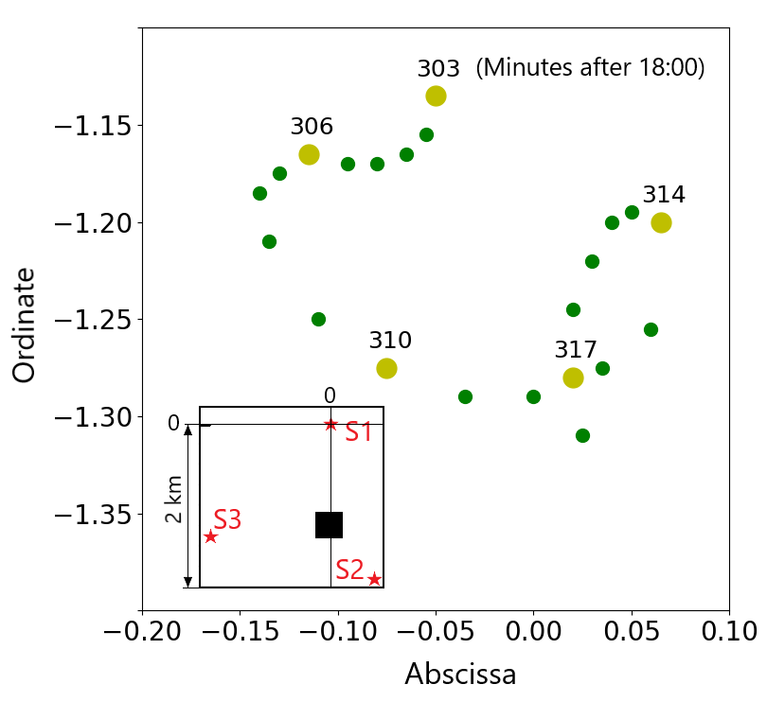
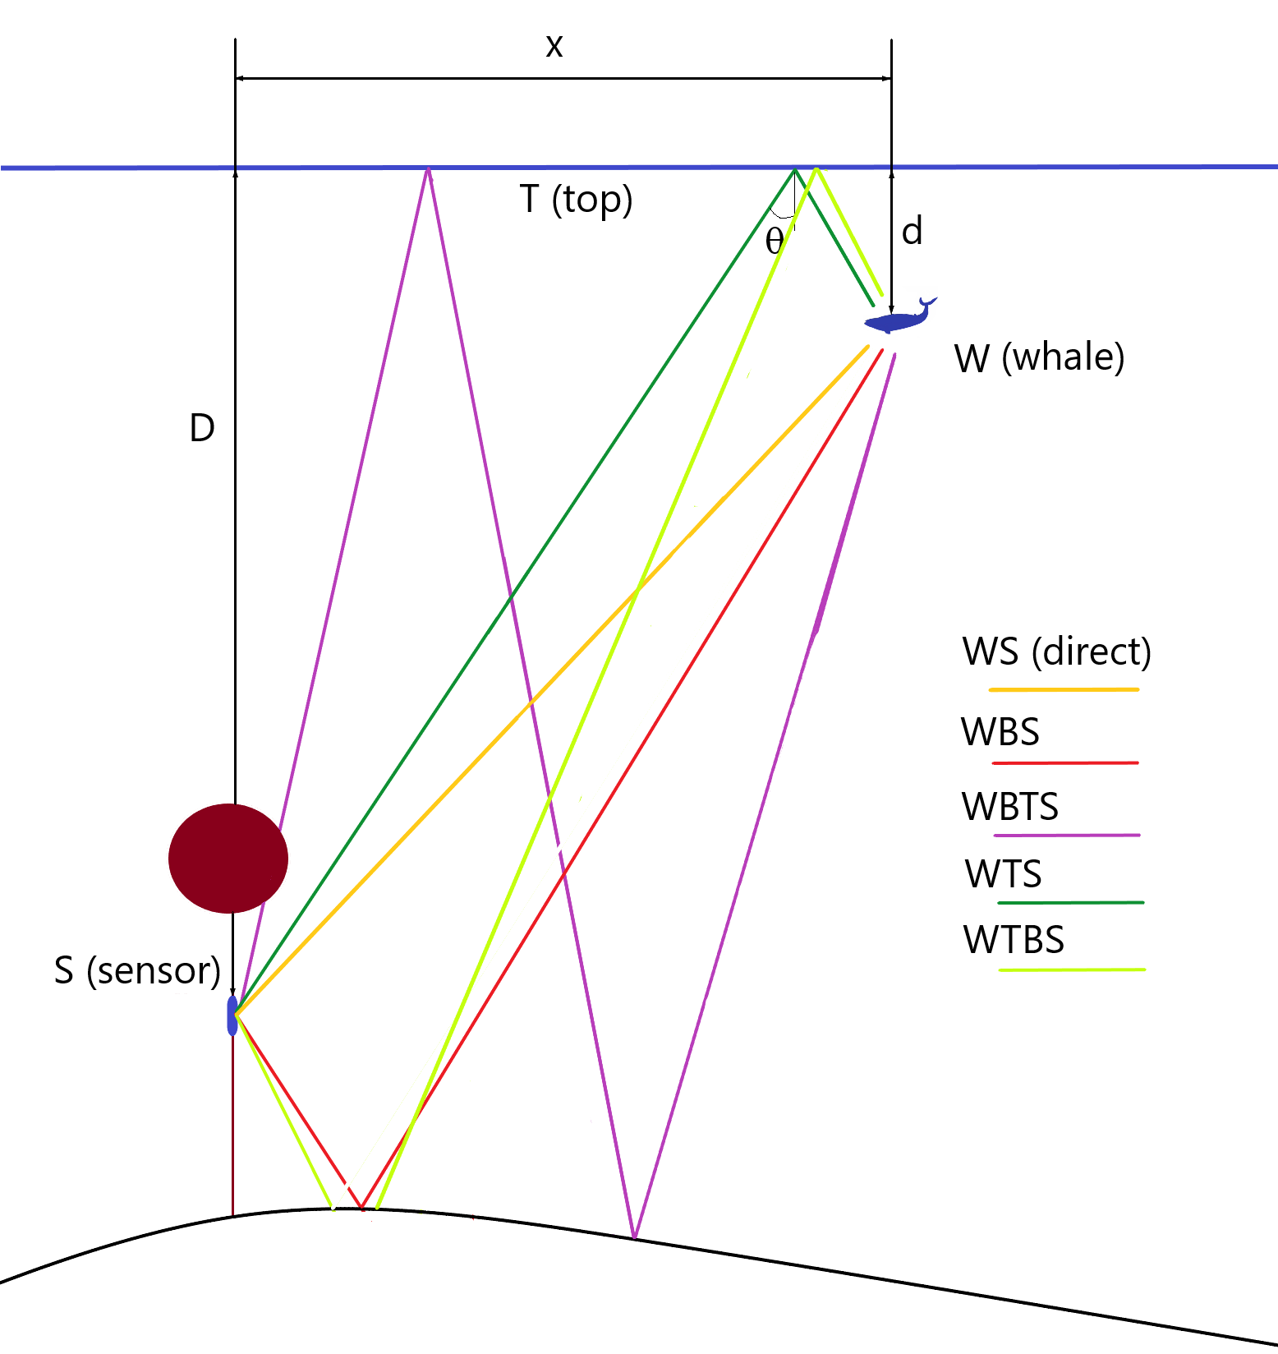
PLEASE DON‘T FORGET TO PUT THE E-POSTER TITLE AND YOUR NAME IN THE PRESENTATION HEADER.
DUPLICATE THIS SLIDE IF YOUR E-POSTER HAS MORE THAN 1 PAGE
P1.3-851
Interpretation of whales diving behaviour in the vicinity of IMS hydrophone triplet.
Ronan Le Bras, Peter Nielsen, and Paulina Bittner
Location via Grid Search for a Flat Bottom Assumption
Future work. Effect of sea-floor bathymetry
The results presented in the panel to the left are for a flat bottom assumption where rays are shown on the bottom left figure. Out of five rays shown, three are identified in the data: WS, WBS, WBTS. The ray paths including and ocean surface reflection (WTS and WTBS) could not be identified in the data. The top left is the fit for the TDOAs between hydrophones, the top right is for the first reflection (WBS) delays, the middle left for the second reflection (WBTS). The depth determinations are shown on the middle right panel and the whale track on the bottom right, labelled in minutes.
The results presented in the previous panels are published in:
Le Bras, R.; Nielsen, P.; Bittner, P. Tracking of Fin Whales Using a Power Detector, Source Wavelet Extraction, and Cross-Correlation on Recordings Close to Triplets of Hydrophones. J. Mar. Sci. Eng. 2025, 13, 1138. https://doi.org/10.3390/jmse13061138
Additional work is envisaged to assess the importance of the sea floor bathymetry (sketch on the figure to the left) in establishing the results shown in the paper where locally flat bathymetry was assumed. A bathymetric survey was made prior to the station deployment, as shown above on the top left. A close-up of the area of the southern triplet of HA11 is shown below it, and a simplified model is shown on the right with the red stars showing the hydrophone locations. The software is in development to compute the delays for a non-flat bathymetry.
DISCLAIMER. The statements, opinions and data contained in this publication are solely those of the individual author(s) and contributor(s).

