Slide 1
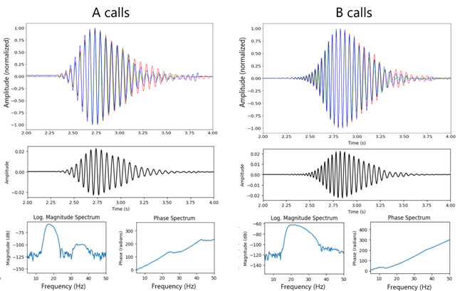
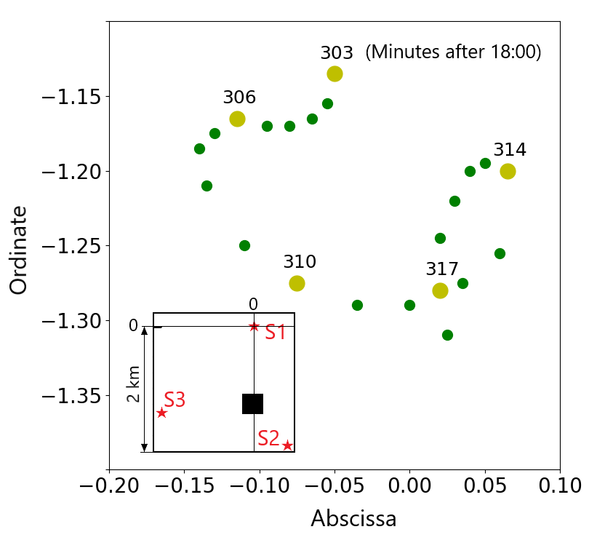
P1.3-851
Interpretation of whales diving behaviour in the vicinity of IMS hydrophone triplet.
Ronan Le Bras, Peter Nielsen, and Paulina Bittner
Analysis of an interesting sequence of fin whale calls at the southern triplet of IMS hydroacoustic station HA11 allows to obtain the following results:
It is well known that fin whales, among other forms of acoustic emissions emit two distinct types of low frequency (15-50 Hz) signals. They are designated as types A and B calls. The B calls have a broader frequency content and higher centre frequency than the A calls. Previous work have suggested that the A and B calls may be emitted by two different animals. This work shows that given the proximity of the tracks computed from the A and B calls, it is likely that they are emitted by the same animal.
Under the assumption that the calls in a call-sequence are all very similar, stacking techniques applied to a multiple calls allow to eliminate multiple reflections and extract the source wavelets for the A and B calls (figure on the side, top).
The high quality and continuous character of the hydroacoustic data recorded at the IMS underwater stations allow precise tracking of whales passing in their neighbourhood (figure on the side, bottom)
Extracting the source wavelet of signal emitted by fin whales allows for precise identification of arrival multiple reflected arrivals from the bottom and sea surfaces.
DISCLAIMER. The statements, opinions and data contained in this publication are solely those of the individual author(s) and contributor(s).

