Slide 1

P1.3-122
Subsea Environmental Sensing with Operational
Submarine Cables
Valey Kamalov
Valey Kamalov LLC
Introduction. There are 1.5 Million km of private submarine telecommunication cables. Optics enables global ocean monitoring from shores.
Main Results. 1. Optical polarization changes convert transcontinental Curie cable into a geophysical sensor (Science, 2021)
2. Optical phase sensing with fiber arrays (Science, 2022)
3. Volcano early warning in Iceland (Science, 2025)

Slide 2
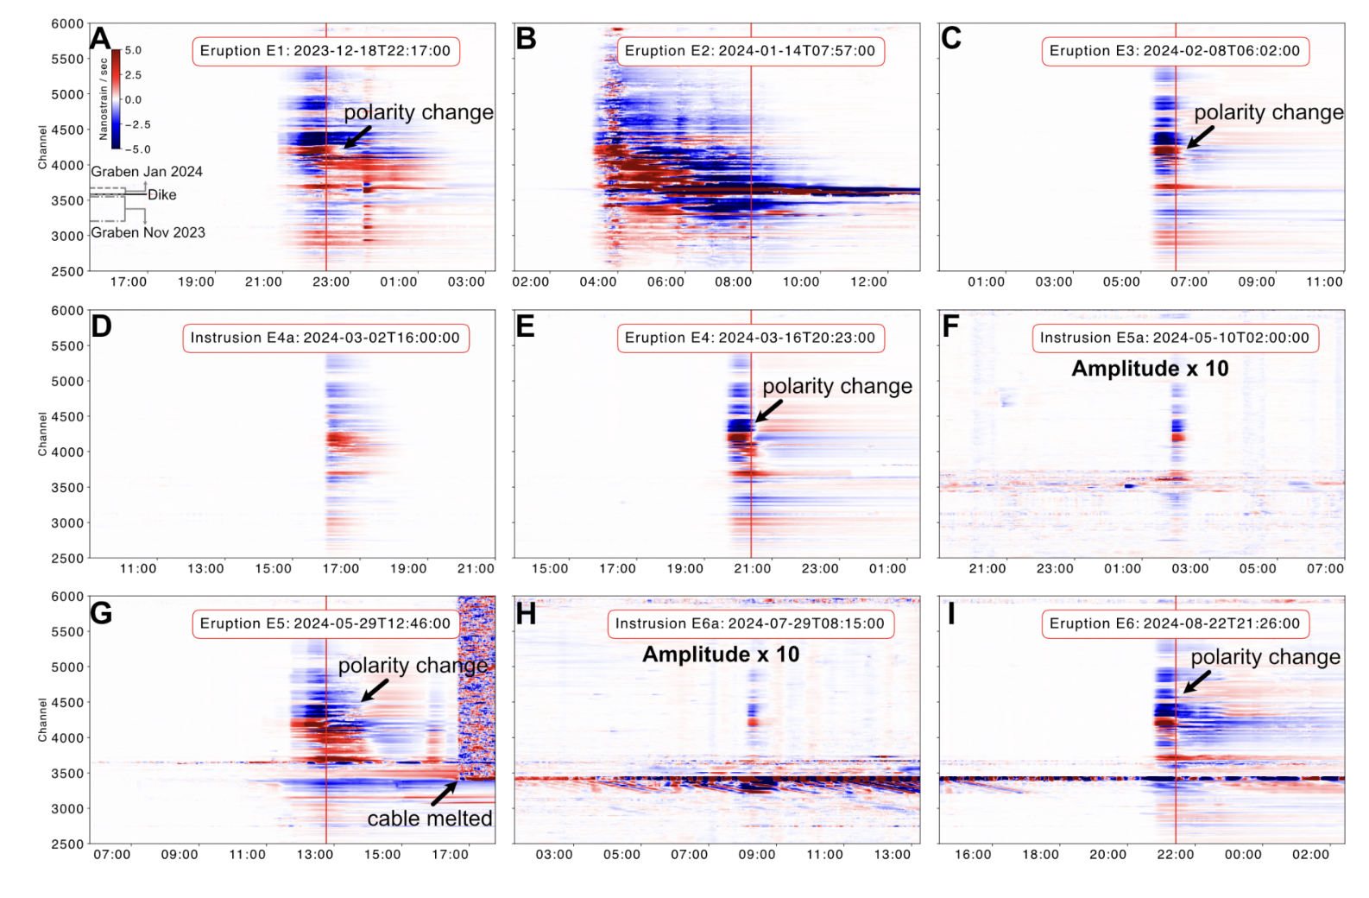
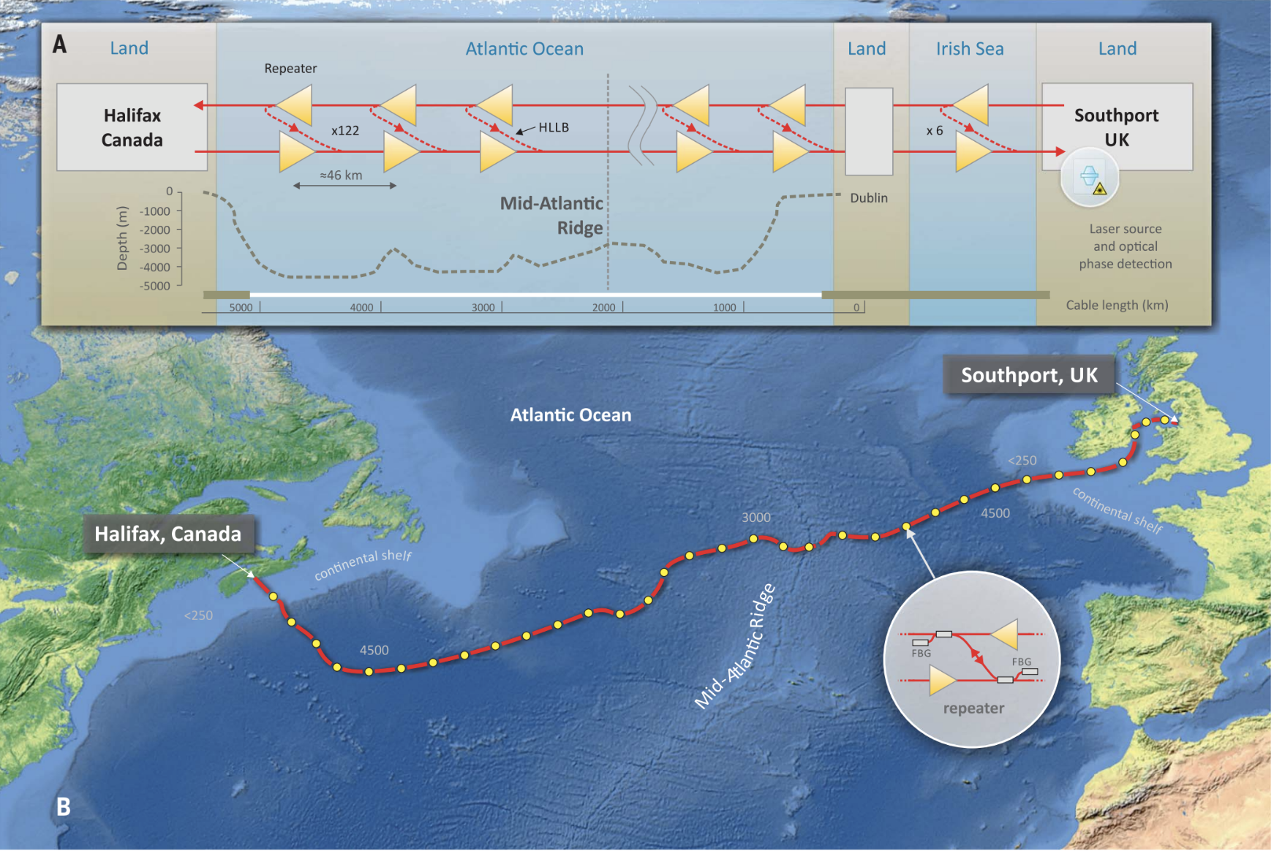
P1.3-122
Subsea Environmental Sensing with Operational
Submarine Cables
Valey Kamalov
1. Optical polarization changes convert transcontinental Curie cable into a geophysical sensor (Science, 2021)
2. Optical phase sensing with fiber arrays (Science, 2022)
3. Volcano early warning in Iceland (Science, 2025)
We demonstrate the detection of earthquakes and ocean signals on individual spans between repeaters of a 5860-kilometer-long transatlantic cable rather than the whole cable. By applying this technique to the existing undersea communication cables, which have a repeater-to-repeater span length of 45 to 90 kilometers, the largely unmonitored ocean floor could be instrumented with thousands of permanent real-time environmental sensors without changes to the underwater infrastructure
Seafloor geophysical instrumentation is challenging to deploy and maintain but critical for studying
submarine earthquakes and Earth’s interior. Emerging fiber-optic sensing technologies that can leverage
submarine telecommunication cables present an opportunity to fill the data gap. We successfully sensed
seismic and water waves over a 10,000-kilometer-long submarine cable connecting Los Angeles,
California, and Valparaiso, Chile, by monitoring the polarization of regular optical telecommunication
channels. We detected multiple moderate-to-large earthquakes along the cable in the 10-millihertz to 5-hertz band. We also recorded pressure signals from ocean swells in the primary microseism band,
implying the potential for tsunami sensing. Our method, because it does not require specialized equipment, laser sources, or dedicated fibers, is highly scalable for converting global submarine cables into continuous real-time earthquake and tsunami observatories.
Denoised Strain rate recordings over 12 hours during the nine intrusive events. (A) Recording of eruption E1. The intersections of the fiber cable with the dike (black solid line) and grabens (gray dashed lines) formed in November 2023 and January 2024 are marked. The vertical red line represents the eruption time. The black arrow marks the polarity change shortly after the eruption. (B,C,E,G,I) Similar to (A) but for recordings of eruptions E2-E6. The strong noise in (G) after around 16:40 was caused by the destruction of the fiber cable by lava. (D,F,H) Recordings of arrested intrusions E4a, E5a, and E6a. The strain rate amplitudes for E5a (F) and E6a (H) are multiplied by a factor of 10 to enhance the visibility of these two weak events.
Zhongwen Zhan, Mattia Cantono, Valey Kamalov, Antonio Mecozzi, Rafael Muller, Shuang Yin, Jorge C. Castellanos
Giuseppe Marra, D. Fairweather, Valey Kamalov et al
Jiaxuan Li, Ettore Biondi, Valey Kamalov et al.

