Slide 1
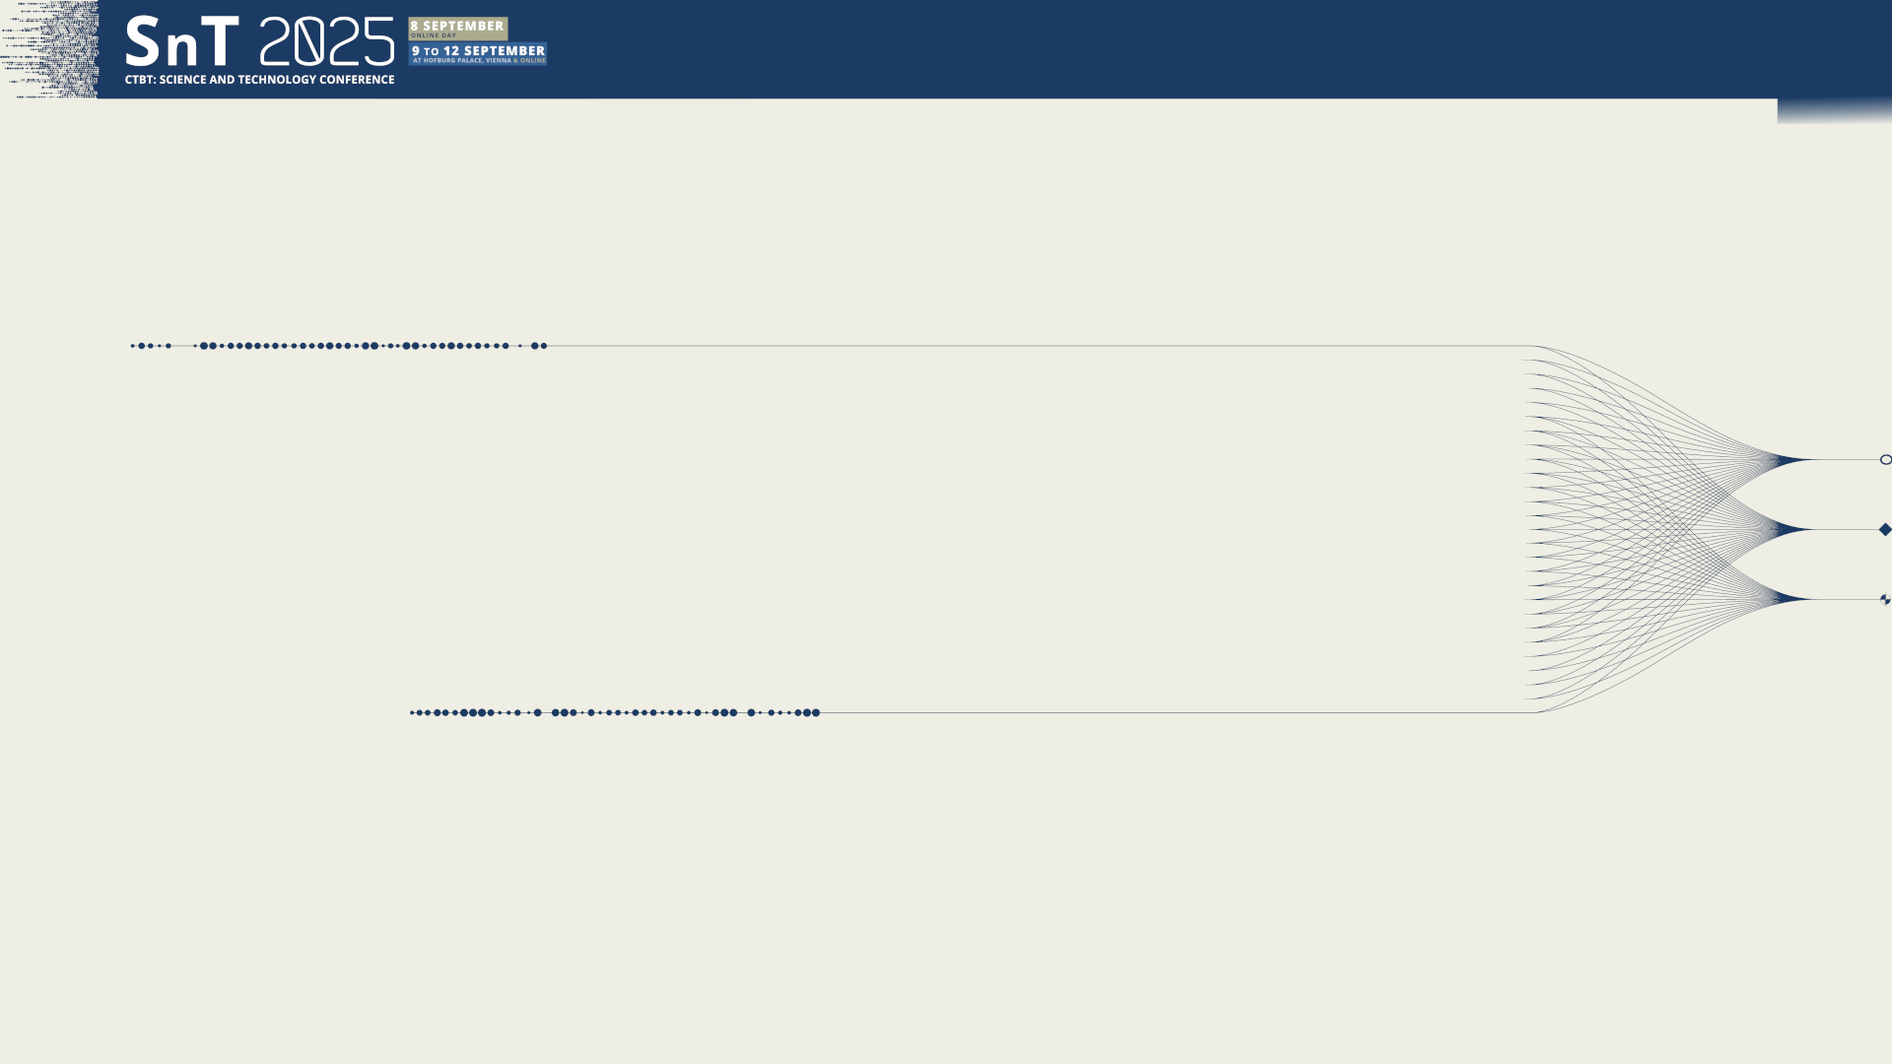

O1.3-278
The CTBT IMS: a window into a century of global soundscapes (1920-2020)
M. A. Ainslie [1], S. P. Robinson [2], P. L. Tyack [3], R. K. Andrew [4], P. M. Harris [2],
M. B. Halvorsen [1] & A. O. MacGillivray [1]
[1] JASCO Applied Sciences
[2] National Physical Laboratory
[3] University of St Andrews
[4] Marasondo
11 September 2025

Slide 2
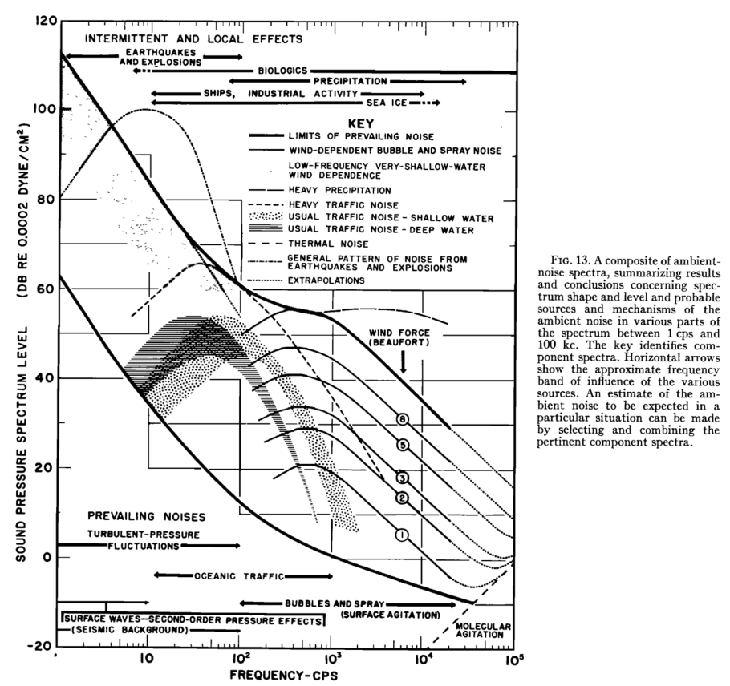
PLEASE DON‘T FORGET TO PUT THE E-POSTER TITLE AND YOUR NAME IN THE PRESENTATION HEADER.
THEN DUPLICATE THIS SLIDE FOR ALL OTHER PRESENTATION SLIDES.
O1.3-278
The CTBT IMS: a window into a century of global soundscapes (1920-2020)
M. A. Ainslie, S. P. Robinson, P. L. Tyack, R. K. Andrew, P. M. Harris, M. B. Halvorsen & A. O. MacGillivray
Wenz curves (“usual traffic noise”)
Broad 25-35 Hz peak in deep water is attributed to “traffic noise”* (Wenz 1962)
* “traffic noise” = sound from distant shipping
USUAL TRAFFIC NOISE – DEEP WATER

Slide 3
PLEASE DON‘T FORGET TO PUT THE E-POSTER TITLE AND YOUR NAME IN THE PRESENTATION HEADER.
THEN DUPLICATE THIS SLIDE FOR ALL OTHER PRESENTATION SLIDES.
O1.3-278
The CTBT IMS: a window into a century of global soundscapes (1920-2020)
M. A. Ainslie, S. P. Robinson, P. L. Tyack, R. K. Andrew, P. M. Harris, M. B. Halvorsen & A. O. MacGillivray
Wenz curves (“usual traffic noise”)
Broad 25-35 Hz peak in deep water is attributed to “traffic noise”* (Wenz 1962)
* “traffic noise” = sound from distant shipping
USUAL TRAFFIC NOISE – DEEP WATER
But … how did Wenz know it was shipping?!?
See also Deane (2025)

Slide 4
PLEASE DON‘T FORGET TO PUT THE E-POSTER TITLE AND YOUR NAME IN THE PRESENTATION HEADER.
THEN DUPLICATE THIS SLIDE FOR ALL OTHER PRESENTATION SLIDES.
O1.3-278
The CTBT IMS: a window into a century of global soundscapes (1920-2020)
M. A. Ainslie, S. P. Robinson, P. L. Tyack, R. K. Andrew, P. M. Harris, M. B. Halvorsen & A. O. MacGillivray
Structure
Background
  Deep water shipping noise (“Wenz curves”)
Global sound energy budget
  Nowcast (2020)
  Hindcast (1920-2020)
A window into the past
  Wenz curves revisited
  Contribution from earthquakes

Slide 5
GLOBAL SOUND ENERGY BUDGET: NOWCAST (2020)

Slide 6
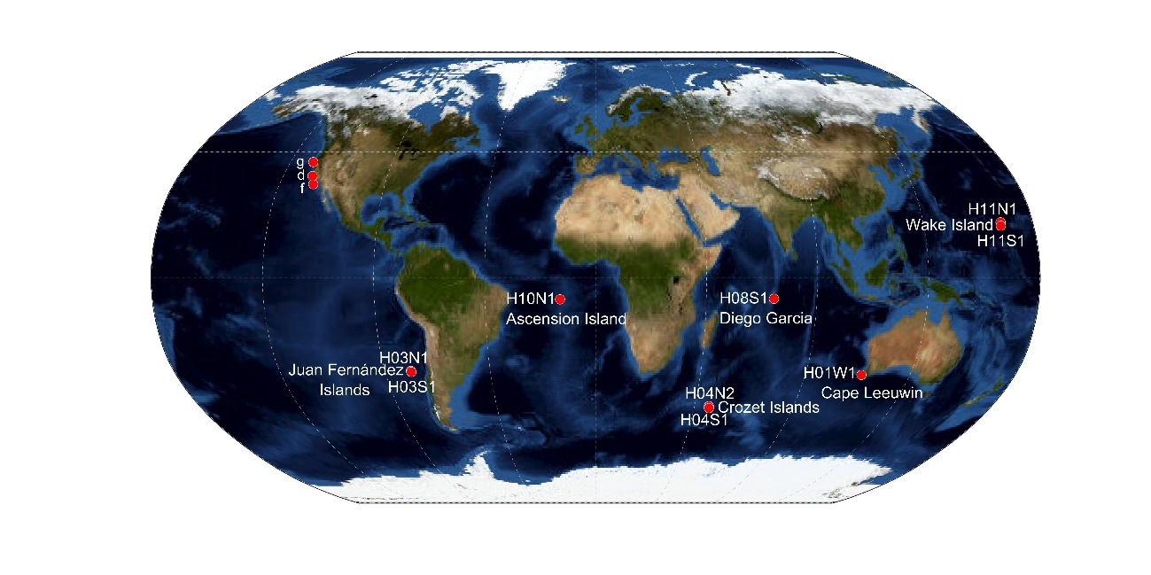
PLEASE DON‘T FORGET TO PUT THE E-POSTER TITLE AND YOUR NAME IN THE PRESENTATION HEADER.
THEN DUPLICATE THIS SLIDE FOR ALL OTHER PRESENTATION SLIDES.
O1.3-278
The CTBT IMS: a window into a century of global soundscapes (1920-2020)
M. A. Ainslie, S. P. Robinson, P. L. Tyack, R. K. Andrew, P. M. Harris, M. B. Halvorsen & A. O. MacGillivray
Global energy budget: measurement
Geographically sparse
CTBTO (IMS): 8 hydrophones (CTBTO, 2024)
NE Pacific: 3 hydrophones (Curtis, 1999)
Total: 11 hydrophones
  100 million km³ each
  Circle of radius 3000 km
CTBTO: Comprehensive Nuclear-Test-Ban Treaty Organization
IMS: International Monitoring System

Slide 7
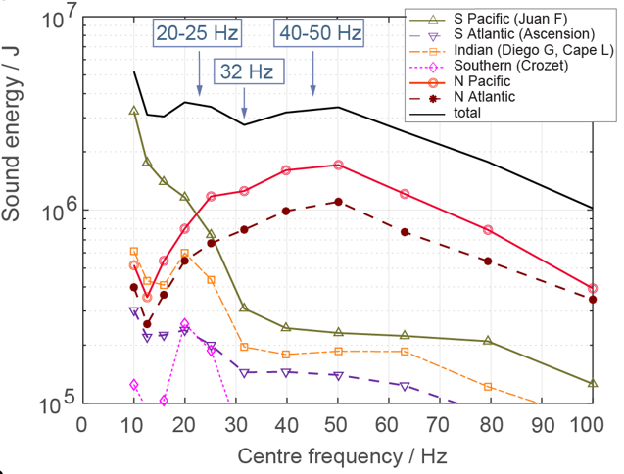
PLEASE DON‘T FORGET TO PUT THE E-POSTER TITLE AND YOUR NAME IN THE PRESENTATION HEADER.
THEN DUPLICATE THIS SLIDE FOR ALL OTHER PRESENTATION SLIDES.
O1.3-278
The CTBT IMS: a window into a century of global soundscapes (1920-2020)
M. A. Ainslie, S. P. Robinson, P. L. Tyack, R. K. Andrew, P. M. Harris, M. B. Halvorsen & A. O. MacGillivray
Global energy budget: measurement
10 MJ
Geographically sparse
CTBTO (IMS): 8 hydrophones (CTBTO, 2024)
NE Pacific: 3 hydrophones (Curtis, 1999)
Total: 11 hydrophones
  100 million km³ each
  Circle of radius 3000 km
Sound energy
1 MJ
N Pacific
N Atlantic
2018-2021 average
S Pacific
0.1 MJ
Decidecade band centre frequency / Hz
CTBTO: Comprehensive Nuclear-Test-Ban Treaty Organization
IMS: International Monitoring System

Slide 8
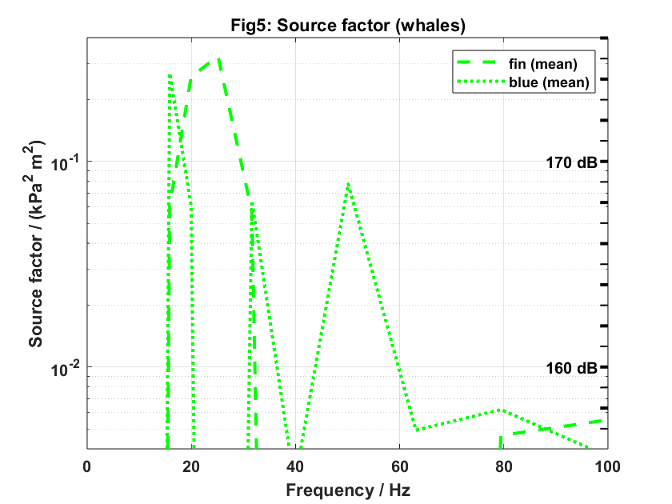
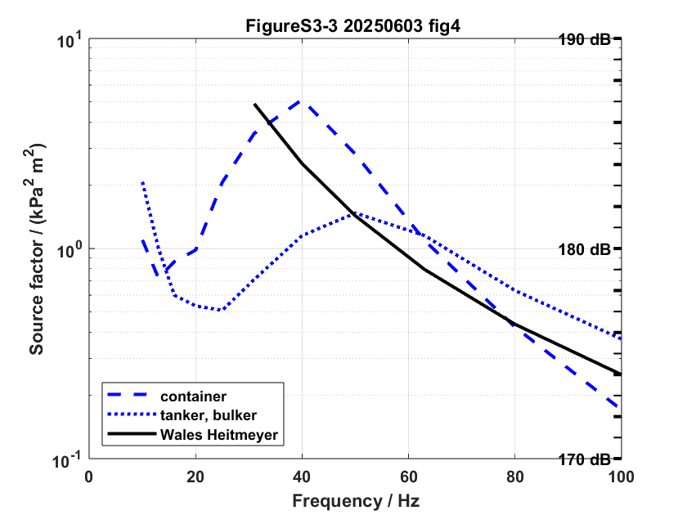

PLEASE DON‘T FORGET TO PUT THE E-POSTER TITLE AND YOUR NAME IN THE PRESENTATION HEADER.
THEN DUPLICATE THIS SLIDE FOR ALL OTHER PRESENTATION SLIDES.
O1.3-278
The CTBT IMS: a window into a century of global soundscapes (1920-2020)
M. A. Ainslie, S. P. Robinson, P. L. Tyack, R. K. Andrew, P. M. Harris, M. B. Halvorsen & A. O. MacGillivray
Global energy budget: model (1)
SOURCES:
Blue whales: Thode 2000
Fin whales: Garcia 2018
ECHO*: MacGillivray 2019)
* ECHO: Enhancing Cetacean and Habitat Observation Program, Port of Vancouver

Slide 9
PLEASE DON‘T FORGET TO PUT THE E-POSTER TITLE AND YOUR NAME IN THE PRESENTATION HEADER.
THEN DUPLICATE THIS SLIDE FOR ALL OTHER PRESENTATION SLIDES.
O1.3-278
The CTBT IMS: a window into a century of global soundscapes (1920-2020)
M. A. Ainslie, S. P. Robinson, P. L. Tyack, R. K. Andrew, P. M. Harris, M. B. Halvorsen & A. O. MacGillivray
Global energy budget: model (1)
SOURCES:
→
Blue whales: Thode 2000
Fin whales: Garcia 2018
+ # sources
+ critical angle
Convert to energy
(Ainslie et al 2021)
→
ECHO*: MacGillivray 2019)
* ECHO: Enhancing Cetacean and Habitat Observation Program, Port of Vancouver

Slide 10
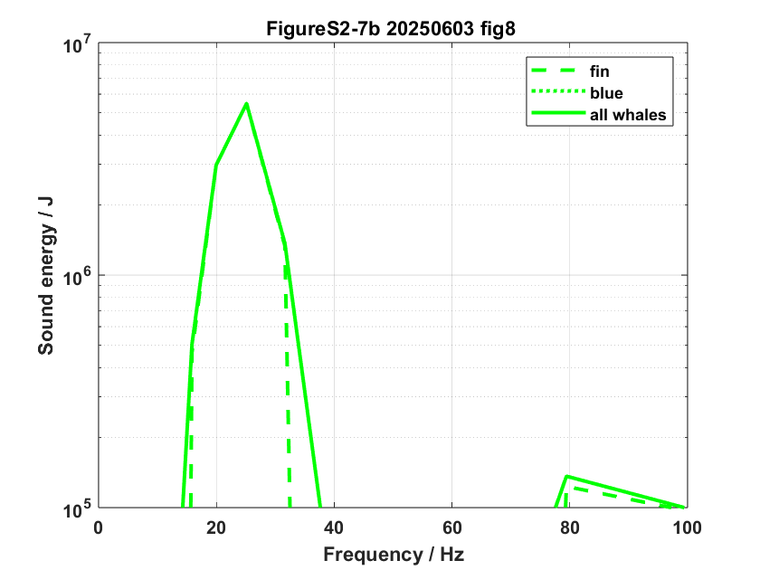
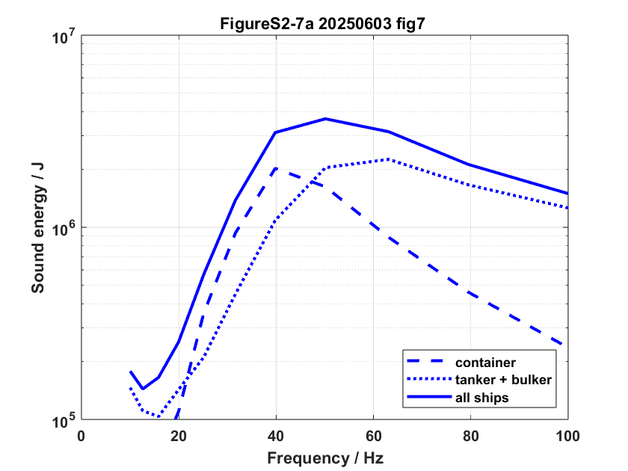
PLEASE DON‘T FORGET TO PUT THE E-POSTER TITLE AND YOUR NAME IN THE PRESENTATION HEADER.
THEN DUPLICATE THIS SLIDE FOR ALL OTHER PRESENTATION SLIDES.
O1.3-278
The CTBT IMS: a window into a century of global soundscapes (1920-2020)
M. A. Ainslie, S. P. Robinson, P. L. Tyack, R. K. Andrew, P. M. Harris, M. B. Halvorsen & A. O. MacGillivray
Global energy budget: model (1)
SOURCES:
→
Blue whales: Thode 2000
Fin whales: Garcia 2018
+ # sources
+ critical angle
Convert to energy
(Ainslie et al 2021)
→
ECHO*: MacGillivray 2019)
* ECHO: Enhancing Cetacean and Habitat Observation Program, Port of Vancouver

Slide 11
PLEASE DON‘T FORGET TO PUT THE E-POSTER TITLE AND YOUR NAME IN THE PRESENTATION HEADER.
THEN DUPLICATE THIS SLIDE FOR ALL OTHER PRESENTATION SLIDES.
O1.3-278
The CTBT IMS: a window into a century of global soundscapes (1920-2020)
M. A. Ainslie, S. P. Robinson, P. L. Tyack, R. K. Andrew, P. M. Harris, M. B. Halvorsen & A. O. MacGillivray
Global energy budget: model (2)
+

Slide 12
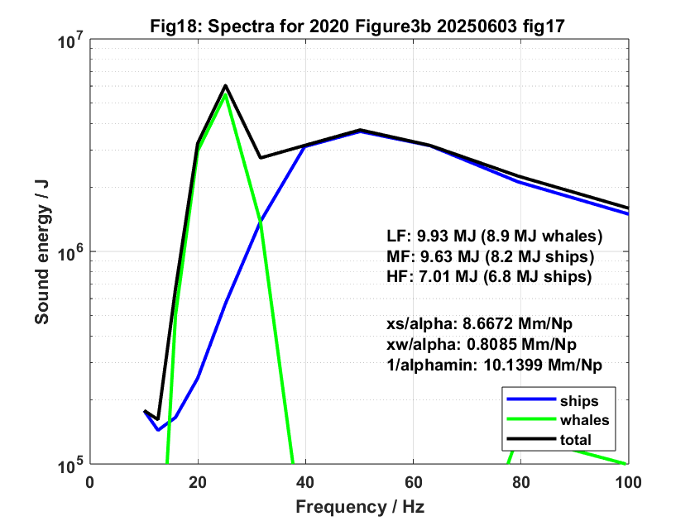
PLEASE DON‘T FORGET TO PUT THE E-POSTER TITLE AND YOUR NAME IN THE PRESENTATION HEADER.
THEN DUPLICATE THIS SLIDE FOR ALL OTHER PRESENTATION SLIDES.
O1.3-278
The CTBT IMS: a window into a century of global soundscapes (1920-2020)
M. A. Ainslie, S. P. Robinson, P. L. Tyack, R. K. Andrew, P. M. Harris, M. B. Halvorsen & A. O. MacGillivray
Global energy budget: model (2)
+
=

Slide 13
PLEASE DON‘T FORGET TO PUT THE E-POSTER TITLE AND YOUR NAME IN THE PRESENTATION HEADER.
THEN DUPLICATE THIS SLIDE FOR ALL OTHER PRESENTATION SLIDES.
O1.3-278
The CTBT IMS: a window into a century of global soundscapes (1920-2020) [Font: Arial Bold/Size: 16 pt]
M. A. Ainslie, S. P. Robinson, P. L. Tyack, R. K. Andrew, P. M. Harris, M. B. Halvorsen & A. O. MacGillivray
Global energy budget: model vs measurement (2020)
Ships: 15 MJ
(32-100 Hz)
Ainslie et al (2025)
LF: Baleen whale calls
MF and HF: Ships (North Pacific)
Whales: 10 MJ
(16-25 Hz)

Slide 14
PLEASE DON‘T FORGET TO PUT THE E-POSTER TITLE AND YOUR NAME IN THE PRESENTATION HEADER.
THEN DUPLICATE THIS SLIDE FOR ALL OTHER PRESENTATION SLIDES.
O1.3-278
The CTBT IMS: a window into a century of global soundscapes (1920-2020) [Font: Arial Bold/Size: 16 pt]
M. A. Ainslie, S. P. Robinson, P. L. Tyack, R. K. Andrew, P. M. Harris, M. B. Halvorsen & A. O. MacGillivray
Global energy budget: model vs measurement (2020)
Ships: 15 MJ
(32-100 Hz)
Ainslie et al (2025)
LF: Baleen whale calls
MF and HF: Ships (North Pacific)
Whales: 10 MJ
(16-25 Hz)

Slide 15
PLEASE DON‘T FORGET TO PUT THE E-POSTER TITLE AND YOUR NAME IN THE PRESENTATION HEADER.
THEN DUPLICATE THIS SLIDE FOR ALL OTHER PRESENTATION SLIDES.
O1.3-278
The CTBT IMS: a window into a century of global soundscapes (1920-2020) [Font: Arial Bold/Size: 16 pt]
M. A. Ainslie, S. P. Robinson, P. L. Tyack, R. K. Andrew, P. M. Harris, M. B. Halvorsen & A. O. MacGillivray
Global energy budget: model vs measurement (2020)
Earthquakes (not modelled)
Ships: 15 MJ
(32-100 Hz)
Ainslie et al (2025)
LF: Baleen whale calls
MF and HF: Ships (North Pacific)
Whales: 10 MJ
(16-25 Hz)

Slide 16
GLOBAL SOUND ENERGY BUDGET: HINDCAST (1920-2020)

Slide 17
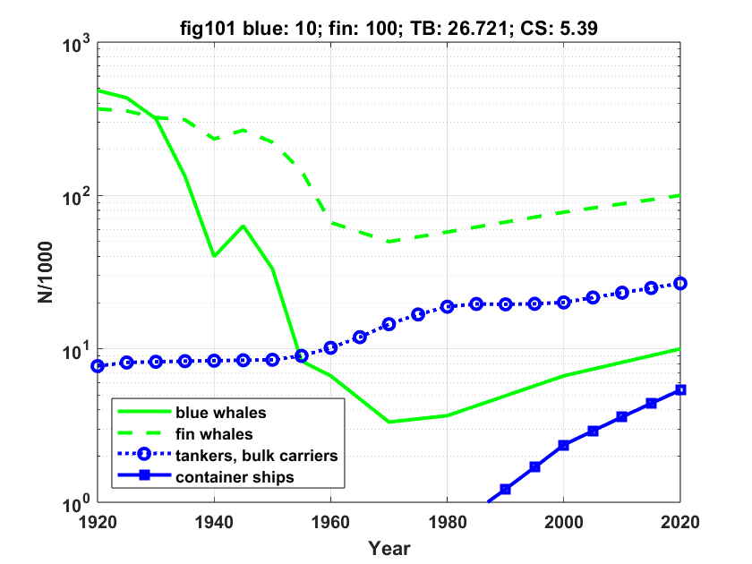
PLEASE DON‘T FORGET TO PUT THE E-POSTER TITLE AND YOUR NAME IN THE PRESENTATION HEADER.
THEN DUPLICATE THIS SLIDE FOR ALL OTHER PRESENTATION SLIDES.
O1.3-278
The CTBT IMS: a window into a century of global soundscapes (1920-2020)
M. A. Ainslie, S. P. Robinson, P. L. Tyack, R. K. Andrew, P. M. Harris, M. B. Halvorsen & A. O. MacGillivray
Global fleet size and baleen whale population since 1920
No. of ships, whales vs time
(1920-2020)
SOURCES
baleen whales: IUCN*
Ships: UNCTAD**
*IUCN: International Union for Conservation of Nature
**UNCTAD: UN Trade and Development

Slide 18
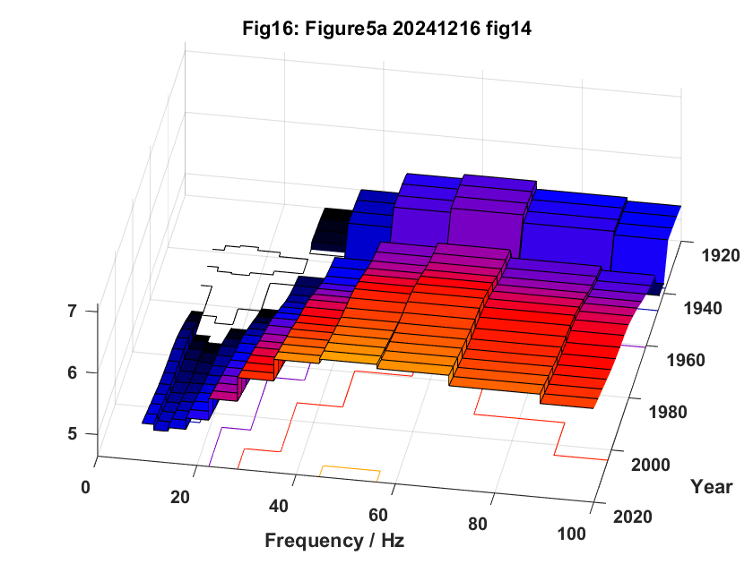
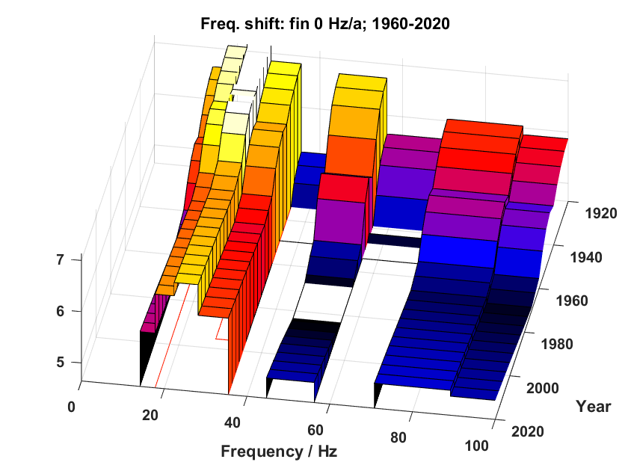
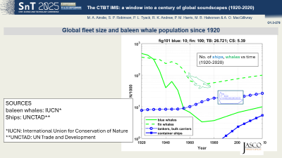
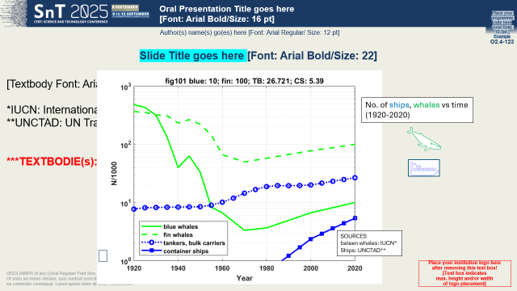
PLEASE DON‘T FORGET TO PUT THE E-POSTER TITLE AND YOUR NAME IN THE PRESENTATION HEADER.
THEN DUPLICATE THIS SLIDE FOR ALL OTHER PRESENTATION SLIDES.
O1.3-278
The CTBT IMS: a window into a century of global soundscapes (1920-2020)
M. A. Ainslie, S. P. Robinson, P. L. Tyack, R. K. Andrew, P. M. Harris, M. B. Halvorsen & A. O. MacGillivray
Global energy budget: hindcast (1920-2020)
Source spectra
log₁₀(energy/J)
Convert to energy
(Ainslie et al 2021)
Year (1920-2020)
Frequency / Hz

Slide 19
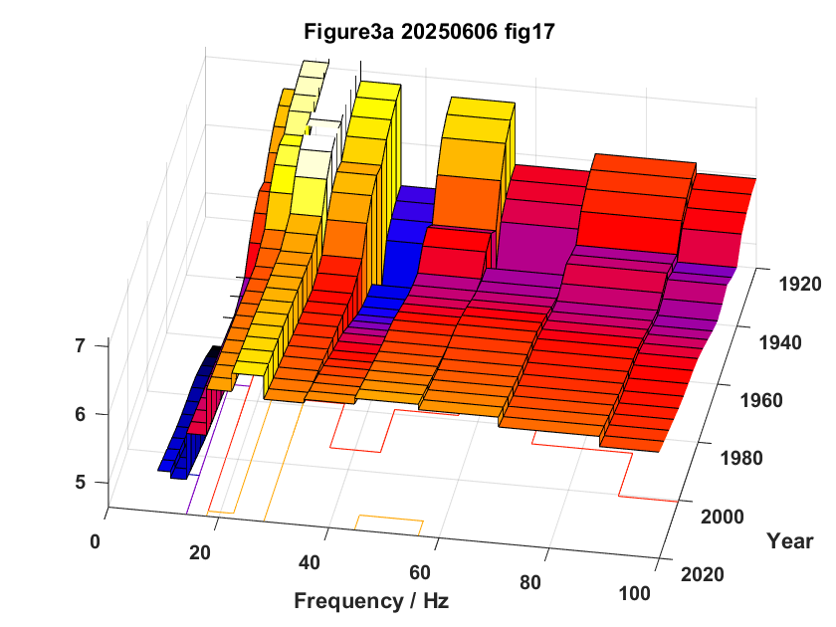
PLEASE DON‘T FORGET TO PUT THE E-POSTER TITLE AND YOUR NAME IN THE PRESENTATION HEADER.
THEN DUPLICATE THIS SLIDE FOR ALL OTHER PRESENTATION SLIDES.
O1.3-278
The CTBT IMS: a window into a century of global soundscapes (1920-2020)
M. A. Ainslie, S. P. Robinson, P. L. Tyack, R. K. Andrew, P. M. Harris, M. B. Halvorsen & A. O. MacGillivray
Global energy budget: hindcast (1920-2020)
log₁₀(energy/J)
Year (1920-2020)
=
+
Frequency / Hz
+

Slide 20
The IMS: A window into the past
Notes:
“So, what does it all mean?”

Slide 21
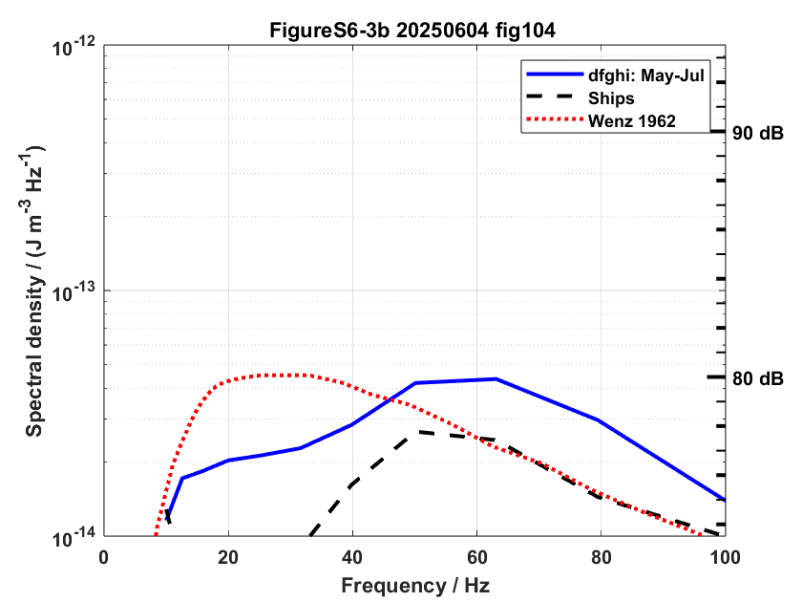
PLEASE DON‘T FORGET TO PUT THE E-POSTER TITLE AND YOUR NAME IN THE PRESENTATION HEADER.
THEN DUPLICATE THIS SLIDE FOR ALL OTHER PRESENTATION SLIDES.
O1.3-278
The CTBT IMS: a window into a century of global soundscapes (1920-2020)
M. A. Ainslie, S. P. Robinson, P. L. Tyack, R. K. Andrew, P. M. Harris, M. B. Halvorsen & A. O. MacGillivray
Wenz “Usual traffic noise” revisited (1)
“Usual traffic noise – Deep water” (Wenz 1962)
NEP May-July (1965)
(Wenz 1969)
Global hindcast (ships, 1960)

Slide 22
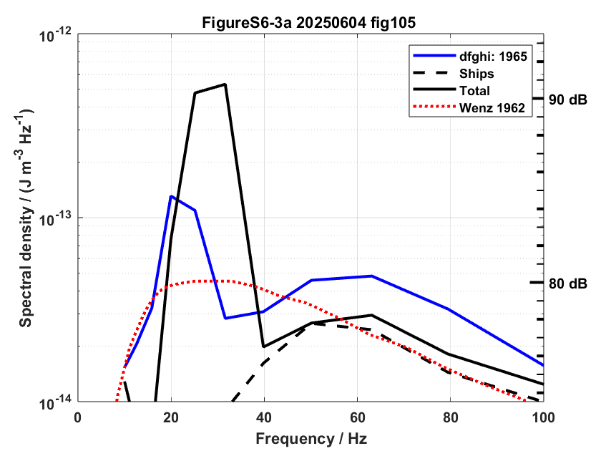
PLEASE DON‘T FORGET TO PUT THE E-POSTER TITLE AND YOUR NAME IN THE PRESENTATION HEADER.
THEN DUPLICATE THIS SLIDE FOR ALL OTHER PRESENTATION SLIDES.
O1.3-278
The CTBT IMS: a window into a century of global soundscapes (1920-2020)
M. A. Ainslie, S. P. Robinson, P. L. Tyack, R. K. Andrew, P. M. Harris, M. B. Halvorsen & A. O. MacGillivray
Wenz “Usual traffic noise” revisited (1)
Global hindcast
(ships + whales, 1960)
“Usual traffic noise – Deep water” (Wenz 1962)
NEP annual average (1965)
(Wenz 1969)
NEP May-July (1965)
(Wenz 1969)
Global hindcast (ships, 1960)

Slide 23
PLEASE DON‘T FORGET TO PUT THE E-POSTER TITLE AND YOUR NAME IN THE PRESENTATION HEADER.
THEN DUPLICATE THIS SLIDE FOR ALL OTHER PRESENTATION SLIDES.
O1.3-278
The CTBT IMS: a window into a century of global soundscapes (1920-2020)
M. A. Ainslie, S. P. Robinson, P. L. Tyack, R. K. Andrew, P. M. Harris, M. B. Halvorsen & A. O. MacGillivray
Wenz “Usual traffic noise” revisited (2)
“Usual traffic noise – Deep water” (Wenz 1962)
1960s Shipping peaked at 50-63 Hz (not 30 Hz)
1960s baleen whale calls peaked at 20-25 Hz

Slide 24
PLEASE DON‘T FORGET TO PUT THE E-POSTER TITLE AND YOUR NAME IN THE PRESENTATION HEADER.
THEN DUPLICATE THIS SLIDE FOR ALL OTHER PRESENTATION SLIDES.
O1.3-278
The CTBT IMS: a window into a century of global soundscapes (1920-2020)
M. A. Ainslie, S. P. Robinson, P. L. Tyack, R. K. Andrew, P. M. Harris, M. B. Halvorsen & A. O. MacGillivray
DISTANT BALEEN WHALE CALLS – DEEP WATER
Wenz “Usual traffic noise” revisited (2)
“Usual traffic noise – Deep water” (Wenz 1962)
1960s Shipping peaked at 50-63 Hz (not 30 Hz)
1960s baleen whale calls peaked at 20-25 Hz

Slide 25
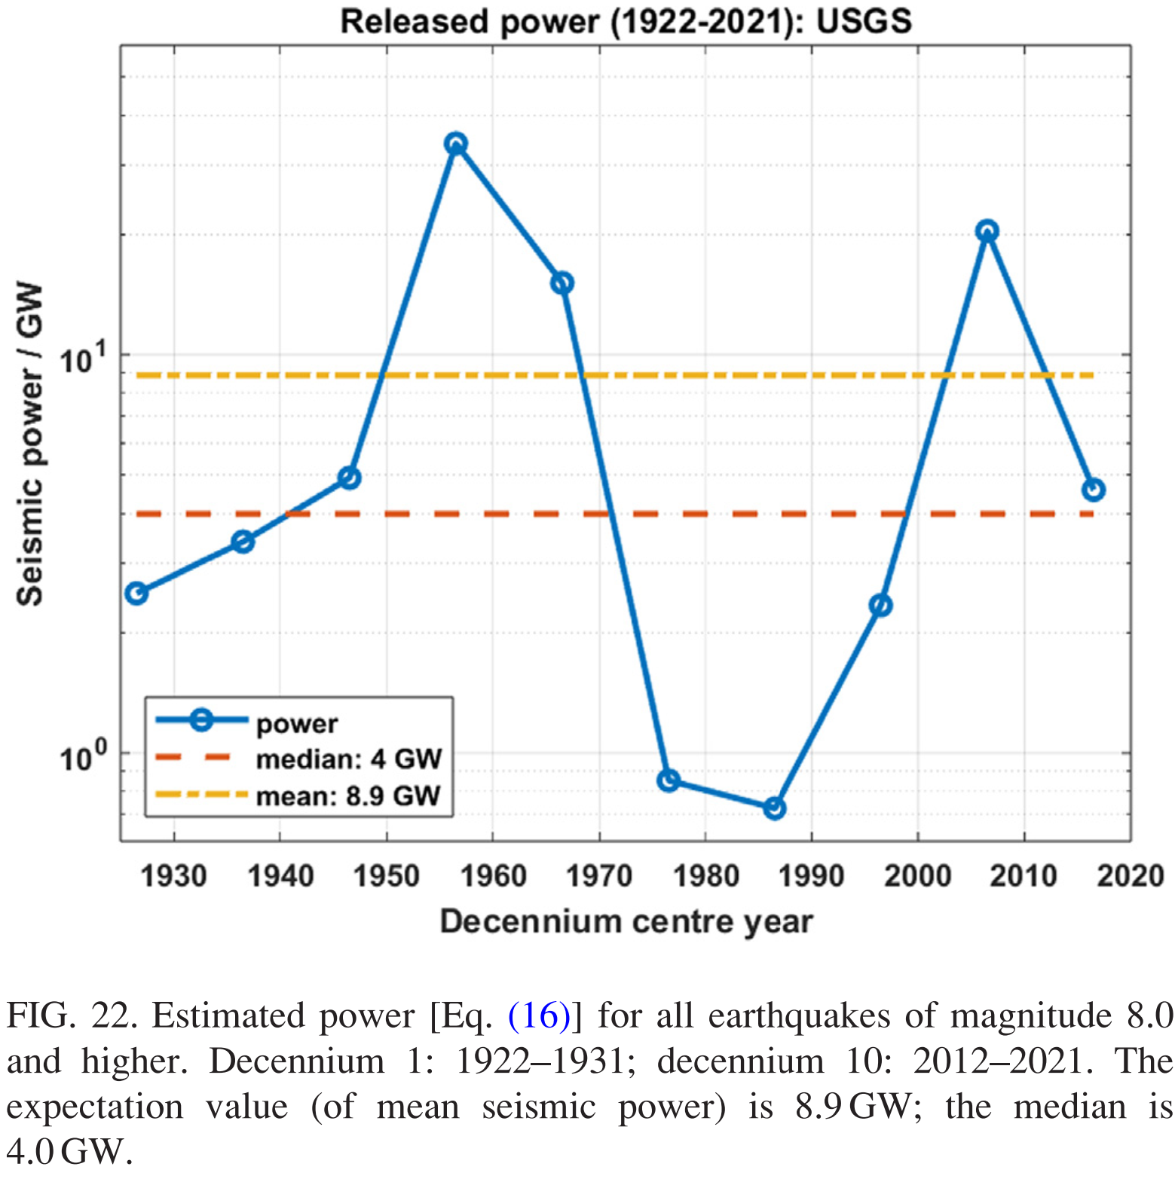



PLEASE DON‘T FORGET TO PUT THE E-POSTER TITLE AND YOUR NAME IN THE PRESENTATION HEADER.
THEN DUPLICATE THIS SLIDE FOR ALL OTHER PRESENTATION SLIDES.
O1.3-278
The CTBT IMS: a window into a century of global soundscapes (1920-2020)
M. A. Ainslie, S. P. Robinson, P. L. Tyack, R. K. Andrew, P. M. Harris, M. B. Halvorsen & A. O. MacGillivray
Contribution from earthquakes: Released power
Power released by earthquakes
  1922-2021
  10-year average
Energy from each quake
Average power
Active seismic periods
1950s
Expectation value: 8.9 GW
2000s
$$E_{n}={10}^{\left(5.24+1.44M\right) } \text{J}$$
Median: 4.0 GW
$$W=\frac{1}{T}\sum_{n=1}^{N\left(T\right)}{E_{n}}$$
$T=10 \text{a}$ $=316 \text{Ms}$
Ainslie et al (2025)
Released power from earthquakes
10-year average
Notes:
Skip this slide and next if short of time

Slide 26
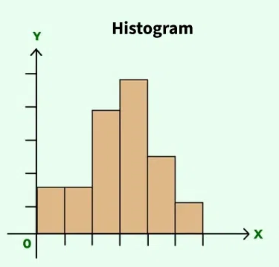
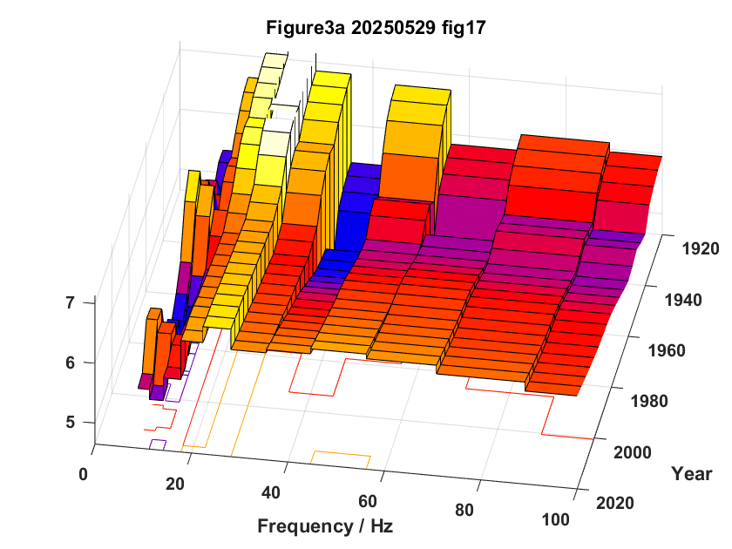

PLEASE DON‘T FORGET TO PUT THE E-POSTER TITLE AND YOUR NAME IN THE PRESENTATION HEADER.
THEN DUPLICATE THIS SLIDE FOR ALL OTHER PRESENTATION SLIDES.
O1.3-278
The CTBT IMS: a window into a century of global soundscapes (1920-2020)
M. A. Ainslie, S. P. Robinson, P. L. Tyack, R. K. Andrew, P. M. Harris, M. B. Halvorsen & A. O. MacGillivray
Contribution from earthquakes: 100-year spectrogram
Active seismic periods in 1950s and 2000s
1950s
2000s
Whales
20-25 Hz
Ships
40-100 Hz
Quakes
10-12.5 Hz

Slide 27
PLEASE DON‘T FORGET TO PUT THE E-POSTER TITLE AND YOUR NAME IN THE PRESENTATION HEADER.
THEN DUPLICATE THIS SLIDE FOR ALL OTHER PRESENTATION SLIDES.
O1.3-278
The CTBT IMS: a window into a century of global soundscapes (1920-2020)
M. A. Ainslie, S. P. Robinson, P. L. Tyack, R. K. Andrew, P. M. Harris, M. B. Halvorsen & A. O. MacGillivray
Conclusions
Global sound energy budget (nowcast)
  Baleen whales: 10 MJ (16-25 Hz bands)
  Ships: 15 MJ (32-100 Hz bands)
Wenz 1962 ‘Usual traffic noise – deep water’ (25-35 Hz)
  Not caused by distance shipping (50-63 Hz bands)
  Most likely distant baleen whales (20-25 Hz bands)
Contribution from earthquakes
  Quakes dominate in 10-12.5 Hz bands
  Ships dominate in 40-100 Hz bands
  Leaves 20-25 bands for whale calls (squeezed between ships and quakes)

Slide 28
PLEASE DON‘T FORGET TO PUT THE E-POSTER TITLE AND YOUR NAME IN THE PRESENTATION HEADER.
THEN DUPLICATE THIS SLIDE FOR ALL OTHER PRESENTATION SLIDES.
O1.3-278
The CTBT IMS: a window into a century of global soundscapes (1920-2020)
M. A. Ainslie, S. P. Robinson, P. L. Tyack, R. K. Andrew, P. M. Harris, M. B. Halvorsen & A. O. MacGillivray
References 1/2
Ainslie, M. A., Andrew, R. K., Howe, B. M., & Mercer, J. A. (2021). Temperature-driven seasonal and longer term changes in spatially averaged deep ocean ambient sound at frequencies 63–125 Hz. The Journal of the Acoustical Society of America, 149(4), 2531-2545.
Ainslie, M. A., Robinson, S. P., Harris, P. M., Tyack, P. L., Halvorsen, M. B., Cheong, S.-H., Livina, V., & Wang, L. S. (2025). Ocean soundscapes and trends from 2003 to 2021: 10–100 Hz. The Journal of the Acoustical Society of America, 157(6), 4358-4384.
CTBTO (2024). Twenty-five Years Progress of the Comprehensive Nuclear-Test-Ban Treaty Verification System. https://www.ctbto.org/sites/default/files/2024-07/20240618-CTBTO%2025th%20Anniversary%20booklet%20Final%20LRes.pdf.
Curtis, K. R., Howe, B. M., & Mercer, J. A. (1999). Low-frequency ambient sound in the North Pacific: Long time series observations. The Journal of the Acoustical Society of America, 106(6), 3189-3200.
Deane, G. B. (2025). The Wenz curves for underwater ambient sound. The Journal of the Acoustical Society of America, 157(5), R9-R10.
Garcia, H. A., Zhu, C., Schinault, M. E., Kaplan, A. I., Handegard, N. O., Godø, O. R., ... & Ratilal, P. (2019). Temporal–spatial, spectral, and source level distributions of fin whale vocalizations in the Norwegian Sea observed with a coherent hydrophone array. ICES Journal of Marine Science, 76(1), 268-283.

Slide 29
PLEASE DON‘T FORGET TO PUT THE E-POSTER TITLE AND YOUR NAME IN THE PRESENTATION HEADER.
THEN DUPLICATE THIS SLIDE FOR ALL OTHER PRESENTATION SLIDES.
O1.3-278
The CTBT IMS: a window into a century of global soundscapes (1920-2020)
M. A. Ainslie, S. P. Robinson, P. L. Tyack, R. K. Andrew, P. M. Harris, M. B. Halvorsen & A. O. MacGillivray
References 2/2
IUCN: Cooke, J.G. 2018a. Fin Whale (Balaenoptera physalus) (webpage). The IUCN Red List of Threatened Species 2018: e.T2478A50349982, 4 Feb 2018. https://doi.org/10.2305/IUCN.UK.2018-2.RLTS.T2478A50349982.en; Cooke, J.G. 2018b. Blue Whale (Balaenoptera musculus) (errata version published in 2019) (webpage). The IUCN Red List of Threatened Species 2018: e.T2477A156923585, 16 Mar 2018. https://doi.org/10.2305/IUCN.UK.2018-2.RLTS.T2477A156923585.en.
MacGillivray, A. O., Li, Z., Hannay, D. E., Trounce, K. B., & Robinson, O. M. (2019). Slowing deep-sea commercial vessels reduces underwater radiated noise. the Journal of the Acoustical Society of America, 146(1), 340-351.
Thode, A. M., D’Spain, G. L., & Kuperman, W. A. (2000). Matched-field processing, geoacoustic inversion, and source signature recovery of blue whale vocalizations. The Journal of the Acoustical Society of America, 107(3), 1286-1300.
UNCTAD. Review of Maritime Transport 1971, 1980, 2002, 2020.
Wenz, G. M. (1962). Acoustic ambient noise in the ocean: spectra and sources. The journal of the acoustical society of America, 34(12), 1936-1956.
Wenz, G.M. 1969. Low-frequency deep-water ambient noise along the Pacific Coast of the United States. US Navy Journal Underwater Acoustics 19: 423–444.

