Slide 1


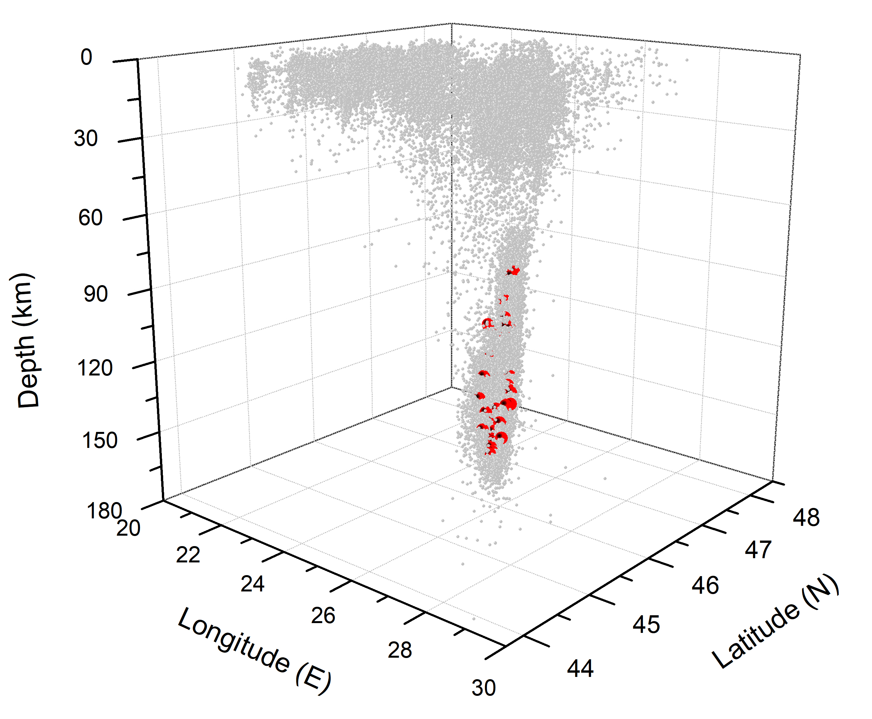
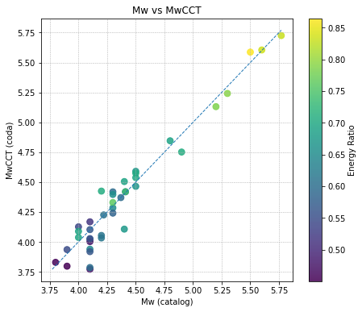
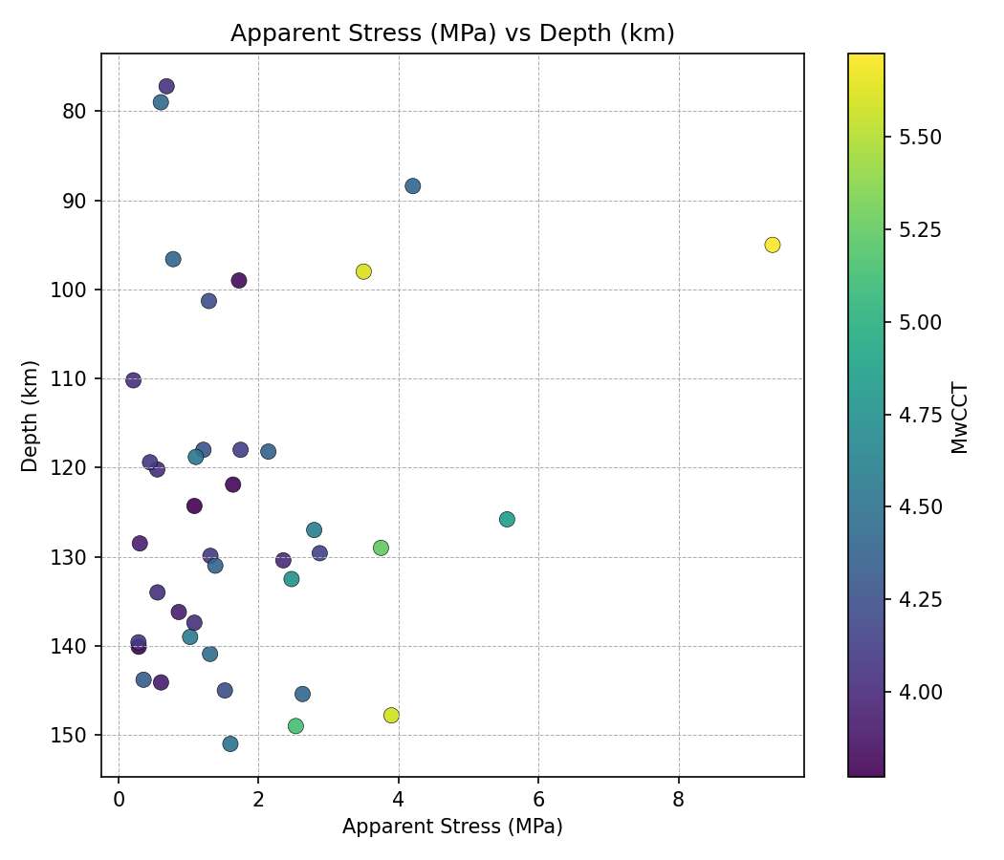




Application of the Coda Calibration Tool (CCT) Methodology to Intermediate Depth Events in the Vrancea Region, Romania
Raluca Dinescu¹, Kevin Mayeda², Felix Borleanu¹, Jorge Roman-Nieves², Justin Barno³
1 National Institute for Earth Physics
2 AFTAC, Air Force Technical Applications Center, Patrick AFB, FL, USA
3 LLNL, Lawrence Livermore National Laboratory, Livermore, CA, USA
P1.2-610
The Coda Calibration Tool (CCT), a Java-based application, calibrates 1D narrowband coda envelopes with hypocentral distance to estimate stable source spectra, moment magnitude, and apparent stress.
Compared to waveform inversion methods (e.g., ISOLA), CCT-derived magnitudes from our study show small differences (±0.3) but deliver more stable estimates across depth ranges.
In complex regions such as Vrancea, where wave propagation complicates direct measurements, coda-based calibration offers a reliable tool for understanding crustal and intermediate-depth seismicity.
CCT is freely available to the community and we welcome testing and collaboration in the spirit of improving upon the tool over the next year.
https://github.com/LLNL/coda-calibration-tool

