Slide 1


P1.2-281
Seismicity of the Shkodër-Pejë Fault Zone: 50 Years Overview
Dionald Muçaj; Rrapo Ormeni; Olgert Gjuzi; Klevis Sheteli
Academy of Sciences of Albania
The Shkodër–Pejë Fault Zone is a major NE-trending active structure combining transverse, thrust, and oblique tectonics.
Over the past 50 years, it has shown mostly low-energy seismicity, but historical records reveal several M≥6 earthquakes at its edges, indicating significant potential for future high-magnitude events tied to Pliocene–Quaternary reactivation process.

Slide 2
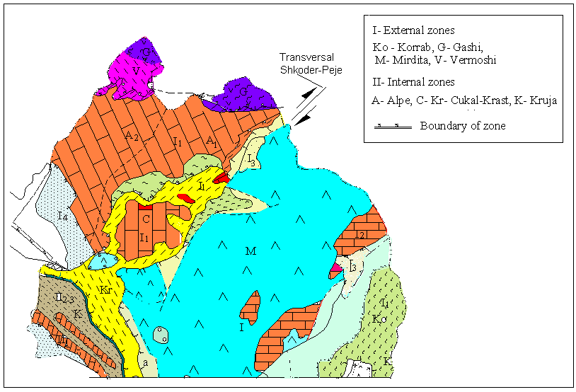
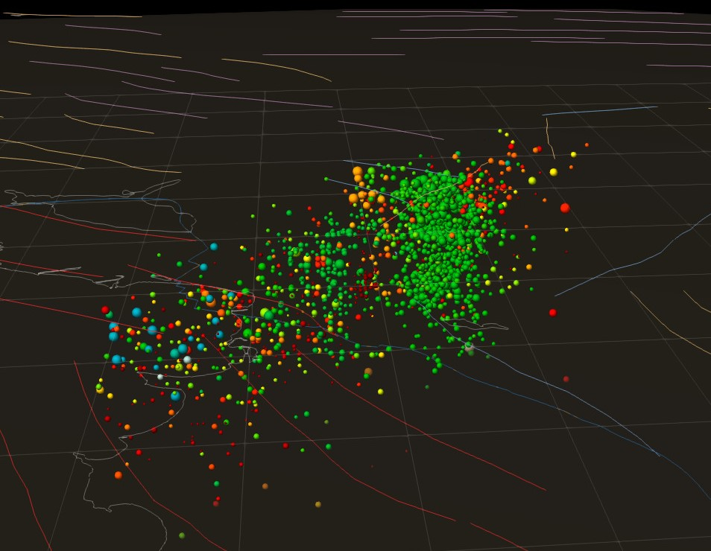
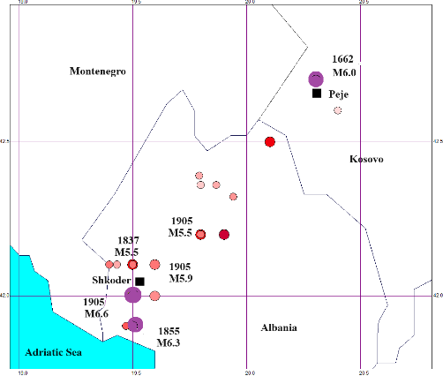
Seismicity of the Shkodër-Pejë Fault Zone: 50 Years Overview
PP1.2-281
Dionald Muçaj; Rrapo Ormeni; Olgert Gjuzi; Klevis Sheteli
Geological and Seismotectonic Data
Data and methods
Albania lies within the Albanides, positioned between the Hellenides (south) and Dinarides (north) as part of the Dinaric branch of the Mediterranean Alpine Belt. These arcs are split into two segments by the Shkodër–Pejë transverse fault zone, a key structural boundary influencing the region’s tectonics. The movement of the Adria microplate drives deformation along the Dinarid–Albanid–Hellenid fold-and-thrust system. The Albanides feature a complex mix of sedimentary, magmatic, and metamorphic rocks, divided into:
Outer compressional zone – subdivided by the Shkodër–Pejë Fault.
Inner extensional zone – overthrust onto the Krasta sub-tectonic unit.
Shkodër–Pejë Fault.
This inherited tectonic fracture runs NE from Fierza to Bajram Curri and remains active today. It marks a sharp structural contrast between Pliocene and Quaternary deposits and exhibits high neotectonic movement rates.
Historical Seismicity Strong earthquakes have occurred mainly at the edges of this fault zone, including:
1662 Pejë, M6.0; 1855 Barbullush, M6.3
1905 Beltoj, M6.6; 1922 Gjakovë, M5.0
1948 Trush, M5.5; 1956 Iballa, M5.0
The seismic phases recorded by the Albanian network, integrated with data from the INGV (Italy), Thessaloniki (Greece), Montenegro, and MEDNET networks, are used for the preparation of Albania’s monthly seismological bulletin (www.geo.edu.al).
The database for this study, comprising over 1,600 seismic events with ML > 1.0, is characterized by earthquakes of tectonic origin. The standard procedure employs the Hypoinverse program (Klein, 2002) from the Atlas package and the velocity model (Muco, 2001; Ormeni, 2011) for earthquake location.
Map of the Tectonic Structure of Northern Albania, Including the Shkodër–Pejë Transverse Fault
Map of the historical earthquakes M>5 in Shkoder-Peja fault zone

Slide 3
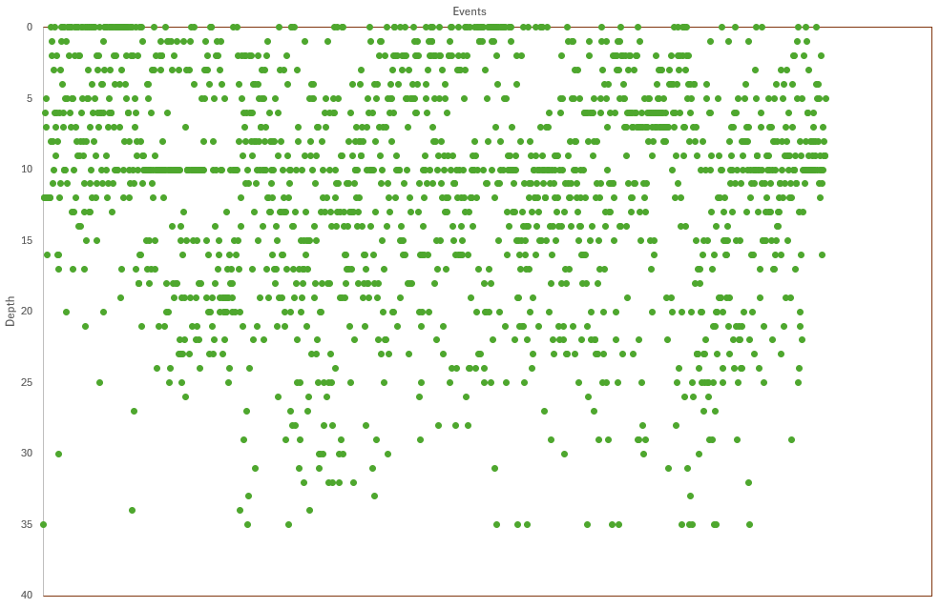
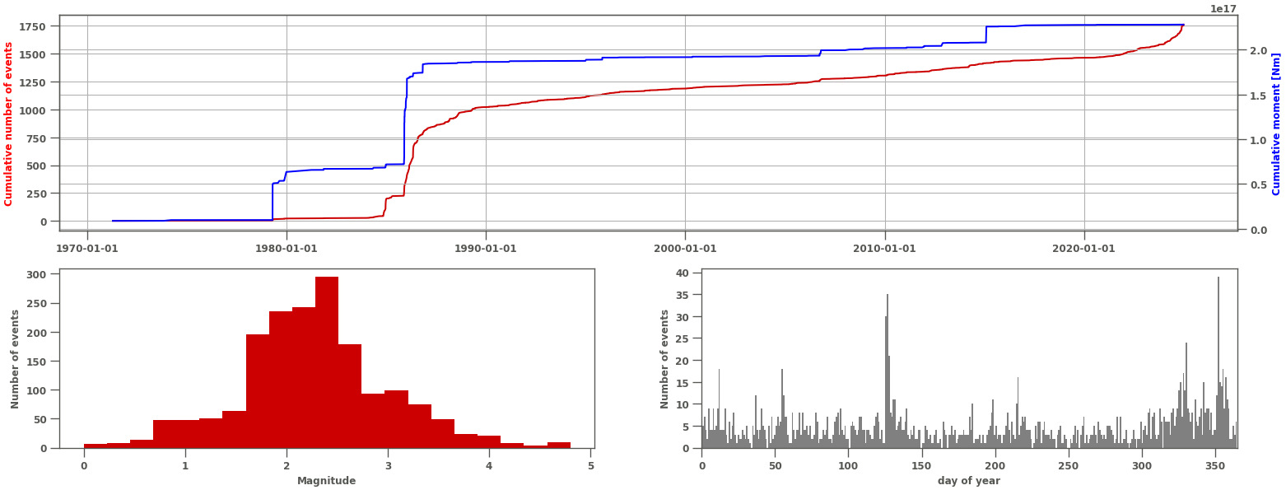
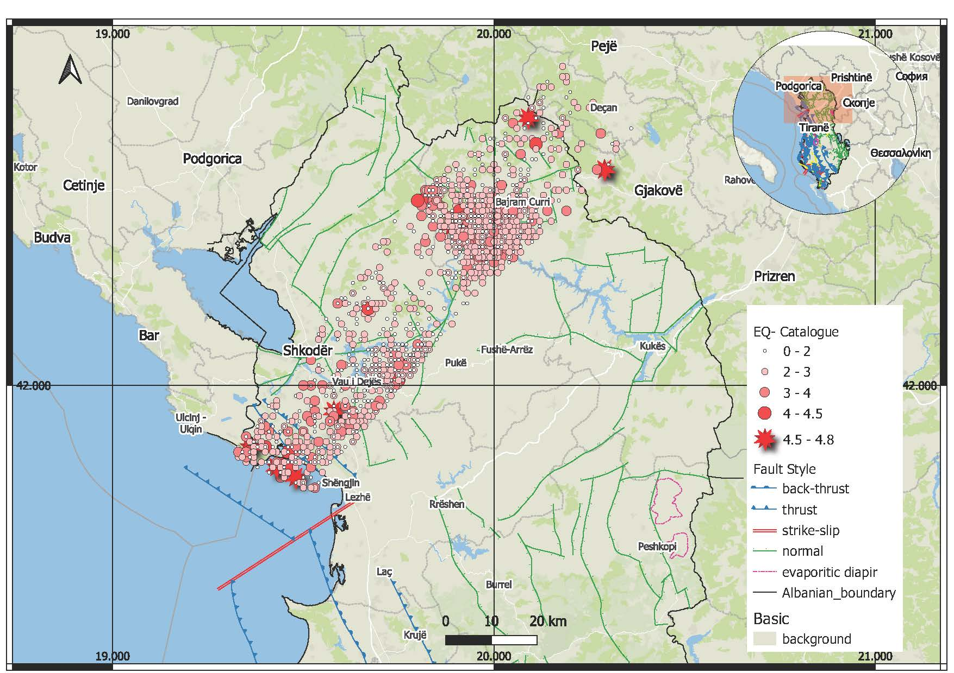
Seismicity of the Shkodër-Pejë Fault Zone: 50 Years Overview
PP1.2-281
Dionald Muçaj; Rrapo Ormeni; Olgert Gjuzi; Klevis Sheteli
Results and discussions
More than 1,600 earthquakes were located, with magnitudes up to 4.8, an average depth of 8 km, and a b-value of 0.84. About 97% occurred at depths ≤25 km, with most concentrated between 1–10 km.
From these, 193 events had M ≥3.0, 13 had M ≥4.0, and one exceeded M 4.5. Seismicity peaked in 1986, with a slight increase after 2020. From 2001–2025, the fault produced on average 6 events/year with M ≥ 3.5 and 1 event/year with M ≥4.0.Most frequent magnitudes range from 1.7–3.2, though events as small as M 0.5 were recorded.
Focal mechanisms of moderate earthquakes indicate compressional activity in the SW Shkodër segment and extensional activity in the NE Fierza segment. The inner zone (Vau i
Dejës–Pukë–Tropojë) shows a NW–SE stress regime, with earthquakes mainly generated in the upper to middle crust. These depth patterns are important for seismotectonic and seismic hazard assessments.
Focal Mechanisms examples in the Shkodër–Pejë Transverse fault
Conclusions
Over the past 50 years, the Shkodër–Pejë fault and surrounding areas have experienced around 1,600 earthquakes ranging from M 0.5 to 4.5.
This internal transverse zone features an active NW–SE trending normal fault with complex neotectonic and crustal structures.
Focal mechanism solutions for moderate events indicate a prevailing NW–SE stress regime, with reverse faulting combined with strike-slip components.
Most earthquakes occurred in the upper and middle crust, with fewer in the lower crust.
The seismicity pattern reflects ongoing tectonic activity, posing a persistent hazard to nearby urban areas in Albania, Kosovo, and Montenegro.
These findings provide valuable insights into the region’s seismotectonics, crustal geodynamics, and seismic hazard assessment.

