Slide 1


P1.2-465
Effect of Earthquakes Epicentral Distances on Peak Ground Acceleration (PGA) Values Recorded By the Egyptian Strong Motion Network (ESMN)
Shaimaa.A.M.Khair
Seismology Department, National Research Institute
of Astronomy and Geophysics, Helwan (NRIAG),
It is well known that structures can be damaged by earthquake shaking caused by the rapid rupture of the fault, which releases the stored energy that can result in significant loss of life and property. For economical and hazard aspects, the general seismological laboratory, seismology department, NRIAG, made the first step of hazard mitigation and vulnerability of buildings and structures by constructing the Egyptian Strong Motion Network (ESMN), trying to get a better understanding of structure vulnerability in urban areas in Egypt. The primary goal of this study is to define hazard zones within the urban areas in order to assess structure vulnerability. Analysis was carried out for 2023 earthquake data. In 2023, Egypt has been struck by about one hundred thirty earthquakes in the magnitude range (3.5–7.9) with deferent epicentral distances (30–900 km). Using peak ground acceleration in terms of magnitude, source-to-site distance, tectonic environment, and source type has been a key research area in seismic hazard estimation studies for attenuation of earthquakes (Sharma 2000). The primary results showed that the values of PGA are not just affected and decrease by epicentral distances but are mainly dependent on site effect and local amplification.

Slide 2
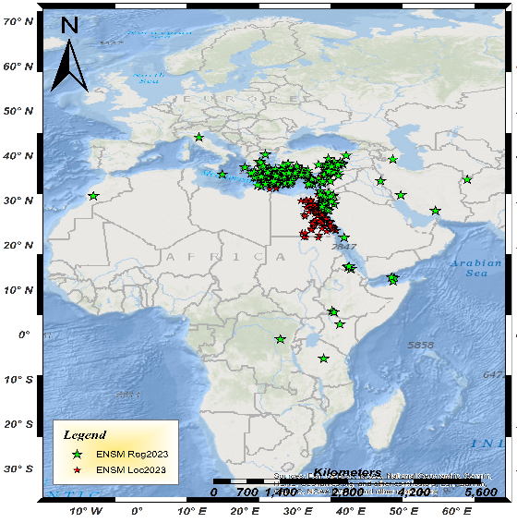
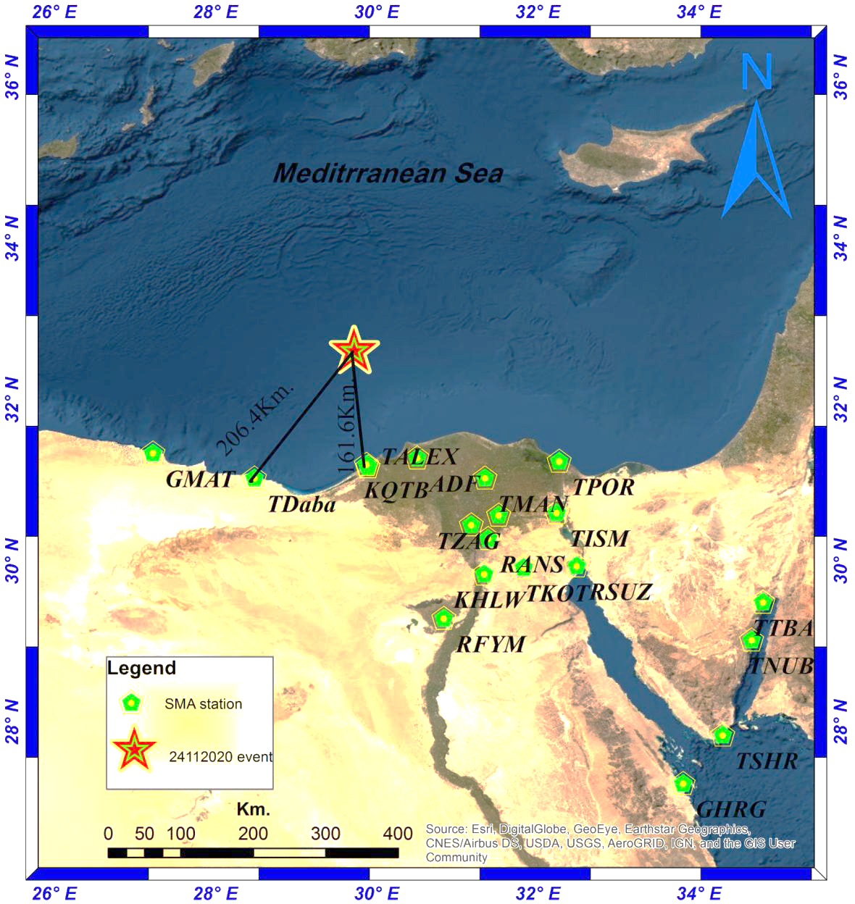
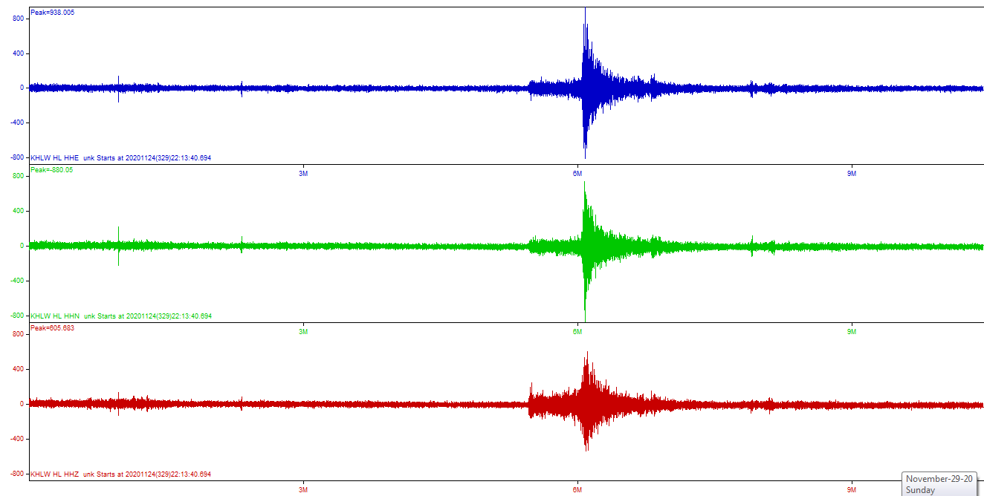
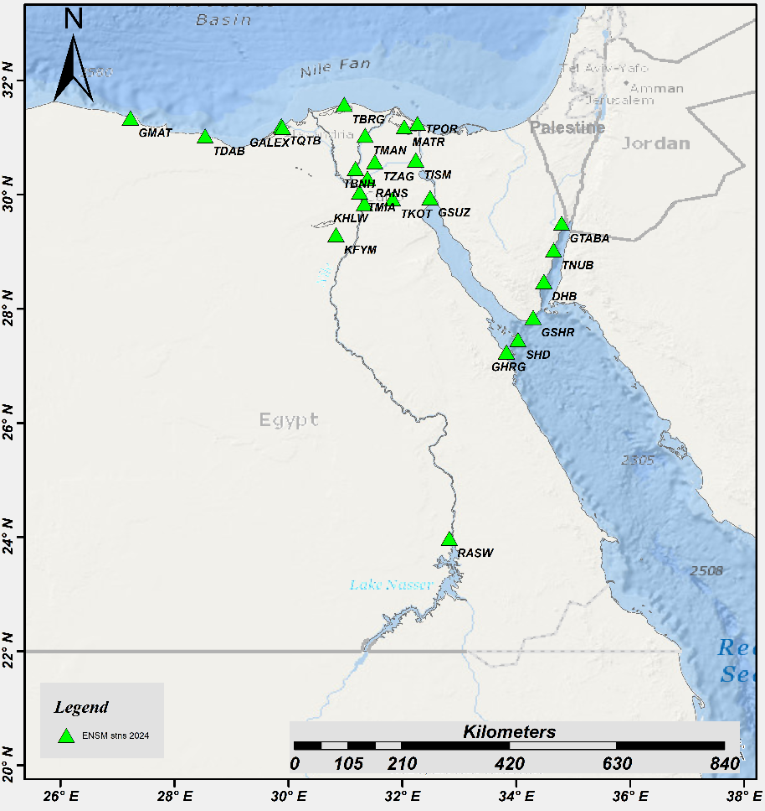
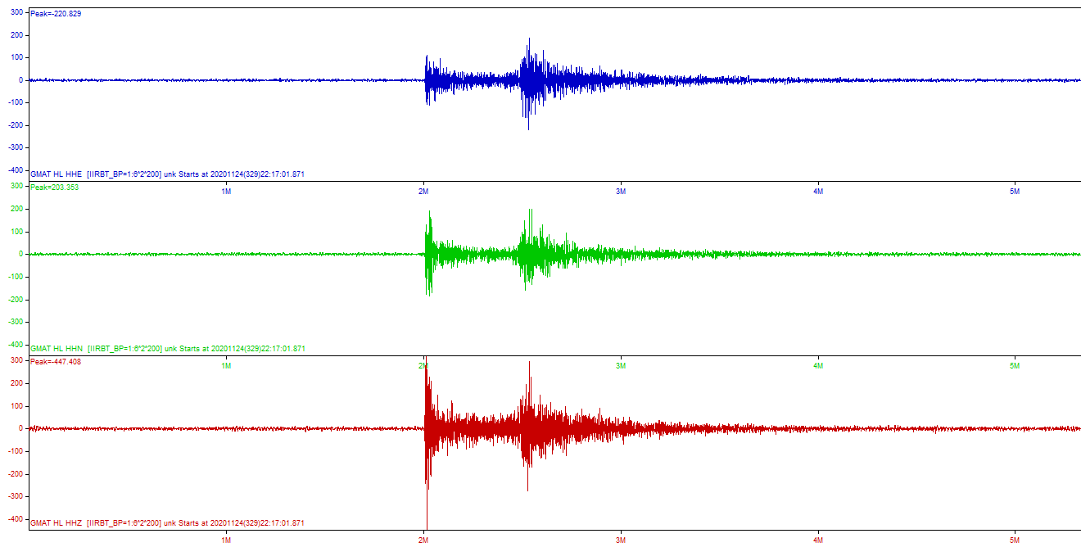
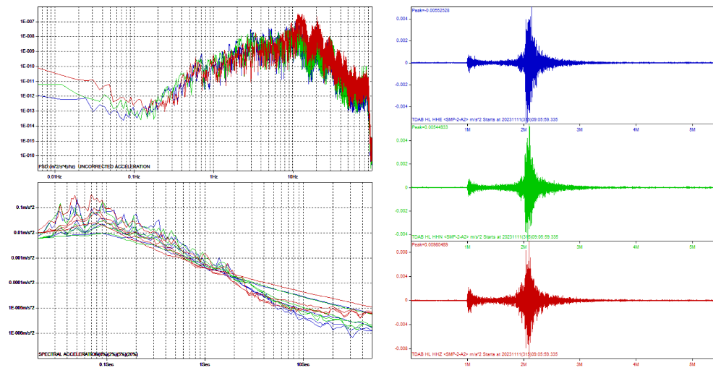
PLEASE DON‘T FORGET TO PUT THE E-POSTER TITLE AND YOUR NAME IN THE PRESENTATION HEADER.
DUPLICATE THIS SLIDE IF YOUR E-POSTER HAS MORE THAN 1 PAGE
Effect of Earthquakes Epicentral Distances on Peak Ground Acceleration (PGA) Values Recorded By the Egyptian Strong Motion Network (ESMN)
Shaimaa.A.M.Khair
P1.2-465
ESMN stations history
Purpose of ESMN Records:
According to ENSN catalogue 2023
Established at 2008 with only one station in Helwan(NRIAG).
Followed by four Reftek stations distributed around the Nile Delta.
It was then extended to reach twenty-four advanced stations in 2024.
Dahab and Ras Mohamed stations constructed after Sharm-Elshek earthquake (31Oct.2024,Ml 4.7).
By the near future we plan to update ESMN to cover also the Gulf of Suez.
Strong-motion attenuation models.
Improve design(building) codes
Study the source, path, and site effects.
Compute ground shaking maps showing the area most strongly affected by earthquakes.
About One Hundred thirty local and regional earthquakes was been felted in Egypt.
Along decays the effect of far field earthquakes has been ignored.
A comprehensive strong motion recorded data for year 2023 local and regional earthquakes has been compiled in this study.
Through out the analysis of those all earthquakes
Fig.1 ENSM stations geographic distribution

Slide 3
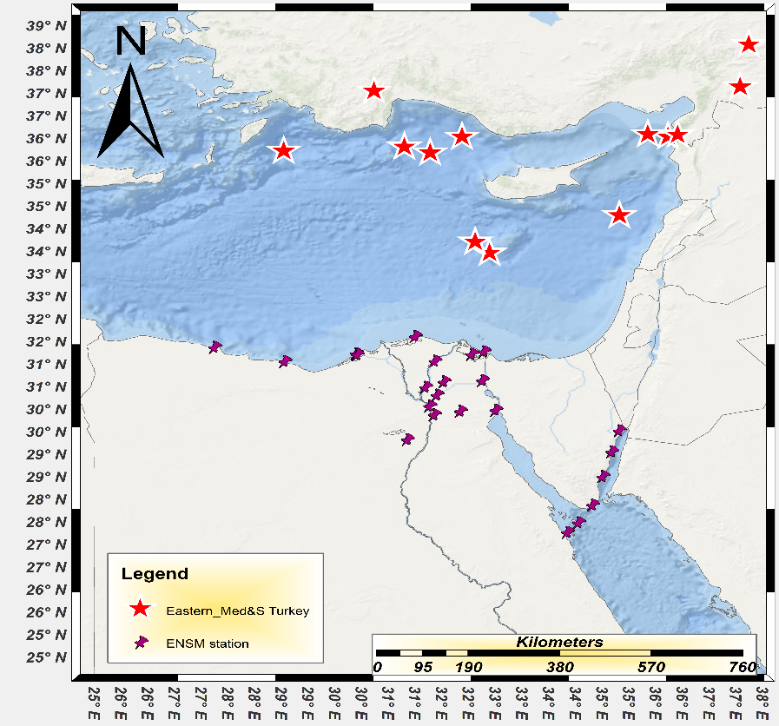
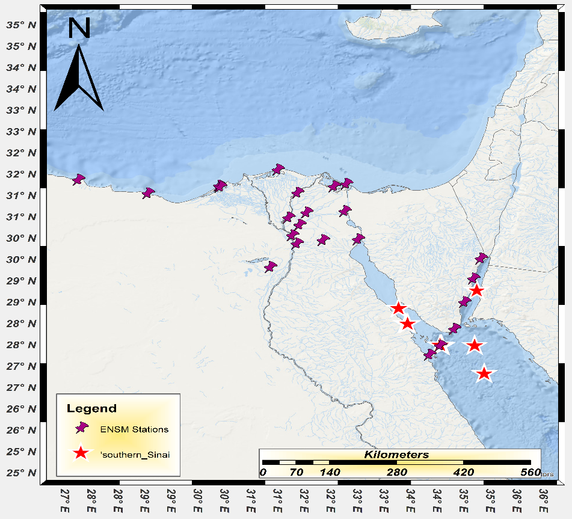
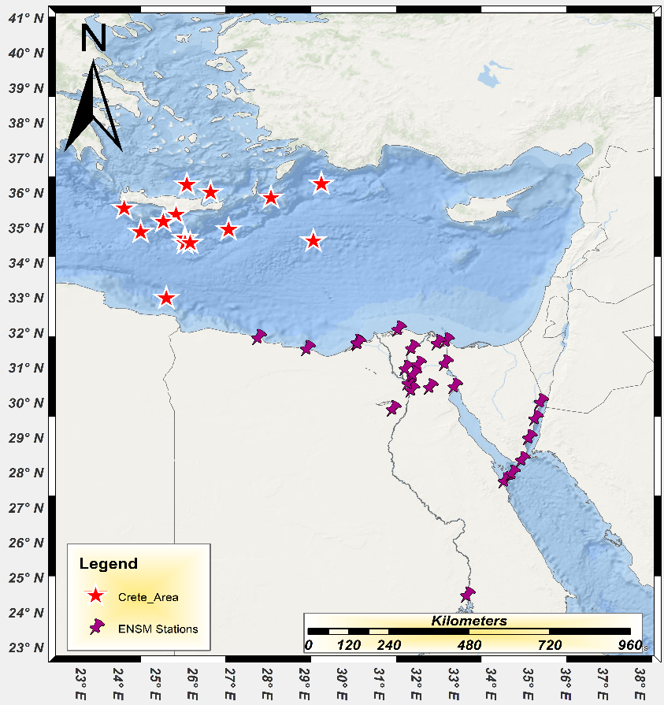
PLEASE DON‘T FORGET TO PUT THE E-POSTER TITLE AND YOUR NAME IN THE PRESENTATION HEADER.
DUPLICATE THIS SLIDE IF YOUR E-POSTER HAS MORE THAN 1 PAGE
Effect of Earthquakes Epicentral Distances on Peak Ground Acceleration (PGA) Values Recorded By the Egyptian Strong Motion Network (ESMN)
Shaimaa.A.M.Khair
P1.2-465
1.Eastern Mediterranean and south turkey Source
3. Local Southern Sinai Source
This process leads to amplification of ground motion, particularly for surface waves, which already carry large energy over long distances.In thick alluvial deltas, the depth of soft sediments can create resonance effects. The incoming seismic waves may match the natural frequency of the sedimentary basin, causing prolonged shaking and stronger amplitudes than would occur on rock sites. Moreover, surface waves such as Rayleigh and Love waves, which dominate at far-field distances, can be significantly amplified in these conditions because the low-velocity layers act like a waveguide. As a result, communities built on such thick deltaic deposits may experience more intense shaking and longer durations of motion than areas with similar epicentral distances but underlain by bedrock. This amplification effect highlights the importance of local site conditions in seismic hazard assessment, even for earthquakes occurring far away.
The results of this study indicate that far-field and deep-focus earthquakes exert a disproportionately greater impact on the Nile Delta compared to other regions. This effect is primarily attributed to the unique geological setting of the delta, which is underlain by thick alluvial deposits composed of soft, unconsolidated sediments. These low-velocity layers amplify incoming seismic energy, particularly the long-period surface waves that dominate ground motion at large epicentral distances. Consequently, seismic shaking within the Nile Delta tends to be stronger and more prolonged than in areas founded on bedrock or thinner sedimentary sequences. This amplification highlights the heightened seismic vulnerability of the Nile Delta, underscoring the importance of incorporating local site effects into hazard assessments and risk mitigation strategies.
2. Crete source
Result and Conclusion
Far-field earthquakes, even though they occur at considerable distances from a site, can have significant effects when the ground is composed of thick alluvial delta deposits. These deltas are typically made of unconsolidated sediments such as silt, sand, and clay, which have much lower stiffness and density compared to bedrock. When seismic waves from a distant earthquake reach such layers, their velocity decreases, and the energy becomes trapped within the softer materials.

