Slide 1

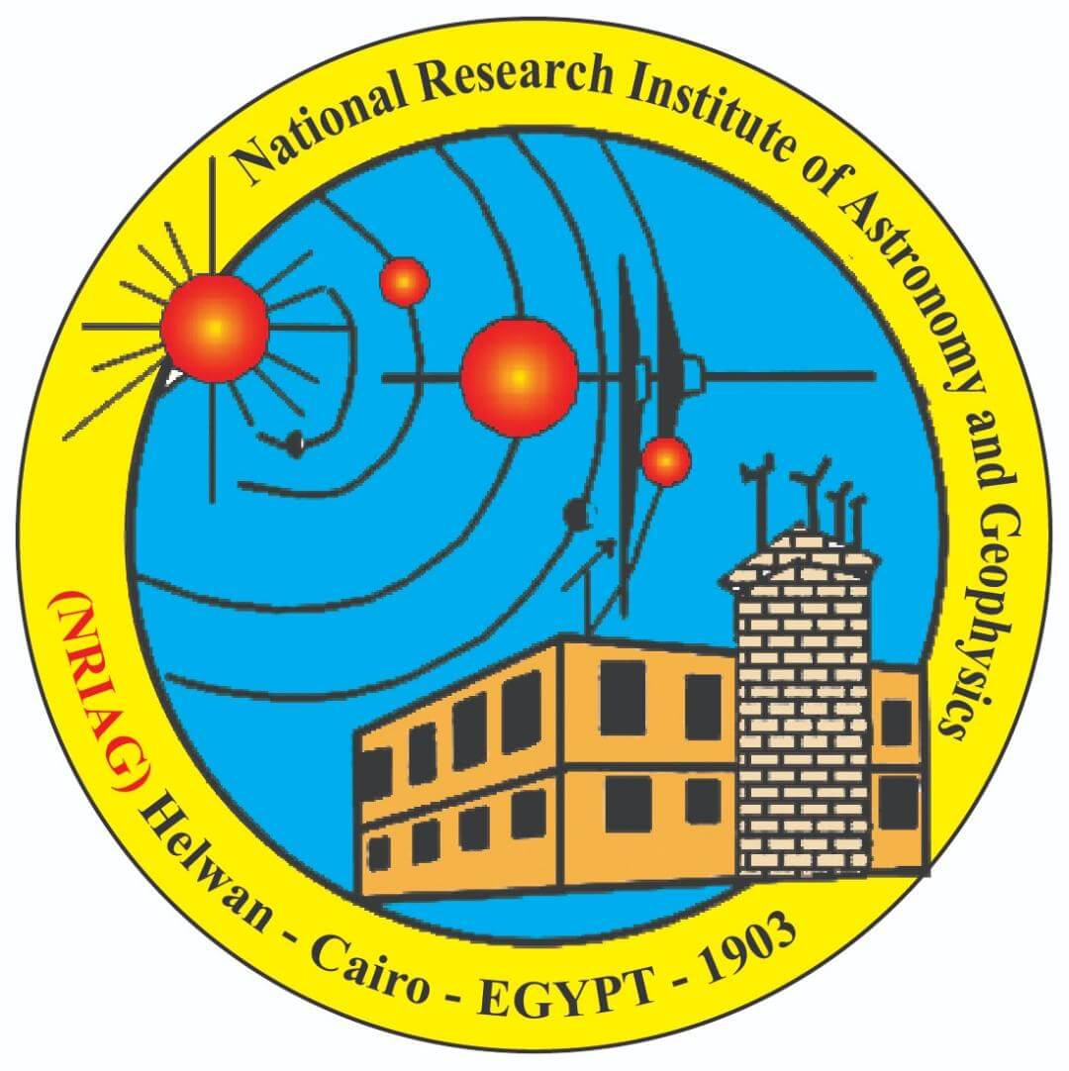
Comparative Analysis of Pulse-Like Ground Motion Identification and Classification Using Machine Learning Techniques
Mohamed H.Yassien, Mahmoud Salam and Shimaa H. El khouly
National Research Institute of Astronomy and Geophysics (NRIAG)
P1.2-868
Our poster is about …Classification of near fault ground motion pulse.
I am going to tell you that pulse classification is important for various engineering applications, including seismic hazard assessment, structural design based on real-time strong motion monitoring.
We use machine learning algorithms to identify type of first ground motion pulses
The most important result of our work is … show that the Seilf Organizing Map (SOM) algorithm achieves superior classification performance with an accuracy of 94.2%. Performance evaluation including AUC-ROC (0.97) confirms the robustness of the proposed methodology.
If you want to find out more, come over for a chat in front of our poster

