Slide 1

P1.2-868
Comparative Analysis of Pulse-Like Ground Motion Identification and Classification Using Machine Learning Techniques
Mohamed Yassien, Mahmoud Sami and Shimaa El kholy
National Research Institute of Astronomy and Geophysics (NRIAG)
Near-fault ground motions are characterized by distinct velocity pulses that significantly influence structural response and seismic hazard assessment. This study seeks to enhance the identification and classification of these impulsive ground motions by integrating traditional data-processing methods with advanced machine learning techniques. Results show that the SOM algorithm achieves superior classification performance with an accuracy of 94.2%. Performance evaluation including AUC-ROC (0.97) confirms the robustness of the proposed methodology.

Slide 2
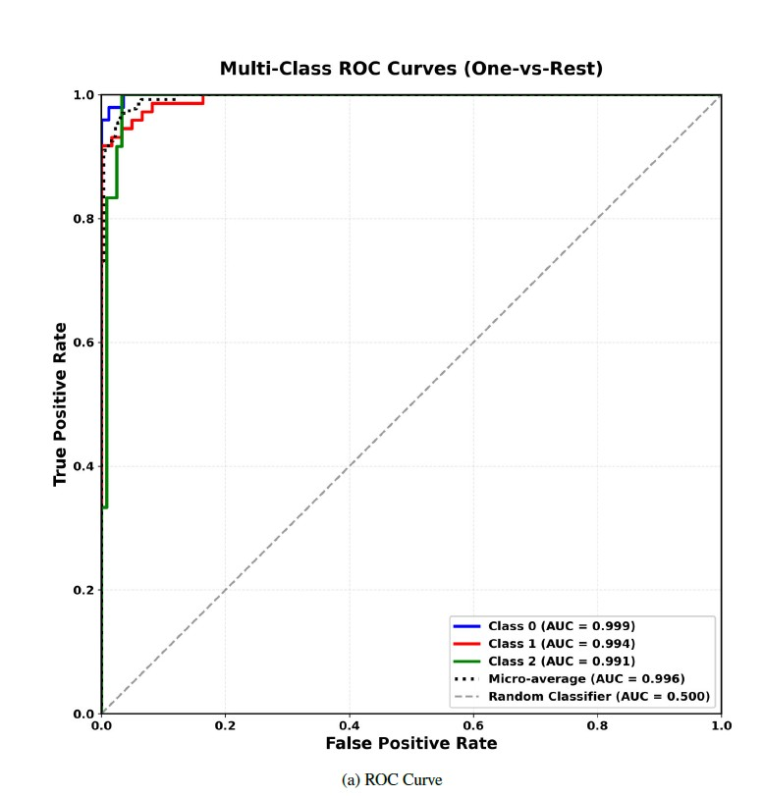
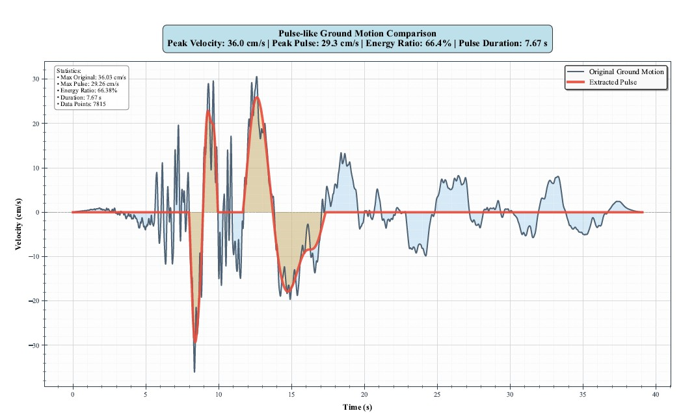
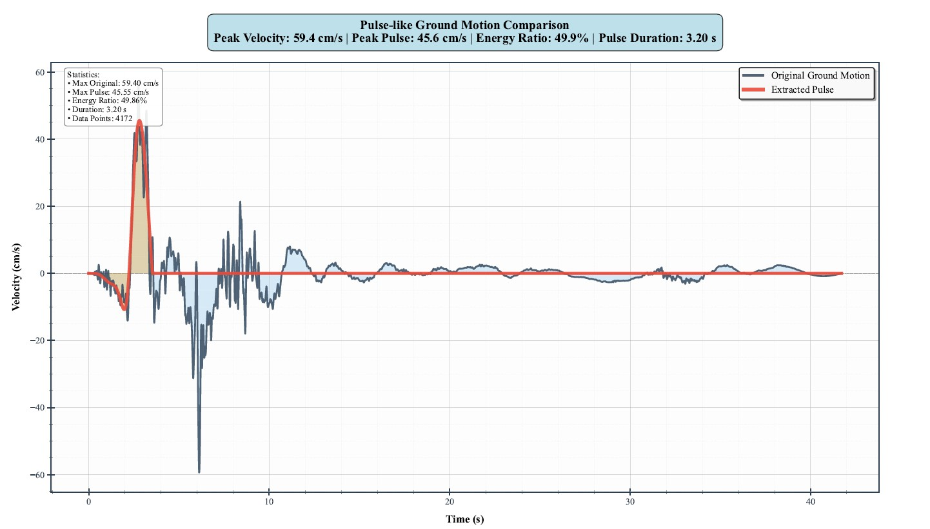
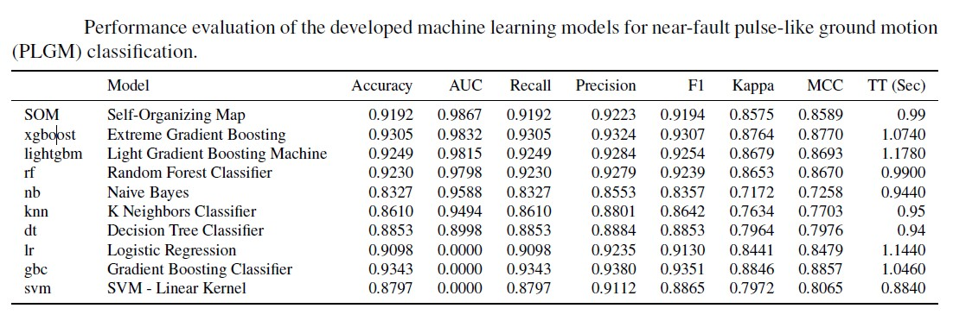
PLEASE DON‘T FORGET TO PUT THE E-POSTER TITLE AND YOUR NAME IN THE PRESENTATION HEADER.
DUPLICATE THIS SLIDE IF YOUR E-POSTER HAS MORE THAN 1 PAGE
P1.2-868
Comparative Analysis of Pulse-Like Ground Motion Identification and Classification Using Machine Learning Techniques
Mohamed Yassien, Mahmoud Sami , Shimaa El kholy
Introduction
The study use 2,847 near-fault ground motion records of 57 events (5.5-7.9 Mw) within approximately 10-15 kilometers of an active fault rupture from major seismic events worldwide.
Research objectives
Developing an improved methodology for near-fault pulse extraction using non-causal filtering and zero-point method,
Applying Machine learning framework for automated pulse classification into single-pulse, double-pulse, and non-pulse categories
Evaluating the performance of self-organizing map (SOM) as the primary classifier against eight benchmark algorithms.
providing comprehensive performance analysis using multiple evaluation metrics. Near-fault ground motions, occurring, exhibit unique features that significantly differentiate them from far-field ground motions.
Results
Fig(2) Receiver Operating Characteristic (ROC) curves of the best-performing machine learning model—Self Organizing Map (SOM)—for near-fault pulse-like ground motion (PLGM) classification
Conclusions
This study presents a comprehensive framework for the automated identification and classification of near-fault pulse-like ground motions (PLGMs) by integrating advanced signal processing techniques with machine learning algorithms.
The methodology’s reliability and generalizability render it suitable for various engineering applications, including seismic hazard assessment, structural design based on pulse characteristics, real-time strong motion monitoring, and systematic database curation.
Methods
1-Signal Preprocessing
2. Pulse Extraction Algorithm
3.Pulse Classification by ML Algorithms, while (S.Vector Machine, Random Forest, k-Nearest Neighbors, Decision Tree, Naive Bayes, XGBoost, Artificial Neural Network, and Logistic Regression)
The output results show that:
54.7% single-pulse-like,
36.3% as non-pulse-like, and
9.0% as double-pulse.

