Slide 1

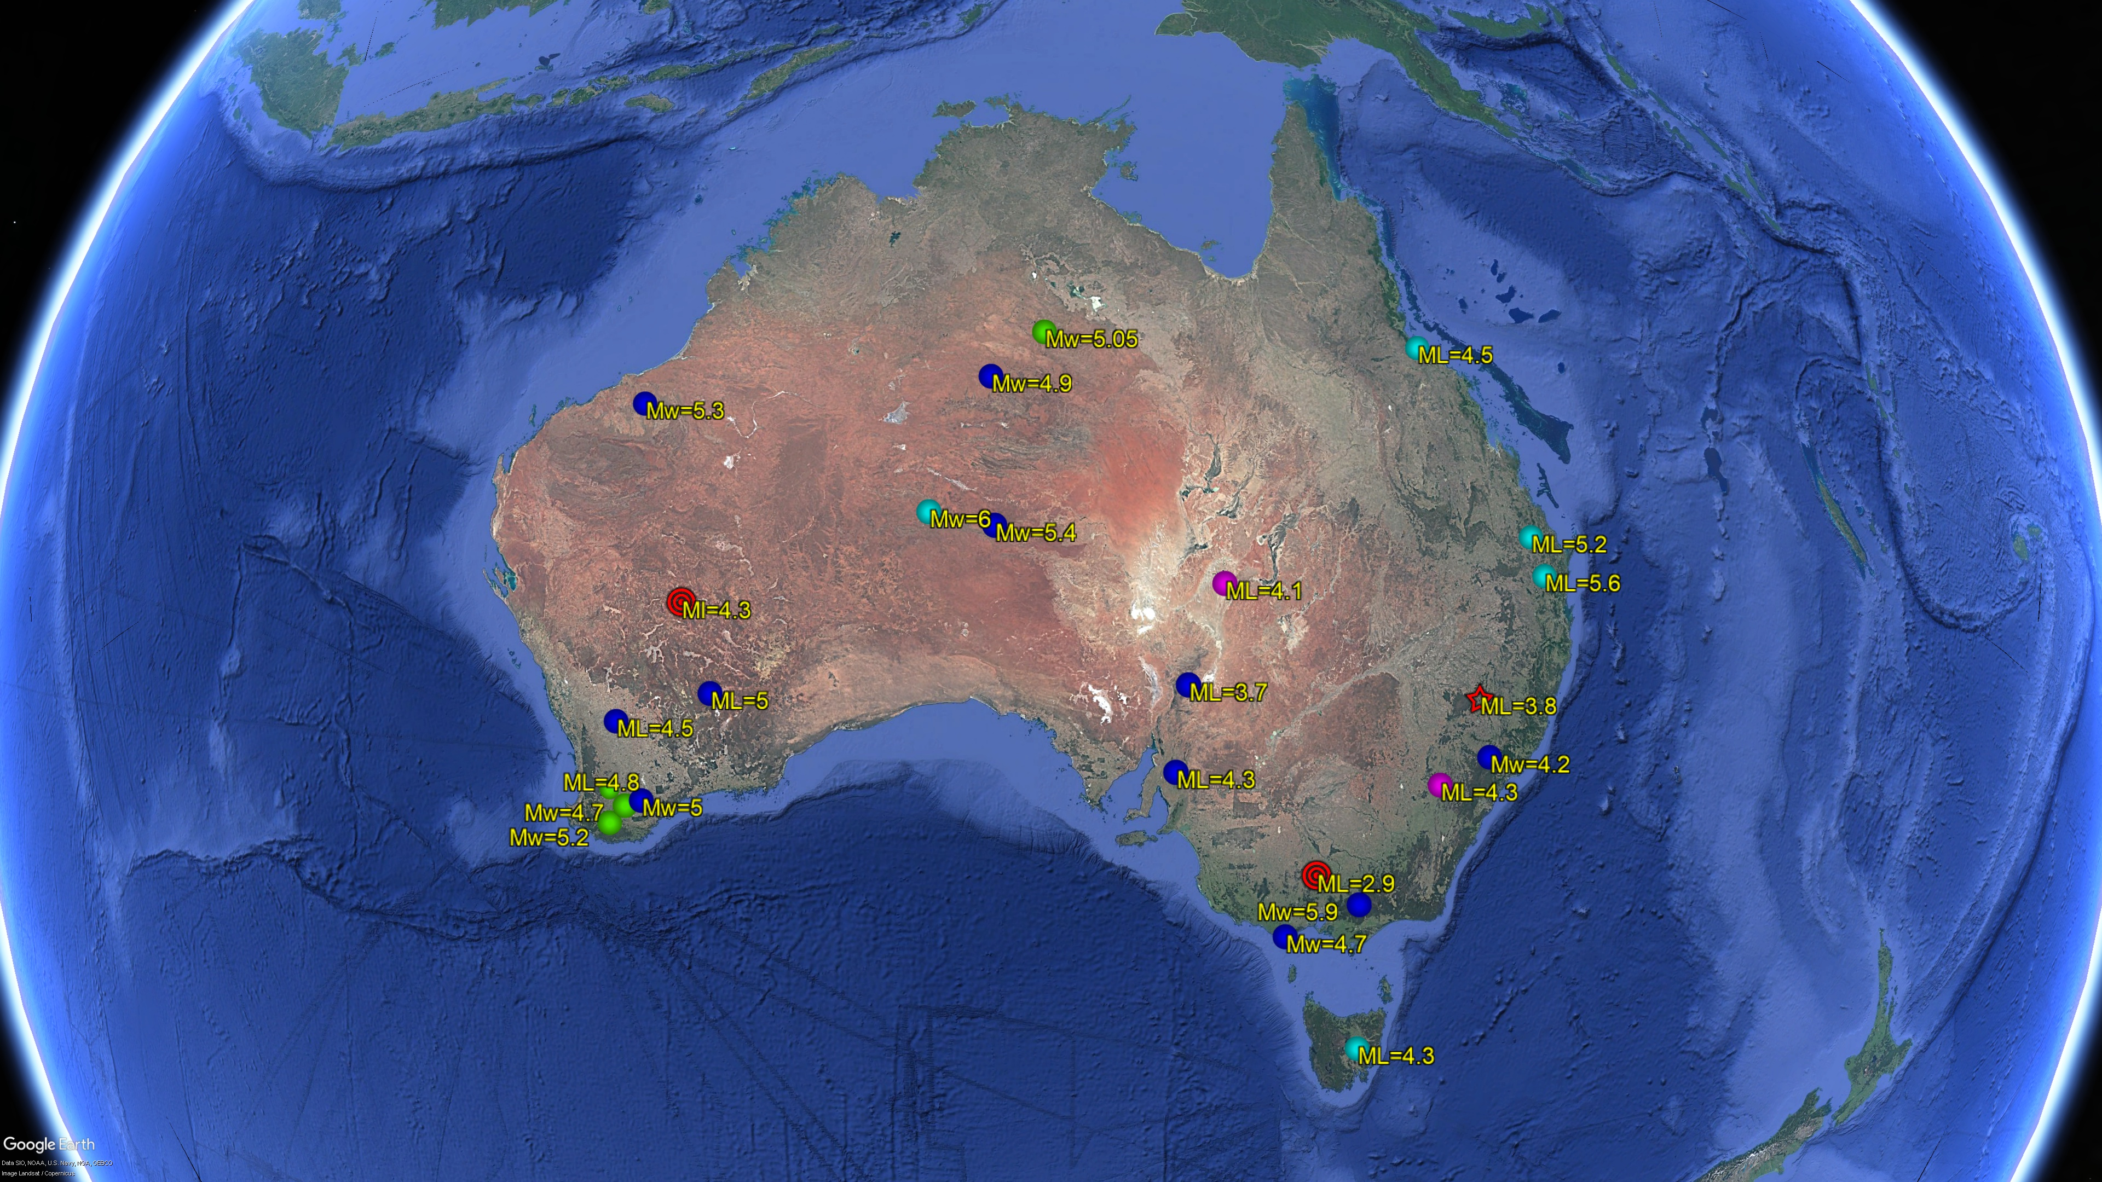

A Compilation of Ground Truth Events in Australia
Dariush Nadri, Spiro Spiliopoulos, Sharmin Shamsalsadati, Svetlana Nikolova.
Geoscience Australia
P1.2-496
Our poster is about presenting ground truth (GT) events in Australia. GT events are important
for velocity model calibration particularly with sparse IMS network. GT events help locating the events more precisely and they reduce CTBT onsite inspection search area. We will show you how we selected these events, how we collected the data and how we analysed them.
If you want to find out more, come over for a chat in front of our poster.

