Slide 1


P1.2-825
Seismicity in Southern Brazil: Analyzing the Nature
of Events
J. M. CARVALHO¹, D. ALBUQUERQUE¹, M. S. ASSUMPCAO², L. V. BARROS¹
1) Seismological Observatory of the University of Brasilia, 2) University of São Paulo.
Southern Brazil, encompassing Rio Grande do Sul, Paraná, and Santa Catarina, has generally low seismicity, yet notable earthquakes have occurred. Historical events and reservoir-induced cases highlight the region’s complexity, influenced by the Paraná Basin geology. This study analyzes natural and anthropogenic factors shaping its seismic behavior.
DISCLAIMERr: Interpretations are based on available data and aim to provide a regional perspective on seismicity..

Slide 2
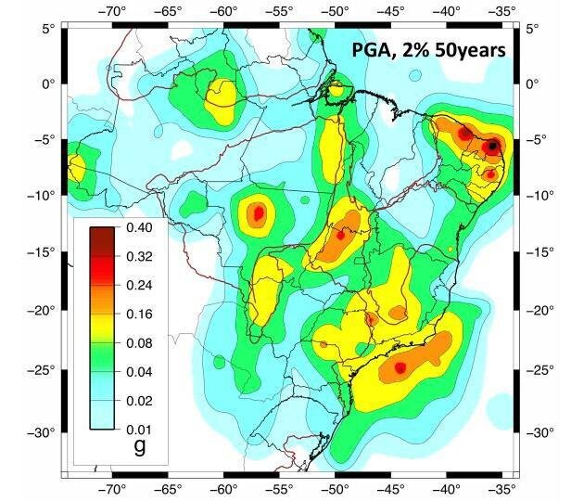
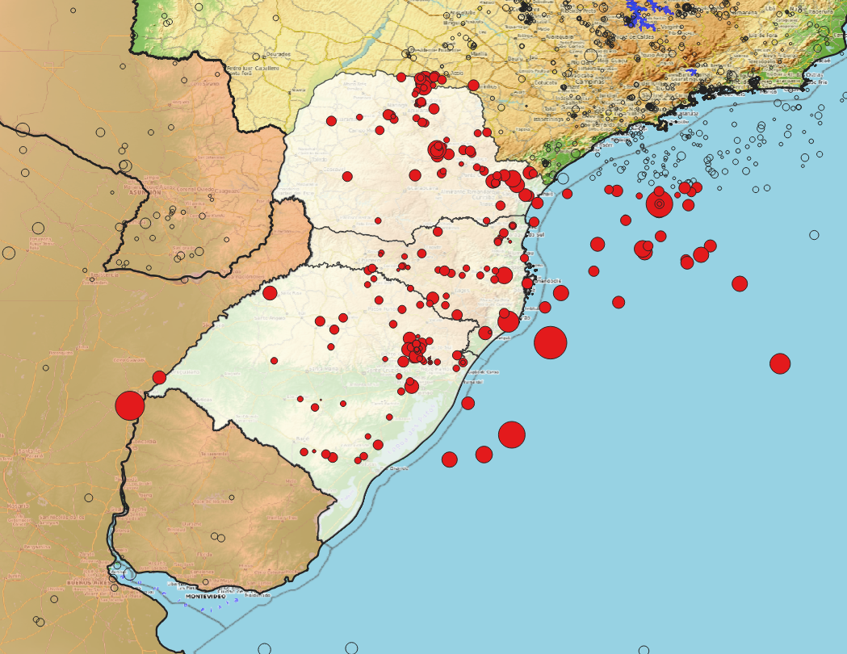
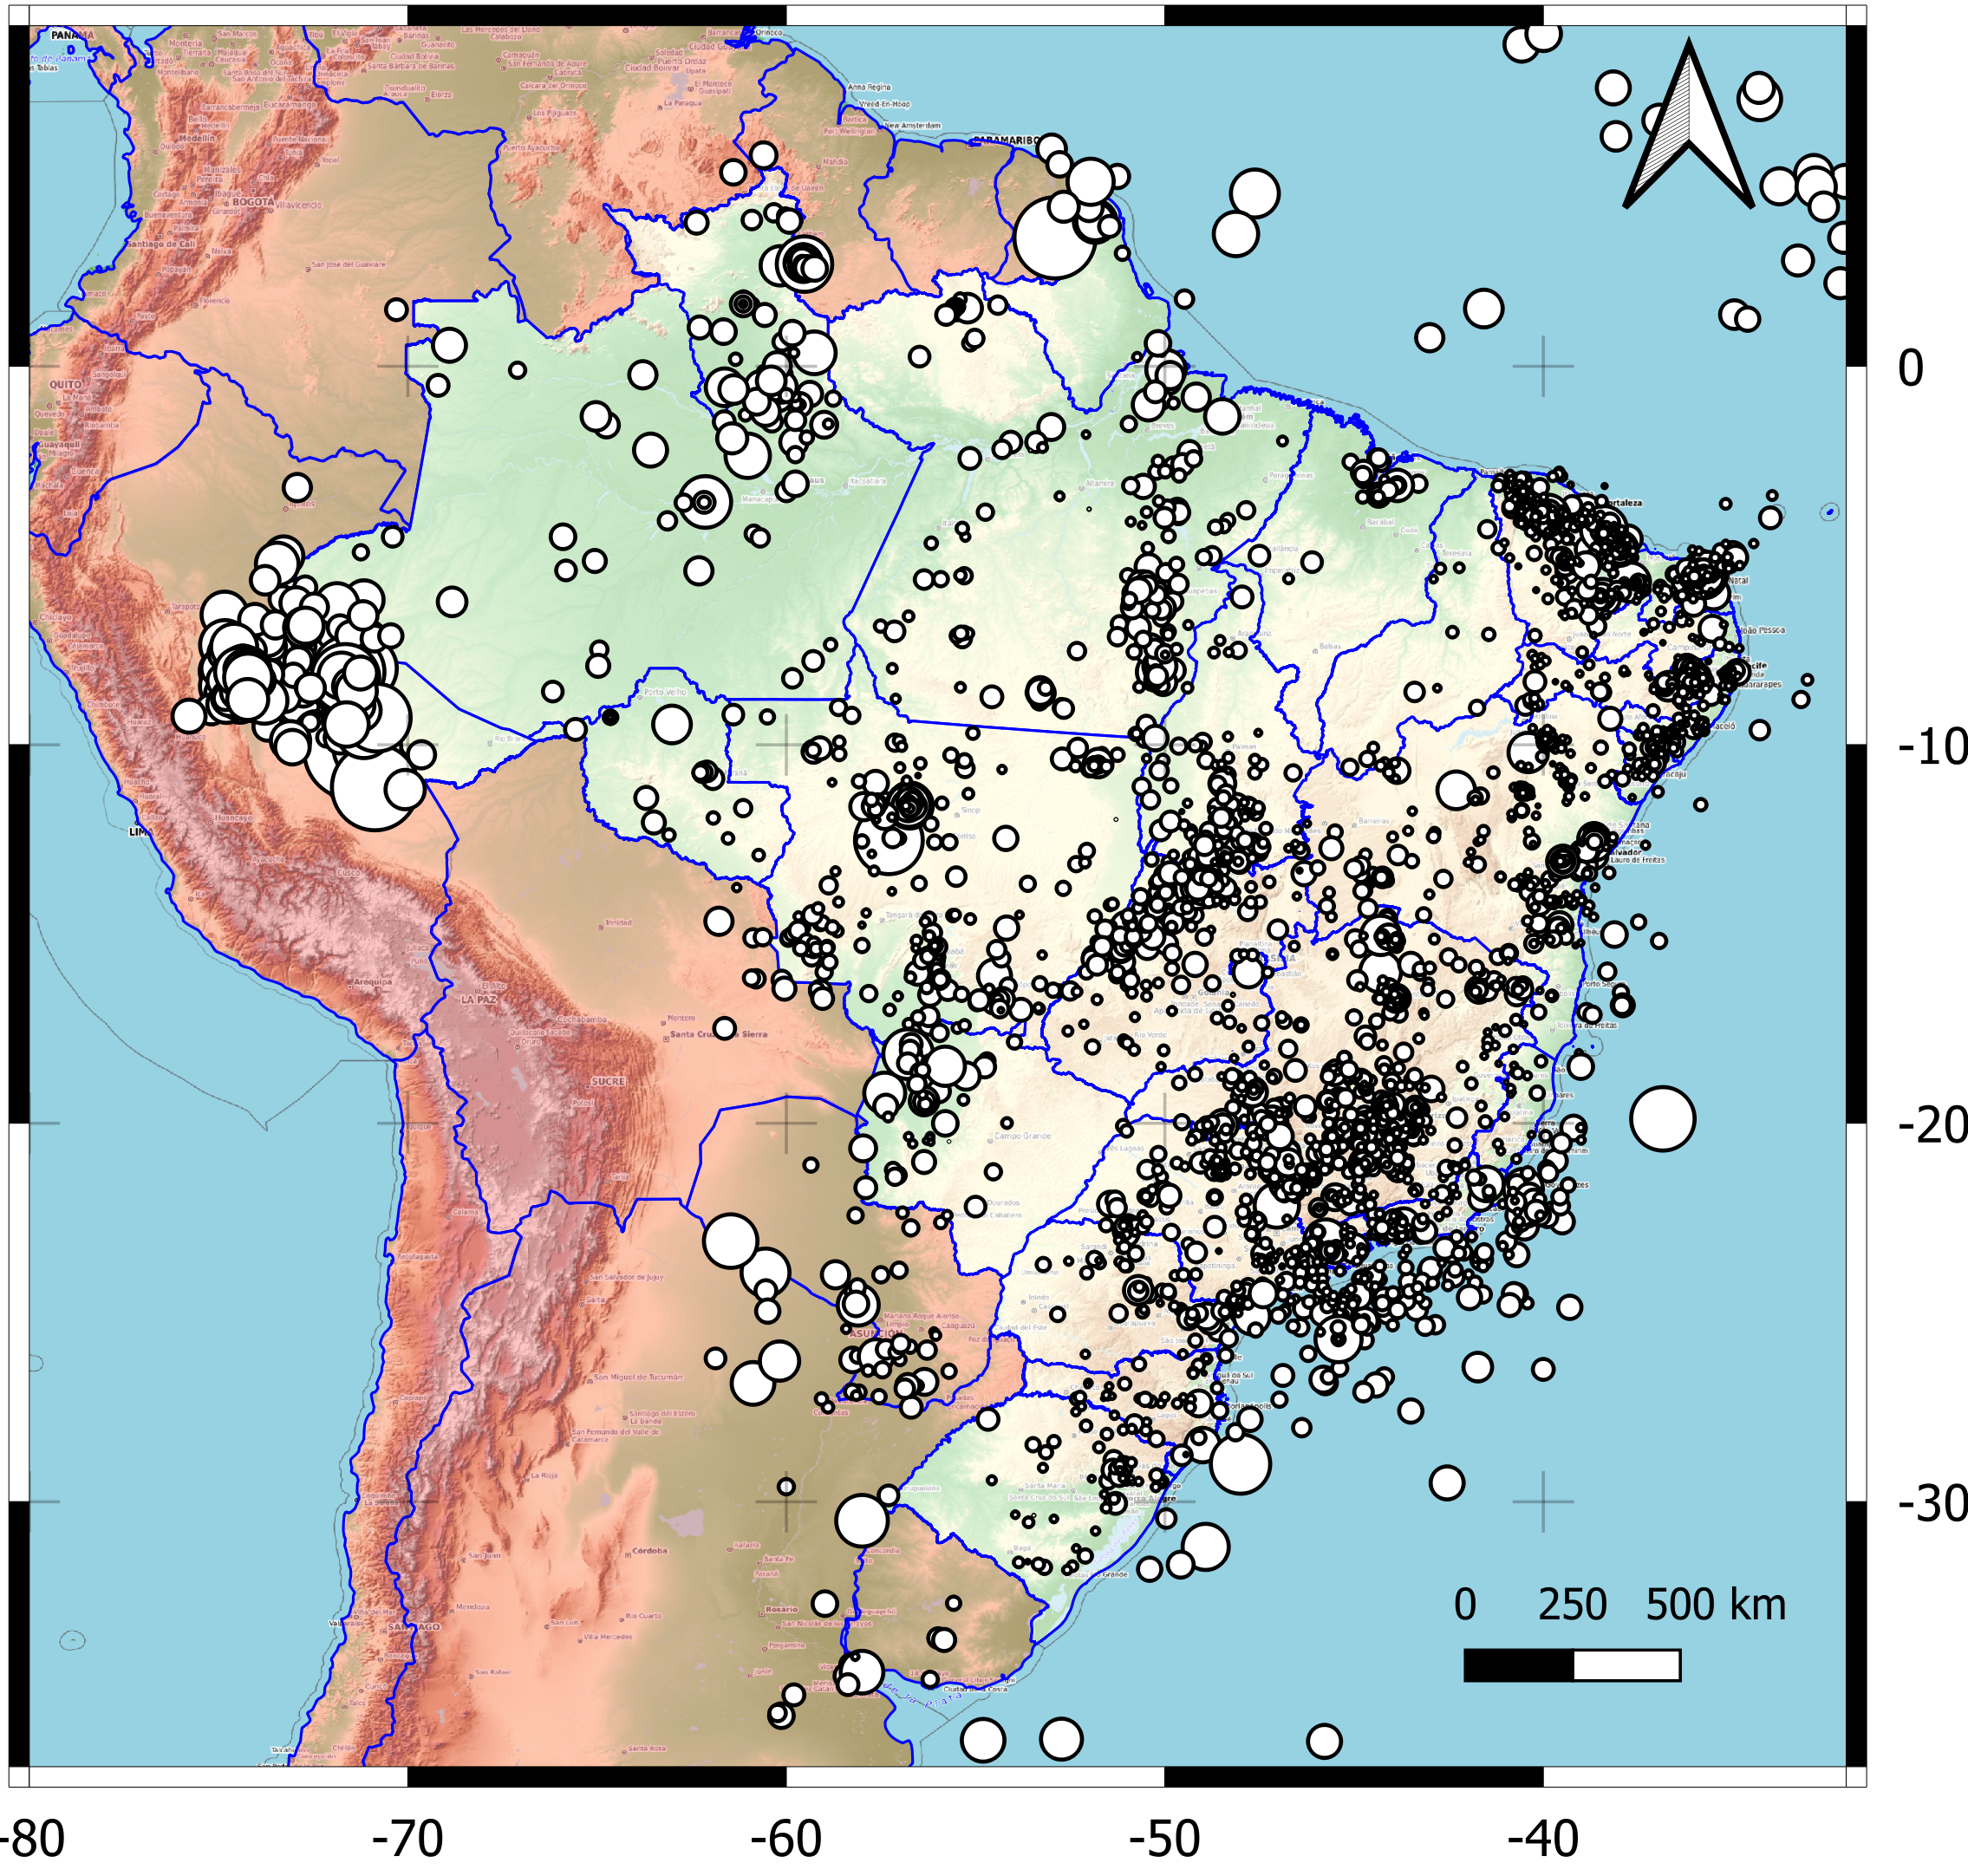
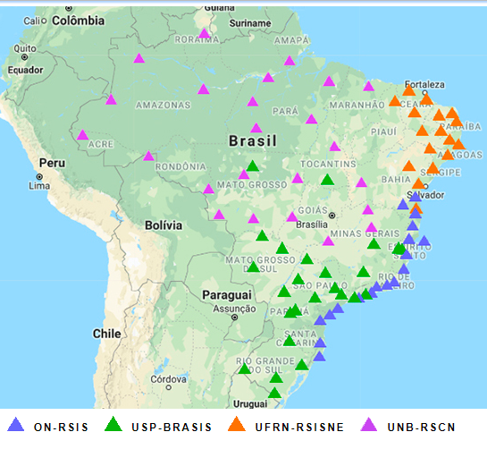

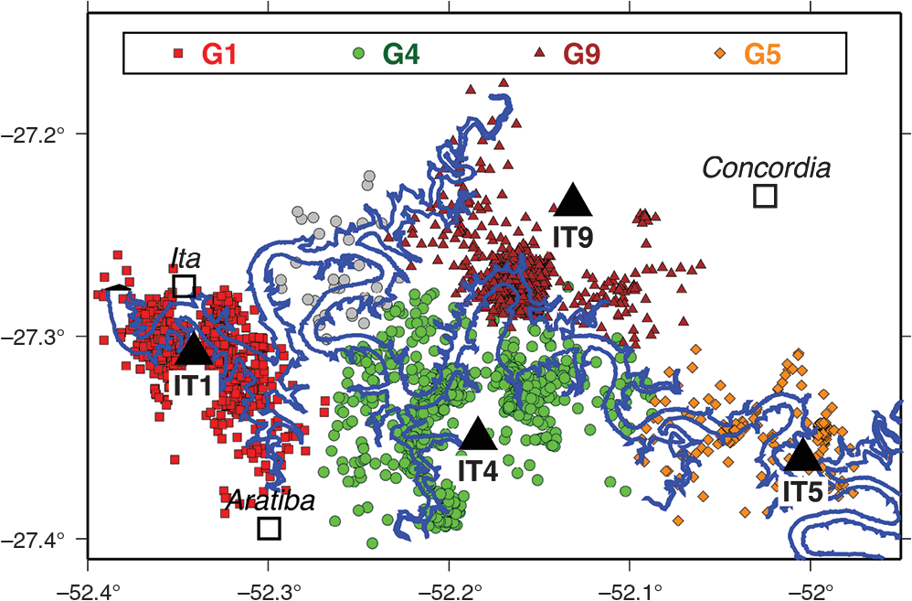

P1.2-825
Seismicity in Southern Brazil: Analyzing the Nature
of Events
Introduction
J.M. CARVALHO, D. ALBUQUERQUE, M.S. ASSUMPCAO, L.V. BARROS
Brazil is generally characterized by low to moderate seismicity, yet relevant earthquakes have occurred across its territory. Among them, two magnitude 6.2 events in Mato Grosso and Espirito Santo in 1955 stand out as the strongest ever recorded in the country. In this broader context, southern Brazil region, comprising of Rio Grande do Sul, Santa Catarina, and Paraná, also presents important seismic history. Despite being a region of overall low activity, it registered some important events, in addition to several cases of reservoir induced seismicity. The Brazilian Seismographic Network (RSBR), established in 2011-2014, significantly expanded seismic monitoring across the country. Since 2014, its densification has markedly increased the detection level, allowing a more detailed understanding of national and regional seismicity.
Seismicity and Geological Setting of Southern Brazil
Seismic Hazard and Regional Risk in Southern Brazil
Southern Brazil, covering Rio Grande do Sul, Santa Catarina, and Paraná, lies mostly within the Paraná Basin, composed of Mesozoic sediments over Precambrian crystalline basement. Although considered a low-seismicity area, the region has experienced significant earthquakes, including 1939 (M5.9), 1948 (M5.5), and 1990 (M5.2). More than 30 events above M3.5 are reported. Wadati diagram analyses reveal Vp/Vs values about 1.7, suggesting geological heterogeneity and supporting investigations on the nature and sources of local seismic activity.
The seismic hazard map of southern Brazil indicates relatively higher ground acceleration in some parts, overlapping regions with large populations and major infrastructure projects, thus emphasizing the importance of assessing seismic risk.
Southern Brazil’s seismic events, though infrequent, have often been felt by local populations, raising awareness of regional seismic risk.
BRAZILINA SEISMOGRAPH NETWORK
RSBR
Discussion and Conclusions
Seismicity in southern Brazil is generally low but includes significant historical earthquakes and well-documented cases of reservoir-induced seismicity. Geological heterogeneity contributes to observed Vp/Vs ratios, supporting the need for continued investigation. Strengthening local monitoring networks is essential to improve detection capabilities, distinguish natural from induced events, and enhance seismic risk assessment for both populations and critical infrastructure.
Reservoir-induced seismicity in southern Brazil has been reported at Itá, Machadinho, Barra Grande, Capivari and Capivara, while no cases have been associated with the Itaipu Reservoir.
MT 1955, 6.2
ES 1955, 6.2
CE 1980, 5.2
JC 1986, 5.1
JC 1989, 5.0
GO 2010, 5.0
Detected seismic events in Brazil increased with the RSBR expansion in 2014..

