Slide 1

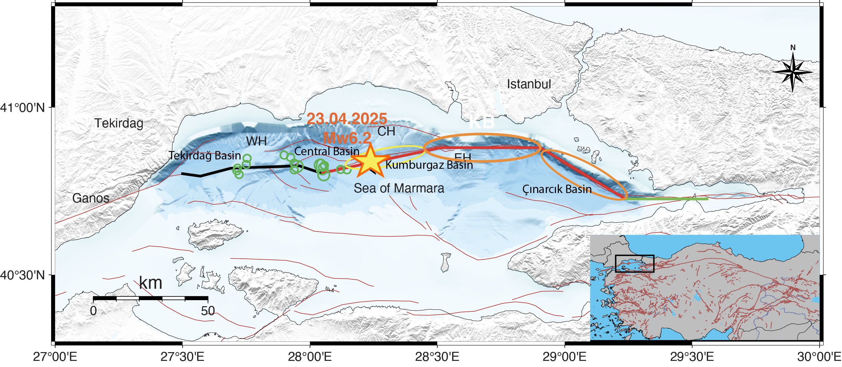
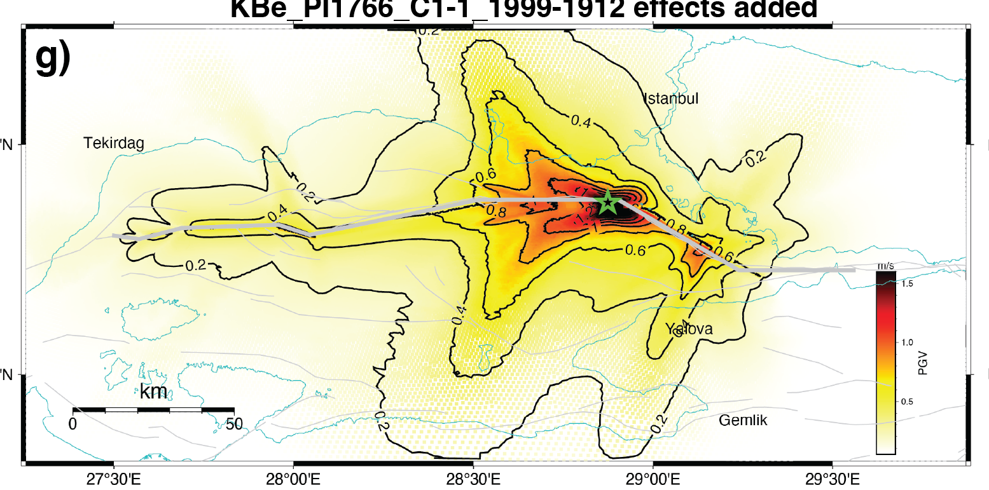

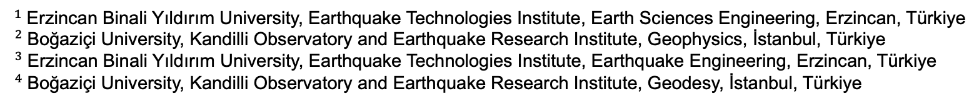
A New Dynamic Simulation of the Main Marmara Fault Earthquake through Incorporation of Stress Perturbation due to 1912 Ganos and 1999 İzmit Earthquakes and Interseismic Stress Load
P1.2-093
Yasemin KORKUSUZ ÖZTÜRK$^{1}$, Nurcan MERAL ÖZEL$^{2}$, Ali Özgün KONCA$^{2}$, Şevket ÖZDEN$^{3},$ and Semih ERGİNTAV$^{4}$
$^{1}$Erzincan Binali Yıldırım University, Earthquake Technologies Institute, Earth Sciences Engineering, Erzincan, Türkiye
$^{2}$Boğaziçi University, Kandilli Observatory and Earthquake Research Institute, Geophysics, İstanbul, Türkiye
$^{3}$Erzincan Binali Yıldırım University, Earthquake Technologies Institute, Earthquake Engineering, Erzincan, Türkiye
$^{4}$Boğaziçi University, Kandilli Observatory and Earthquake Research Institute, Geodesy, İstanbul, Türkiye
Potential Marmara Sea Earthquake may strongly impact the İstanbul Metropolitan area.
We simulate a new 3D dynamic rupture scenario for the Main Marmara Fault.
Our model includes both interseismic stress accumulation and stress perturbations from the 1912 Ganos and 1999 İzmit earthquakes.
Results show higher maximum slip and extended rupture when perturbations are added.
Discussion - What is the effect of the 23 April 2025 M6.2 Marmara Sea earthquake on the potential MMF earthquake?
Interested in the İstanbul earthquake? 👉 Visit our poster for details! P1.2-093
?

